Slide 1

器官移植麻醉
Organ Transplantation
湘雅医院麻醉科 张海萍

Slide 2
Anesthesia for Renal Transplantation
Kidneys are the most common major organ transplanted，the success of renal transplantation，which is largely due to advances in immunosuppressive therapy ，has greatly improved the quality of life for patients with end-stage renal disease.
2
Notes:
2

Slide 3
Indications
Patients with end-stage renal diseases and dependent on dialysis（透析） for a long time.
3

Slide 4
Characteristic of
Pathophysiology
Changes of electrolyte and acid-base balance
Water intoxication（水中毒），hyperkalemia（高钾）， hyponatremia（低钠），hypernatremia（高钠）and metabolic acidemia（代酸）.
4

Slide 5
Cardiovascular
Hypertension（高血压）
Renal ischemia，sodium retention and abnormalities in the renin-agiotension system result in systemic hypertension.
5

Slide 6
Cardiovascular
Uremic cardiac disease
myocardiosis （心肌炎），pericarditis
（心包炎） ， left ventricular hypertroph
（左室肥大），coronary ischemia（冠
脉缺血）， angiosclerosis （血管硬化）.
6

Slide 7
Cardiovascular
Potential congestive heart failure（潜在性充血性心力衰竭）
pulmonary edema（肺水肿）
arrhythmia（心律失常）
7

Slide 8
Hematologic
Bone marrow suppression , decreased erythropoietin production , decreased erythrocyte production, increased deformation erythrocyte production and increased bleeding tendency Anemia ( 贫血).
8

Slide 9
Hematologic
Liver disease coagulation factor ，Uremia(尿毒症) and using of heparin coagulation disorder， bleeding time .
9

Slide 10
Other changes
Nausea（恶心） ，vomit（呕吐） ，anorexia（厌食） ， diarrhoea（腹泻） ，ascites（腹水） and gastric dilatation（胃扩张）.
Infection （感染）.
Hypoproteinemia（低蛋白血症）.
hyperglycemia（高血糖症）.
10

Slide 11
Evaluation and preparation before anesthesia
Preanesthetic evaluation
This assessment includes a patient history,a physical examination and any indicated lab tests , classifying the patient according to the ASA physical status scale completes the assessment.
11

Slide 12
Preanesthetic evaluation
Hypoproteinemia
Anemia
Coagulation disorder
Fluid electrolyte and acid-base disturbance
Concurrent diseases
Immunosuppression and infection.
12

Slide 13
Preanesthetic preparation
Care of donor kidney Kidney should have good circulation perfusion before being separated from donor,warm ischemia time and cold ischemia time should be minimized,separated kidney should be frozen for preservation in reason, transplanted kidney should have good perfusion after rebuilding circulation and renal function should be recovered in time.
13

Slide 14
Preanesthetic preparation
Blood transfusion（输血） should generally be given only to severely anemic patients(hemoglobin <6-7g/dl) or when significant intraoperative blood loss is expected.
Controlling infection.
14

Slide 15
Dialysis（透析）
is the most important preparation before operation.
Dialysis often precedes transplantation to correct volume or electrolyte derangements.
Hemodialysis（血液透析） is more effective than peritoneal dialysis（腹膜透析）.
15

Slide 16
Preanesthetic preparation
Treatment of complication
Fasting（禁食）
Premedication（术前用药）
Protection of arteries and veins fistula
16

Slide 17
Principles of anesthesia management
Principles of anesthetics chosen Anesthetics not primarily dependent on renal excretion for elimination ，no nephrotoxicity（肾毒性） and having short duration of action should be used.
17

Slide 18
Venous anesthetics
Propofol（异丙酚）
Fentanyl（芬太尼）
Midazolum（咪达唑仑）
Etomidate（依托咪酯）
small doses of Sodium pentothal（硫喷妥钠）
18

Slide 19
Inhalational anesthetics
Isoflurane（异氟烷）,Enflurane（安氟烷）,Nitrous oxide（笑气）, Desflurane(地氟烷)and sevoflurane（七氟烷） are often used
methoxyflurane（甲氧氟烷） is forbidden because of its nephrotoxicity .
19

Slide 20
Muscle relaxants
Atracurium（阿曲库铵）,Rocuronium（罗库溴铵） and Vecuronium（维库溴铵） are often used.
Don’t use succinylcholine（琥珀胆碱）.
20

Slide 21
Local asnesthetics
Lidocaine,Bupivacaine, Rupivacaine and Dicaine are often used.
notice toxicity reactions induced by excessive of local anesthetics.
don’t use epinephrine（肾上腺素）.
21

Slide 22
Postoperative analgesics
Dolantin
Tramal
Fortanoryn
PCEA
22

Slide 23
Choice of anesthesia
Principles
No pain
muscle relaxed
sedation perfectly
vital signs stable
no complications
23

Slide 24
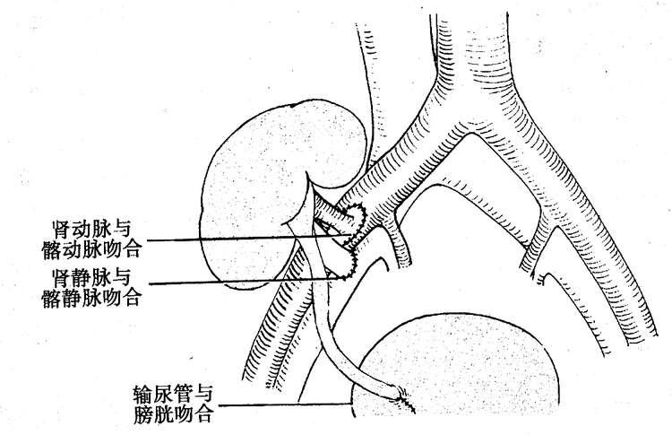
24

Slide 25
Continuous epidural anesthesia
Continuous epidural anesthesia for kidney transplantation
Choice of puncture sites, T₁₁₋₁₂ or T₁₂L₁ ，L₂₋₃ or L₃₋₄ .
25

Slide 26
Advantage
Having good muscle relaxation
Avoiding side effects of muscle relaxants
Avoiding pulmonary infection induced by endotracheal intubation
Avoiding depression to respiration and circulation if the block level is well controlled.
26

Slide 27
Disadvantage
Mental stress
Epidural hemorrhage（出血） and hematoma（血肿） (direct pressure and ischemia to spinal cord ) ,
Circulation and respiration depression(if the block level is inadequate controlled).
27

Slide 28
Combined spinal and epidural anesthesia
General anesthesia
28

Slide 29
Intraoperative monitoring and
anesthetic management
Monitoring Includes ECG, Blood pressure , SPO₂ , Temperature , Electrolyte ,Blood gas analysis and urinary output，monitoring direct intra-arterial blood pressure and CVP if it is necessary.
29

Slide 30
Anesthetic management
Prevention and cure of hypotension
Prevention and cure of hypertension
Monitoring serum kalium
Urinary output
Drugs
30

Slide 31
Venous road 1
5%Glucose 250ml/iv by drip
DXM 75 mg / iv by drip( 30～60′) 5%Glucose 250ml / iv by drip
Lasilix（速尿） 80mg iv when starting to anastomose renal artery
20% Mannitol（甘露醇） 250 ml iv by dvip (fast) as soon as blood vessel is anastomosed
31

Slide 32
Venous road 1
5%Glucose 250ml / iv by dvip
DXM 75mg / iv by drip( 30～60′)
5%Glucose 250ml / iv by dvip
0.9%NS 250ml / iv by dvip
10%kcl iv when patient has diuresis（多尿）
32

Slide 33
Venous road 2
Blood transfusion should be given and Dopamine 2～3μg/kg.min iv by drip when it is necessary to enhance 10～20mmHg of pressure before rebuilding circulation.
Maintenance of intravenous fluids is decided by anesthetist.
33

Slide 34
Postoperative management
Sterilize
Avoid anoxia
prevent and cure respiratory airway complications
Recover the function of transplanted kidney as soon as possible
Postoperative pain management
34

Slide 35
Postoperative management
Transfuse albumin10～20g each day， correct acid-base and electrolyte disorder.
Resist infection.
Diagnose , prevent and cure rejection response immunosuppressant drug ( Cyclosprine ,
Azathioprine and Prednisone ).
35

Slide 36


Thank you!
36

