Slide 1
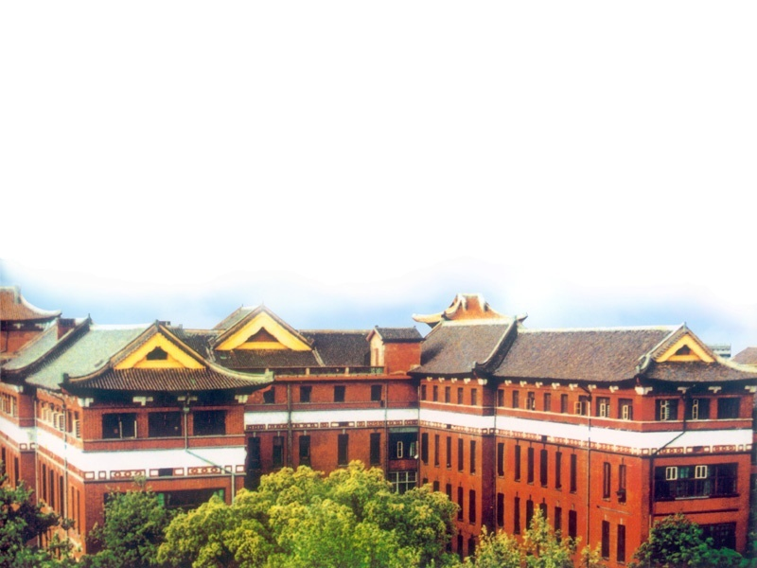
Anesthesia for radiology, radiotherapy
and diagnostic examination
中南大学湘雅医院麻醉科
周艳平

Slide 2
一、General considerations
Specific enviroment
Many problems encountered in the radiology
department, radiotherapy suite and diagnostic
examination are similar:
1. In most hospitals, radiology, radiotherapy
and diagnostic examination suites have not been
designed with anesthetic requirements in mind.
2. Monitoring equipment may not be available
readily and is often the oldest in the hospital.
Clinical observation may be limited by poor lighting.

Slide 3
3. Preparation of the patient may be inadequate.
4. Anesthetic assistance and maintenance of
anesthetic equipment may be less than ideal.
5. Communication between radiologist,
radiotherapist and the anesthetist may be poor,
with failure to recognize the other's requirements.
6.Often, recovery facilities are inadequate and
anesthetists may have to recover their own patients.

Slide 4
Adverse effects of contrast media
Most contrast media are exceedingly hypertonic(osmolarity 2000 mosmol. litre⁻¹)
and consequently produce expansion of the circulating blood volume. Injection of
contrast medium causes burning pain in the face and eye and vasodilation produces
headache and flushing. Newer agents, such as metrizamide, are less hypertonic and
there-fore preferable.

Slide 5
Dangerous technique procedures
Apparatus for examination may penetrate the organs
such as esophagus and rectum. The cardiac catheter may injure
the blood vessel and cardiac muscle. Consequently, it may result
in fatal hemorrhage embolism or serious arrhythmias. Injection of
contrast medium may cause aneurysm rupture.

Slide 6
二、Anesthesia management rules
The rules are to allay anxiety and fear, to keep the
patients in safety, to avoid any factors that will affect
the examination accuracy.
1. pay attention to the preanesthesia preparation.
2. allay anxiety and fear.
3. Be familiar with the patient's whole condition.
The preanesthesia assessment should be adequate.

Slide 7
4. Be familiar with he important procedures of the examination
and therapy.
5. according to the specific enviroment, the anesthesia method
should be simple, safe and effective.
6. If the diagnoses rely on the blood gas analysis, Oxygen
inhalation should be avoided.

Slide 8
三、Anesthesia for common diagnostic examination, radiology and radiotherapy
（一）Anesthesia for angiography in neurodiagnosis
computerized tomography has reduced the need for
angiography in neurodiagnosis. However, angiography is indicated
for the investigation of a suspected cerebral aneurysm,arteriovenous
malformation or vascular tumor. Vertebral angiography and carotid
angiograpiy are usually used.

Slide 9
Anesthesia rules are to:
① Maintain the respiration and circulation
function.
②Donn't increase ICP.
③Keep the patients motionless.

Slide 10
1. Preanasthesia preparation:
It is the same as general anesthesia.
2. Anesthesia procedures:
For adults, local anesthesia combined with sedatives is
administered. For children and uncooperative patients, base or
general anesthesia is administered. r-Hydroxybutyric acid and
ketaine are usually used. Ketamine is forbidden in the ICP
increased patients.

Slide 11
3. Complications:
Local-Haematoma and haemorrhage, vessel wall dissection,
thrombosis, embolism of air or atheroma and the development
of Horner's syndrome are all recognized complications.
General—The hypertonicity of contrast medium may
eracerbate cerebral edema and result in seizures. Transient
hypotension and bradycardia on asystole can occur during
cerebral angiography with contrast dye injection and usually
respond to volume replacement and atropine.

Slide 12
（二）Anesthesia for cardiac catheter
examination

Slide 13
Anesthesia rules are to:
①Keep the patients quiet.
②Maintain circulation steady.
③Maintain the airway. If blood gas analysis is
required, oxygen inhalation should be avoided.

Slide 14
1. Preanesthesia preparation:
It is the same as general anesthesia.
To improve the circulation and respiration
function. Usually atropine is replaced by
hyosine to prevent tachycardia.

Slide 15
2. Anesthesia procedures:
For most of the patients, caradiac catheter
examination and cardiovascular angiography
can be administered under local anesthesia
combined with sedatives. For chidren or some
uncooperative patients, base anesthesia or
general anesthesia is necessary.

Slide 16
3.Complications:
①Arrhythmias (tachycardid and premature ventricular
contractions are common).
②Hypotension (due to hypoxaemia, deep anesthesia,
Vasodilatioa, haemorrhage and arrhythmias).
③cardia function failure and pumonary edema.
④Myocardial infarction.
⑤Respiration depression.
⑥Acute brain hypoxaemia.
⑦Low temparature.

Slide 17
（三）Anesthesia for bronchography
Bronchography is used mainly for the diagnosis and evaluation
of bronchiectasis and its use is declining. Most bronchograms are
carried out using local anesthesia, but children and anxious adult
patients require general anesthesia.
Commonly, respiratory function in these patients is compromised
and additional hypoxaemia is inevitable after inhalation of the
oil-based contrast medium.

Slide 18
        Intravenous or inhalational induction is followed by
        tracheal intubation without any local anesthetic spray,
        so that the cough reflex returns rapidly at the end of
        the procedure. Spontaneous ventilation is preferred.
        Contrast medium is instilled through a catheter passed
        down the lumen of the tracheal tube. The posture of the
        patient is altered sequentially to fill the various lobes of
        the lung.

Slide 19
As much contrast material as possible is removed at the end
of the procedure by suction and physiotherapy. The tracheal tube
remains in situ until there is an active cough reflex. Humidified
oxygen should be given during the recovery period and the patient
should be nursed in a head-down position with the healthier lung
uppermost.

Slide 20


谢谢

