Slide 1

内科学
循环系统第五章
瓣膜性心脏病
Valvular Heart Disease
中南大学湘雅二医院 · 心血管内科
彭道泉 教授

Slide 2
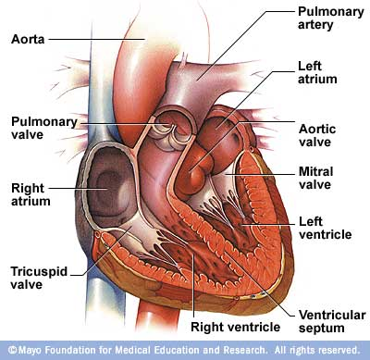
心脏瓣膜解剖

Slide 3
介绍
定义:
瓣膜性心脏病指由于炎症、缺血、退形性变等因素所致的心瓣膜的结构改变（如关闭不全和狭窄）以及由此引起的心脏结构和功能改变。
受累瓣膜:
二尖瓣 (70%);二尖瓣+主动脉瓣 (20-30%) , 单纯主动脉瓣 (2-5%)
Notes:
By definition, valvular heart disease refers to…………. Every valve of hear may be affected, but the chance of involvement differs from valve to valve. For example, mitral valve is the most common target of rheumatic fever. The simultaneous involvement of mitral and aortic valve take the second place. Tricuspid and pulmonary valve are less affected.

Slide 4
Mitral Stenosis, MS
病 因
风湿 (>90%)
其它:
先天性
钙化/退形性变
结缔组织疾病: SLE, RA
Notes:
First of all, we are going to discuss the most common type of valvular hear disease, that is MS. Rheumatic damage account for more than 90% of the cause of MS. Other rare cause of MS include the congenital deficit, calcification or degeneration in the elderly patients. MS can also present in some connective tissue disease such as SLE and rheumatoid arthritis.

Slide 5
病 理
风湿心内膜炎(Aschoff’s 小体)
纤维组织沉积
纤维化/瓣膜钙化
瓣叶挛缩/腱索融合/瓣叶粘连
瓣口漏斗样狭窄
Notes:
Let’s go over the pathology of rheumatic damage of heart valve. Repeated rheumatic endocarditis,which is characterized by formation of aschoff’s nodule, will result in the deposition of fibrous tissue in valve and consequently lead to formation fibrosis and calcification of valve. Lesions alone the line of closure results in fusion of the commissure and contracture and thickening of the valve leaflet. The chordal lesions are manifested as shortening and fusion of these structure. The combination of commissural fusion, valve leaflet contracture, and fusion of the chordae tendineae results in a narrow, funnel-shaped orifice, which restrict the flow of the blood from LA to LV,.

Slide 6
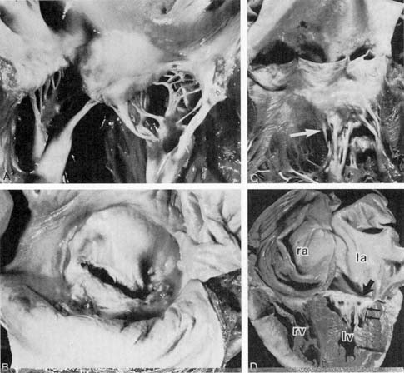
风湿性MS-病理标本
Notes:
Rheumatic mitral stenosis. A, Moderate valvular changes including diffuse leaflet fibrosis, commissural fusion, and chordal thickening and fusion. In another patient, an atrial view (B) and subvalvular and aortic aspects (C) show prominent subvalvular involvement; severe subvalvular distortion is evident (arrow). D, Severe rheumatic mitral stenosis with specimen shown in apical four-chamber echocardiographic view, demonstrating small left ventricle (lv) and enlarged left atrium (la), right ventricle (rv), and right atrium (ra). Note the calcified stenotic valve (arrow) and prominent subvalvular changes (double arrows). (A and D from Schoen FJ, St. John Sutton M: Contemporary issues in the pathology of valvular heart disease. Hum Pathol 18:568, 1987

Slide 7
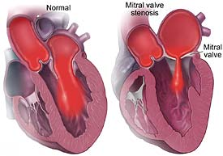
二尖瓣狭窄示意图

Slide 8
病理生理
≤1 cm²
二尖瓣狭窄
舒张期缩短 (心动过速) AV顺序消失（房颤, 房室传导阻滞) ↑ 肺静脉血流 (容量负荷)
≥25 mmHg
↑ 二尖瓣口压差
↑ 左房压力
左房扩大
↑ 肺静脉压
房性心律失常
肺水肿
PCWP≥35 mmHg
肺动脉高压
RVH & RV Hypertension TR & RVE
Symptoms
Notes:
Orifice 4-6cm2, <2, <1.5, <1cm2. Mitral stenosis results in a diastolic pressure gradient from LA to LV. The actual gradient is depend on the mitral valve area and the mitral valve flow per diastolic second. As a result, there is an elevation of LA pressure and therefore also of pulmonary venous pressure. Physiological and pathological changes-such as tachycardia and atrial fibrillation (which shorten diastole and may also result in loss of effective atrail contraction) or pregnancy, volume loading, and left-to-right shunts (at ventricular and aortopulmonary levels), which increase pulmonary venous flow-will increase the mitral valve gradient as well as LA and pulmonary venous pressure. An elevated LA pressure has several important effects; these include enlargement of the atrium, atrial arrhythmia, and an increase of pulmonary venous pressure. Pulmonary venous hypertension may result in pulmonary edema and pulmonary arterial hypertension. PA hypertension and RV ventricular hypertension results in RV hypertrophy and may result in tricuspid regurgitation and RV enlargement. All of these changes contribute to the producing symptoms.

Slide 9
症状
活动性
呼吸困难, 喘息,咳嗽
(↑肺静脉压)
疲乏无力
活动受限
心悸 (心律失常)
虚脱, 晕厥前兆, 晕厥
(↓ 心输出量)
Notes:
An asymptomatic interval is usually present between the initiating event of acute rheumatic fever and the presentation of symptomatic MS (an average of 10-20 yrs). Initially, there is little or no gradient at rest, but with increased cardiac output, LA pressure rises and exertional dyspnea develops. As mitral valve obstruction increases, dyspnea occurs at lower work levels. As obstruction progresses, the patients note orthopnea and paroxysmal nocturnal dyspnea. With severe MS and elevated pulmonary vascular resistance, fatigue rather than dyspnea may be predominant symptom. Palpitations are a frequent complaint in patients with MS and may represent frequent premature atrial contractions or paroxysmal atrial fibrillation/flutter.

Slide 10
症状(cont)
休息
咳嗽, 喘息
夜间阵发性呼吸困难
端坐呼吸
咳血: blood stained, pink frothy, severe and profuse
(↑肺静脉压,
肺水肿/梗死,
支气管静脉破裂)
声嘶 (Ortner’s syndrome)
(左房扩大,肺动脉压迫)
MS并发症的表现
Notes:
Hemoptysis may result from a variety of causes. Hemoptysis usually results from increased pulmonary venous pressure. Sputum may be blood-stained with paroxysmal nocturnal dyspnea, pink frothy sputum from rupture of alveolar capillary can be associated with acute pulmonary edema, from pulmonary infarction due to pulmonary embolism, or hemoptysis may be severe and profuse (pulmonary apoplexy). The latter results from rupture of thin-walled, dilated bronchi veins. The edematous bronchial mucosa is more likely to be associated with chronic bronchitis, especially in cold and wet climates, it can also result in blood-stained sputum. .
compress recurrent laryngeal nerve

Slide 11
并发症
心律失常: AF
栓塞：系统 - 脑, 外周
肺动脉
急性肺水肿
右心衰竭
感染性心内膜炎
Notes:
Claudication,

Slide 12
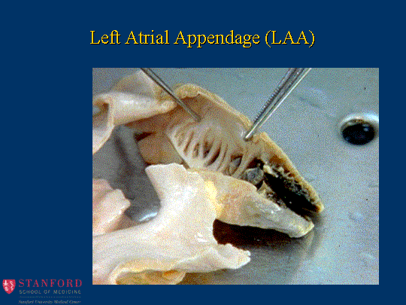
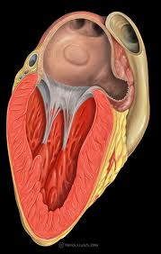
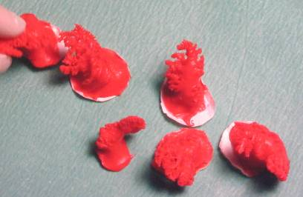

Slide 13
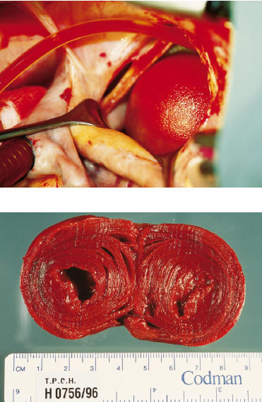
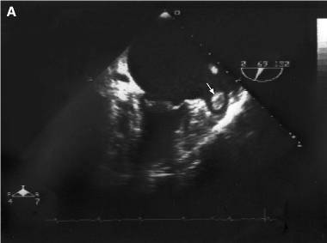
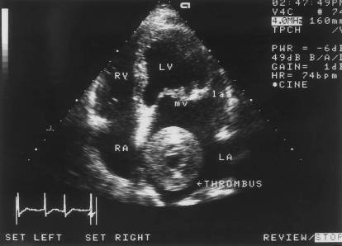

Slide 14
体征
二尖瓣面容:
心脏:
心悸: 舒张期震颤;
叩诊: 心脏左侧扩大
听诊: ↑S1, 舒张期隆隆性杂音;
开瓣音; 递增性，P2分裂
Graham-Steell 杂音
Notes:
The MS facies,characterized by malar flush (pinkish-purple patches on the cheek) is caused by peripheral cyanosis, which is usually associated with low cardiac output systemic vasoconstriction,and sever PA hypertension.
On ausculation in the supine position, the only abnormality appreciated may be the accentuated S1,which is caused by flexible valve leaflets and the wide closing excursion of the valve leaflets. Left lateral decubitus position make the diastolic murmur more audible.
Halitus murmur:

Slide 15
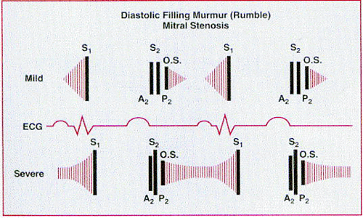
Severity of stenosis by auscultation
舒张期杂音长短，S2－开瓣音间隔
Notes:
The severity of MS can be assessed by auscultation of diastolic rumble and opening snap. As the MS becomes more severe, the S2-OS interval is shortened and the length of the middiastolic rumble is increased. P2 is increased in intensity too. In the presence of rigid mitral valve, S2 is soft and the OS is usually not heard.

Slide 16
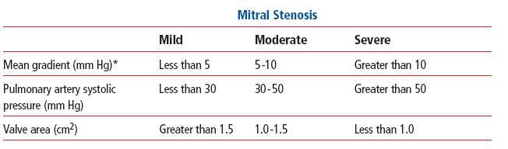
二尖瓣狭窄严重程度判断

Slide 17
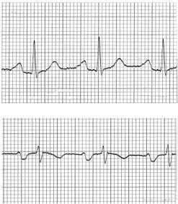
ECG
II
左房肥大: II导联P波宽大、切迹, ↑ptfV1
右室肥厚
V1
Notes:
Widen and notched P wave in Lead II, PtfV1>-0.04 in precordial V1. ECG is usually is not specific. Patients in sinus rhythm may have a widened P wave caused by interatrial conduction delay and/or prolonged LA depolarization. Classically, the P wave is broad and notched in lead II and biphasic in lead V1, it measures 0.12 s or more.

Slide 18
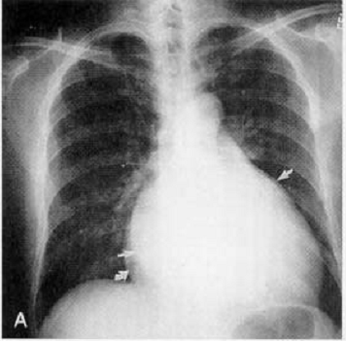
Roentgenogram
梨形心
左心耳突出
双房影
食道钡餐提示左房增大(食道切迹）
肺静脉充血
Notes:
The posteroanterior chest film is often so typical that experienced clinicians can make the tentative diagnosis from the film. The thoracic cage is normal. The lung fields shows evidence of elevated pulmonary venous pressure. Blood flow is more evenly redistributed to the upper lobes, resulting in apparent prominence of upper lobe vascularity. Increased pulmonary venous pressure results in transudation of fluid into the interstitium. Accumulation of fluid in the interlobular septa produces linear streaks in the bases, which extend to the pleura (Kerley B lines). Interstitial fluid may also be seen as perivascular or peribronchial cuffing (Kerley A line). PA hypertension results in enlargement of the main of the main PA and right and left main pulmonary areteries.
The cardiac silhouette usually don’t show generalized cardiomegaly, but the LA is invariably enlarged. This is manifest in the posteroanterior film by a density behind the RA border (double atrial shadow), prominence of the LA appendage on the left heart border between the main PA and LV apex., and elevation of the left main bronchus. The LV silhouette is normal. So the combination of a normal-sized LV, enlarged LA, and pulmonary venous congestion should raise the possibility of MS.
Hemosiderin deposition i

Slide 19
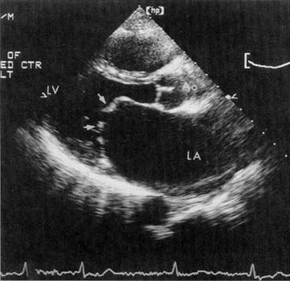
Echocardiography
胸骨旁长轴:
LA增大
二尖瓣开放受限
二尖瓣前叶呈“圆顶样改变”
Notes:
A parasternal long-axis view of mitral stenosis. The LA is enlarged, mitral opening is limited, and doming of the anterior leaflet is present.

Slide 20
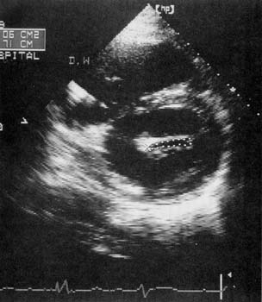
Echocardiography
胸骨旁短轴:
二尖瓣口狭窄: 舒张期面积= 1.1 cm²
呈“鱼口样”

Slide 21
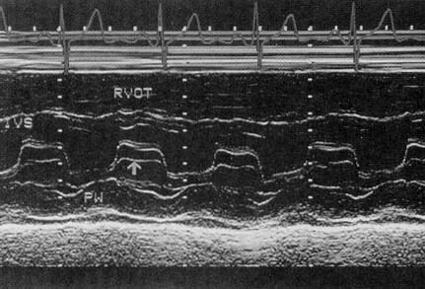
M-Model Ultrasound
Parallel movement of posterior leaflet, ↓EF, “Battlement”
Notes:
M-model tracings depict a characteristic decrease in the closure rate of the anterior mitral leaflet in early diastole (reduced E-F slope)due to a persistent left atrial/left ventricular pressure gradient and a slow rate of LV filling. The decrease of the E-F (early-filling? ) slope has been found to correlate grossly with the severity of MS.

Slide 22
诊断/鉴别诊断
诊断: 舒张期隆隆性杂音 + Echo
舒张期杂音鉴别诊断
二尖瓣口相对狭窄
Austin-flint杂音: AI
左房粘液瘤: 体位性的杂音变化
Notes:
The most important feature of asymptomatic interval is the susceptibility to repeated bouts of both rheumatic valvulitis and streptococcal infection. For some patients, the MS was diagnosed by chance from general physical examination. The correct diagnosis can be made based typical diastolic rumble and echocardiography. The differentiation of MS is based on the diastolic rumble. Other conditions that present a diastolic rumble include relative narrowing of mitral orifice, which is usually due to enlarged LV. Austin-Flint murmur also need to be differentiated from MS. The former one is caused by severe AR. It is heard best at the apex and has many of the qualities of the murmur of the MS. It’s introduce by S3 rather than by an OS, however, and S1 is often normal or decreased amplitude. Maneuvers or pharmacological agents that increase the degree of aortic regurgitation, such as hand grip or vasoconstricting drugs, will increase the intensity of the rumble, while vasodilating agents such as amyl nitrate will decrease its intensity. Obstruction of the mitral orifice can also be produced by a left atrial tumor. The diastolic murmur may be very similar to that produced by mitral stenosis. But this murmur is related to the position of the patients. It’s obvious when patient is in sitting position. In addition, a loud tumor “plop” is present instead of the opening snap, and the presystolic crescendo murmur occurs as the protruding tumor mass returns rapidly through the mitral orifice into the left atrium during early ventriclar systole. A systolic murmur of mitral regurgitation may also be present. And both murmurs may vary from examination to examination and with changes in body position.

Slide 23
治 疗
30岁以下病人预防性抗生素应用
Benzathine PNC G,120万单位, IM, 4周一次
限制活动
AF:
控制心室率: 洋地黄 + 地尔硫卓,洋地黄+胺碘酮; β阻滞剂,
可能的话，恢复窦性心率: 左房正常或外科术后.
心衰:
利尿剂; 洋地黄;

Slide 24
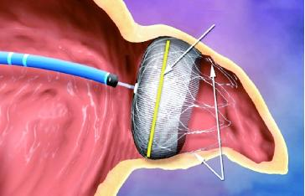
预防栓塞
口服抗凝药：华法林，Xa因子抑制剂
INR： 2-3 （自体瓣）， 金属瓣时可适当提高INR
在开胸换瓣手术时, 对有症状的AF患者应进行外科消融
暂无证据支持左心耳封闭预防血栓,除非作为射频治疗AF的补充.

Slide 25
手术治疗指征
所有有重症状的病人(心功能III-IV级)
所有轻度症状的病人 (心功能 II级)
无症状的病人:
肺动脉高压
有肺水肿发作
心房颤动 (持续/反复发作)
血栓栓塞病人 (系统栓塞/肺动脉)
严重 MS (瓣膜适合球囊扩张/手术)

Slide 26
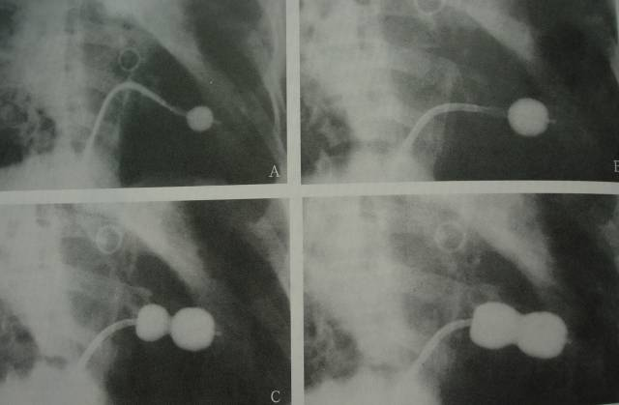
Catheter Balloon Commissurotomy
PBMV: Mild or Sever MS, pliable non-calcified valve and without important mitral regurgitation.
Notes:
Or percutaneous balloon mitral valvuloplasty:
Pliable
Catheter Balloon Commissurotomy

Slide 27
外科手术方式
二尖瓣闭式扩张
二尖瓣修补/置换
置换指征:
严重 MS + 心功能 III-IV
中度二尖瓣返流
老年和瓣膜钙化

Slide 28
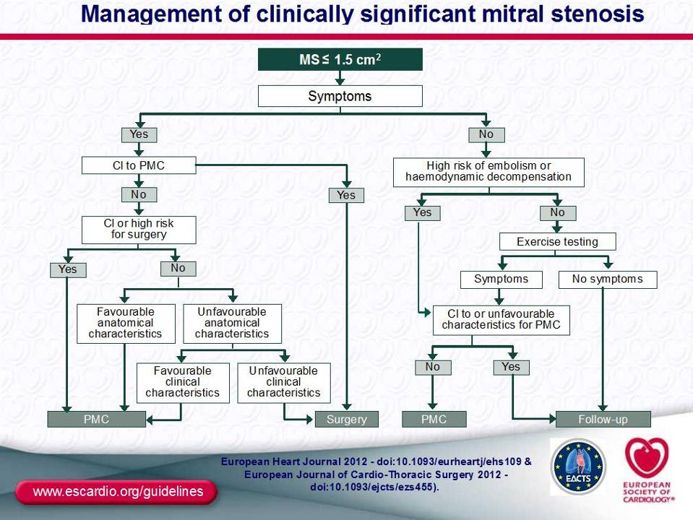

Slide 29
二尖瓣关闭不全 (MI)
二尖瓣结构异常引起的急性或慢性关闭不全
1: 瓣环异常:
感染; Marfan’s 综合症; 退形性病变;
2: 瓣叶:前叶/后叶病变:
风湿; 感染; SLE
3: 腱索病变
感染, 风湿
4: 乳头肌和邻近的室壁
缺血; 感染; 心衰

Slide 30
病 理
二尖瓣叶闭合不全造成瓣口的返流
返流造成左房收缩负荷和左室舒张期负荷增加,导致左室结构功能改变
Notes:
aptation

Slide 31
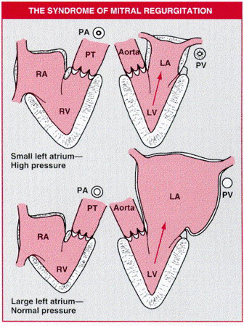
Acute v.s. Chronic
急性: LA小-压力高
慢性: LA大-压力正常
Notes:
Diagram depicting the two extremes of the spectrum in pure mitral regurgitation. When severe mitral regurgitation appears suddenly in individuals with previously normal or near-normal hearts (top), the left atrium (LA) is relatively small and the high pressure within it is reflected back into the pulmonary vessels and right ventricle (RV). The anatomical indicator of this latter physiological event is severe hypertrophy of the left atrial and right ventricular walls and marked intimal proliferation and medial hypertrophy of the pulmonary arteries (PA), arterioles, and veins (PV). At the other extreme, in patients with severe chronic mitral regurgitation (bottom), the left atrial cavity is of giant size and its wall is thin. It is thus able to “absorb” the left ventricular (LV) pressure without reflecting it back into the pulmonary vessels or right ventricle. As a consequence, pulmonary vessels remain normal, and the right ventricular wall does not thicken. PT = pulmonary trunk; RA = right atrium. (From Roberts WC, et al: Nonrheumatic valvular cardiac disease. A clinicopathologic survey of 27 different conditions causing valvular dysfunction. In Likoff W [ed]: Cardiovascular Clinics. Vol. 5, No. 2, Valvular Heart Disease. Philadelphia, F.A. Davis Co, 1973, p 403.)

Slide 32
症 状
慢性二尖瓣关闭不全
无症状
劳力性气促
夜间阵发性呼吸困难
端坐呼吸; 水肿
急性二尖瓣返流:
劳力性呼吸困难
急性肺水肿

Slide 33
体 征
抬举性心尖搏动: 左下移位; 弥散;短促
S1减弱; S2分裂; S3, S4
收缩期吹风样杂音: 可有震颤,放射到腋下 (风湿性) 或到心底部(后叶脱垂)

Slide 34
ECG
LA扩大
LV肥厚伴继发性ST-T异常
Af

Slide 35
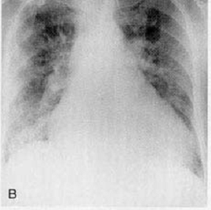
Chest Roentgenogram
肺间质水肿
心脏扩大,左房及左心耳肥大
Notes:
FIGURE 8–18. A, Pulmonary blood flow redistribution. Enlargement of the upper lobe vessels is seen in a patient with ischemic cardiomyopathy and elevated pulmonary venous pressure. B, Pulmonary interstitial edema. The vessels are indistinct and enlarged, and peribronchial cuffing is present. C, Pulmonary alveolar edema in a patient with congestive cardiomyopathy. The central perihilar distribution of edema, termed “bat wing” edema, is typical of pulmonary alveolar edema caused by cardiovascular or fluid overload (uremic). D, Preferential right upper lobe distribution of pulmonary edema in a 65-year-old man with mitral regurgitation. E, Right pleural effusion and residual right upper and bilateral lower lobe edema in a patient with acute mitral regurgitation.

Slide 36
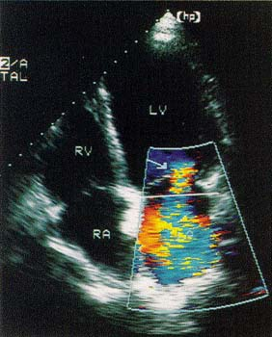
Color Doppler Imaging
红色血流 表示血流方向面对探头(舒张期充盈)
蓝色血流 表示血流方向背离探头 (收缩期射流)
Notes:
FIGURE 7–54. Apical four-chamber view in a patient with a dilated cardiomyopathy and severe mitral regurgitation due to a dilated annulus and abnormal mitral valve coaptation. The solid horizontal white line represents the plane of the mitral annulus. Note that the mitral valve closes well within the cavity of the left ventricle. The actual origin of the mitral regurgitation jet can be seen as it accelerates toward the regurgitant orifice (arrow) and is likewise displaced into the cavity of the left ventricle.

Slide 37
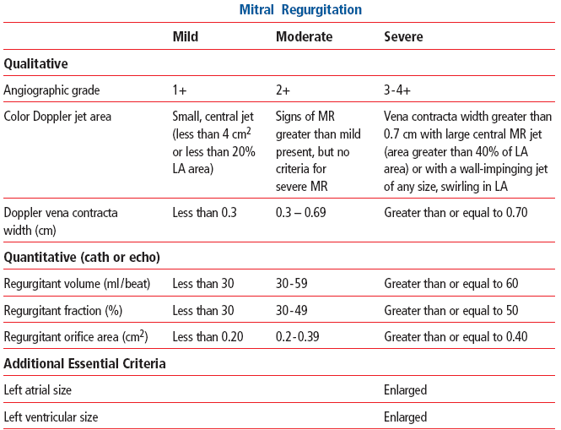

二尖瓣返流严重程度判断
Notes:
Impinging vena contracta；缩流断面 ；

Slide 38
诊断/鉴别
诊断:
心尖SM + LA 和LV扩大 + Echo
鉴别: 根据SM
TR: 柔和, 不超过左锁骨中线
吸气期增强
VSD: 全收缩期杂音
AS: 主动脉第一听诊区最强, 放射到颈部
左锁骨旁收缩期杂音: 生理性
Notes:
holosystolic

Slide 39
治 疗
药物
主要降低后负荷: 扩血管: 硝普钠, ACEI
利尿剂; 洋地黄
手术:
二尖瓣重建
二尖瓣置换
指征:
所有有症状的病人和/或LV肥大的病人

Slide 40
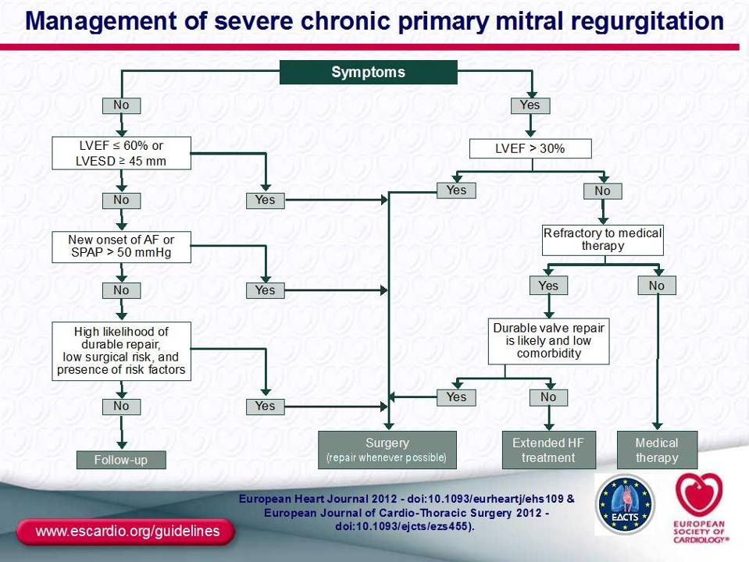
valve repair should be considered (IIaC) in patients with flail leaflet and LVESD ≥40 mm; valve repair may be considered (IIbC) if one of the following is present: LA volume ≥60 mL/m² BSA and sinus rhythm or pulmonary hypertension on exercise (SPAP ≥60 mmHg).
Notes:
AF = atrial fibrillation; BSA = body surface area; HF = heart failure; FU = follow-up; LA = left atrium; LV = left ventricle; LVEF = left ventricular ejection fraction;
LVESD = left ventricular end-systolic diameter; SPAP = systolic pulmonary arterial pressure.
aWhen there is a high likelihood of durable valve repair at a low risk, valve repair should be considered (IIaC) in patients with flail leaflet and LVESD ≥40 mm; valve repair may be
considered (IIbC) if one of the following is present: LA volume ≥60 mL/m² BSA and sinus rhythm or pulmonary hypertension on exercise (SPAP ≥60 mmHg).
bExtended HF management includes the following: cardiac resynchronization therapy; ventricular assist devices; cardiac restraint devices; heart transplantation.

Slide 41
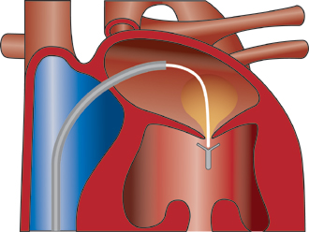
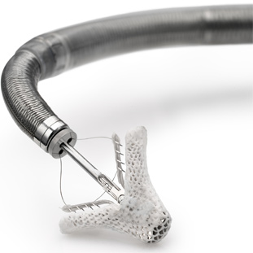
MitraClip:二尖瓣缝夹

Slide 42
主动脉瓣狭窄 (AS)
AS是左室到主动脉的血流受阻,受阻的部位包括瓣膜水平、瓣膜上或瓣膜下. 瓣上狭窄多数是先天性的. 瓣下狭窄通常由于纤维肌性或肌性阻塞

Slide 43
Etiology
风湿性: 瓣叶的粘连和融合.
先天性: 年龄相关的异常: 单瓣, 双瓣, 或三瓣畸形
钙化/退形性变: 受损或正常瓣膜的钙化; 可能代表机体对瓣膜上抗原的免疫反应

Slide 44
Age-dependent Etiology
Unicommissural 3%
Hypoplastic 3%
Indeterminate 2%
Bicuspid:50%
Bicuspid:27%
Degenerative: 18%
Degenerative: 48%
Post-inflammatory: 25%
Post-inflammatory: 23%
Age<70 Age>70
Notes:
Causes of aortic stenosis, shown for two age groups. Among patients younger than 70 years (top), calcification of congenitally bicuspid valves accounted for half of the surgical cases. In contrast, in those 70 years of age or older (bottom), degenerative calcification accounted for almost half of the cases. (From Passik CS, et al: Temporal changes in the causes of aortic stenosis: A surgical pathologic study of 646 cases. Mayo Clin Proc 62:119, 1987.)

Slide 45
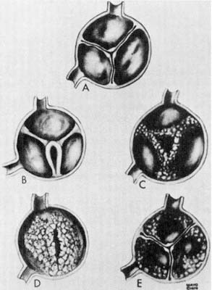
Pathology
A, 正常瓣膜.
B, 先天性主动脉狭窄.
C, 风湿性主动脉狭窄.
D, 钙化主动脉狭窄
E, 钙化性老年主动脉狭窄
Notes:
Types of aortic valve stenosis. A, Normal aortic valve. B, Congenital aortic stenosis. C, Rheumatic aortic stenosis. D, Calcific aortic stenosis. E, Calcific senile aortic stenosis. (From Brandenburg RO, et al: Valvular heart disease—When should the patient be referred? Pract Cardiol 5:50, 1979.)
Four types of calcific aortic stenosis. In each, the unopened aortic valve is viewed form above.
A. Acquired bicuspid aortic valve with secondary calcification. At the center of the conjoined cusp (lower center) are elements of two preexisting cusps, now fused.
B. Congenital bicuspid valve. The characteristic raphe of the congenital bicuspid aortic valve appears at the lower portion of the figure.
C. Senile type. None of the commissures is fused, but there is a major intrinsic calcification of the three cusps.
D. Unicuspid, unicommissural congenital aortic stenosis with secondary calcification.
JE Edwards: Pathology of acquired valvular disease of the heart. Semin Roentgenol 14:96, 1979.

Slide 46
病理生理
主动脉狭窄
LV流出道梗阻
LV收缩压↑
LVET↑
LV舒张压↑
AO压↓
LV体积↑
心肌耗氧↑
舒张时间↓
LV功能失调
心肌氧供↓
心肌缺血
左心衰竭
Notes:
Aortic stenosis lead to LV outflow obstruction. The major compensatory mechanism by which the hear copes with LV outflow obstruction is ventricular hypertrophy.

Slide 47
症状
劳力性气促
(端坐呼吸; 夜间阵发性呼吸困难; 肺水肿)
心绞痛
晕蹶: 劳力性晕蹶前兆
猝死

Slide 48
体 查
抬举心尖搏动
S2减弱或逆分裂
可有S4
收缩期喷射音和吹风样杂音, 胸骨左缘3rd-4th 肋间最明显, 伴有震颤,放射到颈部
脉搏上升缓慢,细小而持续(Parvus et tardus)

Slide 49
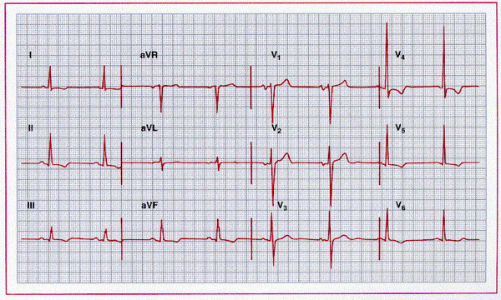
ECG
LV Hypertrophy with secondary ST-T changes
Abnormal conduction: AVB, LBBB

Slide 50
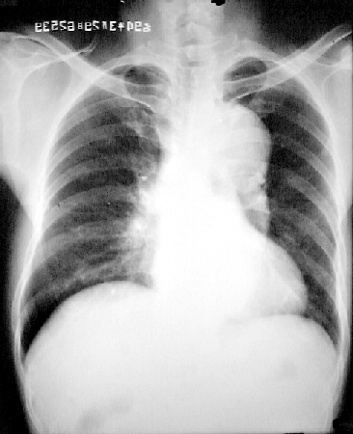
Chest X-Ray
狭窄后扩张
Notes:
Normal heart size with dilated proximal ascending aorta(poststenotic dilation). Calcification of aortic valve may be present as a hallmark of AS
Concentric hypertrophy of LV, no change of LV size on chest film. But lV wall thickening may be detected on echo.
Eccentric hypertrophy may be present in the late stage of AS.

Slide 51
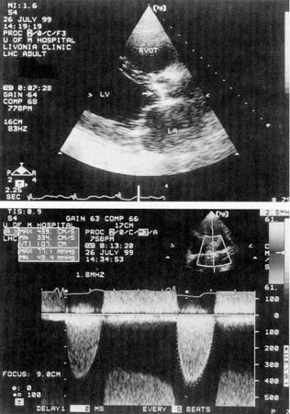
Echo/Doppler
Thickened and calcified AV
V_{AO=}430cm/s
Maximum gradient=77mmHg
Mean gradient=49.4mmHg
Notes:
Echocardiogram recorded in a patient with severe aortic stenosis. The top panel is a parasternal long-axis view recorded in systole. Left ventricular function is diminished. The aortic valve is markedly thickened and partially calcified. Its motion is markedly reduced and in systole it appears that the valve occludes the orifice (arrow). The lower panel is a continuous-wave Doppler recorded from the apex of the left ventricle along a line aimed through the stenotic aortic valve. Note the aortic stenosis signal below the zero crossing line. The peak velocity is 430 cm/sec, which corresponds to a maximum gradient of 77 mm Hg and a mean gradient of 49.4 mm Hg. Abbreviations are as per previous figures.

Slide 52
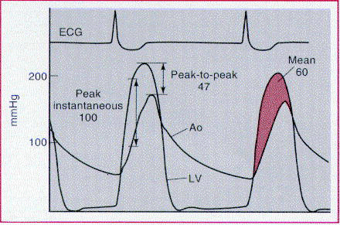
Cardiac Catheterization
左室-主动脉压差平均>50mmHg,峰压差>70mmHg
Notes:
Various methods of describing an aortic transvalvular gradient. The peak-to-peak gradient (47 mm Hg) is the difference between the maximal pressure in the aorta (Ao) and the maximal left ventricle (LV) pressure. The peak instantaneous gradient (100 mm Hg) is the maximal pressure difference between the Ao and LV when the pressures are measured in the same moment (usually during early systole). The mean gradient (shaded area) is the integral of the pressure difference between the LV and Ao during systole (60 mm Hg). (From Bashore TM: Invasive Cardiology: Principles and Techniques. Philadelphia, BC Decker, 1990.)

Slide 53
Evaluation of Stenosis
 | 轻度狭窄 | 中度狭窄 | 严重狭窄
主动脉瓣口面积（cm²） | > 1.0 | 0.7~1.0 | <0.75
平均左室-主动脉压差（mmHg） | 25 | 26~50 | >50
正常主动脉瓣口面积 =1.6-2.6 cm²

Slide 54
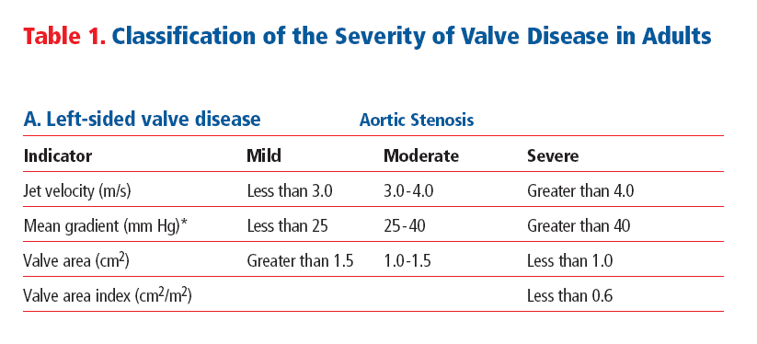

Slide 55
诊断/鉴别
诊断依据主要是收缩期杂音和Echo/Doppler
合并二尖瓣损害,考虑风湿性
青少年: 单瓣畸形, <65y: 双瓣畸形
>70y: 退行性变或钙化
鉴别:
其他瓣上-或瓣下主动脉狭窄
肥厚梗阻性心肌病

Slide 56
治 疗
药物:
预防性使用抗生素防止感染性心内膜炎
避免中重度体力活动或竞争性运动
房颤时恢复窦性
避免强烈的扩血管和利尿
外科: 指征
严重狭窄: AVA<0.8, 左室-主动脉压差>50mmHg
心绞痛, 晕蹶
左心衰
球囊扩张:
有手术指征但不能手术或不愿手术者

Slide 57
经导管主动脉置放(ATVI)
Transcatheter aortic valve implantation
适应症
重度症状AS但不能耐受开胸手术的患者

Slide 58
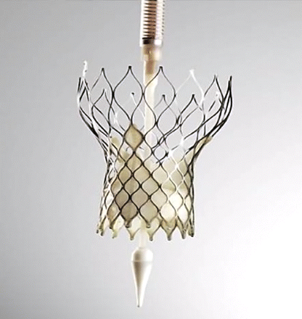
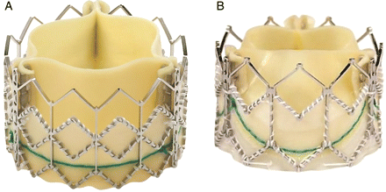
目前使用的两种瓣膜
Edwards SAPIEN valve
CoreValve Revalving system

Slide 59
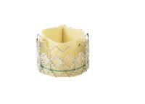
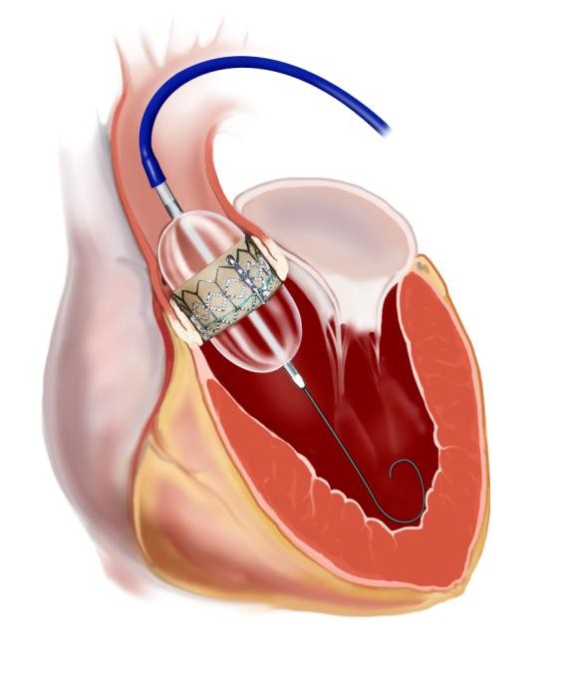
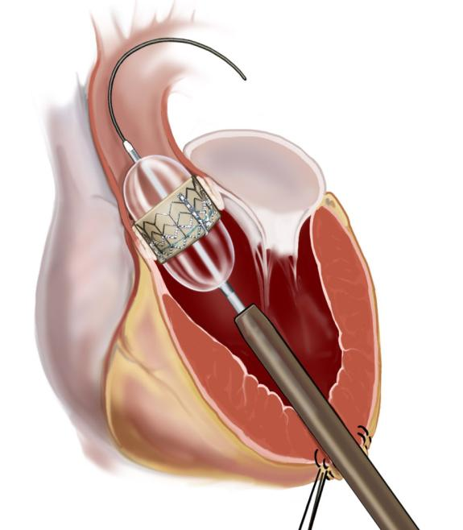
Edwards SAPIEN™ THV
Access to the aortic valve
Transfemoral Approach
Transapical Approach
Notes:
59
The first which was used in man was the antegrade transseptal approach. Here , we puncture the interatrial septum, and deliver the valve from the femoral vein into the right atrium, left atrium , left ventricle before seating it into the native aortic valve.
In the retrograde approach, we are able to deploy the percutaneous heart valve by crossing the native valve retrograde from the femoral artery and thoracic aorta.

Slide 60
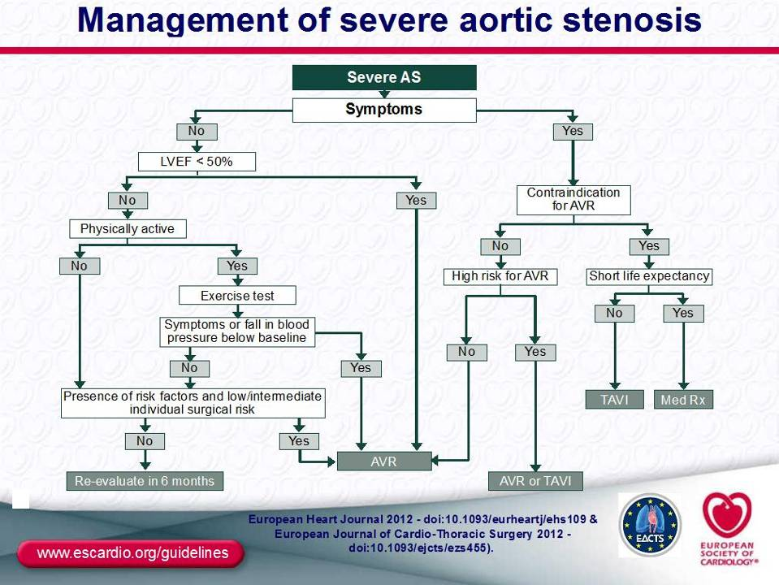
IIa: peak velocity >5.5m/s; severe valve calcification + peak velocity progression ≥0.3 m/s/year. IIbC : markedly elevated natriuretic peptide levels; mean gradient increase with exercise >20 mmHg; excessive LV hypertrophy.
Notes:
AS = aortic stenosis; AVR = aortic valve replacement; BSA = body surface area; LVEF = left ventricular ejection fraction;Med Rx = medical therapy;
TAVI = transcatheter aortic valve implantation.
aSee Table 4 for definition of severe AS.
bSurgery should be considered (IIaC) if one of the following is present: peak velocity >5.5m/s; severe valve calcification + peak velocity progression ≥0.3 m/s/year. Surgery may be
considered (IIbC) if one of the following is present: markedly elevated natriuretic peptide levels; mean gradient increase with exercise >20 mmHg; excessive LV hypertrophy.
cThe decision should be made by the ‘heart team’ according to individual clinical characteristics and anatomy..

Slide 61
主动脉返流(AR)
瓣膜疾病：
慢性:
RHD, 亚细, 先天性
主动脉瓣脱垂
自身免疫性(强直性脊椎炎)
急性：
亚细, 人工瓣撕裂
主动脉根部扩张：
慢性：
梅毒、Marfan’s 综合症, Valsalva窦瘤。
急性:
主动脉夹层破裂。
Notes:
ankylosing spondylitis

Slide 62
Pathophysiology
主动脉瓣返流
↑LV容积
↑每搏射血量
↓AO舒张压
↓有效SV（疲劳）
↑LV质量
↑收缩压
↑LVET
↑心肌氧耗
↓舒张时间
↑LVEDP
↓心肌氧供
心肌缺血
左心衰
Notes:
Pathophysiology of aortic regurgitation. Aortic regurgitation results in an increased left ventricular (LV) volume, increased stroke volume, increased aortic (Ao) systolic pressure, and decreased effective stroke volume. Increased LV volume results in an increased LV mass, which may lead to LV dysfunction and failure. Increased LV stroke volume increases systolic pressure and prolongation of left ventricular ejection time (LVET). Increased LV systolic pressure results in a decrease in diastolic time. Decreased diastolic time (myocardial perfusion time), diastolic aortic pressure, and effective stroke volume reduce myocardial O2 supply. Increased myocardial O2 consumption and decreased myocardial O2 supply produce myocardial ischemia, which further deteriorates LV function ( = increased, ¯ = decreased). (From Boudoulas H, Gravanis MB: Valvular heart disease. In Gravanis MB: Cardiovascular Disorders: Pathogenesis and Pathophysiology. St. Louis, CV Mosby Co, 1993, p 64.)

Slide 63
症 状
心悸:
感觉心跳
胸痛:
心绞痛 (20%)
呼吸困难:
Exertional, Nocturnal, Orthopnea

Slide 64
体 查
周围血管征:
点头征(de Musset sign): 头部随心跳而点头运动
枪击音(Traube’s sign): 股动脉部位的枪击音
二重音(Duroziez’ sign): 压迫股动脉近端,可闻及收缩期杂音,压迫远端,闻及舒张期杂音
毛细血管搏动(Quinke’s pulse)
水冲脉 (Corrigan’s pulse, cannonball pulse)
Notes:
(de Musset sign): bobbing of the head with each heat beat
Traube’s sign: pistol-shot sound heard over the femoral artery
Duroziez’ sign: systolic murmur over femoral artery when it’s compressed proximally and diastolic murmur when compressed distally
Quinke’s pulse: capillary pulsation
Water-hammer pulse (Corrigan’s pulse, cannonball pulse) rapid rise and quick collapse

Slide 65
体 查
望诊: 心尖左下搏动
震颤提示严重返流
S1, S2下降
胸骨左缘3-4肋间舒张期哈气样杂音 (sine qua non):
Austin-Flint杂音: 无开瓣音和S1亢进,硝酸酯降低A-F 杂音, 而增加 MS 杂音
Notes:
The clinical sine qua non of AR is an early or immediate, blowing, decrescendo diastolic murmur beginning after A2.

Slide 66
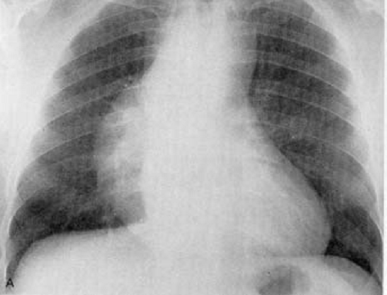
Chest X-ray
Aortic dilation and dilated LV
Notes:
Aortic regurgitation with massive diffuse aortic dilation in a male with severe valvular regurgitation related to annuloaortic ectasia Boot shaped heart=Coeur en sabot

Slide 67
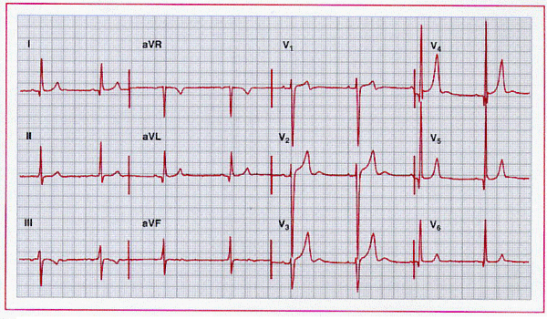
ECG

Slide 68
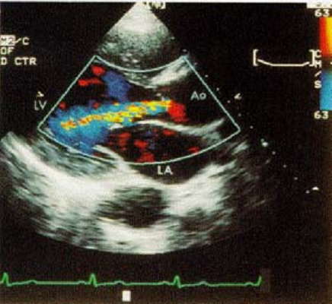
Echocardiography
Color jet fills over one third of the left ventricular outflow tract
Notes:
Parasternal long-axis two-dimensional echocardiograms in a patient with moderate aortic regurgitation. note the color jet of aortic regurgitation that fills over one third of the left ventricular outflow tract.

Slide 69
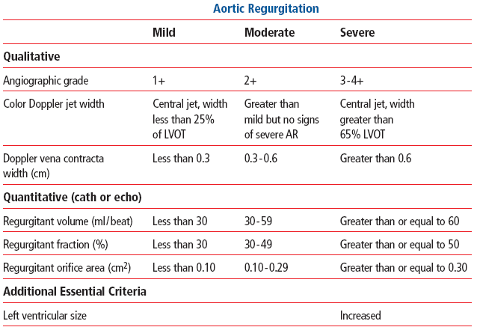

Slide 70
诊 断
临床表现可明确 70%病人的诊断
症状:无特异性
体征: AR杂音 + 周围血管征
超声: 确诊 (100%)
鉴别:
Graham Steell杂音:类似AR杂音但P2亢进
Austin-Flint杂音: MS

Slide 71
处 理
药物:
预防性抗生素
扩血管: CCB, ACEI
心衰治疗
外科
所有有症状的病人
无症状但: LVED>50mm

Slide 72
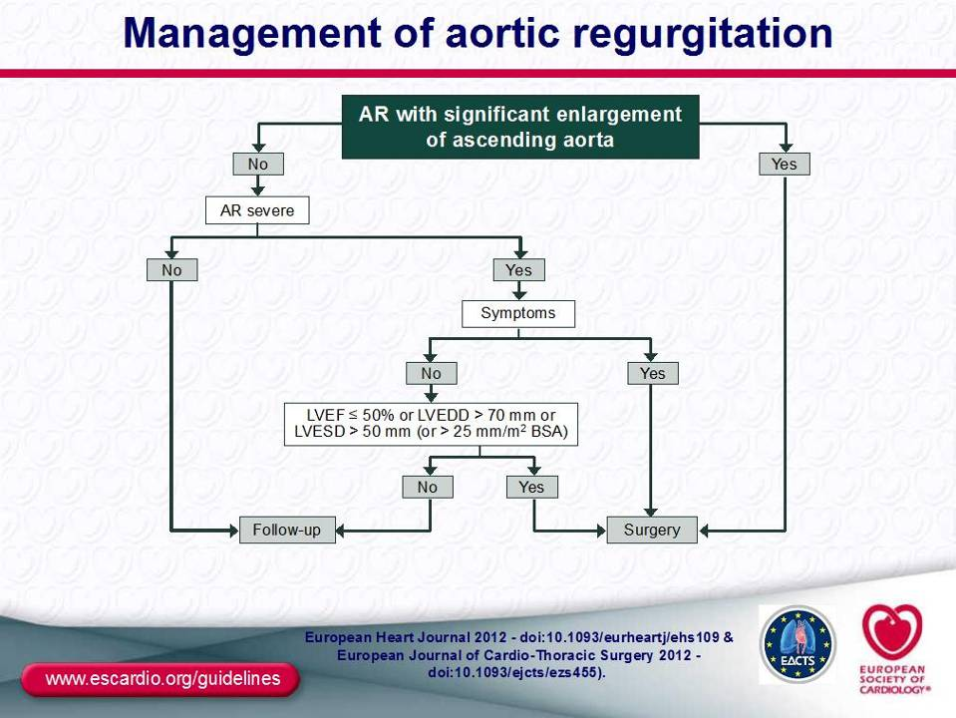

Slide 73
感染性心内膜炎
（Infective Endocarditis, IE）
定义：是病原微生物循血行途径引起的心内膜、心瓣膜或邻近大动脉内膜感染并伴赘生物形成。
分类：急性IE、亚急性IE
自体瓣膜IE、人工瓣膜IE

Slide 74
心脏基础疾病
人工瓣膜
先天性紫绀型心脏病
动脉导管未闭（PDA）
主动脉关闭不全AR/狭窄AS
二尖瓣关闭不全（MR）
室间隔缺损（VSD）
二尖瓣脱垂（MP）

Slide 75
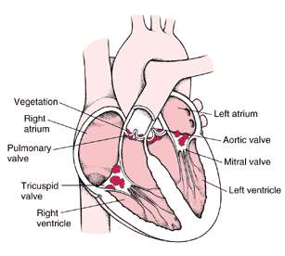
易感部位：低压面

Slide 76
病原微生物
微生物种类 | 感染机会（％）
链球菌Streptococci | 31
肠球菌Enterococci | 9
金葡萄球菌S. aureus | 36
凝固酶阴性葡萄球菌 | 5
HACEK（非肠道G⁻菌） | 3
培养阴性 | 5

Slide 77
病 理
瓣膜损害：返流
赘生物：
栓塞：
免疫损害：肾脏、皮肤、关节

Slide 78
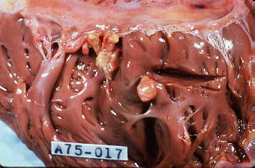
瓣膜赘生物

Slide 79
临床表现
全身性感染表现（非特异性）
发热/寒战(80－90％）、乏力、气促、肌肉/关节痛、纳差、贫血、体重减轻、胸/腰/背痛
心脏（特异性）
杂音(80%)、新杂音/杂音变化（30％）

Slide 80
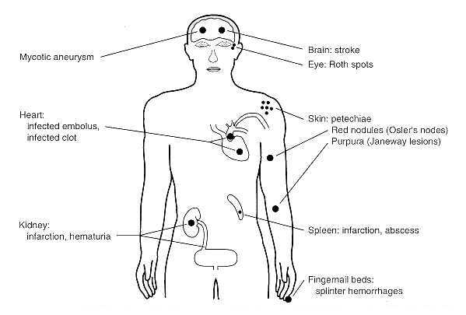
感染性心内膜炎:由于栓塞转移性感染
脑卒中
脑脓肿
眼：Roth斑
皮肤淤点
感染性赘生物，血栓
红色（Oslar结节）
紫红色（Janeway损害）
肠系膜栓塞，便血
肾脏：梗死、血尿
脾梗塞，脓肿
甲床：裂片状出血
Notes:
Heart valve infections generally are classified as acute endocarditis, subacute endocarditis, and prosthetic valve endocarditis. If they are untreated, these infections are fatal. With treatment, mortality averages 30 percent; it is higher in acute and prosthetic valve infections.
Acute endocarditis usually occurs when heart valves are colonized by virulent bacteria in the course of microbemia (Fig. 94-3). The most common cause of acute endocarditis is Staphylococcus aureus; other less common causes are Streptococcus pneumoniae, Neisseria gonorrhoeae, Streptococcus pyogenes, and Enterococcus faecalis. Patients with acute endocarditis usually have fever, marked prostration, and signs of infection at other sites. Infected heart valves may be destroyed rapidly, leading to heart failure from valve leaflet perforation and acute valvular insufficiency. Infected pieces of fibrin and platelet vegetations on the valves may break loose into the circulation and lodge at distant sites, producing damage to target organs. Metastatic infection due to emboli may involve arterial walls (mycotic aneurysm) or produce abscesses.
Patients with subacute endocarditis usually have underlying valvular heart disease and are infected by less virulent organisms such as viridans streptococci, enterococci, nonenterococcal group D streptococci, microaerophilic streptococci, and Haemophilus species. Frequently, the source and onset of infection are not clear, and patients consult physicians with complaints of fever, weight loss, or symptoms related to embolic phenomenon and congestive heart failure.
Prosthetic valvular endocarditis may present either acute or subacute in onset, and the infecting organisms differ, depending on whether endocarditis develops within 2 months of surgery or later (Table 94-1). Whereas infections on nonprosthetic valves usually are eradicated by antimicrobial therapy alone, prosthetic valve infections frequently require surgical removal of the infected valve before the infection is eliminated. Antimicrobial therapy of endocarditis is prolonged and should be guided by susceptibility studies. Fungal endocarditis is rare, but Candida infections occur in those with prosthetic valves and in drug addicts. Aspergillus endocarditis may occur after cardiac valve surgery.
Mycotic， petechiae

Slide 81
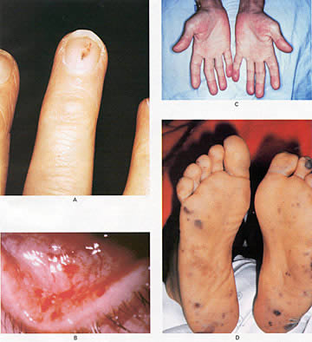
Osler结节(疼痛)
Janeway 损害
Notes:
Common Peripheral Manifestations of Infective Endocarditis.
Splinter hemorrhages(Panel A) are normally seen under the fingernails. They are usually linear and red for the firstr two to three days and brownish thereafter.
Panel B shows conjunctival petechiae.
Osler's nodes (Panel C)are tender, subcutaneous nodules, often in the pulp of the digits or the thenar eminence.
Janeway's lesions (Panel D) are nontender, erythematous, hemorrhagic, or pustular lesions, often on the palms or soles.

Slide 82
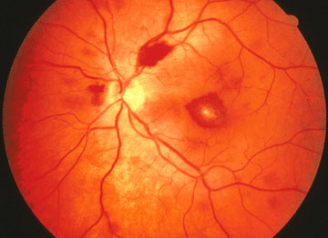
Roth斑：中央苍白性出血
Notes:
The Roth Spot is a white-centered hemorrhage. Actually, it is a cotton wool spot surrounded by hemorrhage. The cotton wool comes from ischemic bursting of axons; the small hemorrhage comes from ischemic bursting of a pre-capillary arteriole. Many, many conditions may cause this. It is not, as often supposed, specific to bacterial endocarditis!

Slide 83
实验室检查
检验项目 | 阳性机会（％）
ESR | >90
贫血 | 70-90
循环免疫复合物 | 65-100
蛋白尿 | 50-65
RF | 50
镜下血尿 | 30-50
白细胞增多 | 20-30
补体下降 | 5-40

Slide 84
血培养
85－95％阳性
采血
疑急性：3次，不同部位、间隔15-30min，1-2小时内
疑亚急性: 3次，不同部位、24小时内
用过抗生素：稳定病人,停用药几天后，多次 采血,10-
20ml
特殊培养，
药敏试验（MIC，MBC）
Notes:
o Blood cultures are positive in 85% to 95% of cases
o In patients suspected of having acute infective endocarditis, a minimum of three sets of blood cultures should be obtained from different venipuncture sites at 15- to 30-minute intervals over a period of 1-2 hours. Antibiotic therapy should then be started.
o In patients suspected of having subacute infective endocarditis, a minimum of three sets of blood cultures should be obtained from different venipuncture sites over a period of 24 hours.
o Additional blood cultures may be needed in patients who have received prior antimicrobial therapy. In these cases, the clinician may choose to delay endocarditis therapy in stable patients until repeat blood cultures can be performed over a period of a few days.
o If unusual bacteria are suspected (ie, Legionella, Brucella, Mycoplasma, Chlamydia, Histoplasma, Bartonella, HACEK, nutritionally variant streptococci), the laboratory should be notified regarding these concerns because culture results will be negative unless the laboratory uses appropriate microbiologic techniques.

Slide 85
ECG、X线检查
ECG：
心律失常、ST-T改变、AVB
X线检查
肺部感染、心衰充血改变

Slide 86
超声心动图
了解心脏结构改变
发现赘生物：TTE：25％-60%敏感性
TEE：87－100%敏感性
TEE优于TTE：肺动脉瓣和人工瓣膜炎
TTE阴性不能排除IE诊断
了解心室、瓣膜功能，有助于临床决策
Notes:
• Echocardiography
o Essential for the diagnosis of infective endocarditis
o Essential for the management of infective endocarditis
o Should be obtained in all patients suspected of having endocarditis
o Sensitivity of the transthoracic echocardiogram (TTE) is 25% to 60%
o Sensitivity of the transesophageal echocardiogram (TEE) is 87% to 100%
o TEE is superior to TTE for the detection of prosthetic valve endocarditis
o TEE is the study of choice for imaging of the pulmonary valve
o TTE and TEE are roughly equivalent in their ability to detect vegetations on the tricuspid valve
o Complications of endocarditis (abscess, fistula) are more easily identified by TEE
o A negative TTE does not exclude the diagnosis of endocarditis
o The clinician should realize that the echocardiogram may not always reliably differentiate the valvular vegetations of endocarditis from other echocardiographic abnormalities (ie, imaging artifacts, tumor, thrombus, nonbacterial thrombotic endocarditis, valvular thickening, valvular calcification). In addition, the study may not be able to ascertain whether the vegetation is active or old.
o In addition to providing support for the diagnosis, echocardiography also provides information regarding ventricular and valve function. This information is useful in decision-making (ie, need for surgery, timing of surgery).

Slide 87
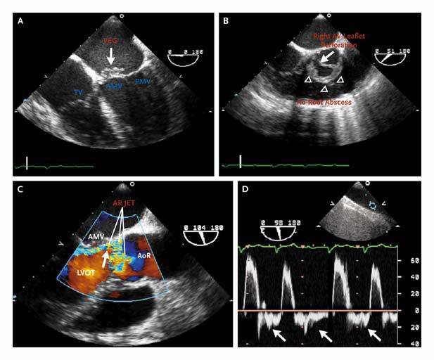
二尖瓣前叶赘生物
右主动脉瓣穿孔
前主动脉根脓肿
Notes:
Transesophageal echocardiography (see video 1, 2, 3, and picture 1) is more costly and invasive but increases the sensitivity for detecting vegetations to 75 to 95 percent while maintaining specificity and 85 to 98 percent. Panel A and Video Clip 1 show a large area of vegetation (VEG, arrow in Panel A) on the anterior mitral valve (AMV), seen on the midesophageal four-chamber view. PMV denotes posterior mitral valve, and TV tricuspid valve. Panel B and Video Clip 2 of the Supplementary Appendix show a perforation (arrow in Panel B) of the right aortic valve (AV) leaflet and an abscess (triangles in Panel B) of the anterior aortic (Ao) root, seen on the midesophageal short-axis view of the aortic root. Panel C and Video Clip 3 of the Supplementary Appendix show a color Doppler study of a posteriorly directed jet of aortic regurgitation (AR, arrow in Panel C) against the anterior mitral leaflet. AoR denotes aortic root, and LVOT left ventricular outflow tract. A pulsed Doppler study (Panel D) shows the pan-diastolic flow reversal (arrows) in the distal ascending aorta. The scale to the right indicates flow velocity measured in centimeters per second, the signal above the baseline indicates forward flow, and the signal below the baseline indicates reverse flow.
Transesophagealent echocardiography is particularly useful in patients with Prosthetic valves and for the valuation of myocardial invasion. A negative transesophageal echocardiogram has a negative predictive value for infective endocarditis of over 92%.
Recent guidelines suggest that among patients with suspected infective endocarditis transthoracic echocardiography should be used in the valuation of those with native valves who are good candidates for imaging. In fact, the appropriate use of echocardiography depends on the prior probability of infective endocarditis. If this probability is less than 4 percent, a negative transthoracic echocardiogram is cost effective and clinically satisfactory in ruling out infective endocarditis. For patients whose prior probability of infective endocarditis is 4 to 60 percent, initial use of a transesophageal echocardiography is more cost effective and diagnostically efficient than initial use of transthoracic echocardiography, which, if negative, is followed by a transesophageal echocardiography. This category of intermediate prior probability includes patients with unexplained bacteremia with a gram positive coccus, those with catheter-associated Staph.aureus bacteremia, and those admitted with fever or bacteremia in the setting for recent injection-drug use.
Clinical diagnosis of perivavular extension of infective endocarditis is imprecise. Persistent bacteremia or fever, recurrent emboli, heart block, congestive heart failure or a new pathological murmur in a patient with infective endocarditis may suggest such extension. Transesophageal echocardiography is more sensitive than transthoracic echocardiography for defining perivalvular extension of the infective endocarditis and the presence of a myocardial abscess. Transesophageal echocardiography with spectral and color-flow Doppler techniques can also demonstrate the distinctive flow patterns of fistulas, pseudo aneurysms, ruptured abscess cavities and is more sensitive than transthoracic echocardiography for identifying valve perforations.

Slide 88
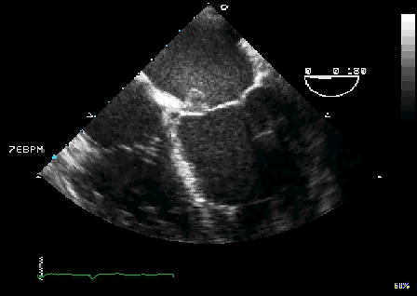
Notes:
Transesophageal echocardiography (see video 1, 2, 3, and picture 1) is more costly and invasive but increases the sensitivity for detecting vegetations to 75 to 95 percent while maintaining specificity and 85 to 98 percent. Panel A and Video Clip 1 show a large area of vegetation (VEG, arrow in Panel A) on the anterior mitral valve (AMV), seen on the midesophageal four-chamber view. PMV denotes posterior mitral valve, and TV tricuspid valve. Panel B and Video Clip 2 of the Supplementary Appendix show a perforation (arrow in Panel B) of the right aortic valve (AV) leaflet and an abscess (triangles in Panel B) of the anterior aortic (Ao) root, seen on the midesophageal short-axis view of the aortic root. Panel C and Video Clip 3 of the Supplementary Appendix show a color Doppler study of a posteriorly directed jet of aortic regurgitation (AR, arrow in Panel C) against the anterior mitral leaflet. AoR denotes aortic root, and LVOT left ventricular outflow tract. A pulsed Doppler study (Panel D) shows the pan-diastolic flow reversal (arrows) in the distal ascending aorta. The scale to the right indicates flow velocity measured in centimeters per second, the signal above the baseline indicates forward flow, and the signal below the baseline indicates reverse flow.
Transesophagealent echocardiography is particularly useful in patients with Prosthetic valves and for the valuation of myocardial invasion. A negative transesophageal echocardiogram has a negative predictive value for infective endocarditis of over 92%.
Recent guidelines suggest that among patients with suspected infective endocarditis transthoracic echocardiography should be used in the valuation of those with native valves who are good candidates for imaging. In fact, the appropriate use of echocardiography depends on the prior probability of infective endocarditis. If this probability is less than 4 percent, a negative transthoracic echocardiogram is cost effective and clinically satisfactory in ruling out infective endocarditis. For patients whose prior probability of infective endocarditis is 4 to 60 percent, initial use of a transesophageal echocardiography is more cost effective and diagnostically efficient than initial use of transthoracic echocardiography, which, if negative, is followed by a transesophageal echocardiography. This category of intermediate prior probability includes patients with unexplained bacteremia with a gram positive coccus, those with catheter-associated Staph.aureus bacteremia, and those admitted with fever or bacteremia in the setting for recent injection-drug use.
Clinical diagnosis of perivavular extension of infective endocarditis is imprecise. Persistent bacteremia or fever, recurrent emboli, heart block, congestive heart failure or a new pathological murmur in a patient with infective endocarditis may suggest such extension. Transesophageal echocardiography is more sensitive than transthoracic echocardiography for defining perivalvular extension of the infective endocarditis and the presence of a myocardial abscess. Transesophageal echocardiography with spectral and color-flow Doppler techniques can also demonstrate the distinctive flow patterns of fistulas, pseudo aneurysms, ruptured abscess cavities and is more sensitive than transthoracic echocardiography for identifying valve perforations.

Slide 89


Slide 90
诊 断
主要标准：
血培养：
♣不同部位2次相同的典型细菌，或
♣持续阳性，相隔12小时以上，或
♣所有3次或4次中3次阳性，相隔>1小时
心内膜受累的表现
♣超声证实有赘生物、脓肿、人工瓣移位，或
♣新的瓣膜返流
Notes:
Major criteria
1)
Positive blood culture for infective endocarditis
Typical organisms from 2 separate blood cultures or
Persistently positive cultures separated by 12 hours or
All of 3 or 3 of 4 positive cultures drawn at least 1 hour apart
2)
Evidence of endocardial involvement
Echocardiographic confirmation or
New valvular regurgitation
Minor criteria
1)
Predisposing cardiac condition or intravenous drug use
2)
Fever >38°C (100.4°F)
3)
Vascular phenomena (major arterial emboli, septic pulmonary infarcts, mycotic aneurysm, intracranial hemorrhage, conjunctival hemorrhages, Janeway lesions)
4)
Immunologic phenomena (glomerulonephritis, Osler's nodes, Roth spots, rheumatoid factor)
5)
Microbiologic evidence, such as blood culture that is positive but does not meet the major criterion as defined, or serologic evidence of active infection with an organism consistent with infective endocarditis
6)
Echocardiogram consistent with infective endocarditis but not meeting the major criterion
*The diagnosis is established if 2 major criteria, 1 major + 3 minor, or 5 minor criteria are present (definite infective endocarditis). The diagnosis of infective endocarditis is rejected if the patient has any of the following:
Firm alternate diagnosis for manifestations of endocarditis.
Resolution of manifestations of endocarditis with antibiotic therapy for 4 days or less.
No pathologic evidence of infective endocarditis at surgery or autopsy, after antibiotic therapy for 4 days or less.
Those who fall short of having "definite" endocarditis but in whom the diagnosis has not been rejected have possible infective endocarditis. Most of these patients will be treated for infective endocarditis.
Adapted from Durack DT, Lukes AS, and Bright DK, "The Duke Endocarditis Service. New Criteria for Diagnosis of Infective Endocarditis: Utilization of Specific Echocardiographic Findings,"Am J Med, 1994, 96:200-9.

Slide 91
诊 断
次要标准
IE易患因素或吸毒者
发热，>38C
血管现象（大动脉栓塞，颅内出血，结合膜出血，Janeway损害）
免疫现象：肾炎，Oslar结节，Roth斑，RF
微生物证据：血培养阳性但不够主要标准，或有IE致病菌活动感染的血清学证据
超声心动图：有IE表现但未达到主要标准

Slide 92
诊 断
确诊IE条件
♣ 2项主要标准，或
♣ 1项主要标准＋3项次要标准，或
♣ 5项次要标准
排除IE条件
♣临床表现未明确的其他诊断，而非IE，或
♣ 应用抗生素4天以内临床症状完全缓解，或
♣应用抗生素4天以内，随后外科手术或活检没有IE病理证据

Slide 93
治 疗
抗菌治疗
原则：早期
足量
长疗程（4-6W)
杀菌
联合

Slide 94
抗菌素选择
经验治疗：PNC（1800万U）＋庆大霉素（16万U）
草绿色链球菌：PNC（1800万U）+庆大霉素
PNC耐药：头孢曲松钠：2g/d
PNC过敏：万古霉素：1-1.5g/d ，Bid
肠球菌：PNC（1800－3000万U/d）+庆大霉素
PNC耐药：Amp（12g/d) + 庆大霉素
PNC过敏：万古霉素
葡萄球菌：苯唑西林（12g/d)+庆大霉素
PNC过敏：万古霉素或头孢唑林（6g/d)
其他：根据药敏选择
真菌：咪康唑(0.6-1.8g/d), 氟康唑（200-400mg/d)

Slide 95
其他药物治疗
心衰治疗
心律失常治疗
抗血小板治疗效果不肯定
抗凝治疗：增加脑出血危险
慎用抗凝药：华法林
禁用肝素

Slide 96
治愈标准
抗生素治疗4-6周后
体温正常
血沉正常
症状缓解－消失
脾脏缩小
Hb上升
尿常规转阴

Slide 97
外科治疗
瓣膜损害导致充血性心衰
正规抗菌治疗7－10天仍有败血症
反复栓塞
心内脓肿或瘘管形成
真菌性心内膜炎
抗生素治疗不敏感的病原菌感染
正规抗炎治疗后又复发的病人
人工瓣心内膜炎出现瓣周漏、移位、裂开等
Notes:
INDICATIONS FOR SURGERY IN ACTIVE INFECTIVE ENDOCARDITIS
Native valve endocarditis
Congestive heart failure due to valve dysfunction
Persistent sepsis after a prolonged period (7-10 days) of appropriate antibiotic therapy
Recurrent embolism
Intracardiac abscess or fistula formation
Fungal endocarditis
Infection with a pathogen that is not susceptible to antimicrobial therapy
Relapse after an adequate course of antimicrobial therapy
Prosthetic valve endocarditis
Congestive heart failure caused by valve dysfunction
Fungal endocarditis
Staphylococcal endocarditis not responding to antibiotic therapy
Evidence of intracardiac abscess or fistula formation
Persistent sepsis
Infection with a pathogen that is not susceptible to antimicrobial therapy
Recurrent septic emboli
Relapse after an adequate course of antibiotic therapy
Adapted from Crawford MH and DiMarco JP, Cardiology, London: Mosby Co, 2001, 6.14.12

Slide 98
预 防
IE高危者再行下列操作时预防性用抗生素
牙科、口腔、上呼吸道操作
术前一小时口服阿莫西林
胃肠、泌尿道操作
术前半小时肌注/静脉用抗生素

Slide 99

THANK YOU

