Slide 1
精神病学: 绪论
中南大学精神医学
郝伟 教授

Slide 2
主要内容
概述
疾病模式
精神病学的神经科学基础
精神障碍病因学及思考
精神病学展望

Slide 3
主要内容
概述
疾病模式
精神病学的神经科学基础
精神障碍病因学及思考
精神病学展望

Slide 4
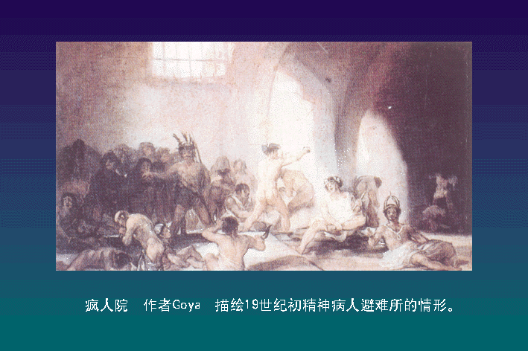

Slide 5





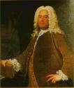
林肯、舒曼、罗伯特、贝多芬、托尔斯泰、海明威……
患有双相障碍的天才们

Slide 6
Principles for the protection of persons with mental illness and the improvement of mental health care
All persons with mental illness or who are being treated as such…. should be treated with humanity and respect for the inherent dignity of the human person…should be free of discrimination… shall have the right to exercise all civil economic social and cultural rights and to protection when these rights are exploited, abused and degraded… shall have the right to the best available mental health care within the health and social care system.”
From: United Nations General Assembly Adopted Resolution (46/119), 1991

Slide 7
精神病学
精神病学(psychiatry)是医学的一个分支学科, 是研究精神疾病病因、发病机理、临床表现、预后以及治疗和预防的一门学科。
  社会精神病学
  司法精神病学
  儿童精神病学
  老年精神病学
  精神药理学
  精神病理学
  ……

Slide 8
精神障碍
有临床意义的认知、情绪、行为问题；
有明显的痛苦和/或功能损害；
文化相容的、与社会不容的行为不一定是精神障碍。

Slide 9
精神卫生服务的范畴
普通人群心理卫生、社区心理卫生
心身疾病、躯体疾病相关精神障碍
应激相关障碍、酒精药物滥用、人格障碍
神经症性障碍
精神病性障碍

Slide 10
疾病负担
疾病负担由残疾调整生命年(Disability Adjusted Life Years, DALYs)表示。
DALYs指因过早死亡(years of life lost due to premature mortality, YLL)或残疾(years lost due to disability, YLD)而丧失的健康生命年数的总和。
通过加权来表示不同疾病所致残疾的严重性。例如. 精神分裂症发病期、严重痴呆、全瘫的加权系数为0.7-1 (0为健康, 1为死亡), 重症抑郁、失明或截瘫的加权系数为0.5-0.7。

Slide 11
精神障碍的影响
精神障碍占整个疾病负担 (burden of disease) 的12%以上, 超过各种癌症的疾病负担。根据世界卫生组织(WHO)的统计, 非传染性疾病占全球疾病负担的比重日益增加, 其中, 精神障碍占全球疾病总负担的10.5% (中低收入国家)和23.5%(高收入国家)。
大约25%~30%的急诊病人是由于精神障碍方面的原因而就诊；
在美国, 每10个人中就有1个人将在其一生中可能住进精神病院, 约1/3~1/4的人群将因精神健康问题寻求专业人员的帮助。

Slide 12

精神障碍所致全球疾病负担的排位
 | 全球 | 高收入 | 低收入
重症抑郁症 | 4 | 2 | 4
酒依赖 | 17 | 4 | 20
双相情感障碍 | 18 | 14 | 19
精神分裂症及相关障碍 | 22 | 12 | 24
强迫症 | 28 | 18 | 27
痴呆症 | 33 | 9 | 41
药物依赖 | 41 | 17 | 45
惊恐障碍 | 44 | 29 | 48
Notes:
The DALY expresses years of life lost to premature death and years lived with a disability of specified severity and duration. One DALY is thus one lost year of healthy life.

Slide 13
主要内容
概述
疾病模式
精神病学的神经科学基础
精神障碍病因学及思考
精神病学展望

Slide 14
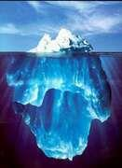
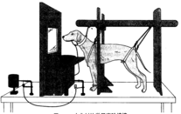

心理学模式
精神分析学说
  潜意识作用
  精神决定论
  能量守恒
行为主义学说
  研究刺激-反应
  研究可观察到的外显行为
  内心活动是纯粹主观, 难以测量
  情感、思想和幻想与实际的行为相比,只能是次要的
人本主义学说
  人生来就有积极健康、符合社会规范的方向发展的倾向, “人之初，性本善”
Brainless
Notes:
行为主义认为, 除了由于生物学的或其他方面的原因造成的, 如药物、成熟、外伤等等, 所有的行为变化都是习得的。适应良好的行为是习得的,
应不良的行为同样是习得的。实验还表明; 如果不良行为是“学习”来的, 便可以通过“去学习”将它消除。一般认为, 判定“学习”或“去学习”出现的标准是个体的可观察的行为变化; 也就是说, 我们从一个人的行为表现来推测一种“学习”或“去学习”的过程发生了
人本主义心理学（humanistic psychology）起源于50年代，主要是不满于当时流行的两大心理学派——行为主义及精神分析学派而兴起。人本主义者认为精神分析理论来源于病人，以病态解释正常，强调潜意识、本能而忽视健康人的积极向上的真善美的心理品质和特征；而行为主义学派则把人类降为一只较大的老鼠或一架较慢的计算机的水平，忽视了人性，忽视了思维、意识。人本主义者声称自己是“第三种势力”，人本主义的人性现非常乐观，接近我国古代先哲老子“人之初，性本善”的观点。罗杰斯认为，人生来就有积极健康、符合社会规范的方向发展的倾向。他承认人类有虚伪、罪恶、精神障碍，但这仅是环境不合适造成的．认为人作为一个整体，有能力选择、引导自己的行为，只要条件合适，都有达到自我实现的倾向。由于它对人的个性和自由的重视，因此，普遍受到人们的欢迎, 人本主义理论在心理学、教育学、哲学都有很大的影响。其代表人物有马斯洛(Marslow, A. H.)和罗杰斯(罗杰斯, C.R.)。
因此, 促进者的主要任务是通过设身处地的理解、无条件的尊重和真挚真诚的态度，创造良好的气氛、环境，仅此就能人们能正确理解自我，发挥潜能，使之成熟成长，适应社会，恢复真善美的本来面目。在当今相互倾轧、竞争激烈的社会里，受到了人们的欢迎和重视。而且此理论还成功地应用到了医疗、教育、管理的领域中去了。

Slide 15

生物医学模式
疾病可以用偏离正常的, 可以测量的生物学变量解释
把疾病视为独立于社会的实体, 而且要求根据生化或生理变化来解释行为
  还原论
  心身二元论
神经科学（分子生物学、细胞生物学、神经生物学等）是它的生物精神病学的基本学科
Mindless

Slide 16
社会·心理·生物学模式
每一个体都是不同的且相互作用的系统构成: 原子→分子→细胞→组织→器官→系统→个体→家庭→社区→社会、文化→国家→生物圈
生物、心理、社会因素密不可分, 且相互作用
心脑不可分
要从整体上看待疾病、病人

Slide 17
主要内容
概述
疾病模式
精神病学的神经科学基础
精神障碍病因学及思考
精神病学展望

Slide 18
脑与精神活动
现代神经科学证明, 所有人类精神活动均由大脑中介。我们对孩提时代的清晰的回忆来自于我们的大脑, 我们的喜怒哀乐、一言一行, 皆是大脑的功能。
正常的大脑功能产生正常的精神活动, 异常的大脑功能与结构可能导致精神活动的异常。
大脑(躯体的一部分)与精神不可分割, 如果没有包括大脑的完整性, 就不可能有精神活动, 如果没有环境的刺激、个人的经历, 这种完整性毫无意义。

Slide 19
脑结构与精神活动
在目前科学的研究对象中, 大脑的结构最为复杂。
大脑包含1000亿个神经细胞和更多的神经胶质细胞。
平均每个神经元与其他神经元能形成1000多个突触联系。我们人类脑内就大约有万亿至10万亿个突触联系。
大脑形成了各式各样、大大小小的环路, 构成我们的行为和精神活动的结构基础。一单个的神经元可能是多个环路一部分。
脑通过不同环路以并行的方式处理信息。
Notes:
例如, 从视网膜接受的信息通过初级的处理后, 在几个环路上分别同时处理不同的内容, 如一个环路分析是何种物体, 另一个环路分析物体所在的位置, 还有环路分析其颜色、形状等, 最后, 脑对不同环路所处理的信息进行整合, 并结合与之有关的触觉、听觉体验, 既往的经历、记忆等, 形成一个完整的知觉体验。

Slide 20
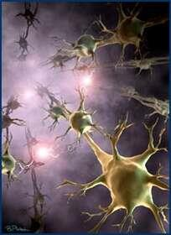
神经科学（Neuroscience）
Interdisciplinary field studying how biological processes relate to behavioral and mental processes

Slide 21
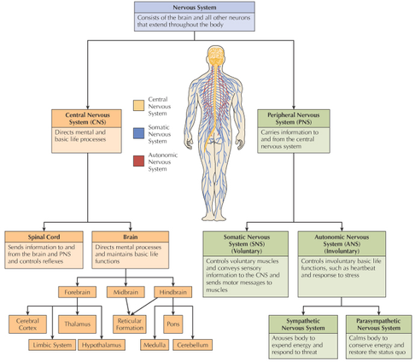
神经系统 （Nervous System

Slide 22
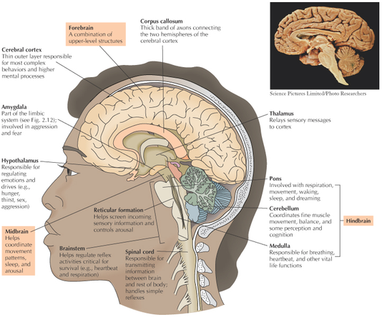
脑的重要结构

Slide 23
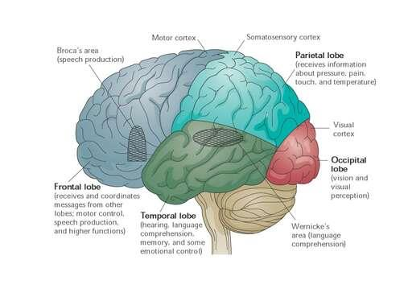
大脑皮层分区

Slide 24
边缘系统 (Limbic system)
扣带回
穹窿
乳头体
Limbic System: interconnected group of forebrain structures involved with emotions, drives, and memory
杏仁核
海马

Slide 25
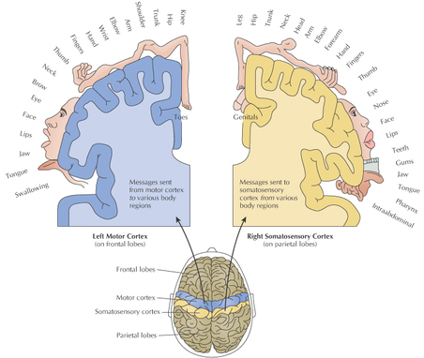
运动与感觉皮层

Slide 26
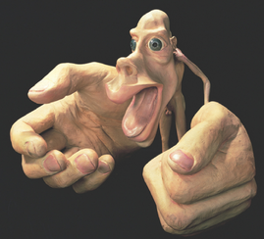
运动与感觉皮层
Why are the hands and face on this drawing so large? What do they represent?

Slide 27
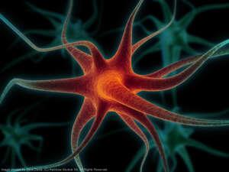
神经元(Neurons)
The nervous system consists of neurons (cells responsible for receiving and transmitting electrochemical information).

Slide 28
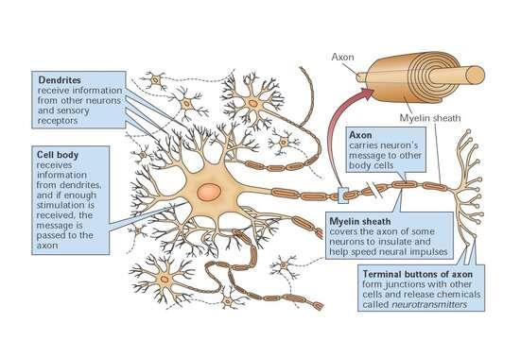
神经元结构 (Structure of neuron)

Slide 29
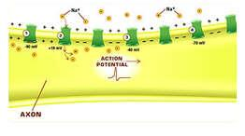
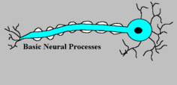
神经元之间的信息传递(communication between the neurons)
Within a neuron, communication occurs through an action potential (neural impulse that carries information along the axon of a neuron).

Slide 30
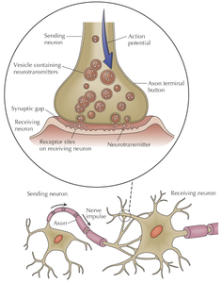
神经元之间的信息传递(communication between the neurons)
Between neurons, communication occurs through transmission of neural information across a synapse by neurotransmitters (chemicals released by neurons that alter activity in other neurons).

Slide 31
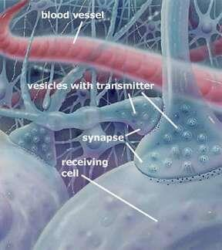
神经元之间的信息传递(communication between the neurons)
Receiving neurons receive multiple messages from other neurons, and these messages determine if an action potential occurs or not.

Slide 32
脑神经化学与精神活动(1)
兴奋性氨基酸
  谷氨酸
抑制性氨基酸
  γ氨基丁酸(GABA)
  甘胺酸
单胺类及相关神经递质
  去甲肾上腺素
  多巴胺
  5-羟色胺
  组织胺
  乙酰胆碱
嘌呤类
  腺苷
神经肽
  内源性阿片肽
    脑啡肽
    β-内啡肽
    强啡肽
  速激肽
    P物质
  下丘脑释放因子
    促肾上腺皮质激素释放激素

Slide 33
脑神经化学与精神活动(2)
配体门控通道(ligand-gated channel):神经递质与受体结合后, 离子通道开放, 细胞膜通透性增加, 正离子或负离子进入细胞。
  兴奋性神经递质受体:使正离子进入细胞的受体称之为, 如谷胺酸受体;
  抑制性神经递质受体: 负离子进入细胞, 跨膜电位增加, 使产生动作电位更为困难, GABA受体。
G蛋白偶联受体(G protein-linked receptors)。大多数神经递质, 如多巴胺、5-羟色胺、去甲肾上腺素、神经肽均属于G蛋白偶联受体。作用于G蛋白质偶联受体会产生更为复杂的生物效应

Slide 34
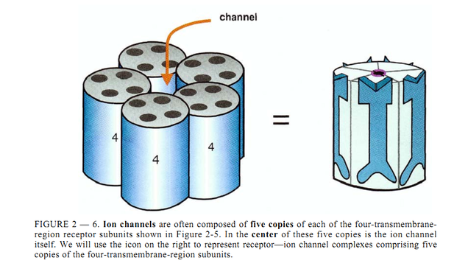
配体门控通道(ligand-gated channel

Slide 35
多巴胺(DA)与精神分裂症
精神分裂症的DA过度活动假说
几乎所有的经典的抗精神病药物药物都是DA受体阻滞剂;
DA激动剂(如甲基苯丙胺, 能增加突触内DA含量)能产生精神病性症状(如幻觉、妄想), 这些症状与偏执性精神分裂症的症状非常类似;
传统的抗精神病药物在缓解精神病性症状的同时，也产生EPS, 原因是抗精神病药物阻滞了中脑边缘皮层的和黑质纹状体的多巴胺D₂受体;
对D₂受体的抑制程度与抗精神病的效价相关。

Slide 36


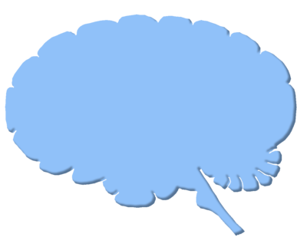


精神分裂症的多巴胺假说
额叶皮层
活性下降
边缘系统
活性增强
阴性症状
阳性症状
Notes:
36

Slide 37
脑可塑性与精神活动
脑的结构与化学活动在变化之中(可塑性, plasticity)。可塑性是神经系统的重要特征, 不论在发育阶段还是成年时期(甚至老年时期), 也不论是外周神经还是中枢神经系统, 从神经元到神经环路都可能发生可塑性变化。神经系统的可塑性已成为行为适应性的生理基础。
在宏观上可以表现为脑功能(如学习记忆功能、行为表现及精神活动改变;
在微观水平有神经元突触、神经环路的微细结构与功能的变化, 包括神经化学物质(递质、受体等)、神经电生理活动以及突触形态亚微结构等方面的变化。
Notes:
现以记忆为例, 来说明脑的可塑性。人们对各种经历的记忆最初是保存在海马中, 运动记忆主要在纹状体中, 而情绪记忆则其他区域(如杏仁核)编码。所以, 人们无时不在有意或无意学习新的东西, 学习过程改变了我们脑的结构。神经递质仅能表现当前的信息, 如果环境刺激合适、有足够强度, 就会有新的突触的联系, 当然也可以强化或弱化原有的突触联系。如果应激过于强烈、滥用药物, 或疾病可能使神经元死亡。目前的研究表明, 即使是成人的大脑, 仍有新的神经元产生, 以适应处理和贮存信息的需要。脑可塑性与记忆的关系至少有两个水平, 一个是分子和细胞变化, 形成新突触联系, 另一个是突触间信息循环、交流, 产生行为改变。以这种方式, 我们能够回忆10年、20年甚至是50年以前一个亲人的音容笑貌, 我们能够终身都能唱出儿童时代听到的儿歌, 我们在70岁还能掌握新的技术。

Slide 38

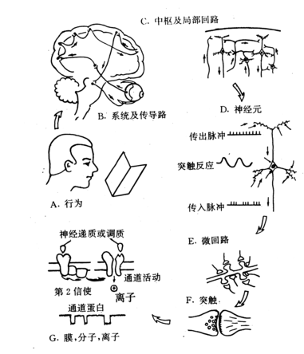
A. 示读书行为; B. 示大脑的整体观, 从眼睛开始到引起感觉, 到理解、记忆所看到的内容, 以及通过运动传导途径引起眼球运动; C. 皮层内某个神经元形成局部环路; D. 神经元是一个功能单位, 传入冲动引起兴奋及及抑制突触后电位, 然后经神经元整合后调控其冲动的输出; E. 微环路中的突触连接; F. 一个突触就是一个复杂的输出-输入单元; G. 突触涉及到许多离子通道、递质、受体, 以及可塑性变化等。

Slide 39
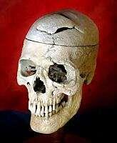
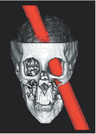
矿工Gage的故事：前额叶重要性
Phineas Gage’s mining accident sent a 13-pound tamping iron through his frontal lobes. How did this affect his short- and long-term behavior and mental processes?
Notes:
In 1848, a twenty-five-year-old construction foreman named Phineas Gage won nationwide fame by way of a hole in his head. While working on a railroad project in Vermont, he experienced a severe brain injury when a three-foot-long, fourteen pound tamping iron was violently propelled through his skull. Astonishingly, he lived to tell about it.
At the time of the accident, one of Gage’s duties was to set explosive charges to remove unwanted sections of large rocks. Typically, a long, narrow hole was drilled into the rock which was then filled with gunpowder and ignited. Before lighting the fuse, the hole was topped off with sand, and a three-foot-long, 1.25″ diameter iron tamping rod was used to pack down the gunpowder. However on 13 September 1848, Gage was distracted momentarily while in the process of preparing a blast, and he neglected to add the protective barrier of sand. When he thrust the iron tamper into the hole in the rock, it created a spark, and the gunpowder was ignited.
The resulting explosion propelled the fourteen pound iron rod straight into the air with the force of a cannon, causing it to pass through Gage’s skull in the process. It entered through the bottom of his left cheekbone and exited through the top of his head, then continued to fly in an arc across the sky, landing almost 100 feet behind him.
The unscheduled explosion got the attention of his fellow railroad workers, who rushed over to see if there was a problem. What they found was Phineas Gage slumped on the ground with a hole through his skull. Amazingly, the man was still alive and breathing. Even more amazingly, within moments his eyes were open and he was speaking to his fellow workers. The injured Gage was quickly loaded into a cart, and transported back to his boarding house, some 45 minutes away.
When Dr. John Martyn Harlow arrived, Phineas was conscious and had a regular heartbeat, and both of his pupils reacted to light normally. He was reported to be “in full possession of his reason, and free from pain.” He was under the care of Dr. Harlow for ten weeks, at which point he was sent home to Lebanon, New Hampshire. But while he was recovering, the doctor noted some changes in the man’s demeanor and personality. People who had known him before the accident described him as hard-working, responsible, and popular with his workers, but after the traumatic injury, Phineas Gage was not the same man.
In regards to his patient, Dr. Harlow wrote:
Gage was fitful, irreverent, indulging at times in the grossest profanity (which was not previously his custom), manifesting but little deference for his fellows, impatient of restraint or advice when it conflicts with his desires, at times pertinaciously obstinate, yet capricious and vacillating, devising many plans of future operations, which are no sooner arranged than they are abandoned in turn for others appearing more feasible. A child in his intellectual capacity and manifestations, he has the animal passions of a strong man. Previous to his injury, although untrained in the schools, he possessed a well-balanced mind, and was looked upon by those who knew him as a shrewd, smart businessman, very energetic and persistent in executing all his plans of operation. In this regard his mind was radically changed, so decidedly that his friends and acquaintances said he was ‘no longer Gage’.
Several months after the accident Gage felt strong enough to return to work, yet due to his personality changes, his previous employers would not entrust him with the foreman position he had previously held. In the following years, he took various jobs caring for horses, driving stagecoaches, and doing some farm work. He also briefly appeared at a museum in New York which was curated by the infamous P. T. Barnum, alongside the tamping iron which had impaled his brain.
Not much is known about his years after the injury, but eleven years after the accident, when he was aged thirty-seven years, Gage began to experience epileptic seizures. He died several months later, on 21 May 1860. His brain was not subjected to any medical examination at that time, but seven years later his body was exhumed so that his skull might be studied. It has since been subjected to much scrutiny.
It was determined that damage occurred to Gage’s skull in three places: There is a relatively small area under the cheek bone where the tamping iron first impacted, the orbital bone behind the eye socket, and very large hole where the iron rod emerged. The bone fragments over the exit wound were very skillfully put back in place by Dr. Harlow– so much so that it was hardly visible from outside the skull– but the original hole was about three and a half inches long by two inches wide.
There is still some controversy over the extent of damage to Phineas’ brain. It is certain that it passed through the anterior frontal cortex and white matter, but it has not been determined with certainty whether the lesion involved both frontal lobes or was limited only to the left side. In any case, the damage caused by the accident was roughly equivalent to a frontal lobotomy.
Today, Gage’s skull and the tamping rod which damaged it are on permanent display at Harvard’s Countway Library of Medicine. The incident did much to advance the field of neurology, as it was among the first evidence suggesting that damage to the frontal lobes could alter aspects of personality and affect social skills. Before Gage’s brain injury, the frontal lobes were largely thought to have little role in behavior.

Slide 40
主要内容
概述
疾病模式
精神病学的神经科学基础
精神障碍病因学及思考
精神病学展望

Slide 41
精神障碍的病因学(1)
大多数所谓功能性精神障碍没有清楚的病因与发病机制, 也无明显的体征和实验指标异常。但是, 我们知道精神障碍与其他躯体疾病一样, 均是生物、心理、社会(文化)因素的相互作用的结果 ;
对于这些疾病来说, 生物的易感性是必备的因素, 但并不能足以说明疾病的发生与发展的全部过程。对于其他疾病来说, 心理、社会可能是必备的因素, 但也不足以解释全部的病因。

Slide 42
精神障碍的病因学(2)
精神障碍的生物学因素
  遗传因素: 这些疾病具有遗传性, 是基因将疾病的易感性一代传给一代; 多数精神障碍不是单基因遗传, 而是多基因遗传。
  感染
    神经梅毒
    HIV感染
心理、社会因素: 应激性生活事件、情绪状态、人格特征、性别、父母的养育方式、社会阶层、社会经济状况、种族、文化宗教背景、人际关系等均构成影响疾病的心理社会因素 。

Slide 43
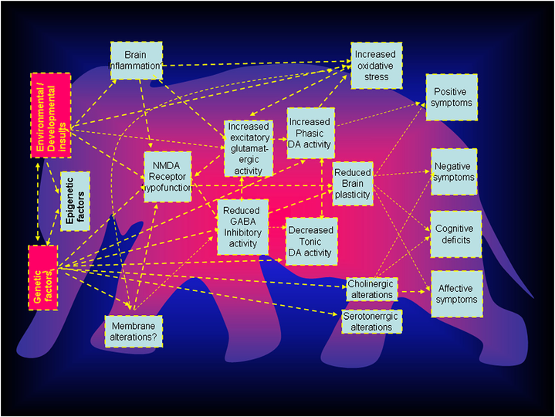
盲人摸象：精神分裂症病因学及发病机理思考
Keshavan et al., Schizophrenia Research, 2011

Slide 44
精神障碍的病因学几个基本概念
关联(correlation)
危险因素(risk factor)
疾病的结果(consequence)
病因(cause)
生物学因素(内在因素)
心理社会因素(外在因素)

Slide 45
主要内容
概述
疾病模式
精神病学的神经科学基础
精神障碍病因学及思考
精神病学展望

Slide 46
展望：政策
国家会增加精神卫生的投入，基础的精神卫生服务将会成为公共卫生的一部分。
精神卫生法已经通过，对精神障碍患者的保护的显现作用日益增强
精神卫生的概念会进一步深入人心，“没有精神健康就没有健康”会逐渐形成共识。唤起公众意识的教育宣传活动, 减少对精神障碍的偏见与歧视活动会逐渐增加。
服务重点部分转向社区, 人们对精神卫生设施的利用会逐渐增加，人们对精神卫生的服务质量的要求也会增加，精神卫生与躯体健康保健联系更加紧密。
除了卫生部门外, 诸如教育、劳动、社会保障、司法以及非政府组织也会参与及加强社区精神卫生服务工作。

Slide 47
展望：服务
减少监禁式精神病房、精神病院，逐渐扩大精神卫生服务范围。
新的精神药物的出现会在较大程度上改善精神病人的生活质量与回归社会，社会心理康复也会逐渐得到加强。
综合医院的精神卫生服务水平得到加强，综合医院的精神科将会得到进一步发展，内科同行对精神卫生问题的识别率会进一步增加。
专科医师培训将会逐步展开。精神卫生领域的人才应包括医学与非医学领域的专家, 如精神病学家、临床心理学家、精神科护士、从事精神科领域的社会工作者以及职业治疗师, 他们的积极参与能更好服务于社区的病人。
精神卫生服务的来源增加，私人医院的高端服务会得到强化。

Slide 48
展望：自身
精神科医师的数量与质量会有很大提高。
精神病学成为主流学科。
精神科医师的社会地位、经济收入会有较大的提高。

Slide 49
总结
精神病学是涉及到社会、心理、生物学的最为复杂的学科；
没有精神健康就没有健康，精神障碍所致的疾病负担很重、影响范围很大，需要各位学生的努力；
精神病学是朝阳学科，欢迎加入精神卫生队伍。

Slide 50

谢 谢！

