Slide 1
精神活性物质
所致精神障碍
郝 伟 教授

Slide 2
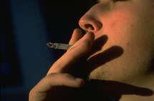
我国药物滥用的形势
吸烟
饮酒
毒品

Slide 3
吸 烟
我国是世界第一大产烟国, 产量占世界上的1/3, 是第二大产烟国美国的3倍;
我国总税收的9.1%来自于烟草工业;
我国成人男性吸烟率60-70%, 女性为7-15%世界上有11亿吸烟者, 其中3200百万在中国;
我国香烟的尼古丁及焦油的含量比国外高;
每年中国有2百万人死于与吸烟有关的疾病。

Slide 4
中国烟草业十年税利(RMB 亿元)

Slide 5
我国卷烟生产销售情况(亿支)

Slide 6
饮酒
我国酒生产量有逐年上升的趋势, 平均每年递增10%左右;
我国人均饮酒两逐年上升, 目前15岁以上人群饮酒量约3升
与饮酒有关的疾病逐年增加

Slide 7
The output of alcohol beverage
 | 1999 | 1998
Spirit and wine(kg) | 5,022,600,000 | 5,733,300,000
Beer(kg) | 20,987,700,000 | 19,876,700,000
Pure alcohol of spirit and wine(kg) | 2,009,040,000 | 2,293,320,000
Pure alcohol of beer(kg) | 839,508,000 | 795,068,000
Total pure alcohol (kg) | 2,848,548,000 | 3,088,388,000
Per capita of pure alcohol (15 year+)(kg) | 3.09 | 3.35
From: China Statistical Yearbook, 2000

Slide 8
Drinking rate by gender (%)

Slide 9
Drinking frequency in current drinkers by gender (%)
 | Male (10,468) |  |  | Female (4,264) |  |  | Total (14,732)
 | N | % |  | N | % |  | N | %
≤1/ Mon | 2,375 | 22.7 |  | 2,867 | 67.2 |  | 5,242 | 35.6
2~4/ Mon | 2,185 | 20.9 |  | 928 | 21.8 |  | 3,113 | 21.1
2~3/ Week | 2,569 | 24.5 |  | 304 | 7.1 |  | 2,873 | 19.5
4~6/ Week | 1,010 | 9.6 |  | 57 | 1.3 |  | 1,067 | 7.2
≥1/ Day | 2,329 | 22.2 |  | 108 | 2.5 |  | 2,437 | 16.5

Slide 10
Drinking rate by age (%)

Slide 11
Alcohol consumption
The average annual consumption in pure alcohol among all respondents was 4.47 liters (SD= 10.93). Males drank 13.4 times more than females;
The average annual consumption in pure alcohol for male, female and total one-year drinkers was 10.1 liters, 1.5 liters and 7.6 liters, respectively.
Heavy drinkers defined as those who used pure alcohol 50 ml or more per day, accounted for 6.7% (1674 of 24992) of all the sample, and consumed 55.3% of the total alcohol consumption.

Slide 12
我国记录在案吸毒人数(万人)

Slide 13
每年新发吸毒的人数(全国6地区)
人数

Slide 14
1993、1996、2000年毒品终身使用率比较(全国5地区)
%

Slide 15
The economic costs of heroin addiction in the US
Notes:
This study documents the costs of heroin addiction in the United States, both to the addict and society at large. Using a cost-of-illness approach, costs were estimated in four broad areas: medical care, lost productivity, crime, and social welfare. We estimate that the cost of heroin addiction in the United States was US$21.9 billion

Slide 16
基本概念
药物 (drug)
成瘾 (addiction)
依赖(dependence)
滥用(abuse)
耐受性(tolerance)
戒断综合征(withdrawal syndrome)

Slide 17
药 物
能够影响人类心境、情绪、行为、改变意识状态, 并有致依赖作用的一类化学物质, 人们使用这些物质的目的在于取得或保持某些特殊的心理、生理状态。
药物(drug)在此又称“物质(substances)”、“精神活性物质(psychoactive substances)”、致依赖药物、成瘾物质等等。
毒品是指具有很强成瘾性的精神活性物质, 并被社会禁止使用, 我国的毒品主要指阿片类、可卡因、大麻等药物。

Slide 18
成 瘾
成瘾被广泛使用在日常生活中。成瘾具有以下特征:
1. 成瘾者有做某种行为的强烈欲望, 但其结果有害;
2. 如果控制不做, 则紧张、焦虑逐渐增加;
3. 一旦完成此行为, 则紧张、焦虑迅速、暂时得以解脱;
4. 过一段时间后, 如几小时、几天或几周又重新出现实施此行为的欲望;
5. 外部、内部环境刺激可条件反射性引起此欲望;
6. 成瘾者希望能控制此行为, 但屡屡失败。
50年代世界卫生组织专家委员会将药物成瘾正式定义为:“由于反复使用某种药物所引起的一种周期性或慢性中度状态, 具有以下特征: (1)有一种不可抗拒的力量强制性地驱使人们使用该药, 并不择手段去获得它;(2)有加大剂量的趋势;(3)对该药的效应产生精神依赖并一般都产生躯体依赖; (4) 对个人和社会都产生危害。

Slide 19
依 赖
DSM-IV对依赖的定义为: 一组认知、行为和生理症状群, 表明个体尽管明白使用成瘾物质会带来明显的问题, 但还在继续使用, 自我用药结果导致了耐受性增加、戒断症状和冲动性觅药行为。
传统上将依赖分为躯体依赖和心理依赖, 躯体依赖也称生理依赖, 它是由于反复用药所造成的一种适应状态, 表现为耐受性增加和停药后戒断症状。心理依赖又称精神依赖, 它使产生一种愉快满足的或欣快的感觉, 驱使使用者为满足这种感觉反复使用药物, 表现所谓渴求状态(craving)。

Slide 20
滥 用
在DSM-IV中, 滥用是指一种适应不良方式, 由于反复使用药物导致了明显的不良后果, 如不能完成重要的工作、学业, 损害了躯体健康, 导致法律上的问题等。这里滥用强调了不良后果, 没有明显的耐受性增加或戒断症状, 反之就是依赖状态。

Slide 21
耐受性
药物使用者必须增加使用剂量方能获得所需的效果，或还是以原来的剂量使用则达不到使用者所追求的效果。
代谢耐受性(metabolic tolerance)
细胞耐受性(cellular tolerance)或机能耐受性(functional tolerance)。

Slide 22
戒断综合征
停止使用药物或减少使用药物后或使用拮抗剂占据受体后所出现的特殊的心理生理症状群。此症状群的表现与所使用的药物的药理作用相反。

Slide 23
成瘾药物的分类
药理特征
使用环境
国际公约

Slide 24
根据药理作用分类
1. 中枢神经系统抑制剂：能抑制中枢神经系统，如巴比妥类、安定类、酒精等。
2. 中枢神经系统兴奋剂：能兴奋中枢神经系统，如咖啡因、苯丙胺、可卡因。
3. 大麻：大麻是世界上最古老、最有名的致幻剂，适量吸入或食用，可使人欣快，增加剂量可使人进入梦幻, 陷入深沉而爽快的睡眠之中。
4. 致幻剂：能改变意识状态或知觉感受，如麦角酸二乙酰胺（LSD）、仙人掌毒素 (Mescaline)等
5. 阿片类：包括天然、人工合成或人工合成的阿片类物质，如海洛因、吗啡、鸦片、美沙酮等。
6. 挥发性溶剂: 如, 丙酮、苯环已哌啶(PCP)等
7. 烟草（尼古丁）

Slide 25
根据使用环境分类
社交性成瘾物质。
非社会性成瘾物质
  处方用药
  毒品

Slide 26
根据国际公约分类
为了加强对成瘾药物的国际管制, 1961年联合国在纽约签订了《1961年麻醉品单一公约》, 以后又发现苯丙胺兴奋剂和安眠酮等镇静催眠药, 又于1972年签订了《1971年精神药物公约》。
1. 麻醉药品: 特指那些连续使用后产生依赖, 并在人群中造成严重滥用的毒品。包括三大类, 即阿片类、可卡因类和大麻类。
2. 精神药物: 广义讲, 麻醉品也属精神药物, 1971年公约中规定的精神药物又称亲精神药物(psychotropic drugs), 也包括三大类, 即苯丙胺类中枢神经系统兴奋剂、镇静催眠药和致幻剂。

Slide 27
药物滥用的原因
社会因素
心理因素
生物学因素

Slide 28
社会因素
可获得性
家庭因素
同伴影响、社会压力
文化背景、社会环境

Slide 29
心理因素
个性研究
药物的心理强化作用
从行为理论解释强化作用。
  正强化：
  负强化：

Slide 30
精神病理因素
精神病理是成瘾性疾病的危险因素
精神病理改变了成瘾性疾病的病程、治疗反应、临床表现及预后
精神病理与成瘾性疾病共存
精神病理表现是成瘾性疾病的结果

Slide 31
开始使用精神活性物质的心理原因
好奇心理
侥幸心理
享乐、解脱心理
逆反心理
追求刺激心理

Slide 32
生物学因素
脑内的“犒赏"系统与药物依赖
依赖的生物学基础
  决定因素:
    药物必须具备神经系统的作用和可致依赖潜力
    是机体本身的反应
    药物的特殊精神效应会使使用者成瘾, 生理上表现为耐受性和戒断症状
遗传学因素

Slide 33
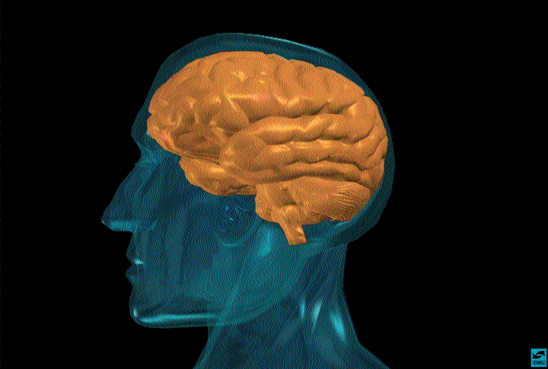
Notes:
Slide 2: The brain is the most complex organ in the body.
The brain is made up of a complex network of billions of nerve cells called neurons, as well as other kinds of cells, all protected by the bones of the skull. The typical brain weighs only about 3 pounds, but it is the source of most qualities that make you who you are. Neurons in the brain and spinal cord are part of the nervous system and act as a body’s “Command Central.”
The brain is constantly active, even when we are asleep. As a matter of fact, asleep or awake, the brain requires 20 percent of the heart’s output of fresh blood and 20 percent of the blood’s oxygen and glucose to keep functioning properly. Glucose is a type of sugar that is our brain’s primary fuel.
The brain produces enough electrical energy to power a 40-watt light bulb for 24 hours. That’s a lot of energy for a human organ a little bigger than a softball.
Photo courtesy of the NIDA Web site. From A Slide Teaching Packet: The Brain and the Actions of Cocaine, Opiate , and Marijuana.

Slide 34
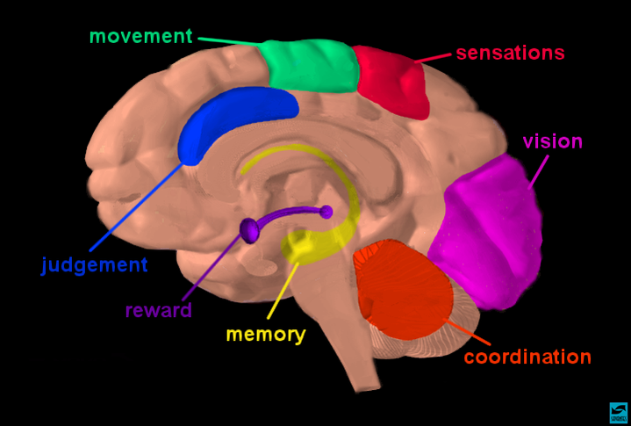

Slide 35
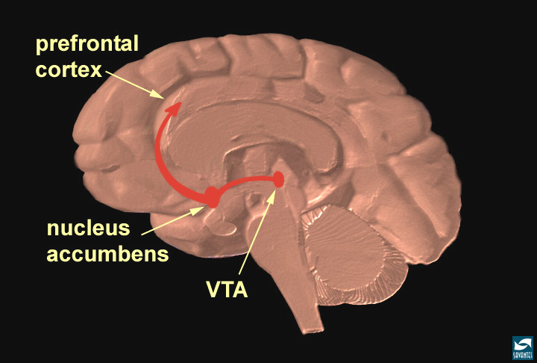

Slide 36
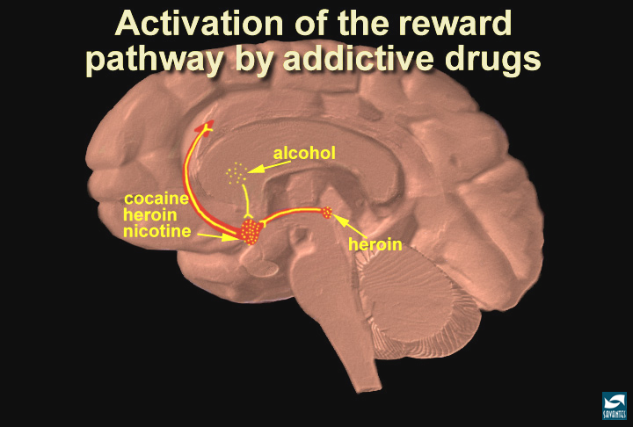
酒
可卡因
尼古丁
海洛因
海洛因

Slide 37
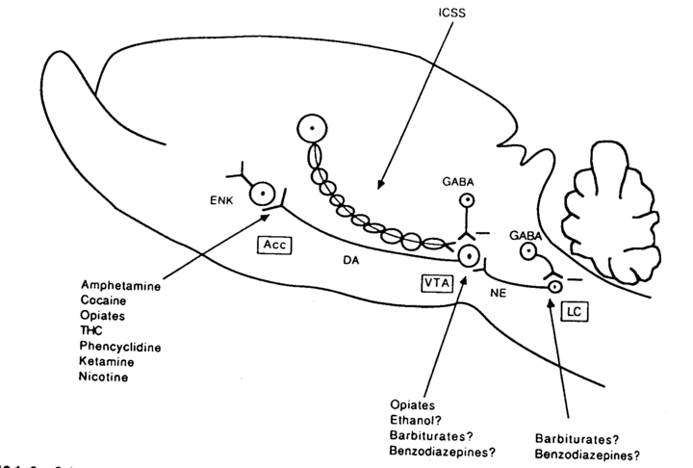

Slide 38
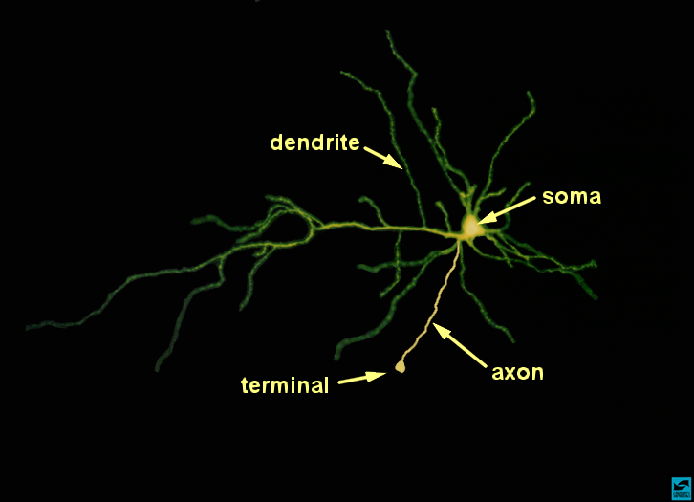

Slide 39
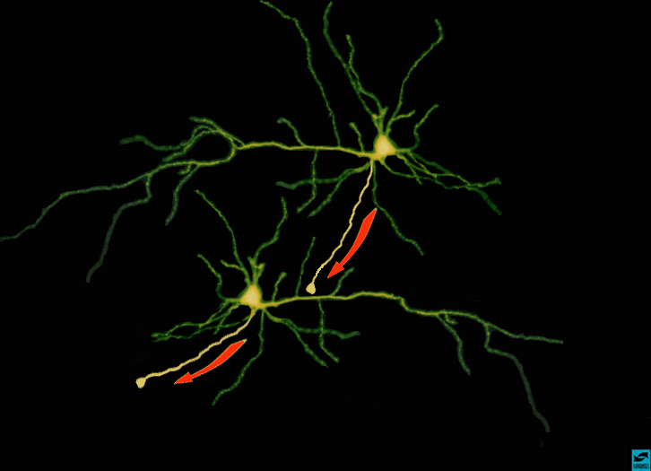

Slide 40
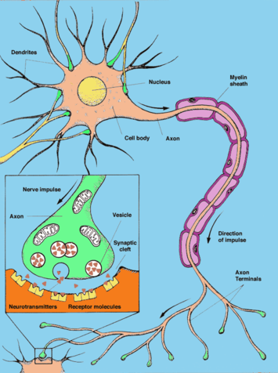
Notes:
Slide 3: How a neuron works.
Neurons are unique because they can send information from the brain to the rest of the body.
Your brain communicates with the rest of your body by sending messages from one neuron to the next and ultimately to the muscles and organs of the body. Neurons can also store information as memories.
Typically, a neuron contains three important parts: a cell body that directs all activities of the neuron; dendrites (the part that looks like tree branches), which are short fibers that receive messages from other neurons and relay those messages to the cell body; and the axon, a long single fiber that transmits messages from the cell body to dendrites of other neurons. Every moment, messages are moving with amazing speed back and forth from neuron to neuron. As a matter of fact, scientists often compare the activity of neurons to the way electricity works.
A neuron communicates with other neurons at special places called synapses or synaptic clefts. To send a message, a neuron releases a chemical messenger, or neurotransmitter, into the synaptic cleft. From there, the neurotransmitter crosses the synapse and attaches to key sites called receptors on the next neuron in line. When neurotransmitters attach to these receptors, they cause changes inside the receiving neuron and the message is delivered.
Neurons communicate with each other through a network of interconnected cells that scientists are still trying to fully understand. Scientists do know that this complex communication system within the brain can be disrupted by the chemicals in drugs. Did you know that more than 400 chemicals are in a marijuana leaf? And over 4,000 chemicals besides nicotine are in tobacco!
Illustration used with permission, courtesy of Lydia V. Kibiuk and the Society for Neuroscience.

Slide 41
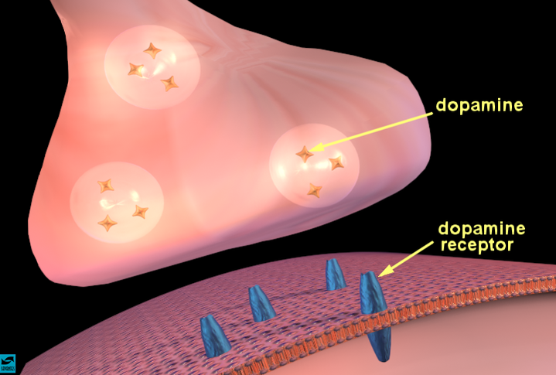

Slide 42
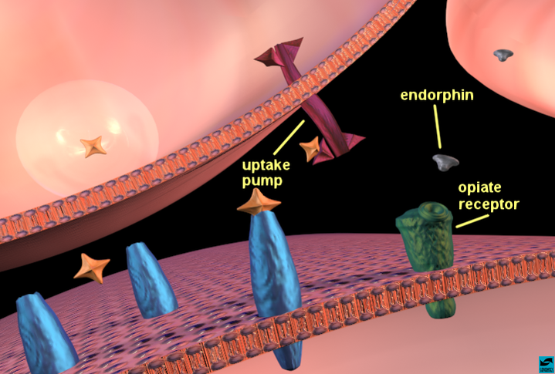

Slide 43
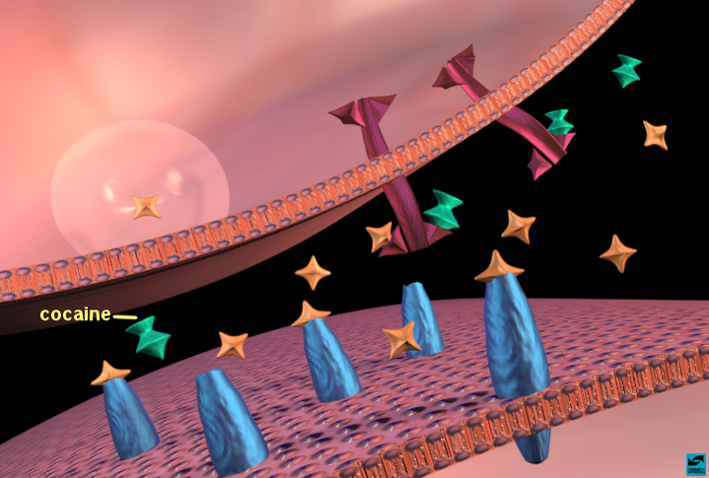
苯丙胺

Slide 44
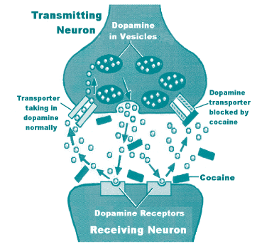
Notes:
Stimulants appear to impair normal functioning of dopamine in the brain.[3] For example, the subjective and reinforcing effects of cocaine are associated with dysfunctions of dopamine mechanisms in the mesolimbic reward system, particularly the nucleus accumbens. It is believed that cocaine boosts dopamine release and blocks its reuptake by transporters. This leaves more dopamine saturating synaptic clefts to overstimulate critical brain sites. Figure 1 (See also, "The Hijacked Brain" in this issue). Reuptake of other monoamines ­ norepinephrine and serotonin ­ is also blocked, producing changes in these neurobiological systems.[1,7]
Dopamine acts at 5 different "D" receptor subtypes; however, the exact contributions of D1-like (D1,D5) and D2-like (D2,D3,D4) receptor families is not well established.[7] Plus, there has been increasing evidence that cocaine's effects are not solely attributable to dopamine. When dopamine production was curtailed in the brains of laboratory animals, they continued to seek cocaine, so other neurotransmitters also may serve as reinforcers of reward from stimulants.[13]
Recent research isolated a protein called Delta-FosB in the brain, which triggers addiction by regulating genes controlling the nucleus accumbens. It is believed that this agent also activates genes producing glutamate, which carries messages in brain cells that increase cocaine sensitivity and craving.[14]
Amphetamines increase dopamine levels by as much as 2,600%, primarily by stimulating presynaptic release of the neurotransmitter, rather than by reuptake blockade.[1,15] Amphetamine effects last for days in the body, and some degree of neurological impairment may last up to 2 years or more after cessation of the drug.[3]
It has been proposed that sensitization to cocaine and amphetamines results from increased synaptic connectivity due to repeated exposure to the drugs. Circumstances surrounding drug taking (environmental cues) can trigger this neuronal hypersensitivity and exert a powerful influence leading to physiological arousal and increased craving at the mere sight or thought of the drug.[1,3,16] To a degree, the brain may become "rewired" for stimulant addiction.
MDMA (ecstasy) appears to involve serotonin stimulation, and chronic abuse can lead to long-term damage to serotonin-containing neurons, causing persistent memory impairments. Other functional aspects of serotonin ­ mood, impulse control, sleep cycles ­ may be affected, and it is now believed that serotonergic dysfunction may persist for many years or even become permanent.[4,5]
Some psychostimulants are known to have paradoxical effects, such as methylphenidate (Ritalin), which exerts a calming effect in children with ADHD (attention-deficit hyperactivity disorder). New research in animals suggest that these stimulants act by facilitating therapeutic concentrations of serotonin, rather than affecting dopamine.[17]
From d:\internet\naloxonestimulant.html

Slide 45
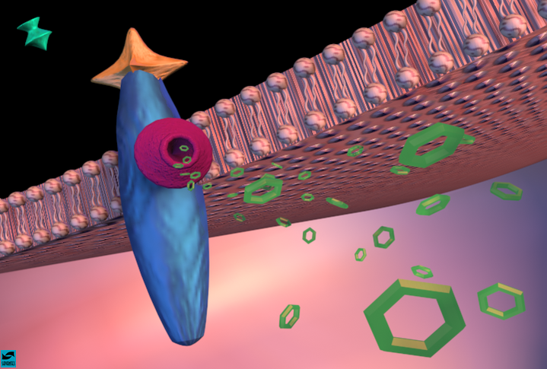

Slide 46
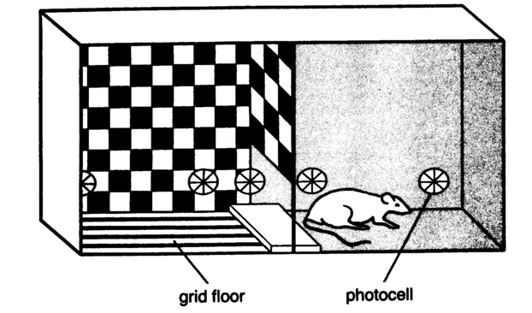
Fig. 1. A typical two-compartment CPP apparatus.

Slide 47
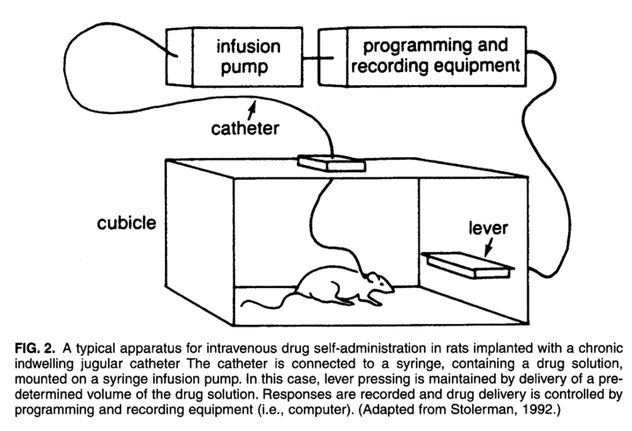

Slide 48
药物的急性作用
药物的共同通路：
作用于中脑边缘多巴胺系统(mesolimbic dopamine system), 增加中脑腹侧被盖区(ventral tegmental area, VTA)多巴胺神经元冲动释放, 将多巴胺释放至伏隔核(nucleus accumbens, NAc), 以及其他区域如前额叶皮质(prefrontal cortex)中。
从进化学的观点看, 中脑边缘多巴胺系统及前脑的投射脑区发生较古老, 构成部分的动机系统, 调节对自然犒赏物, 如饮食、性的反应。药物作用这一系统, 其作用远比自然犒赏物要强烈、持续得多。

Slide 49
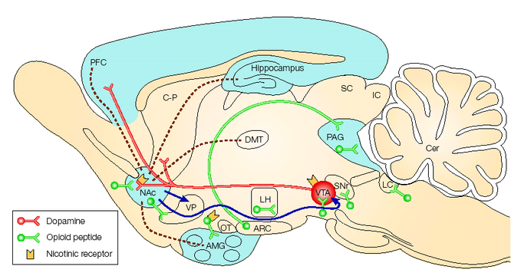
图1. 依赖的神经环路

Slide 50
药物的急性作用
药 物 | 作 用 | 受体信号系统
阿片类 | 激动μ、δ及κ受体, 抑制GABA受体对多巴胺的抑制作用, 间接促进多巴胺的释放 | Gi
可卡因 | 通过抑制多巴胺转运间接激动多巴胺受体 | Gi、Gs
苯丙胺类药物 | 通过促进多巴胺释放等, 间接激动多巴胺受体 | Gi、Gs
酒精 | 易化GABAa受体功能, 抑制NMDA受体功能, 作用于内源性阿片肽及多巴胺系统 | 配体门控通道、电压门控通道
尼古丁 | 激动尼古丁乙酰胆碱受体 | 配体门控通道

Slide 51
内源性阿片肽系统
经典的阿片肽包括三大家族:
脑啡肽(ENK): 是由5个氨基酸组成的小肽，包括甲硫胺酸脑啡肽（MENK）和亮胺酸脑啡肽（LENK）；
内啡肽(EP: 包括31个氨基酸的β-内啡肽（β-EP）、16个氨基酸的α-内啡肽(α-EP)和17个氨基酸的γ-内啡肽（γ-EP）；
强啡肽(DYN): 主要包括17个氨基酸的强啡肽A(Dyn-A)和13个氨基酸的强啡肽B（Dyn-B）;
内源性阿片肽均由特定的前体大分子脑啡肽原（PPE）、阿黑皮素原（POMC）、强啡肽原（PPD）酶切产生。

Slide 52
阿片受体
阿片使用后首先作用于具有七个跨膜域的抑制性μ、δ、κ阿片受体，阿片受体与G_{i/o}偶联，激活时G_{i/o}解离为两个亚基G_{a} 及G_{βγ}二聚体，G_{ai}作用于腺苷酸环化酶（AC），产生急性抑制作用，导致细胞内cAMP水平下降。然而，慢性阿片使用可选择性的上调蓝斑腺苷酸环化酶（ACⅠ、ACⅧ），引起神经元cAMP信号传导通路的代偿性上调，抵消急性阿片使用对该通路的抑制作用，当中止阿片使用后，上调的cAMP通路功能亢进，造成依赖及戒断。
脑啡肽及内啡肽作用于δ、μ受体而介导奖赏效应，
强啡肽作用于κ受体介导厌恶效应，

Slide 53
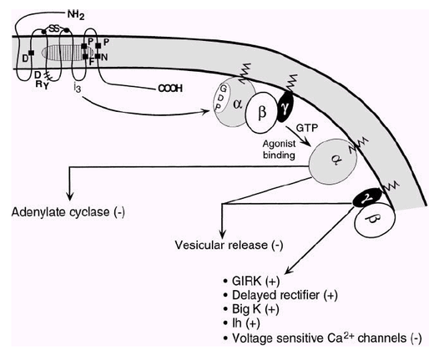
GIRK, G protein inwardly rectifying conductance.
图2. 阿片类物质的急性作用

Slide 54
药物的慢性作用
阿片类长期反复暴露，使中枢神经系统特别是中脑边缘多巴胺系统发生了细胞及分子水平上的适应:
多巴胺系统
5-羟色胺系统
γ-氨基丁酸系统
谷氨酸能神经系统
去甲肾上腺素系统
内源性阿片肽系统等
反复长期用药, 使这些神经元发生变化, 改变了强化机制和动机状态,出现了耐受性(tolerance)、戒断症状(withdrawal symptoms)及敏感化(sensitization)。

Slide 55
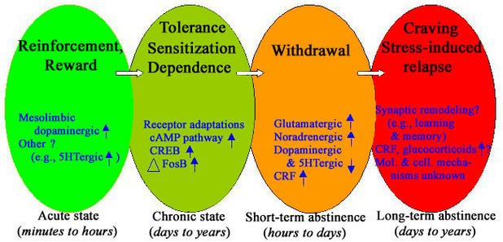
小结:依赖形成的生物学过程

Slide 56
药物滥用与自然犒赏的类比
自然犒赏物
激发属性
阿 片
满足属性
刺激中枢多
巴胺犒赏系统
兴 奋 剂
刺激中枢阿
片肽系统
激起趋向行为
获得继发性
激发属性
对继发性激发
属性反应
趋向行为
激发性习得
获得
复发
维持

Slide 57
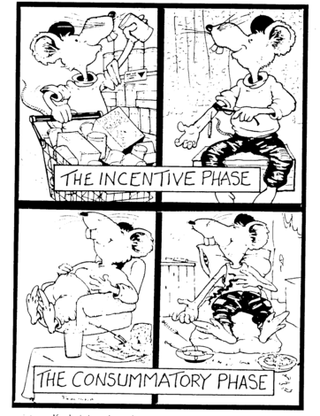

Slide 58
依赖行为的心理社会生物学模式
个人因素
社会因素
人格特征
情景
环境
认知、期望
开始使用
依赖状态
神经适应
生物学因素

Slide 59
药物依赖的心理社会生物学模式
觅药行为
药物的不良效应
对药物效果的期望
条件反射
正性强化作用
社会背景
快感
遗传因素
焦虑缓解
行为机制
修饰因素
人格心理特征
促进功能
神经机制
药物滥用史
戒除戒断症状
单胺类
氨基酸类
神经肽

Slide 60
正电子扫描 (PET)
Notes:
Slide 6: A positron emission tomography (PET) scanner.
Now let’s take a look inside your mind... One of the tools that scientists use to see the effects of drugs on the brain is called positron emission tomography or a PET [say the word “pet”] scan. Similar to an x-ray, but much more sophisticated, a PET scan is used to examine many different organs including the heart, liver, lungs, and bones, as well as the brain. A PET scan shows much more than the physical structure of bone and tissue. A PET scan shows how well (or how little) an organ is functioning.
Using a PET scan, a doctor or a scientist can see what is actually happening in a person’s brain and see the effects of drugs. The PET scan shows areas of the brain that are active and also areas that are inactive or not functioning at all. Typically, a PET scan takes 1 to 2 hours with the person lying completely still so that the PET images will be clear.
Let’s see the effects a drug like cocaine has on the brain.

Slide 61
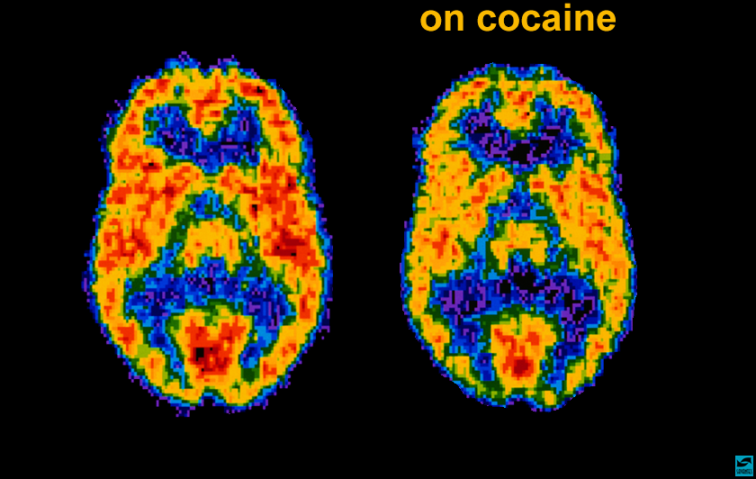
可卡因使用中

Slide 62
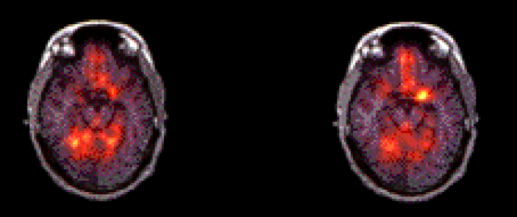
可卡因相关线索刺激时PET变化
杏仁核
可卡因无关刺激
可卡因有关刺激

Slide 63
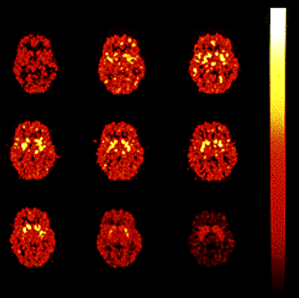
药物对大脑的影响
1-2 分
3-4
5-6
6-7
7-8
8-9
9-10
10-20
20-30
Notes:
Slide 7: This is literally the brain on drugs.
When someone gets “high” on cocaine, where does the cocaine go in the brain? With the help of a radioactive tracer, this PET scan shows us a person’s brain on cocaine and the area of the brain, highlighted in yellow, where cocaine is “binding” or attaching itself. This PET scan shows us minute by minute, in a time-lapsed sequence, just how quickly cocaine begins affecting a particular area of the brain.
We start in the upper left hand corner. You can see that 1 minute after cocaine is administered to this subject nothing much happens. All areas of the brain seem to be functioning normally. But after 3 to 4 minutes [the next scan to the rightl, we see areas highlighted in yellow where cocaine is starting to bind to the striatum [stry-a-tum] of the brain and activate it.
At the 5- to 8-minute interval, we see that cocaine is affecting a large area of the brain. After that, the drug’s effects begin to wear off. At the 9- to 10-minute point, the high feeling is almost gone. Unless the abuser takes more cocaine, the experience is over in about 20 to 30 minutes.
Scientists are doing research to find out if the striatum produces the “high feeling”and controls our feelings of pleasure and motivation. One of the reasons scientists are curious about specific areas of the brain affected by drugs such as cocaine is to develop treatments for people who become addicted to these drugs. Scientists hope to find the most effective way to change an addicted brain back to normal functioning.
Photo courtesy of Nora Volkow, Ph.D. Mapping cocaine binding sites in human and baboon brain in vivo. Fowler JS, Volkow ND, Wolf AP, Dewey SL, Schlyer DJ, Macgregor RIR, Hitzemann R, Logan J, Bendreim B, Gatley ST. et al. Synapse 1989;4(4):371-377.

Slide 64
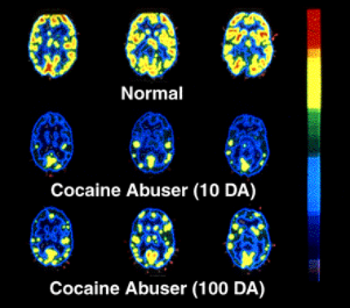
药物对大脑的影响
正常
可卡因滥用10天后
可卡因滥用100天后
Notes:
Slide 8: Long-term effects of drug abuse.
This PET scan shows us that once addicted to a drug like cocaine, the brain is affected for a long, long time. In other words, once addicted, the brain is literally changed. Let’s see how...
In this slide, the level of brain function is indicated in yellow. The top row shows a normal-functioning brain without drugs. You can see a lot of brain activity. In other words, there is a lot of yellow color.
The middle row shows a cocaine addict’s brain after 10 days without any cocaine use at all. What is happening here? [Pause for response.] Less yellow means less normal activity occurring in the brain—even after the cocaine abuser has abstained from the drug for 10 days.
The third row shows the same addict’s brain after 100 days without any cocaine. We can see a little more yellow, so there is some improvement— more brain activity—at this point. But the addict’s brain is still not back to a normal level of functioning. . . more than 3 months later. Scientists are concerned that there may be areas in the brain that never fully recover from drug abuse and addiction.
Photo courtesy of Nora Volkow, Ph.D. Volkow ND, Hitzemann R, Wang C-I, Fowler IS, Wolf AP, Dewey
SL. Long-term frontal brain metabolic changes in cocaine abusers. Synapse 11:184-190, 1992; Volkow ND,
Fowler JS, Wang G-J, Hitzemann R, Logan J, Schlyer D, Dewey 5, Wolf AP. Decreased dopamine D2
receptor availability is associated with reduced frontal metabolism in cocaine abusers. Synapse 14:169-177,
1993.

Slide 65
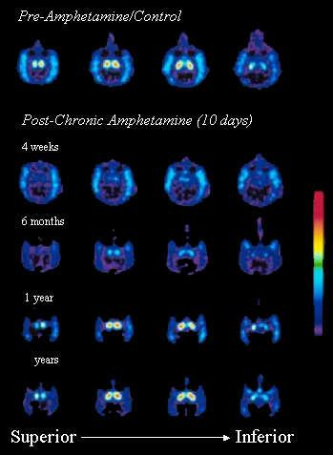
药物的长期效应
Notes:
Slide 9: Drugs have long-term consequences.
Here is another example of what science has shown us about the long-term effects of drugs. What this PET scan shows us is how just 10 days of drug use can produce very dramatic and long-term changes in the brain of a monkey. The drug in these images is amphetamine, or what some people call “speed.” Remember the previous slide showed us what the brain of a chronic cocaine abuser looks like. This slide shows us what using a drug like amphetamine can do in only 10 days to the brain of a monkey.
This slide also gives us a better idea of what methamphetamine, a drug similar in structure, can do to the brain. Methamphetamine use is becoming increasingly popular in certain areas of the country.
The top row shows us, in white and red, normal brain activity. The second row shows us that same brain 4 weeks after being given amphetamine for 10 days. There is a dramatic decrease in brain activity. This decreased brain activity continues for up to 1 year after amphetamine use. These continuous brain changes often trigger other changes in social and emotional behavior, too, including a possible increase in aggressiveness, feelings of isolation, and depression.
Photo courtesy of NIDA from research conducted by Melega WP, Raleigh MJ, Stout DB, Lacan C, Huang SC, Phelps ME. Recovery of striatal dopamine function after acute amphetamine- and methamphetamine­induced neurotoxicity in the vervet monkey. Brain Res 1997 Aug 22;766(1-2);113-120.

Slide 66
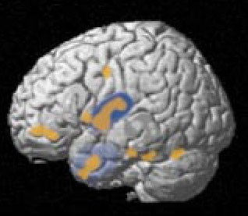
Brain Activity During Cue-Induced Craving
The amygdala and rhinal cortex (A, light blue) are involved in identifying familiar objects and assigning them a motivational value. In cocaine craving, the amygdala and rhinal cortex appear to link a perceived object—in this case, video representations of drug paraphernalia—with cocaine and with the memory of experiences with both the object and the drug. The insula (dark blue), which shares connections with the rhinal cortex, helps confirm the association of perception and memory. In individuals addicted to cocaine, the insula appears to “authorize” the assignment of emotional significance to the link between the perceived cue and memories of the physical response to the drug.

Slide 67
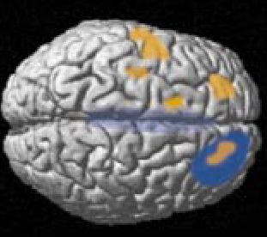
Brain Activity During Cue-Induced Craving
The anterior cingulate (B, light blue ) acts to establish and process emotional memory and to control allocation of attention. It links perceived cues with emotional states in which the expectation of a particular outcome has repeatedly been fulfilled. In cocaine addiction, the anterior cingulate stimulates the recall of specific feelings associated with drug use, “reminding” an individual of repeated drug reward.
Increased activity in the amygdala, rhinal cortex, insula, and anterior cingulate appears to initiate the process that leads to craving by linking visual cues to memory. This complex process is monitored by the dorsolateral prefrontal cortex (B, dark blue), a brain region that acts as a “manager” for working memory. In cocaine addiction, this region maintains the brain’s focus on cocaine-related cues and produces an active urge to take the drug.

Slide 68
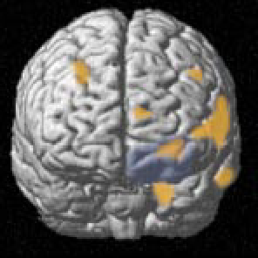
Brain Activity During Cue-Induced Craving
The orbitofrontal cortex (C, light blue) helps to form, and then maintain or modify, expectations of possible outcomes by combining memories of past experiences with changing current events. In cocaine craving, the orbitofrontal cortex appears to guide addicted individuals away from decisions based on objective consideration of the negative effects of drug use—its risks to personal, social, and professional life— and toward acting on an emotion-based expectation of outcome or reward.

Slide 69
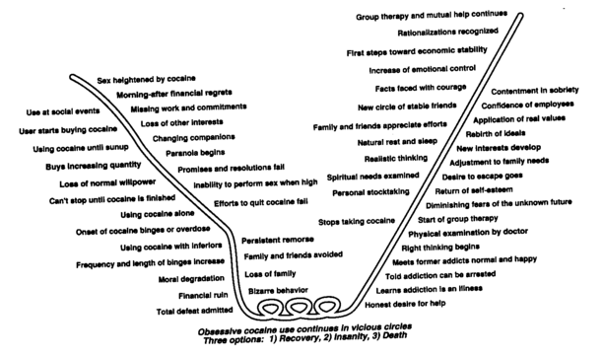
药物滥用的自然病程
Notes:
The progressive downhill course in many patients who develop substance dependence is illustrated here. This represents a modification of the Jellnick curve for alcohol dependence. The substance-related events and recovery patterns listed are for cocaine addiction; similar patterns exist for other substances.

Slide 70
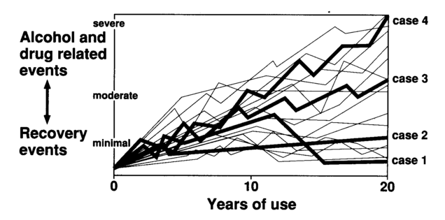
药物滥用的自然病程
Notes:
Clinical course in 18 patients with alcohol and drug disorders. Each line represents a single patient and his or her course over 20 years. The upward deflection of each line represents a clinical event such as an episode of prolonged binge drinking. An accident, or other psychosocial problem related to alcohol or drug use. The down ward deflection represent a recovery or treatment event. Case 1 represents a patient with spontaneous recovery after 12 years of problematic use. Case 4 represents severe progressive disease culminating in death.

Slide 71
药物滥用的检查(1)
1．病史
药物使用史: 所使用药物的种类、剂量特别是入院前5天的使用情况, 每天所花费的钱物、使用途径(口服、静脉、吸入)、开始使用的年龄、使用的时间等。
治疗史: 包括既往治疗环境、自愿强制、治疗方法、病人的合作程度、期限、病人对治疗的态度及评价等。
与药物滥用有关的内科问题: 包括肝炎史、颅脑外伤史、躯体损伤史、结核史、肺部感染史、性病史、艾滋病史、亚急性心内膜炎史、溃疡脓肿史等。
心理社会史: 包括家庭、社会、精神病史, 还有生活环境、住房、经济来源、法律问题、教育程度、工作史、性生活史、嗜好、家族史是否有药物、酒精滥用者)、是否欠债等。

Slide 72
药物滥用的检查(2)
2．躯体检查
一般情况: 营养状况、体重、脱水征、有无中毒或戒断症状等。
生命体征: 体温、呼吸、脉搏、血压。
皮肤: 注射痕迹、瘢痕(沿静脉走行, 一般在四肢, 也可见于颈部、乳房、腹股沟、阴茎处), 皮肤的各种感染、立毛肌树起等。
眼睛: 瞳孔大小、流泪等。
鼻子: 流鼻涕、鼻腔溃疡、脓鼻涕, 严重的鼻腔感染提示通过鼻内用药。
口及咽喉: 反复的口腔感染、溃疡提示有艾滋病的可能。
肺部: 结核以及其它慢性感染等。
心脏: 有心脏杂音提示亚细菌性心内膜炎。
腹部: 特别注意肝脏情况。
神经系统: 注意腱反射、周围神经损伤、麻木等

Slide 73
药物滥用的检查(3)
3. 精神状况检查
人格特征
抑郁
焦虑
精神病性症状
4. 试验室检查
三大常规
性病检查, 包括HIV试验
肺部X-线检查
肝功能检查、两对半
心电图检查等

Slide 74
药物依赖的诊断(DSM-IV)
A. 为一种适应不良的使用方式，导致明显的临床损害，在某12个月的期间里至少有以下3 条表现。
1. 耐受性，表现为以下的一种：
需要增加较大剂量方能达到中毒水平或所需的效果
如果按以前的剂量使用不能达到所需的效果
2. 戒断症状，表现为以下的一种：
所使用成瘾物质的特征性戒断症状
使用同样的（或类似）成瘾物质能够解除戒断症状
3 实际使用成瘾物质的量及时间比打算的要多、要长
4. 总想戒断或控制使用成瘾物质但不成功
5. 在获得成瘾物质、使用成瘾物质或从使用成瘾物质所引起的作用恢复过来所花费的时间较长
6. 由于使用成瘾物质，放弃了或减少了重要的社会、职业或娱乐活动
7. 尽管明白使用成瘾物质可引起持续或反复的躯体或心理问题，但继续使用
B. 指明
具有生理依赖（有耐受性和戒断症状的证据，表现第1或第2条）
不具有生理依赖（没有耐受性和戒断症状的证据，不符合第1条和第2条）

Slide 75
药物滥用的诊断(DSM-IV)
A 为一种适应不良的使用方式，导致明显的临床损害，在某12个月的期间里至少有以下1条表现。
  1. 反复使用成瘾物质不能履行工作、学业、家务重要职责，（如由于使用成瘾物质多次无故旷工，工作能力下降，被学校开除、不能照顾小孩、家务）
  2. 在有可能引起躯体损害的情况下仍然反复使用成瘾物质（如在使用成瘾物质情况下驾车、开机器）
  3. 多次因使用成瘾物质导致法律问题（如因使用成瘾物质行为不端而被捕）
  4. 尽管使用成瘾物质引起了持续或反复的社会或人际关系问题，但继续使用（如，由于中毒与配偶争吵、打架。）
B. 不符合诊断依赖的标准

Slide 76
治疗的基础
社会司法模式
生物、心理模式
亚文化模式

Slide 77
社会、司法模式
瘾君子是意志薄弱者、反社会者、道德败坏者, 他们对社会、家庭造成了巨大危害, 他们应该受到惩罚。如果不将他们投进了监狱, 就不能阻止毒品的蔓延。医疗处理并不重要。

Slide 78
生物、心理模式
成瘾行为是一渐进、慢性、复发性的脑部疾病
  自我失去控制、冲动性、持续性使用毒品,
  成瘾者体内出现病理生理的改变, 如耐受和戒断症状。
所以, 成瘾行为与其它躯体、精神疾病一样, 是一种病态, 故应予以积极的治疗。

Slide 79
亚文化模式
吸毒是一种亚文化现象, 由于这种亚文化现象与社会主流格格不入, 吸毒就被视为不正常的行为。他们认为吸毒者的违法、犯罪行为往往是由于吸毒行为被社会认定为违法所造成的, 用吸毒者的话说就是“吸自己的钱, 违国家的法。”这种模式未被大多数人所认可。

Slide 80
治疗目标
1. 戒断或减少使用药物
2. 减少复发的频度及严重性
3. 促进心理和社会功能

Slide 81
治疗分类
治 疗 方 法 | 治 疗 环 境 | 治 疗 内 容
急性脱瘾治疗 美沙酮维持治疗 社区治疗 劳教 | 住院治疗 治疗社区 门诊治疗 门诊强化治疗 | 药物治疗 行为治疗 短期干预治疗 应激应付 社会技能训练 预防复发训练 个体心理治疗 集体心理治疗 自助组织 精神科处理

Slide 82
成瘾行为的治疗
一般处理
过量中毒处理
急性戒断症状处理
预防复发
群体治疗
家庭治疗
美沙酮维持治疗
其他

Slide 83
一般处理
建立和维持良好的医患关系
注意病人的临床状态
安全性: 如可能的自杀、杀人及治疗的毒副作用。
精神状况: 很重要, 保证病人是否合理的治疗以及病人的治疗的反应, 从而随时改变治疗计划
通过呼吸、血液、唾液、尿等来监测病人是否在使用成瘾物质

Slide 84
过量中毒处理
把病人置于安静的环境中, 避免环境的不良刺激
及时判断病人使用了何种成瘾物质以及使用的时间、剂量、使用方式等
延缓药物的吸收、促进药物的排泄
注射拮抗剂等。

Slide 85
戒断综合征处理
一般处理
替代治疗
  美沙酮-阿片类戒断症状
  安定类-酒戒断症状
非替代治疗
  镇静催眠药
  丁螺环酮
  莨菪碱类
  抗精神病药物
  中药

Slide 86
预防复发
处理稽延症状
  慢性渴求
  焦虑、抑郁
  失眠
帮助病人找出及避免药物线索(如训练病人如何避免吸毒朋友的诱惑等)
训练病人自我控制自己的情绪、认知
放松训练减少焦虑、控制渴求
帮助病人提供应付不良情绪的能力及社会技能。
危机干预
μ受体阻滞剂应用-纳屈酮
中药应用
抗焦虑药物

Slide 87
群体治疗
群体治疗使病人有机会发现他们之间共同的问题、相互理解表达自己的情感、学习如何表达自己的意愿。群体治疗给病人提供讨论和修改他们的治疗方案场所, 也可以在治疗期间监测他们的行为, 制订切实可行的治疗方案, 促进他们与医师保持接触, 有助于预防复发、促进康复。

Slide 88
家 庭 治 疗
重要性:
帮助家庭成员认识、解决家庭的问题, 促进相互理解、相互帮助, 避免戒毒者在治疗结束后有回到一个病态的家庭环境中去;
帮助家庭成员认识毒品问题, 支持、帮助、监督戒毒者摆脱对毒品的心理依赖;
帮助家庭其它成员度过自身难关, 消除吸毒者给他们造成的心理创伤。
内 容:
定期召开讨论会, 讨论吸毒者的人格、行为等问题
帮助戒毒者认真遵循治疗康复程序
通过各种活动逐渐加深各个家庭之间和家庭与戒毒者之间的相互联系
强 调
人际间、家庭成员间的不良关系是导致吸毒成瘾、治疗后的复发的主要原因
打破否认, 打破对治疗的阻抗, 促进家庭间的团结。

Slide 89
美沙酮维持治疗
理 论
并非所有的吸毒者均能顺利戒毒。
吸毒过程必然因吸毒问题来扰乱社会、家庭, 引起各种传染病(如HIV)的传播。
疗 效
减少毒品使用
减少犯罪
改善社会功能、增加就业
改善总体健康
使病人不脱离治疗
减少因注射而致的相互传染

Slide 90
其 他
减少因吸毒所引起的各种问题
克服病人、家属的否认
保持与病人的接触、预防复发
  监测病人的戒毒动机及特殊行为
    违法活动
    与其他吸毒者联系
    渴求增加
    负性情绪增加
  增加病人的动机
    鼓励病人参加自助组织;
    鼓励不与吸毒的朋友在一起;
    改变不良的生活方式;
  提高病人社会适应能力,
  教会他们如何与家人朋友相处; 帮助病人解决某些实际问题。
向病人及家属提供有关药物滥用的知识

Slide 91
疗效的评价
成瘾药物使用 | 戒断 减少使用量 减少过量次数 用合法的药物替代非法的药物 产生无药的生活方式
医疗与躯体健康 | 有基本的食物与住处 改善总体健康水平 减少医疗问题 减少看病次数 减少高危的性行为
社会心理功能 | 改善人际关系 改善家庭关系 促进心理功能 治疗情绪问题 治疗精神障碍 改善照顾子女能力
工作 | 增加获得新工作的可能性 增加工作时间 改善作业能力 减少意外事故
犯罪活动 | 减少违法犯罪行为 减少暴力行为
预防复发 | 减少再次使用成瘾药物 延缓复发时间 减少由于复发所引起的各种问题

Slide 92
对成瘾治疗的总体评价
治疗有效: 经过治疗的病人即使未能停止使用成瘾物质, 也大多减少了成瘾物质的使用, 这种效果常常能维持数月甚至数年。不仅如此, 治疗还对病人躯体健康、社会功能、工作情况起良性的作用, 并能减少犯罪, 减少复发。
病人主动参与治疗会明显增加效果
长期治疗较短期治疗效果好: 但要使病人愿意接受长期治疗取决于所提供的治疗质量因素。
临床治疗的质量、治疗内容、病人的特征、医师护士的特征是治疗效果的决定因素。
总体来说, 治疗取得的效益超过治疗的费用。

Slide 93
影响疗效的主要因素
治疗的特征: 治疗强度取决于治疗效果, 而治疗强度与管理水平、治疗实施者水平、病人/治疗者比率、医患关系等有关。良好的治疗能较为灵活地满足不同病人的不同需求
治疗者的特征: 在治疗中, 治疗者的富有同情、理解心最为重要, 其它的素质有社交技能、知识结构、乐于助人等。
病人的特征: 良好的社会功能, 如有固定工作、有较好的婚姻关系、吸毒史较短、无犯罪史、无精神病及人格障碍、文化水平较高等治疗效果较好。
治疗时间

Slide 94
几点体会
脱瘾药物不是灵丹妙药
吸毒者并非不可救药
吸毒者随着时间的推移也在改变自己
治疗并非完全无效
戒毒治疗需要改进

Slide 95
误区1:
药物滥用纯粹是意志或人格力量的失败
事实：
根据世界卫生组织的定义, 吸毒、药物成瘾是一种发生在大脑的慢性复发性疾病，因此吸毒、药物滥用者与患有其他躯体疾病患者一样, 都是病人。在吸毒、药物滥用过程中, 病人的大脑的结构和功能均发生了改变。诚然，吸毒、药物滥用者以强制(冲动)性用药行为的形式表现出来，但这种行为与反复使用药物过程中发生的大脑改变密切相关。近年来发现，遗传因素与个体药物成瘾的发生或多或少有一定的关系。

Slide 96
误区2：
为吸毒成瘾者耗资治疗是浪费
事实：
在对药物成瘾确实有效的治疗上投资，能降低毒品、成瘾药物对健康和社会的负面影响(例如：犯罪、经济负担和艾滋病病毒感染等)。国外的研究证明, 用于治疗的每1美元的投入可获得7美元的回报。无论在发达国家还是在发展中国家，治疗均有成本效益，其耗资低于逮捕入狱的耗费。

Slide 97
误区3：
药物滥用问题主要存在于发达国家中
事实：
有确凿的证据表明，吸毒、酒精滥用相关问题在发展中国家呈上升趋势，我国也不例外。二十世纪70年代末期以来，吸毒人数持续上升，毒品案件不断增多。1999年，全国共查获毒品犯罪案件6.5万起，缴获海洛因5.364吨、鸦片1.193吨、冰毒16.059吨，以及部分可卡因、摇头丸（MDMA）、大麻等，破案数和缴获毒品总量分别比1998年增加2.4%和33.6%。中国公安部门登记在册的吸毒人数，1991年为14.8万，1995年为52万，1999年为68.1万。目前，全国各省、自治区、直辖市都程度不同地存在着与毒品有关的违法犯罪活动，中国已由毒品过境受害国转变为毒品过境与消费并存的受害国。据统计, 吸毒造成的经济损失每年约千亿元, 更为严重的是, 吸毒使劳动力丧失、国民素质下降、疾病传播。我国70%的艾滋病患者是由共用注射器注射毒品而感染。

Slide 98
误区4：
吸毒者未受到足够的惩罚
事实：
首先, 从医学的角度看, 吸毒导致脑部功能与结构的变化, 吸毒不能控制自己的行为, 他们属于病人的范畴, 因而应该接受治疗，而不仅仅是惩罚。吸毒者处于社会边缘状态，更需要社会关心、治疗。当然, 对于吸毒行为需要一定的社会控制和必要的惩罚, 但仅仅把他们囚禁起来, 予以惩罚, 而不予任何形式的治疗, 只会加重他们对主流社会的不满和报复, 或“破罐子破摔”。所以, 惩罚并非是有效的预防或治疗策略。

Slide 99
误区5
戒毒所能解决吸毒的所有问题
事实：
治疗药物依赖没有神奇的方案，这是一个长期的过程。戒毒所主要能提供某些方面的医疗服务, 如使用医疗手段, 使发瘾的严重程度降低。但必须认识到，吸毒成瘾是一种慢性、复发性疾病，在彻底戒除之前往往需要重复多次的治疗。对于成功的康复，治疗后的照顾和患者本身的恪守、决心、责任感均非常重要。

Slide 100
误区6
一旦吸毒、终生吸毒
事实：
有人随访了100例海洛因使用者, 在吸毒20年后, 35%已戒了毒, 25%死亡, 25%还在吸毒。尽管吸毒者预后不佳, 但毕竟有1/3的人能最终摆脱毒品。不可否认, 有不少吸毒者自暴自弃, 毫无戒毒动机, 对此类人单纯脱毒治疗当然无效, 反复进戒毒所的人也都是此类人(已成功戒毒的人也不会让大家知道他有吸毒史!), 所以就给我们造成了毒不能戒掉的印象。即使是反复戒毒、反复吸毒, 也不能完全说戒毒无效。国外研究发现, 经过戒毒治疗后, 病人常能改变吸毒方式, 如改注射为吸入, 这对于防止艾滋病等传染性疾病的传播有极大的好处。再者, 戒毒失败能使病人及家属进一步明白戒毒的长期性和艰巨性, 为下一次的成功戒毒奠定基础。

Slide 101
NIDA药物依赖治疗的13项原则
任何一种单独的治疗方法都不可能适用于所有的病人,与每个病人的问题和需求相对应的治疗环境、干预措施和配套服务非常重要。
治疗应该容易得到,若不能迅速容易地进入治疗程序,则原先愿意治疗的病人很容易流失。
有效的治疗应该考虑患者多方面的问题,而不应仅仅局限于滥用药物本身。对于患者的用药行为及相关的医学、心理学、社会、职业及法律问题应一并考虑。
应该根据病人不断变化的需求随时评估和调整治疗。
足够的治疗时间对于疗效至关重要。具体取决于病情需要,对于大部分病人来说,显效的时间在第三个月,更长的治疗会产生更好的效果。治疗计划应包括防止病人过早脱离治疗的措施。

Slide 102
NIDA药物依赖治疗的13项原则
个体和群体咨询及其它行为治疗对于疗效极为重要。在治疗过程中,应帮助病人树立信心,建立对抗药物滥用和对抗复吸的技能,使其以建设性奖励性的非药物行为替代用药行为,提高其解决问题、对抗危险的能力,行为治疗也能改善患者的人际关系。
对于许多病人来说,药物治疗仍是重要的治疗手段,特别是结合咨询及各种行为疗法时更是这样。美沙酮和LAAM有助于病人稳定生活,减少药物滥用。纳曲酮对于部分阿片成瘾和并发酒瘾患者疗效明确,而尼古丁贴片、口香糖或口服药片可治疗烟瘾患者。

Slide 103
NIDA药物依赖治疗的13项原则
对于并发精神障碍的滥用/成瘾者,应对二者同时进行整体治疗;因滥用/成瘾同时并发精神障碍的情况极为普遍,故发现滥用/成瘾时必须考虑到精神问题并进行相应的检查和治疗。
临床脱毒只是戒毒的第一阶段,仅仅脱毒对治疗长期药物滥用患者的疗效很小,只能控制早期生理问题和戒断症状,对部分患者而言它只是有效治疗的开始。
治疗并非自愿才有效,来自家庭、雇主和司法部门的督导及压力可以明显提高接受治疗、操守和成功的概率。

Slide 104
NIDA药物依赖治疗的13项原则
必须连续不断地监测治疗期间可能发生的药物滥用,如经常进行尿样分析检测酒精和药物,不仅可保持压力预防复吸,也可早期发现已经发生的偷吸行为,及时调整治疗方案。
治疗计划应包括对HIV/爱滋病、乙丙型肝炎、结核等感染性疾病的检测,提供咨询帮助病人改变高危行为,帮助已感染者正确控制其疾病。
成瘾的康复是一个长期的过程,通常需要经历多次治疗,与其它慢性病一样,在戒毒期间甚至成功戒毒之后,复吸都有可能发生。在戒毒治疗期间和完成之后参加自救自助项目训练,有助于维持操守。

Slide 105
社区治疗(TC)
利用精神病学、行为科学、社会学和心理学等学科的知识及原理, 充分调动患者、家属及医护人员的潜力, 帮助患者达到身心康复的目的。
已成功应用于监狱、劳教场所、戒毒康复中心等。

Slide 106
吸毒者的特征
行为问题
  说谎、吹牛、威胁、挑拨关系
  犯罪、性乱
  生活无规律、懒惰
情绪问题
  自卑
  焦虑、抑郁
  冲动, 要求立即满足
认知问题
  “今日有酒今日醉”, “破罐子破摔”
  没有希望, 被抛弃感
  无助感
社会角色丧失
社会隔离
归属感丧失
安全感丧失
吸毒

Slide 107
戒毒后的痛苦
稽延症状
  失眠
  慢性渴求
  焦虑、抑郁
  躯体不适
没有归属, 被遗忘
失望
被怀疑、被歧视
不被人理解
解决痛苦最好、最便捷的方法是再吸毒

Slide 108
TC能干什么?
生理满足
归属感
没有歧视
没有暴力
有等级结构, 有成就感

Slide 109
TC的理论基础
毒品阻碍了药物滥用者心理、行为和人格的发育与成熟。
心理、行为和人格发育缺陷是复吸的主要原因, 改变患者的行为、认知及情绪表达方式是戒毒最最重要的部分。
TC相信吸毒者能重获新生, 认为重获新生的钥匙在吸毒者手里。

Slide 110
TC的康复治疗(1)
等级制
每个居住者处于不同的地位并承担相应的责任和义务, 享受相应的特权
刚进入TC者, 地位最低, 居住者要靠自己的努力、表现和为TC 所做出的贡献来提高自己的地位
让居住者在接受上级指示, 指导下级的过程中尽力和学习与他人交往的能力与技巧
当居住者通过努力得到晋升时, 自然张产生成就感, 这种成就感是在其吸毒生涯中不可能体会到, 也是一个人成长、成熟过程中非常重要的极力因素
如果居住者表现不好, 违反纪律等, 便将收到降级或其他惩罚。

Slide 111
TC的康复治疗(2)
角色模范作用
TC的管理中, 几乎各个等级的“领导”都由居住者承担—模范带头作用
“领导者”的一言一行都会受到居住者的密切关注—不得不努力工作, 身体力行
为了获得“晋升”与“生存”, 居住者也必须向“领导者”表同—不得不努力工作
“领导者”均为康复期成员, 他们熟悉戒毒者的思维与感受, 往往能神奇地预料康复人员在特定情况下可能发生的事情。

Slide 112
TC的康复治疗(3)
有目的、有计划安排自己的生活
改变作息制度
对自己的思想、情绪、行为成就或不足进行总结与思考
对第二天的活动进行安排并严格按计划实施
Notes:
以上这些做法对正常人来说, 听起来可能过于简单, 没有任何意义, 但对吸毒人群来说, 意义非常重大, 因为他们对毒品的过分追求已严重限制了他们的生活内容, “如何获得毒品”是他们的主宰, 而“飘”便成为他们唯一的追求。TC的成功中最重要、最基本的一步就是让他们恢复有目的有计划的生活, 并从中体会到成功、轻松与充实。

Slide 113
TC的康复治疗(4)
治疗工具
Notes:
吸毒者在街头的吸毒生涯及其艰难, 一方面他们要不择手段搞钱维持毒品的高消费, 防止发瘾, 同时又要竭力掩盖自己的吸毒事实, 生怕别人, 尤其是警察和熟人知道。长期担惊受怕, 思想上的高度紧张必然形成敏感的防御。另外, 吸毒形成的懒惰佛不负责任、撒谎、要求立即的满足的心理等问题也必须得到纠正。TC治疗工具就是要打破他们过度防御, 让他们敞开心扉, 揭露自己、面对自己、认识自己, 最终从行为上改变自己, 恢复由于使用毒品而丧失的各种能力。

Slide 114

Thank you very much

