Slide 1
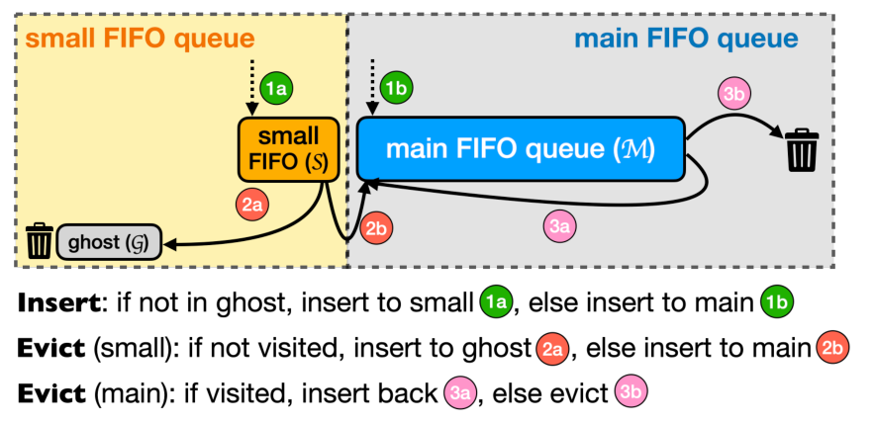
OPERATING SYSTEMS · PAPER PRESENTATION
S3-FIFO:
Cache Eviction
FIFO Queues Are All You Need
for Cache Eviction
Li Zhiqing (1240016612)
Xia Youran (1240010751)
Zhang Xiaocheng (1240021715)
Original Figure 5 · S3-FIFO architecture
Source: Yang et al., SOSP 2023
SOSP 2023 · Juncheng Yang et al.
Yang et al., SOSP 2023 · Operating Systems · Theoretical Presentation
Slide 1
Notes:
Good morning, everyone. Today, our group will introduce a research paper called FIFO Queues Are All You Need for Cache Eviction. It was published at SOSP in 2023. The paper introduces a new cache eviction algorithm called S3-FIFO.

Slide 2
Opening
S3-FIFO · FIFO Queues Are All You Need
Team Structure & Timing
Three speakers follow the supplied script: background, algorithm, then evaluation.
Speaker
Main responsibility
Xia Youran
Background, cache eviction, FIFO / LRU, one-hit wonders.
Li Zhiqing
Three FIFO queues, cache requests and eviction rules.
Zhang Xiaocheng
Experimental setup, results, limitations and conclusion.
10-minute theoretical presentation · Results are reported by the original paper’s authors.
Yang et al., SOSP 2023 · Operating Systems · Theoretical Presentation
Slide 2

Slide 3
PART 1 · MEMBER 1
Background & Motivation
Why does a cache need a better eviction policy?
Background → FIFO vs LRU → One-hit Wonders
Yang et al., SOSP 2023 · Operating Systems · Theoretical Presentation
Slide 3

Slide 4
Part 1 · Background
S3-FIFO · FIFO Queues Are All You Need
What Is Cache Eviction?
Cache space is fast but limited; the system must decide what stays and what goes.
Small & fast cache
A cache is a small and fast storage space that keeps data we may need again.
When the cache is full, the system must decide which data to remove.
This process is called cache eviction.
CACHE: ALL SLOTS OCCUPIED
A cache is a small and fast storage space that keeps data we may need again.
A
B
C
D
Limited space
When the cache is full, the system must decide which data to remove.
New object
Cache eviction
Which object should leave?
This process is called cache eviction.
Key question: what should stay in the cache, and what should go?
Source: Yang et al., SOSP 2023, §§1–2.
Yang et al., SOSP 2023 · Operating Systems · Theoretical Presentation
Slide 4
Notes:
First, what is a cache? A cache is a small and fast storage space that keeps data we may need again. For example, when a computer reads the same data many times, getting it from the cache is faster than getting it from slower storage.
However, cache space is limited. When the cache is full, the system must decide which data to remove. This process is called cache eviction.
In other words, the system needs a smart way to decide what should stay and what should go.

Slide 5
Part 1 · Traditional Algorithms
S3-FIFO · FIFO Queues Are All You Need
Traditional Algorithms: FIFO vs LRU
Eviction rule · Hit updates · Concurrency cost
FIFO
LRU
First In, First Out
Least Recently Used
Cache hit: A | Left = next eviction
Cache hit: A | Left = next eviction
Before
A
B
C
Before
A
B
C
After hit A
A
B
C
After hit A
B
C
A
• Evict earliest inserted
• Evict least recently used
• Simple and fast
• Reorder on cache hits
• May evict useful data
• Overhead with many threads
Goal: FIFO simplicity + better cache efficiency.
Source: Yang et al., SOSP 2023, §2.2.
Yang et al., SOSP 2023 · Operating Systems · Theoretical Presentation
Slide 5
Notes:
There are two common methods: FIFO and LRU.
FIFO means First In, First Out. It removes the data that entered the cache first. FIFO is simple and fast, but it may remove useful data.
LRU means Least Recently Used. It removes data that has not been used for the longest time. LRU can be more effective, but it needs to update the order of objects whenever they are accessed. This can slow down the system when many threads work at the same time.

Slide 6
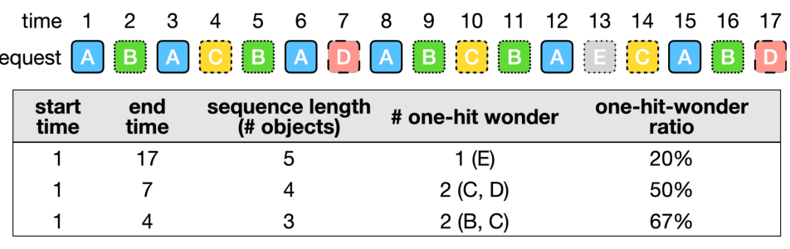
Part 1 · Research Motivation
S3-FIFO · FIFO Queues Are All You Need
One-Hit Wonders & Quick Demotion
Shorter access sequences contain a higher fraction of objects with no reuse.
One-hit wonders
A SHORTER SEQUENCE → A HIGHER RATIO
Many objects are used only once before they leave the cache: one-hit wonders.
Wasted cache space
They take up cache space without being used again.
Quick demotion
Quick demotion removes less useful objects early.
Original Figure 1 · Source: Yang et al., SOSP 2023
Can we combine the simplicity of FIFO with better cache efficiency?
Source: original Figure 1 and §3, Yang et al., SOSP 2023.
Yang et al., SOSP 2023 · Operating Systems · Theoretical Presentation
Slide 6
Notes:
The researchers noticed another problem. Many objects are used only once before they leave the cache. The paper calls these objects one-hit wonders.
The researchers found that these objects are especially common in short access sequences. This means some data take up cache space without being used again.（讲diagram：Like this diagram, if the sequence length is long, the ratio of one hit wonders is quite low. But,as the sequence length decrease,the ratio of one hit wonders become much higher.）
So, the main idea is to remove less useful objects quickly and keep frequently used objects for longer. The researchers call this quick demotion.
This leads to an important question: Can we combine the simplicity of FIFO with better cache efficiency?
To answer this question, the researchers designed S3-FIFO.
Now, my teammate will explain how this algorithm works.

Slide 7
PART 2 · MEMBER 2
How S3-FIFO Works
Thank you. Now, I will explain how S3-FIFO works.
The main idea is simple: three FIFO queues.
S
M
G
Small Queue
Main Queue
Ghost Queue
Yang et al., SOSP 2023 · Operating Systems · Theoretical Presentation
Part 2 01 / 12
Notes:
Thank you. Now, I will explain how S3-FIFO works.
The main idea is simple. S3-FIFO uses three FIFO queues: the Small Queue, the Main Queue, and the Ghost Queue.
Source: Yang et al., FIFO Queues Are All You Need for Cache Eviction, SOSP 2023. Section 4.1.
https://jasony.me/publication/sosp23-s3fifo.pdf
https://doi.org/10.1145/3600006.3613147

Slide 8
Part 2 · Design Overview
S3-FIFO · FIFO Queues Are All You Need
Three FIFO Queues, One Cache
S3-FIFO uses Small, Main and Ghost queues together.
Small Queue
Filters new objects.
Main Queue
Protects useful objects.
Ghost Queue
Remembers removed IDs.
Original Figure 5 · Source: Yang et al., SOSP 2023
Source: Original Figure 5 and Section 4.1 · Yang et al., SOSP 2023
Yang et al., SOSP 2023 · Operating Systems · Theoretical Presentation
Part 2 02 / 12
Notes:
The original architecture shows how the three queues work together. Small filters new objects, Main protects useful objects, and Ghost remembers removed IDs.
Source: Yang et al., FIFO Queues Are All You Need for Cache Eviction, SOSP 2023. Original Figure 5 and Section 4.1.
https://jasony.me/publication/sosp23-s3fifo.pdf
https://doi.org/10.1145/3600006.3613147

Slide 9
Part 2 · Queue Roles
S3-FIFO · FIFO Queues Are All You Need
The Small Queue (S)
First, the Small Queue uses about 10% of the cache space.
S · 10%
M · 90% of cache space
10%
New objects usually enter here.
It helps remove objects
that are not used again.
of cache space
Small filters new objects.
Source: Section 4.1 · Yang et al., SOSP 2023
Yang et al., SOSP 2023 · Operating Systems · Theoretical Presentation
Part 2 03 / 12
Notes:
First, the Small Queue, or S, uses about 10% of the cache space. New objects usually enter here. It helps remove objects that are not used again.
Source: Yang et al., FIFO Queues Are All You Need for Cache Eviction, SOSP 2023. Section 4.1. The original capacity illustration is retained.
https://jasony.me/publication/sosp23-s3fifo.pdf
https://doi.org/10.1145/3600006.3613147

Slide 10
Part 2 · Queue Roles
S3-FIFO · FIFO Queues Are All You Need
The Main Queue (M)
Second, the Main Queue uses the remaining 90%.
90%
It stores objects that are
accessed more frequently.
of cache space
Objects can reach Main after
showing reuse in Small or Ghost.
Main protects useful objects.
Source: Section 4.1 · Yang et al., SOSP 2023
Yang et al., SOSP 2023 · Operating Systems · Theoretical Presentation
Part 2 04 / 12
Notes:
Second, the Main Queue, or M, uses the remaining 90%. It stores objects that are accessed more frequently.
Objects can reach Main after showing reuse in Small or Ghost.
Source: Yang et al., FIFO Queues Are All You Need for Cache Eviction, SOSP 2023. Section 4.1 and Algorithm 1.
https://jasony.me/publication/sosp23-s3fifo.pdf
https://doi.org/10.1145/3600006.3613147

Slide 11
Part 2 · Ghost History
S3-FIFO · FIFO Queues Are All You Need
The Ghost Queue (G)
Third, Ghost stores IDs, without the actual data.
It remembers IDs of objects
recently removed from Small.
RECENTLY REMOVED OBJECT IDs
A
B
C
It helps recognize objects
that may be useful again.
IDs only · No cached payload
Ghost holds as many IDs as Main holds objects. Oldest IDs leave when full.
Source: Section 4.1 · Yang et al., SOSP 2023
Yang et al., SOSP 2023 · Operating Systems · Theoretical Presentation
Part 2 05 / 12
Notes:
Third, the Ghost Queue, or G, only stores the IDs of recently removed objects from the Small Queue, not the actual data. It helps recognize objects that may be useful again.
The paper sizes Ghost to hold as many IDs as Main holds objects. When Ghost is full, it removes the oldest ID in FIFO order.
Source: Yang et al., FIFO Queues Are All You Need for Cache Eviction, SOSP 2023. Section 4.1. Original ID illustration retained.
https://jasony.me/publication/sosp23-s3fifo.pdf
https://doi.org/10.1145/3600006.3613147

Slide 12
Part 2 · Handling Requests
S3-FIFO · FIFO Queues Are All You Need
Cache Hit: Update the Counter
If an object is already in Small or Main, it is a cache hit.
Object in S or M
freq = min(freq + 1, 3)
Its access counter increases, up to a maximum of three.
Unlike LRU, S3-FIFO does not move objects after every hit.
Only two bits per object are needed for the counter: 0, 1, 2, 3.
Source: Section 4.1 and Algorithm 1, lines 1–3 · Yang et al., SOSP 2023
Yang et al., SOSP 2023 · Operating Systems · Theoretical Presentation
Part 2 06 / 12
Notes:
Now, let's see how S3-FIFO handles requests. If an object is already in the cache, it is a cache hit. Its access counter increases, up to a maximum of three. Unlike LRU, S3-FIFO does not move objects after every hit.
The paper uses only two bits per object to store the counter.
Source: Yang et al., FIFO Queues Are All You Need for Cache Eviction, SOSP 2023. Section 4.1 and Algorithm 1, lines 1-3. Original hit diagram retained.
https://jasony.me/publication/sosp23-s3fifo.pdf
https://doi.org/10.1145/3600006.3613147

Slide 13
Part 2 · Handling Requests
S3-FIFO · FIFO Queues Are All You Need
Cache Miss: Use Ghost History
If an object is not in Small or Main, it is a cache miss.
Yes
Cache miss
ID recorded in G?
Insert into Main
No
Insert into Small
Initial counter: freq = 0
If its ID is in Ghost, it enters Main directly.
Otherwise, it enters Small.
Source: Algorithm 1, lines 4–13 · Yang et al., SOSP 2023
Yang et al., SOSP 2023 · Operating Systems · Theoretical Presentation
Part 2 07 / 12
Notes:
If an object is not in the cache, it is a cache miss. If its ID is in the Ghost Queue, it enters the Main Queue directly. Otherwise, it enters the Small Queue.
The new object starts with a counter of zero.
Source: Yang et al., FIFO Queues Are All You Need for Cache Eviction, SOSP 2023. Algorithm 1, lines 4-13. Original admission flowchart retained, including initial freq = 0.
https://jasony.me/publication/sosp23-s3fifo.pdf
https://doi.org/10.1145/3600006.3613147

Slide 14
Part 2 · Eviction
S3-FIFO · FIFO Queues Are All You Need
Cache Eviction: Which Queue?
Next, let's look at cache eviction.
When the cache is full, S3-FIFO chooses which queue
to evict from based on the Small Queue's size.
Small at or above 10%
Small below 10%
Evict from Small
Evict from Main
Each queue checks its oldest object first.
Source: Algorithm 1, lines 14–18 · Yang et al., SOSP 2023
Yang et al., SOSP 2023 · Operating Systems · Theoretical Presentation
Part 2 08 / 12
Notes:
Next, let's look at cache eviction. When the cache is full, S3-FIFO chooses which queue to evict from based on the Small Queue's size.
If Small is at or above 10% of cache capacity, it evicts from Small. Otherwise, it evicts from Main.
Source: Yang et al., FIFO Queues Are All You Need for Cache Eviction, SOSP 2023. Algorithm 1, lines 14-18.
https://jasony.me/publication/sosp23-s3fifo.pdf
https://doi.org/10.1145/3600006.3613147

Slide 15
Part 2 · Small Eviction
S3-FIFO · FIFO Queues Are All You Need
Small Queue Eviction: Filter New Objects
Inspect the oldest object in Small.
Oldest object: freq > 1?
Yes
No
Move to Main
Remove cached data; ID → G
Objects with a counter greater than one move to Main.
Otherwise, remove the data and send their IDs to Ghost.
The paper clears the access bits when an object leaves Small.
Source: Section 4.1 and Algorithm 1, lines 19–30 · Yang et al., SOSP 2023
Yang et al., SOSP 2023 · Operating Systems · Theoretical Presentation
Part 2 09 / 12
Notes:
In the Small Queue, objects with an access counter greater than one move to the Main Queue. Otherwise, they are removed, and their IDs enter the Ghost Queue.
The paper also clears the access bits during the move. If Main becomes full, it runs its own eviction procedure.
Source: Yang et al., FIFO Queues Are All You Need for Cache Eviction, SOSP 2023. Section 4.1 and Algorithm 1, lines 19-30. Original Small eviction flowchart retained.
https://jasony.me/publication/sosp23-s3fifo.pdf
https://doi.org/10.1145/3600006.3613147

Slide 16
Part 2 · Main Eviction
S3-FIFO · FIFO Queues Are All You Need
Main Queue Eviction: A Second Chance
Inspect the oldest object in Main.
Oldest object: freq > 0?
Yes
No
Reinsert into Main; freq − 1
Evict the object
Objects with a positive counter get another chance,
and the counter decreases by one.
Objects with a counter of zero are removed.
Source: Algorithm 1, lines 31–40 · Yang et al., SOSP 2023
Yang et al., SOSP 2023 · Operating Systems · Theoretical Presentation
Part 2 10 / 12
Notes:
In the Main Queue, objects with a positive counter get another chance, and the counter decreases by one. Objects with a counter of zero are removed.
A positive-counter object is reinserted at the head of Main. Reinsertion happens when it becomes an eviction candidate.
Source: Yang et al., FIFO Queues Are All You Need for Cache Eviction, SOSP 2023. Algorithm 1, lines 31-40. Original Main eviction flowchart retained.
https://jasony.me/publication/sosp23-s3fifo.pdf
https://doi.org/10.1145/3600006.3613147

Slide 17
Part 2 · Design Rationale
S3-FIFO · FIFO Queues Are All You Need
Why the Design Is Efficient
The paper combines quick demotion with reinsertion during eviction.
Quick demotion
Lazy promotion
Small removes objects with
little reuse after a short stay.
Main reinserts useful objects
when considering eviction.
Cache hits only update a small counter.
They do not reorder the queues.
Source: Sections 3.2, 4.1 and 4.3 · Yang et al., SOSP 2023
Yang et al., SOSP 2023 · Operating Systems · Theoretical Presentation
Part 2 11 / 12
Notes:
The paper explains why the design works. Small provides quick demotion, so objects with little reuse leave after a short stay. Main gives useful objects another chance during eviction. Cache hits only update a small counter and do not reorder the queues.
Source: Yang et al., FIFO Queues Are All You Need for Cache Eviction, SOSP 2023. Sections 3.2, 4.1 and 4.3. Lazy promotion describes reinsertion at eviction rather than reordering on each hit.
https://jasony.me/publication/sosp23-s3fifo.pdf
https://doi.org/10.1145/3600006.3613147

Slide 18
Part 2 · Summary
S3-FIFO · FIFO Queues Are All You Need
How the Three Queues Work Together
In summary:
Small
filters new objects.
Main
protects useful objects.
Ghost
remembers removed objects.
This design reduces unnecessary updates
and improves cache efficiency.
Now, let's look at the experimental results.
Yang et al., SOSP 2023 · Operating Systems · Theoretical Presentation
Part 2 12 / 12
Notes:
In summary, the Small Queue filters new objects, the Main Queue protects useful objects, and the Ghost Queue remembers removed objects. This design reduces unnecessary updates and improves cache efficiency.
Now, let's look at the experimental results.
Source: Yang et al., FIFO Queues Are All You Need for Cache Eviction, SOSP 2023. Section 4.
https://jasony.me/publication/sosp23-s3fifo.pdf
https://doi.org/10.1145/3600006.3613147

Slide 19
PART 3 · MEMBER 3
Evaluation & Conclusion
What do the paper’s experiments show?
Experimental setup → Efficiency → Scalability
Yang et al., SOSP 2023 · Operating Systems · Theoretical Presentation
Slide 15

Slide 20
Part 3 · Evaluation
S3-FIFO · FIFO Queues Are All You Need
Experimental Setup: Real-World Workloads
The researchers evaluated S3-FIFO using a broad collection of cache traces.
6,594
14
real cache traces
datasets / data groups
WORKLOAD CATEGORIES
Storage blocks
Key-value data
Web content
All experimental results are reported by the original paper’s authors.
Source: Table 1 and §5.1, Yang et al., SOSP 2023.
Yang et al., SOSP 2023 · Operating Systems · Theoretical Presentation
Slide 16
Notes:
Thank you. Next, I’ll go over the test results and key findings of this paper.
The research team tested S3-FIFO using 6,594 real cache records from 14 data
groups. These covered different types of data, such as storage blocks, key-value data,
and web content.

Slide 21
Part 3 · Comparison
S3-FIFO · FIFO Queues Are All You Need
What Did the Researchers Compare?
S3-FIFO was compared with FIFO, LRU and other cache replacement methods.
FIFO
LRU
S3-FIFO
Simple insertion-order eviction
Evict the least recently used object
Three static FIFO queues
Other eviction policies were included in the paper’s evaluation as well.
Compare both cache efficiency and the cost of serving requests.
Source: §§5.1–5.3, Yang et al., SOSP 2023.
Yang et al., SOSP 2023 · Operating Systems · Theoretical Presentation
Slide 17
Notes:
They compared S3-FIFO with FIFO, LRU, and several other cache replacement
methods.

Slide 22
Part 3 · Efficiency Metric
S3-FIFO · FIFO Queues Are All You Need
What Does Miss Ratio Mean?
A cache miss occurs when the requested data is not in the cache.
Miss ratio = cache misses / total requests
A lower miss ratio is better.
It means more requests can be served directly from the cache.
Miss ratio measures cache efficiency: lower is better.
Source: §5.2, Yang et al., SOSP 2023.
Yang et al., SOSP 2023 · Operating Systems · Theoretical Presentation
Slide 18
Notes:
First, let’s look at the miss ratio.
A cache miss means the requested data is not stored in the cache. A lower miss ratio
is better, because more requests can be answered directly from the cache.

Slide 23
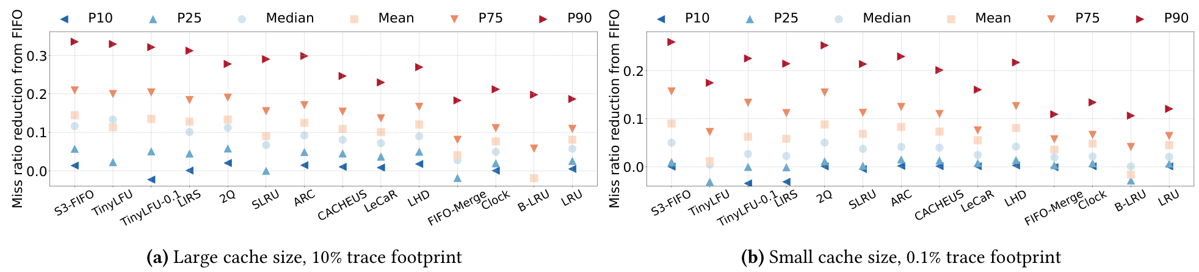
Part 3 · Results
S3-FIFO · FIFO Queues Are All You Need
Result 1: Cache Efficiency
Figure 6 compares miss-ratio reduction relative to FIFO, rather than raw miss ratios.
Original Figure 6 · Miss-ratio reduction relative to FIFO: a larger reduction is better.
10 / 14
Lowest average miss ratio in 10 of 14 datasets
with a relatively large cache.
S3-FIFO performs well across many workloads.
Source: Figure 6 and §5.2, Yang et al., SOSP 2023. The 10/14 dataset result is reported in §5.2 / Figure 7.
Yang et al., SOSP 2023 · Operating Systems · Theoretical Presentation
Slide 19
Notes:
Figure 6 in the paper compares the miss ratio performance of different methods. The
results show that S3-FIFO works well across many workloads. With a fairly large
cache, S3-FIFO had the lowest average miss ratio in 10 out of 14 data groups.

Slide 24
Part 3 · Throughput Metric
S3-FIFO · FIFO Queues Are All You Need
What Does Throughput Mean?
Throughput describes how many requests a system can handle in one second.
Throughput = requests handled per second
Higher throughput means more requests can be processed in the same time.
The next figure shows how throughput changes as thread count increases.
Throughput measures processing performance: higher is better.
Source: §5.3, Yang et al., SOSP 2023.
Yang et al., SOSP 2023 · Operating Systems · Theoretical Presentation
Slide 20
Notes:
The second key point is throughput. Throughput is how many requests a system can
handle in one second.

Slide 25
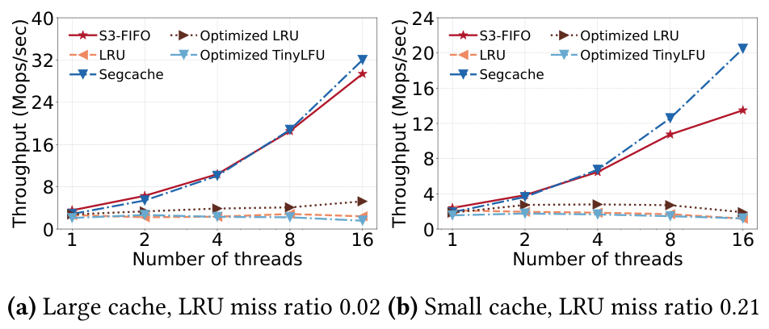
Part 3 · Results
S3-FIFO · FIFO Queues Are All You Need
Result 2: Throughput & Scalability
Figure 8 compares throughput as thread count increases.
>6×
Compared with optimized LRU at 16 threads.
S3-FIFO scales as the number of threads grows.
Original Figure 8 · Synthetic Zipf workload (α = 1.0)
Fewer operations on cache hits support better performance under concurrency.
Source: original Figure 8 and §5.3, Yang et al., SOSP 2023. Reported authors’ experiments.
Yang et al., SOSP 2023 · Operating Systems · Theoretical Presentation
Slide 21
Notes:
Figure 8 shows how each method performs as the number of threads grows.
In the team’s tests, S3-FIFO reached over six times the throughput of a tuned LRU
version with 16 threads. This means S3-FIFO works better when lots of requests are
processed at the same time.

Slide 26
Part 3 · Limitations
S3-FIFO · FIFO Queues Are All You Need
A Limitation: The Second Request May Arrive Late
Performance still depends on how users access the data.
Sometimes an object is removed from the Small Queue before its second request arrives.
This can cause an extra cache miss.
Object enters S
Removed from S
Second request → cache miss
Quick demotion is useful, but a late reuse can still cause an additional miss.
Source: §5.2, Yang et al., SOSP 2023.
Yang et al., SOSP 2023 · Operating Systems · Theoretical Presentation
Slide 22
Notes:
However, S3-FIFO also has downsides. Sometimes a data entry is removed from the
Small Queue before its second request comes in. This can cause an extra cache miss.
So its performance still depends on how users access the data.

Slide 27
Final Takeaway
A simple cache algorithm can still
deliver strong performance.
Three FIFO queues remove less useful data quickly
while keeping useful data for longer.
Lower miss ratios · Better scalability
Thank you for listening.
Yang et al., SOSP 2023 · Operating Systems · Theoretical Presentation
Slide 23
Notes:
To sum up, this paper shows that a simple cache algorithm can still deliver strong
performance.
By using three FIFO queues, S3-FIFO quickly removes less useful data while keeping
useful data for longer. Its main advantages are lower miss ratios and better
scalability.
Thank you for listening.

Slide 28
References
S3-FIFO · FIFO Queues Are All You Need
References
Primary paper, original figures, and the official code and data.
PRIMARY PAPER
Yang, J., Zhang, Y., Qiu, Z., Yue, Y., & Rashmi, K. V. (2023).
FIFO Queues Are All You Need for Cache Eviction. SOSP ’23.
DOI
https://doi.org/10.1145/3600006.3613147
OFFICIAL CODE & DATA
https://github.com/TheSys-lab/sosp23-s3fifo
Figures 1, 5, 6 and 8: Yang et al., SOSP 2023. Mechanism diagrams redrawn from Algorithm 1.
Yang et al., SOSP 2023 · Operating Systems · Theoretical Presentation
Slide 24

