Slide 1
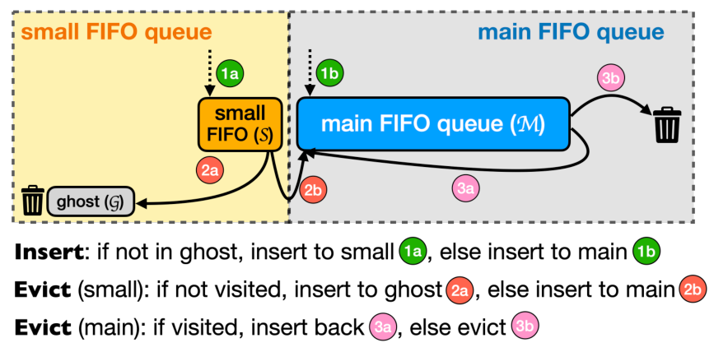
OPERATING SYSTEMS · PAPER PRESENTATION
S3-FIFO:
Cache Eviction
FIFO Queues Are All You Need
for Cache Eviction
Three members · 10 minutes
Original Figure 5 · S3-FIFO architecture
Source: Yang et al., SOSP 2023
SOSP 2023 · Juncheng Yang et al.
Yang et al., SOSP 2023 · Operating Systems · Theoretical Presentation
Slide 1
Notes:
Good morning, everyone. Today, our group will introduce a research paper called FIFO Queues Are All You Need for Cache Eviction. It was published at SOSP in 2023. The paper introduces a new cache eviction algorithm called S3-FIFO.

Slide 2
Opening
S3-FIFO · FIFO Queues Are All You Need
Team Structure & Timing
Three speakers follow the supplied script: background, algorithm, then evaluation.
Speaker
Time
Main responsibility
Member 1
3 min
Background, cache eviction, FIFO / LRU, one-hit wonders.
Member 2
4 min
Three FIFO queues, cache requests and eviction rules.
Member 3
3 min
Experimental setup, results, limitations and conclusion.
10-minute theoretical presentation · Results are reported by the original paper’s authors.
Yang et al., SOSP 2023 · Operating Systems · Theoretical Presentation
Slide 2

Slide 3
PART 1 · MEMBER 1
Background & Motivation
Why does a cache need a better eviction policy?
Background → FIFO vs LRU → One-hit Wonders
Yang et al., SOSP 2023 · Operating Systems · Theoretical Presentation
Slide 3

Slide 4
Part 1 · Background
S3-FIFO · FIFO Queues Are All You Need
What Is Cache Eviction?
Cache space is fast but limited; the system must decide what stays and what goes.
A cache is a small and fast storage space that keeps data we may need again.
When the cache is full, the system must decide which data to remove.
This process is called cache eviction.
CACHE: ALL SLOTS OCCUPIED
A
B
C
D
New object
Which object should leave?
Key question: what should stay in the cache, and what should go?
Source: Yang et al., SOSP 2023, §§1–2.
Yang et al., SOSP 2023 · Operating Systems · Theoretical Presentation
Slide 4
Notes:
First, what is a cache? A cache is a small and fast storage space that keeps data we may need again. For example, when a computer reads the same data many times, getting it from the cache is faster than getting it from slower storage.
However, cache space is limited. When the cache is full, the system must decide which data to remove. This process is called cache eviction.
In other words, the system needs a smart way to decide what should stay and what should go.

Slide 5
Part 1 · Traditional Algorithms
S3-FIFO · FIFO Queues Are All You Need
FIFO vs LRU
Both choose eviction candidates, but their update costs are different.
FIFO
LRU
First In, First Out
Least Recently Used
It removes the data that entered the cache first.
FIFO is simple and fast, but it may remove useful data.
It removes data that has not been used for the longest time.
LRU updates object order on access. This can slow the system down when many threads work together.
The goal: combine FIFO’s simplicity with better cache efficiency.
Source: Yang et al., SOSP 2023, §2.2.
Yang et al., SOSP 2023 · Operating Systems · Theoretical Presentation
Slide 5
Notes:
There are two common methods: FIFO and LRU.
FIFO means First In, First Out. It removes the data that entered the cache first. FIFO is simple and fast, but it may remove useful data.
LRU means Least Recently Used. It removes data that has not been used for the longest time. LRU can be more effective, but it needs to update the order of objects whenever they are accessed. This can slow down the system when many threads work at the same time.

Slide 6
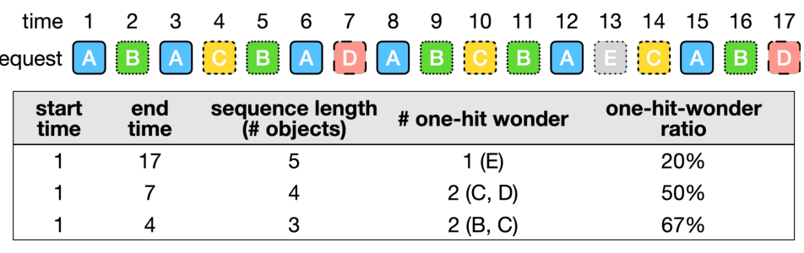
Part 1 · Research Motivation
S3-FIFO · FIFO Queues Are All You Need
One-Hit Wonders & Quick Demotion
Shorter access sequences contain a higher fraction of objects with no reuse.
Many objects are used only once before they leave the cache: one-hit wonders.
They take up cache space without being used again.
Quick demotion removes less useful objects early.
A SHORTER SEQUENCE → A HIGHER RATIO
Original Figure 1 · Source: Yang et al., SOSP 2023
Can we combine the simplicity of FIFO with better cache efficiency?
Source: original Figure 1 and §3, Yang et al., SOSP 2023.
Yang et al., SOSP 2023 · Operating Systems · Theoretical Presentation
Slide 6
Notes:
The researchers noticed another problem. Many objects are used only once before they leave the cache. The paper calls these objects one-hit wonders.
The researchers found that these objects are especially common in short access sequences. This means some data take up cache space without being used again.（讲diagram：Like this diagram, if the sequence length is long, the ratio of one hit wonders is quite low. But,as the sequence length decrease,the ratio of one hit wonders become much higher.）
So, the main idea is to remove less useful objects quickly and keep frequently used objects for longer. The researchers call this quick demotion.
This leads to an important question: Can we combine the simplicity of FIFO with better cache efficiency?
To answer this question, the researchers designed S3-FIFO.
Now, my teammate will explain how this algorithm works.

Slide 7
PART 2 · MEMBER 2
S3-FIFO Design & Algorithm
How do three simple FIFO queues work together?
Small / Main / Ghost → Requests → Eviction
Yang et al., SOSP 2023 · Operating Systems · Theoretical Presentation
Slide 7

Slide 8
Part 2 · Design Overview
S3-FIFO · FIFO Queues Are All You Need
Three FIFO Queues, One Cache
S3-FIFO uses Small, Main and Ghost queues instead of a single cache queue.
S
Small
Filter new objects
M
Main
Keep useful objects
G
Ghost
Remember removed IDs
Original Figure 5 · Source: Yang et al., SOSP 2023
The main idea: use three FIFO queues to filter, protect and remember.
Source: Figure 5 and §4.1, Yang et al., SOSP 2023.
Yang et al., SOSP 2023 · Operating Systems · Theoretical Presentation
Slide 8
Notes:
Thank you. Now, I will explain how S3-FIFO works.
The main idea of S3-FIFO is simple. Instead of using one cache queue, it uses three FIFO queues. These are the Small Queue, the Main Queue, and the Ghost Queue.

Slide 9
Part 2 · Queue Roles
S3-FIFO · FIFO Queues Are All You Need
Small, Main and Ghost
Small and Main store data; Ghost keeps only metadata for recently removed objects.
S · 10%
M · 90% of cache space
SMALL QUEUE
MAIN QUEUE
GHOST QUEUE
10%
90%
IDs only
New objects usually enter S first.
A testing area: objects with no reuse leave quickly.
M keeps objects that have shown they are useful.
Useful objects stay in cache for longer.
G remembers recently removed object IDs.
It stores no actual cached data.
Ghost entries are metadata; they are not part of the cached data payload.
Source: §4.1, Yang et al., SOSP 2023.
Yang et al., SOSP 2023 · Operating Systems · Theoretical Presentation
Slide 9
Notes:
First, the Small Queue, or S, uses about 10 percent of the cache space. New objects usually enter this queue first. We can think of it as a testing area. If an object is not used again, it can leave the cache quickly.
Second, the Main Queue, or M, uses the remaining 90 percent of the cache space. This queue mainly keeps objects that have shown they are useful.
Third, the Ghost Queue, or G, is a little different. It does not store the actual data. It only remembers the IDs of recently removed objects. This helps the system recognize objects that may be useful again.

Slide 10
Part 2 · Cache Requests
S3-FIFO · FIFO Queues Are All You Need
Cache Hit and Cache Miss
A hit updates a capped access counter; a miss uses Ghost history to choose a queue.
HIT: freq = min(freq + 1, 3)
Yes
Request
In S or M?
No
MISS: in G?
Yes
Insert into M
No
Insert into S
New object counter:
freq = 0
Unlike LRU, S3-FIFO does not reorder objects after every cache hit.
Source: Algorithm 1, lines 1–13, Yang et al., SOSP 2023. Simplified editable flowchart.
Yang et al., SOSP 2023 · Operating Systems · Theoretical Presentation
Slide 10
Notes:
Now, let's see what happens when the system receives a request.
If the requested object is already in the Small Queue or the Main Queue, this is called a cache hit. S3-FIFO increases a small access counter for that object. The maximum value of this counter is three.
Unlike LRU, S3-FIFO does not need to move an object to the front of the queue after every cache hit.
If the object is not in the cache, this is called a cache miss. If the object is not recorded in the Ghost Queue, it enters the Small Queue. But if the Ghost Queue remembers it, the object enters the Main Queue directly.

Slide 11
Part 2 · Cache Eviction
S3-FIFO · FIFO Queues Are All You Need
Eviction: Filter or Give Another Chance
When space is needed, S filters low-reuse objects while M protects accessed objects.
SMALL QUEUE / S
MAIN QUEUE / M
Oldest object: freq > 1?
Oldest object: freq > 0?
Yes
No
Yes
No
Move to M
Remove data;
ID → G
Reinsert into M;
freq decreases by 1
Evict object
Objects with enough reuse enter Main.
An accessed object gets another chance.
Quick demotion + selective reinsertion → fewer queue-order updates on cache hits.
Source: Algorithm 1, lines 14–40, Yang et al., SOSP 2023. Simplified editable flowcharts.
Yang et al., SOSP 2023 · Operating Systems · Theoretical Presentation
Slide 11
Notes:
Next, what happens when the cache becomes full?
S3-FIFO first checks the Small Queue. If an object has been accessed enough times, it can move to the Main Queue. Otherwise, it leaves the cache, and its ID is recorded in the Ghost Queue.
The Main Queue works differently. When an object reaches the end of this queue, the system checks its access counter. If the counter is greater than zero, the object gets another chance and returns to the front of the queue. Its counter decreases by one. If the counter is zero, the object is removed.
In this way, the three queues work together. The Small Queue filters new objects, the Main Queue protects useful objects, and the Ghost Queue remembers recently removed objects.
The key advantage is that S3-FIFO can remove less useful data quickly without updating the queue order after every cache hit.
Now, let's look at the experimental results and see how well this design works.

Slide 12
PART 3 · MEMBER 3
Evaluation & Conclusion
What do the paper’s experiments show?
Experimental setup → Efficiency → Scalability
Yang et al., SOSP 2023 · Operating Systems · Theoretical Presentation
Slide 12

Slide 13
Part 3 · Evaluation
S3-FIFO · FIFO Queues Are All You Need
Experimental Setup
The researchers compared S3-FIFO with FIFO, LRU and other cache replacement methods.
6,594
14
real cache traces
datasets / data groups
The data covered storage blocks, key-value data and web content.
The two key measures are miss ratio and throughput.
All experimental results are reported by the original paper’s authors.
Source: Table 1 and §5.1, Yang et al., SOSP 2023. This is a theoretical presentation, not a replication.
Yang et al., SOSP 2023 · Operating Systems · Theoretical Presentation
Slide 13
Notes:
Thank you. Next, I’ll go over the test results and key findings of this paper.
The research team tested S3-FIFO using 6,594 real cache records from 14 data
groups. These covered different types of data, such as storage blocks, key-value data,
and web content.
They compared S3-FIFO with FIFO, LRU, and several other cache replacement
methods.

Slide 14
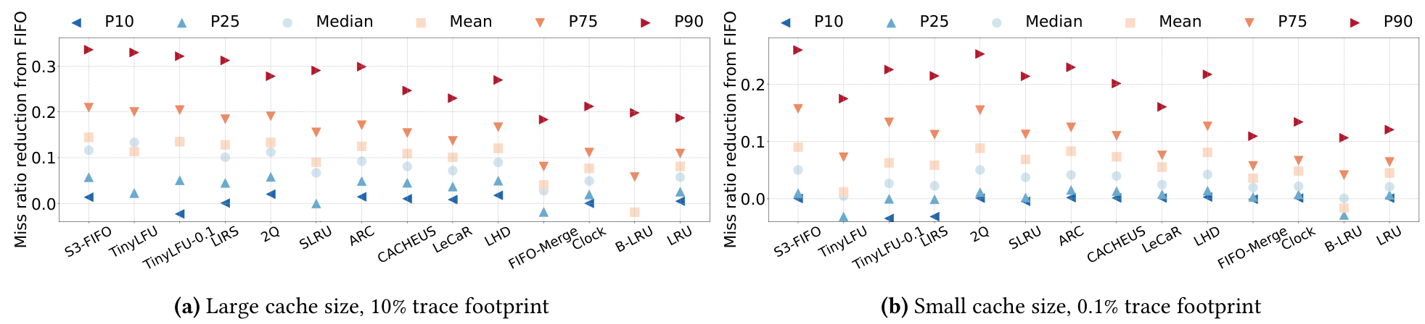
Part 3 · Results
S3-FIFO · FIFO Queues Are All You Need
Result 1: Cache Efficiency
A lower miss ratio means more requests can be answered directly from the cache.
Original Figure 6 · Miss-ratio reduction relative to FIFO: a larger reduction is better.
10 / 14
Lowest average miss ratio in 10 of 14 datasets
with a relatively large cache.
S3-FIFO performs well across many workloads.
Source: Figure 6 and §5.2, Yang et al., SOSP 2023. The 10/14 dataset result is reported in §5.2 / Figure 7.
Yang et al., SOSP 2023 · Operating Systems · Theoretical Presentation
Slide 14
Notes:
First, let’s look at the miss ratio.
A cache miss means the requested data is not stored in the cache. A lower miss ratio
is better, because more requests can be answered directly from the cache.
Figure 6 in the paper compares the miss ratio performance of different methods. The
results show that S3-FIFO works well across many workloads. With a fairly large
cache, S3-FIFO had the lowest average miss ratio in 10 out of 14 data groups.

Slide 15
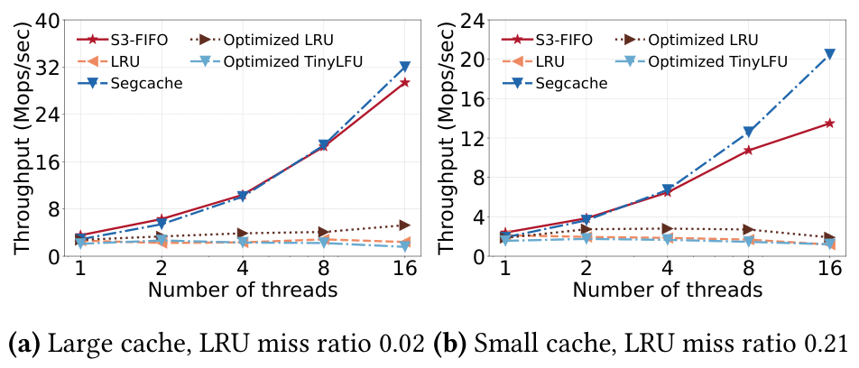
Part 3 · Results
S3-FIFO · FIFO Queues Are All You Need
Result 2: Throughput & Scalability
Throughput means how many requests a system can handle in one second.
>6×
Compared with optimized LRU at 16 threads.
S3-FIFO scales as the number of threads grows.
Original Figure 8 · Synthetic Zipf workload (α = 1.0)
Fewer operations on cache hits support better performance under concurrency.
Source: original Figure 8 and §5.3, Yang et al., SOSP 2023. Reported authors’ experiments.
Yang et al., SOSP 2023 · Operating Systems · Theoretical Presentation
Slide 15
Notes:
The second key point is throughput. Throughput is how many requests a system can
handle in one second.
Figure 8 shows how each method performs as the number of threads grows.
In the team’s tests, S3-FIFO reached over six times the throughput of a tuned LRU
version with 16 threads. This means S3-FIFO works better when lots of requests are
processed at the same time.

Slide 16
Part 3 · Limitations
S3-FIFO · FIFO Queues Are All You Need
A Limitation: The Second Request May Arrive Late
Performance still depends on how users access the data.
Sometimes an object is removed from the Small Queue before its second request arrives.
This can cause an extra cache miss.
Object enters S
Removed from S
Second request → cache miss
Quick demotion is useful, but a late reuse can still cause an additional miss.
Source: §5.2, Yang et al., SOSP 2023.
Yang et al., SOSP 2023 · Operating Systems · Theoretical Presentation
Slide 16
Notes:
However, S3-FIFO also has downsides. Sometimes a data entry is removed from the
Small Queue before its second request comes in. This can cause an extra cache miss.
So its performance still depends on how users access the data.

Slide 17
Final Takeaway
A simple cache algorithm can still
deliver strong performance.
Three FIFO queues remove less useful data quickly
while keeping useful data for longer.
Lower miss ratios · Better scalability
Thank you for listening.
Yang et al., SOSP 2023 · Operating Systems · Theoretical Presentation
Slide 17
Notes:
To sum up, this paper shows that a simple cache algorithm can still deliver strong
performance.
By using three FIFO queues, S3-FIFO quickly removes less useful data while keeping
useful data for longer. Its main advantages are lower miss ratios and better
scalability.
Thank you for listening.

Slide 18
References
S3-FIFO · FIFO Queues Are All You Need
References
Primary paper, original figures, and the official code and data.
PRIMARY PAPER
Yang, J., Zhang, Y., Qiu, Z., Yue, Y., & Rashmi, K. V. (2023).
FIFO Queues Are All You Need for Cache Eviction. SOSP ’23.
DOI
https://doi.org/10.1145/3600006.3613147
OFFICIAL CODE & DATA
https://github.com/TheSys-lab/sosp23-s3fifo
Figures 1, 5, 6 and 8: Yang et al., SOSP 2023. Mechanism diagrams redrawn from Algorithm 1.
Yang et al., SOSP 2023 · Operating Systems · Theoretical Presentation
Slide 18

