Slide 1
THEORETICAL PRESENTATION
MEMBER 1 · 20 SEC
S3-FIFO
FIFO Queues Are All You Need
for Cache Eviction
A simple and efficient cache eviction algorithm
Juncheng Yang et al. · SOSP 2023
Operating Systems · 10-minute group presentation
01 BACKGROUND
02 ALGORITHM
03 EVALUATION
Member 1 · 3 minutes
Member 2 · 4 minutes
Member 3 · 3 minutes
Presenters: Member 1 / Member 2 / Member 3
OPERATING SYSTEMS / S3-FIFO / SOSP 2023
01 / 13
Notes:
Good morning, everyone. Today, our group will introduce a research paper called FIFO Queues Are All You Need for Cache Eviction. It was published at SOSP in 2023. The paper introduces a new cache eviction algorithm called S3-FIFO.

Slide 2
01 / BACKGROUND & MOTIVATION
MEMBER 1 · 40 SEC
What Is Cache Eviction?
Fast access
CACHE: ALL SLOTS OCCUPIED
A cache keeps data for reuse.
Limited space
A
B
C
D
A full cache needs room for new data.
New object
Eviction
Which cached object should leave?
Choose an object to remove.
Cache eviction = choosing what to remove when space is needed.
Source: Yang et al., SOSP 2023, §§1–2 (PDF pp. 1–2).
OPERATING SYSTEMS / S3-FIFO / SOSP 2023
02 / 13
Notes:
First, what is a cache? A cache is a small and fast storage space that keeps data we may need again. For example, when a computer reads the same data many times, getting it from the cache is faster than getting it from slower storage.
However, cache space is limited. When the cache is full, the system must decide which data to remove. This process is called cache eviction.

Slide 3
01 / BACKGROUND & MOTIVATION
MEMBER 1 · 60 SEC
Traditional Algorithms: FIFO vs LRU
FIFO
LRU
First In, First Out
Least Recently Used
• Evict the earliest inserted object
• Evict the least recently accessed object
• Simple and fast
• Update object order on cache hits
• May remove useful data
• Updates add concurrency overhead
The challenge: keep FIFO’s simplicity while improving cache efficiency.
Source: Yang et al., SOSP 2023, §2.2 (PDF p. 3).
OPERATING SYSTEMS / S3-FIFO / SOSP 2023
03 / 13
Notes:
There are two common methods: FIFO and LRU.
FIFO means First In, First Out. It removes the data that entered the cache first. FIFO is simple and fast, but it may remove useful data.
LRU means Least Recently Used. It removes data that has not been used for the longest time. LRU can be more effective, but it needs to update the order of objects whenever they are accessed. This can slow down the system when many threads work at the same time.

Slide 4
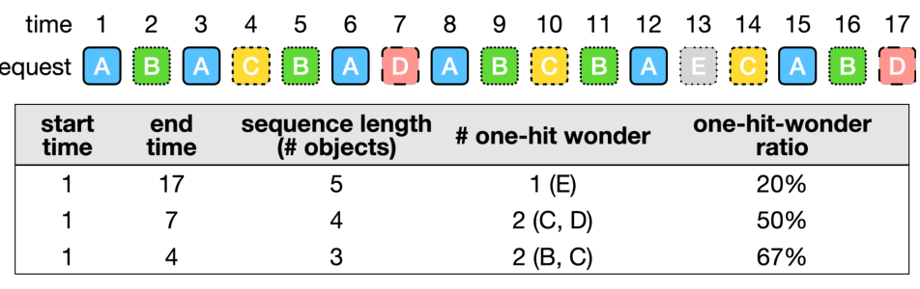
01 / BACKGROUND & MOTIVATION
MEMBER 1 · 60 SEC
Research Motivation: One-Hit Wonders
One-hit wonders
SHORTER WINDOW → MORE ONE-HIT WONDERS
Objects used only once before eviction.
Wasted cache space
No reuse benefit within the short window.
Quick demotion
Remove less useful objects early.
Original Figure 1 · Yang et al., SOSP 2023
Can simple FIFO queues also deliver high cache efficiency?
Source: original Figure 1 and §3, Yang et al., SOSP 2023 (PDF pp. 3–5).
OPERATING SYSTEMS / S3-FIFO / SOSP 2023
04 / 13
Notes:
The researchers noticed another problem. Many objects are used only once before they leave the cache. The paper calls these objects one-hit wonders.
The researchers found that these objects are especially common in short access sequences. This means some data take up cache space without being used again.
So, the main idea is to remove less useful objects quickly and keep frequently used objects for longer. The researchers call this quick demotion.
This leads to an important question: Can we combine the simplicity of FIFO with better cache efficiency?
To answer this question, the researchers designed S3-FIFO.
Now, my teammate will explain how this algorithm works.

Slide 5
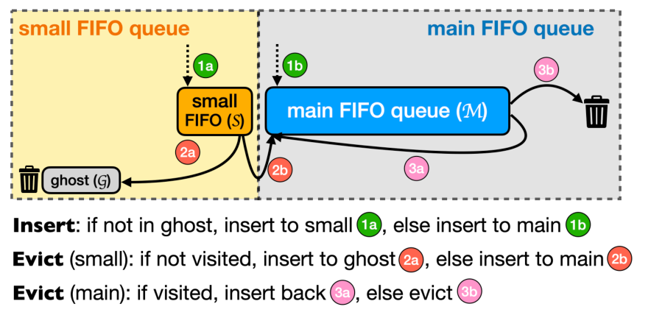
02 / DESIGN & ALGORITHM
MEMBER 2 · 50 SEC
Overview of S3-FIFO
S
Small
Filter newly inserted objects.
M
Main
Retain objects with reuse.
G
Ghost
Remember IDs, not cached data.
Original Figure 5 · Yang et al., SOSP 2023
Three FIFO queues work together: filter, protect, remember.
Source: original Figure 5 and §4.1, Yang et al., SOSP 2023 (PDF p. 5).
OPERATING SYSTEMS / S3-FIFO / SOSP 2023
05 / 13
Notes:
Thank you. Now, I will explain how S3-FIFO works.
The main idea of S3-FIFO is simple. Instead of using one cache queue, it uses three FIFO queues. These are the Small Queue, the Main Queue, and the Ghost Queue.

Slide 6
02 / DESIGN & ALGORITHM
MEMBER 2 · 55 SEC
Three Queues and Their Roles
Cached data: Small + Main = 100% of cache capacity
S · 10%
M · 90%
SMALL / S
MAIN / M
GHOST / G
10%
90%
IDs only
New-object testing area
Filters low-reuse objects
Objects with demonstrated reuse
Retains useful cached data
Recently evicted object IDs
No cached payload
Ghost entries are metadata; they do not hold the actual cached data.
Source: §4.1 and Figure 5, Yang et al., SOSP 2023 (PDF p. 5).
OPERATING SYSTEMS / S3-FIFO / SOSP 2023
06 / 13
Notes:
First, the Small Queue, or S, uses about 10 percent of the cache space. New objects usually enter this queue first. We can think of it as a testing area. If an object is not used again, it can leave the cache quickly.
Second, the Main Queue, or M, uses the remaining 90 percent of the cache space. This queue mainly keeps objects that have shown they are useful.
Third, the Ghost Queue, or G, is a little different. It does not store the actual data. It only remembers the IDs of recently removed objects. This helps the system recognize objects that may be useful again.

Slide 7
02 / DESIGN & ALGORITHM
MEMBER 2 · 60 SEC
Cache Hit and Cache Miss
HIT: freq = min(freq + 1, 3)
Yes
Request
In S or M?
No
MISS: in G?
Yes
Insert into M
No
On insertion:
freq = 0
Insert into S
On a cache hit: update the counter; keep the queue order unchanged.
Source: Algorithm 1, lines 1–13, Yang et al., SOSP 2023 (PDF p. 6). Simplified flowchart.
OPERATING SYSTEMS / S3-FIFO / SOSP 2023
07 / 13
Notes:
Now, let's see what happens when the system receives a request.
If the requested object is already in the Small Queue or the Main Queue, this is called a cache hit. S3-FIFO increases a small access counter for that object. The maximum value of this counter is three.
Unlike LRU, S3-FIFO does not need to move an object to the front of the queue after every cache hit.
If the object is not in the cache, this is called a cache miss. If the object is not recorded in the Ghost Queue, it enters the Small Queue. But if the Ghost Queue remembers it, the object enters the Main Queue directly.

Slide 8
02 / DESIGN & ALGORITHM
MEMBER 2 · 75 SEC
Eviction Process
When space is needed: evict from S if S ≥ 10% of capacity; otherwise evict from M.
SMALL QUEUE / S
MAIN QUEUE / M
Oldest object: freq > 1?
Oldest object: freq > 0?
Yes
No
Yes
No
Move to M
Remove data; ID → G
Reinsert; freq − 1
Evict object
Quick demotion in S + second chances in M; fewer queue updates on hits.
Source: Algorithm 1, lines 14–40, Yang et al., SOSP 2023 (PDF p. 6). Simplified flowcharts.
OPERATING SYSTEMS / S3-FIFO / SOSP 2023
08 / 13
Notes:
Next, what happens when the cache becomes full?
S3-FIFO first checks the Small Queue. If an object has been accessed enough times, it can move to the Main Queue. Otherwise, it leaves the cache, and its ID is recorded in the Ghost Queue.
The Main Queue works differently. When an object reaches the end of this queue, the system checks its access counter. If the counter is greater than zero, the object gets another chance and returns to the front of the queue. Its counter decreases by one. If the counter is zero, the object is removed.
In this way, the three queues work together. The Small Queue filters new objects, the Main Queue protects useful objects, and the Ghost Queue remembers recently removed objects.
The key advantage is that S3-FIFO can remove less useful data quickly without updating the queue order after every cache hit.
Now, let's look at the experimental results and see how well this design works.

Slide 9
03 / EVALUATION & CONCLUSION
MEMBER 3 · 40 SEC
Experimental Setup
6,594
14
3
REAL-WORLD CACHE TRACES
DATASETS
WORKLOAD CATEGORIES
Block
6 datasets
MSR, FIU, CloudPhysics, Systor, Tencent, Alibaba
Key-value
3 datasets
Twitter, Social Network, Meta KV
Object / CDN
5 datasets
CDN 1, CDN 2, Tencent Photo, Wikimedia, Meta CDN
Baselines: FIFO, LRU and other policies · Metrics: Miss Ratio & Throughput
Reported experiments by the paper’s authors; not reproduced by our group.
Source: Table 1 (category summary) and §5.1, Yang et al., SOSP 2023 (PDF p. 7).
OPERATING SYSTEMS / S3-FIFO / SOSP 2023
09 / 13
Notes:
Thank you. Now, I will introduce the experimental results and the main conclusions of this paper.
The researchers tested S3-FIFO using 6,594 real cache traces from 14 datasets. These included different types of data, such as storage blocks, key-value data, and web content.
They compared S3-FIFO with FIFO, LRU, and several other cache eviction algorithms.

Slide 10
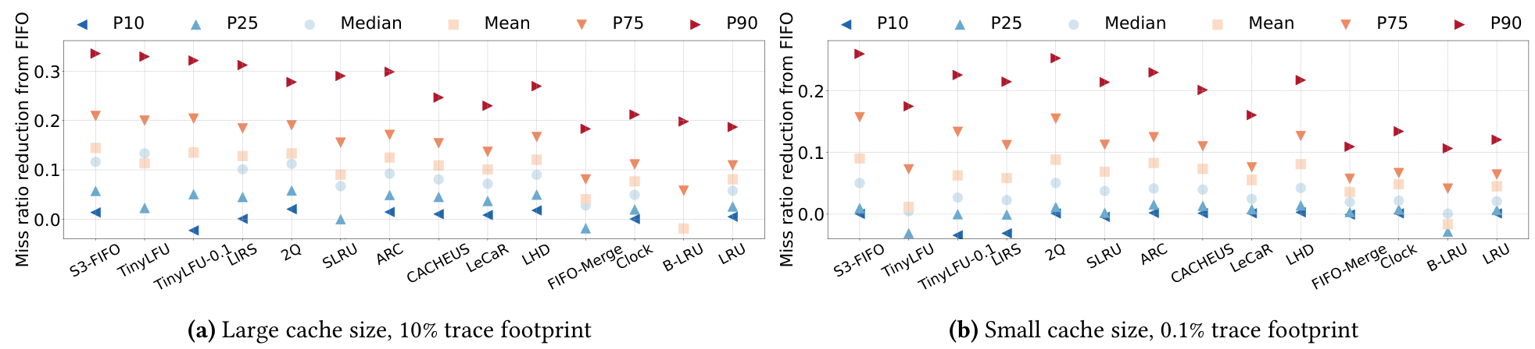
03 / EVALUATION & CONCLUSION
MEMBER 3 · 50 SEC
Results: Cache Efficiency
Miss Ratio: lower is better. Figure 6 shows reduction relative to FIFO: higher is better.
Original Figure 6 · All axes, algorithm labels and percentile legends retained.
10 / 14
Lowest mean miss ratio in 10 of 14 datasets
Larger cache setting · Robust efficiency across many workloads
Source: Figure 6; §§5.1–5.2 (PDF pp. 8–9). Dataset-level 10/14 result: Figure 7 and §5.2. Authors’ results.
OPERATING SYSTEMS / S3-FIFO / SOSP 2023
10 / 13
Notes:
The first important measure is the miss ratio.
A cache miss happens when the requested data is not in the cache. A lower miss ratio is better because more requests can be served directly from the cache.
Figure 6 in the paper compares the miss ratio performance of different algorithms. The results show that S3-FIFO performs well across many workloads. With a relatively large cache, S3-FIFO achieved the lowest average miss ratio on 10 out of 14 datasets.

Slide 11
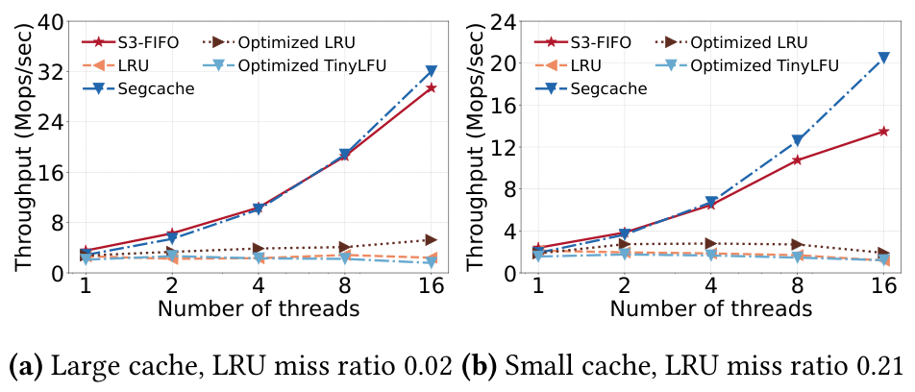
03 / EVALUATION & CONCLUSION
MEMBER 3 · 50 SEC
Results: Throughput & Scalability
THROUGHPUT
Requests handled
per second
>6×
vs optimized LRU
at 16 threads
Original Figure 8 · Synthetic Zipf workload (α = 1.0)
Fewer queue updates on cache hits support higher throughput and scalability.
Source: original Figure 8 and §5.3, Yang et al., SOSP 2023 (PDF p. 10). Authors’ results.
OPERATING SYSTEMS / S3-FIFO / SOSP 2023
11 / 13
Notes:
The second important measure is throughput. Throughput means how many requests a system can handle in one second.
Figure 8 shows the performance of different algorithms as the number of threads increases.
In the researchers' experiments, S3-FIFO achieved more than six times the throughput of an optimized LRU implementation with 16 threads. This suggests that S3-FIFO can work better when many requests are processed at the same time.

Slide 12
03 / EVALUATION & CONCLUSION
MEMBER 3 · 40 SEC
Limitations & Conclusion
LIMITATION: ACCESS PATTERNS STILL MATTER
An object may leave S before its second request → an extra cache miss.
S
Filter
M
Protect
G
Remember
Quick demotion
Retain useful data
IDs without payload
Three simple FIFO queues → low miss ratios + better scalability.
Source: §§5.2 and 8, Yang et al., SOSP 2023 (PDF pp. 9, 14).
OPERATING SYSTEMS / S3-FIFO / SOSP 2023
12 / 13
Notes:
However, S3-FIFO also has limitations. Sometimes, an object is removed from the Small Queue before its second request arrives. This can cause an extra cache miss. Therefore, its performance still depends on the access pattern.
To conclude, this paper shows that a simple cache algorithm can still achieve strong performance.
By using three FIFO queues, S3-FIFO removes less useful data quickly while keeping useful data for longer. Its main advantages are lower miss ratios and better scalability.
Thank you for listening.

Slide 13
REFERENCES
References
PRIMARY PAPER
Yang, J., Zhang, Y., Qiu, Z., Yue, Y., & Rashmi, K. V. (2023).
FIFO Queues Are All You Need for Cache Eviction. SOSP ’23.
DOI
https://doi.org/10.1145/3600006.3613147
OFFICIAL CODE & DATA
https://github.com/TheSys-lab/sosp23-s3fifo
Figures 1, 5, 6 and 8 reproduced from the provided paper. Mechanism diagrams redrawn from Algorithm 1.
OPERATING SYSTEMS / S3-FIFO / SOSP 2023
13 / 13

