Slide 1

Basics of Python

Slide 2
Brief History of Python
Created by Guido van Rossum in 1990
Specifically designed as an easy to use language
High focused on readability
Interpreted and cross platform

Slide 3
Why Choose Python?
Designed for clear, logical code that is easy to read and learn
Lots of existing libraries and frameworks written in Python
Focuses on optimizing developer time
Great documentation online
docs.python.org/3

Slide 4
What can you do with Python?
Automate simple task
Searching for files, read and modify them
Scraping information from websites
Reading and editing excel files
Work with PDFs
Automate emails and text messages
Connect to database systems

Slide 5
What can you do with Python?
Data Science and Machine Learning
Analyze large data files (numbpy, pandas)
Create visualizations (seaborn, plotly)
Perform machine learning tasks (sci-kit-learn, tensorflow)
Create and run predictive algorithms

Slide 6
What can you do with Python?
Create websites
Use web frameworks such as Django and Flask to handle backend of a website and user data
Create interactive dashboards for users such as plotly and dash

Slide 7
What can you do with Python?
Software development
Building desktop applications, automation scripts, and support tools for software development.

Slide 8
Python
Create websites
Use web frameworks such as Django and Flask to handle backend of a website and user data
Create interactive dashboards for users such as plotly and dash

Slide 9
Installing Python
Tools
Python 3 python.org/downloads
IDE (VS Code)
VS Code Python Extension

Slide 10
Create Virtual Environment
Create a virtual environment
Open the Command Palette (Ctrl+Shift+P) or From the View menu, click Command Pallete
Start typing the Python: Create Environment command to search, and then select the command.

Slide 11
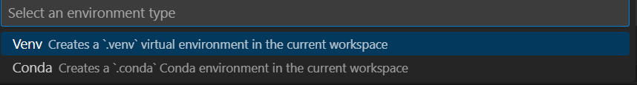
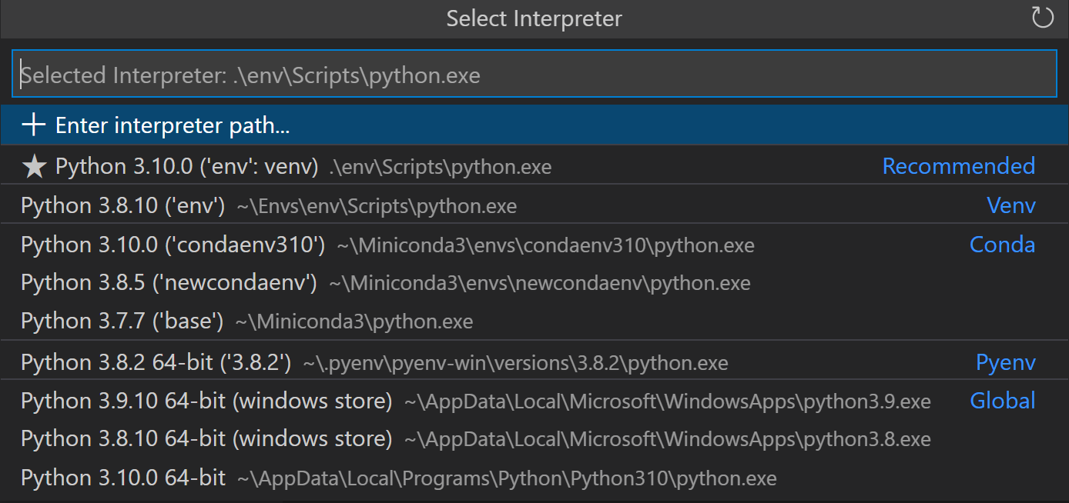
Create Virtual Environment
Create a virtual environment
Select .venv
Select the Python interpreter you installed

Slide 12
Configure and Run the Debugger
View>Extensions (Ctrl+Shift+X)
Search for the installed Python debugger extension or if not install the extension by typing Python debugger on the search bar

Slide 13
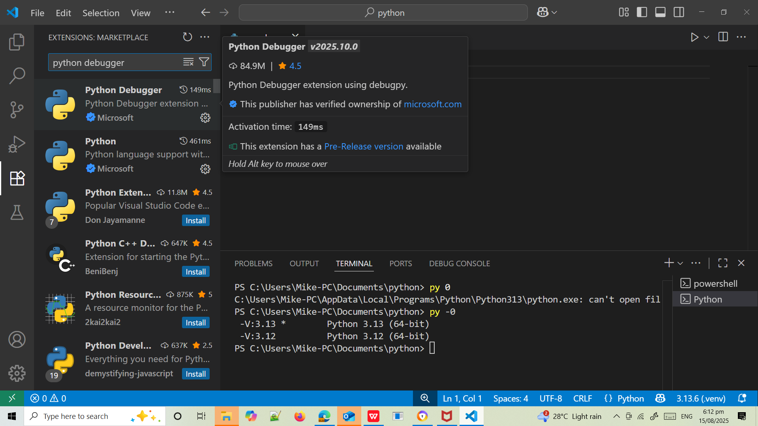
Configure and Run the Debugger

Slide 14
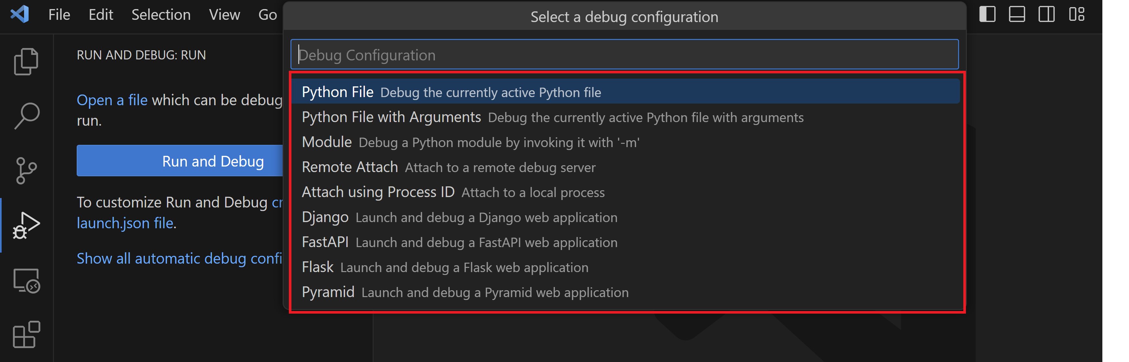
Configure and Run the Debugger
Since this is your first time debugging this file, a configuration menu will open from the Command Palette allowing you to select the type of debug configuration you would like for the opened file.

Slide 15
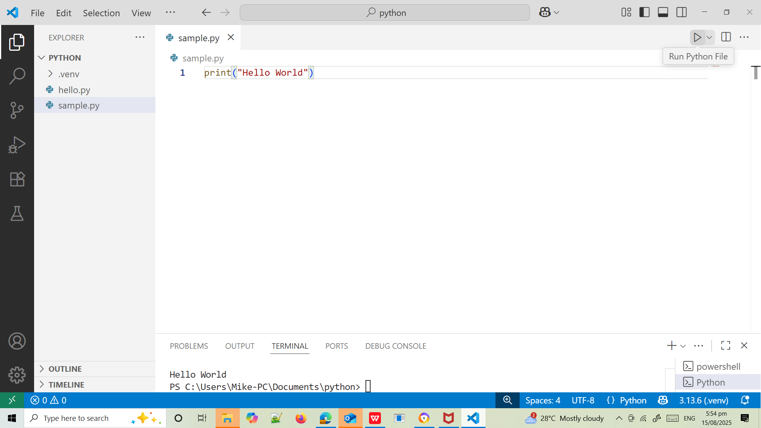
Create Python source file

Slide 16
Syntax
Python uses new lines to complete a command
Python relies on indentation, using whitespace, to define scope; such as the scope of loops, functions and classes
print("Hello, World!")

Slide 17
Creating a Comment
#This is a comment
print("Hello, World!")
#This is a comment
#written in
#more than just one line
print("Hello, World!")

Slide 18
Variables
Rules for Python variables
Must start with a letter or the underscore character
Names cannot start with a number
It can only contain alpha-numeric characters and underscores (A-z, 0-9, and _ )
There can be no spaces in the name, use _ instead
Names are case-sensitive
Names cannot be a Python reserved word

Slide 19
User Input
Syntax
msg=input("Enter your name: ")
print(f"Your name is: {msg}")
print("Enter your name:")
msg=input()
print(f"Your name is: {msg} ")

Slide 20
Assigning Values
Multiple Values to Multiple Variables
x, y, z = "Mike", "Esteron", "Acosta"
print(x)
print(y)
print(z)
One Value to Many Variables
x = y = z = "Mike"
print(x)
print(y)
print(z)
Unpacking a Collection
color = ["blue", "red", "yellow"]
x, y, z = color
print(x)
print(y)
print(z)

Slide 21
Variables
x = "I love Python"
print(x)
x = "Python "
y = "is "
z = "awesome "
print(x, y, z)
x = 5
y = 10
print(x + y)
x = "Python "
y = "is "
z = "awesome"
print(x + y + z)

Slide 22
Data Types
Name | Type | Description
integers | int | whole numbers: 3 200 300
floating point | float | numbers with decimal point: 2.3 4.6 100.0
complex | complex | represents complex numbers, which have both a real and an imaginary part, j represents the imaginary unit (the square root of -1).: 3 + 2j
string | str | Ordered sequence of characters: “hello” ‘Sammy’ “2000”
boolean | bool | logical value indicating True or False
lists | list | ordered sequence of objects: [10, “hello”, 200.3]
tuples | tup | ordered immutable sequence of objects: (10, “hello”, 200.3)
dictionary | dict | Unordered key:value pairs: {“mykey”: “value”, “name”: “frankie”}
sets | set | Unordered collection of unique objects: {“a”, “b”}

Slide 23
Strings
They are sequences of characters by either single quotation marks, or double quotation marks.
‘hello’
“Hello”
“100.50”

Slide 24
Strings
Because strings are ordered sequence, we can slice and index to grab subsections of the string
Indexing notation uses [ ] symbol

Slide 25
Strings
Because strings are ordered sequence, we can slice and index to grab subsections of the string
Indexing notation uses [ ] symbol
Character : h e l l o
Index : 0 1 2 3 4
Reversed : 0 -4 -3 -2 -1

Slide 26
Looping through Strings, len(), in() not in()
for x in "banana":
print(x)
a = "Hello, World!"
print(len(a))
txt = "The best things in life are free!"
print("free" in txt)
txt = "The best things in life are free!"
print("expensive" not in txt)

Slide 27
Slicing Strings
Slicing allows you to grab a sub-section of mutiple characters, a “slice”of the string
Syntax
[start:stop:step]
start is the numerical index for the slice start
stop is the index you will go up to (but dont include)
step is the size of the “jump” you take

Slide 28
Slicing Strings
b = "Hello, World!"
print(b[2:5])
myString="abcdefghijk
"
print(myString[2:7:2])
print(myString[::3])
print(myString[::-1])
b = "Hello, World!"
print(b[:5])
b = "Hello, World!"
print(b[-5:-2])

Slide 29
Modify Strings
String Function | Example
upper() | a = "Hello, World!" print(a.upper())
lower() | a = "Hello, World!" print(a.lower())
strip() | a = " Hello, World! " print(a.strip()) # returns "Hello, World!"
replace() | a = "Hello, World!" print(a.replace("H", "J"))
split() | a = "Hello, World!" print(a.split(",")) # returns ['Hello', ' World!']

Slide 30
Concatenation
a = "Hello"
b = "World"
c = a + " " + b
print(c)
Notes:
a = "Hello"
b = "World"
c = a + b
print(c)

Slide 31
f Strings
Syntax:
f"some text {placeholder}"
age = 36
txt = f"My name is John, I am {age}"
print(txt)
price = 59000
txt = f"The price is {price:,} dollars"
print(txt)
A placeholder can include a modifier to format the value.
price = 59
txt = f"The price is {price:.2f} dollars"
print(txt)

Slide 32
Escape sequence
Code | Result
\’ | Single quote
\\ | Backslash
\n | New line
\r | Carriage return
\t | Tab
ERROR
txt = "We are the so-called "Vikings" from the north."

Slide 33
Arithmetic Operators
Operator | Name | Example x=5; y=3 | Result
+ | Addition | x+y | 8
- | Subtraction | x-y | 2
* | Multiplication | x*y | 15
/ | Division | x/y | 1.666...7
% | Modulo | x%y | 2
** | Exponentiation | x**y | 125
// | Floor division | x//y | 1

Slide 34
Comparison Operators
Operator | Name | Example x=5; y=3
== | equal | x==y
!= | not equal | x!=y
> | greater than | x>y
< | less than | x<y
>= | greater than or equal | x>=y
<= | less than or equal | x<=y

Slide 35
Assignment Operators
Operator | Sames as … | Description
x = y | x = y | The left operand gets set to the value of the expression on the right
x += y | x = x + y | Addition
x -= y | x = x - y | Subtraction
x *= y | x = x * y | Multiplication
x /= y | x = x / y | Division
x %= y | x = x % y | Modulus

Slide 36
Logical Operators
Operator | Description | Example
not | Reverse the result, returns False if the result is true | not(x < 5 and x < 10)
and | Returns True if both statements are true | x < 5 and x < 10
or | Returns True if one of the statements is true | x < 5 or x < 4

Slide 37
Identity Operators
Used to compare objects if they are actually the same object with the same memory location
Operator | Description | Example
is | Returns True if both variables are the same object | x is y
is not | Returns True if both variables are not the same object | x is not y

Slide 38
Identity Operators
x = ["apple", "banana"]
y = ["apple", "banana"]
z = x
print(x is z)
# returns True because z is the same object as x
print(x is y)
# returns False because x is not the same object as y, even if they have the same content

Slide 39
Membership Operators
Used to test if a sequence is presented in an object:
Operator | Description | Example
in | Returns True if a sequence with the specified value is present in the object | x in y | x = ["apple", "banana"] print("banana" in x)
not in | Returns True if a sequence with the specified value is not present in the object | x not in y | x = ["apple", "banana"] print("pineapple" not in x)

Slide 40
Conditional Statements
if statement - executes some code only if a specified condition is true
if...else statement - executes some code if a condition is true and another code if the condition is false
if...elif....else statement - specifies a new condition to test, if the first condition is false
match statement - selects one of many blocks of code to be executed

Slide 41
if Statements
Syntax
if expression:
statementN
day1=100
day2=7
if (day1 - day2) < 100:
print(f"Its {day1-day2} days left before Christmas ")

Slide 42
if else Statements
Syntax
if condition:
statmentN
else:
statementN
mood="Sad"
if mood="Happy":
print("Yehey! Masaya ako nasa mood ako")
else:
print("Di masaya kaya malungkot")

Slide 43
if elif Statements
Syntax
if expression:
statementN
elif expression:
statementN
else:
statementN
score = 85
if score >= 90:
print("Grade A")
elif score >= 80:
print("Grade B")
elif score >= 70:
print("Grade C")
else:
print("Grade D")

Slide 44
match Statements
Syntax
match expression:
case x:
statmentN
case y:
statementN
case z:
statementN
case _:
day = 4
match day:
case 6:
print("Today is Saturday")
case 7:
print("Today is Sunday")
case _:
print("Looking forward to the Weekend")

Slide 45
while loop
Syntax
while expression:
statementN
i = 1
while i < 6:
print(i)
i += 1

Slide 46
break statement
i = 1
while i < 6:
print(i)
if i == 3:
break
i += 1

Slide 47
continue statement
i = 0
while i < 6:
i += 1
if i == 3:
continue
print(i)

Slide 48
range()
loop through a set of code a specified number of times
returns a sequence of numbers, starting from 0 by default, and increments by 1 (by default), and ends at a specified number.
for x in range(6):
print(x)
for x in range(2, 6):
print(x)

Slide 49
range()
The range() function defaults to increment the sequence by 1, however it is possible to specify the increment value by adding a third parameter
for x in range(2, 30, 3):
print(x)

Slide 50
range(): Exercises
Write a Python program using the following patterns:
1 2 3 4 5
6 7 8 9 10
*
* *
* * *
* * * *
* * * * *
* 0 * 0 *
* 0 * 0 *
* 0 * 0 *

Slide 51
for loop
Syntax
for var in object:
statementN
fruits = ["apple", "banana", "cherry"]
for x in fruits:
print(x)

Slide 52
nested loop
for x in range(1,5):
for y in range(6,10):
print(f"{x}{y} ", end="")
print("")

Slide 53
Python Data Structures

Slide 54
List [ ]
Ordered sequences that can hold a variety of object types.
It uses [ ] brackets and commas to separate objects in the list.
Lists can be nested

Slide 55
List [ ]
List Operations
Index
Slicing
Adding Items
Changing Items
Deleting Items
Loop Lists

Slide 56
List Indexing
mylist=["honda", "toyota", "nissan", "mitsubishi"]
print(mylist[2])
print(mylist[-1])
print(mylist[1:3])
print(mylist[-3:-1])
print(mylist[:3:2])
print(mylist[::2])
print(mylist[::-1])

Slide 57
Insert Items
mylist=["honda", "toyota", "nissan", "mitsubishi"]
print(mylist.append("hyundai"))
print(mylist.insert(1,"byd"))

Slide 58
Changing Items
mylist=["honda", "toyota", "nissan", "mitsubishi"]
mylist[3]="byd"

Slide 59
Deleting Items
mylist=["honda", "toyota", "nissan", "mitsubishi"]
print(mylist.remove("nissan"))
print(mylist.pop(1))
print(mylist.pop())

Slide 60
Sort Items
mylist=["honda", "toyota", "nissan", "mitsubishi"]
print(mylist.sort())

Slide 61
Looping Items
mylist=["honda", "toyota", "nissan", "mitsubishi"]
for x in mylist:
print(x)
nested_list = [[1, 2, 3], [4, 5, 6], [7, 8, 9]]
for sublist in nested_list:
for item in sublist:
print(item, end=" ")
print("")
for x in range(len(mylist)):
print(mylist[x])

Slide 62
Nested Loop Items
nested_list = [[1, 2, 3], [4, 5, 6], [7, 8, 9]]
for sublist in nested_list:
for item in sublist:
print(item, end=" ")
print("")

Slide 63
Tuples ( )
They are very similar to lists, however, tuples are IMMUTABLE.

Slide 64
Accesing Tuples
mytuple=("honda", "toyota", "nissan", "mitsubishi")
print(mytuple[2])
print(mytuple[-1])
print(mytuple[1:3])
print(mytuple[-3:-1])
print(mytuple[1:])
print(mytuple[:3:2])
print(mytuple[::2])
print(mytuple[::-1])

Slide 65
Insert, Changing, Deleting Tuple Values
#adding values
mytuple=("honda", "toyota", "nissan", "mitsubishi")
mytuple2=list(mytuple)
mytuple2.append("byd")
mytuple=tuple(mytuple2)
print(mytuple)
#changing values
mytuple=("honda", "toyota", "nissan", "mitsubishi")
mytuple2=list(mytuple)
mytuple2[1]="byd"
mytuple=tuple(mytuple2)
print(mytuple)

Slide 66
Tuple index(), count() methods
mytuple=("honda", "toyota", "nissan", "mitsubishi", "nissan")
print(mytuple.index("nissan"))
print(mytuple.count())

Slide 67
Dictionaries { }
Unordered mappins for storing objects.
It uses key-value pairing
This key value-pir allows user to quickly grab objects without needing to know an index location.
tala={
"id": 1111,
"name": "Mike Acosta",
"location": "Urdaneta"
}

Slide 68
Accesing Dictionaries
tala={
"id": 1111,
"name": "Mike Acosta",
"location": "Urdaneta"
}
print(tala[name]);

Slide 69
Inserting and Changing Items
tala={
"id": 1111,
"name": "Mike Acosta",
"location": "Urdaneta"
}
#adding items
tala["salary"]=5000;
print(tala.keys());
#changing items
tala["salary"]=15000;
print(tala);

Slide 70
Removing Items
tala={
"id": 1111,
"name": "Mike Acosta",
"location": "Urdaneta"
}
print(tala.pop("name"));
#delete last item
print(tala.popitem());

Slide 71
Looping Items in Dict
tala={
"id": 1111,
"name": "Mike Acosta",
"location": "Urdaneta"
}
#display all keys
for x in tala:
print(x)
#display all keys value pairs
for x,y in tala.items:
print(x,y)
#display all values
for x in tala:
print(tala[x])

Slide 72
Nested Loop in Dictionaries
myfamily = {
"child1" : {
"name" : "Emil",
"year" : 2004
},
"child2" : {
"name" : "Tobias",
"year" : 2007
},
"child3" : {
"name" : "Linus",
"year" : 2011
}
}
for x, obj in myfamily.items():
print(x)
for y in obj:
print(y + ':', obj[y])

