Slide 1
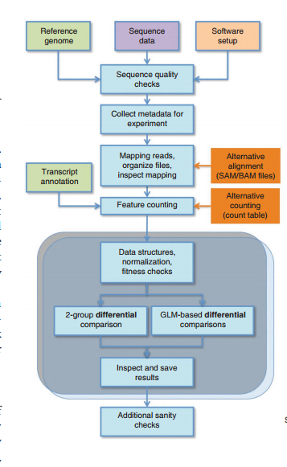
Workflow
Quality control
Alignment
Summarizing read counts
Anders, Simon, et al. "Count-based differential expression analysis of RNA sequencing data using R and Bioconductor." Nature protocols 8.9 (2013): 1765-1786.

Slide 2
Alternative tools?
Multiple tools exist for each step
Different tools will lead to slightly different results
Most tools have their advantage and preference
A discussion on this topic:
Li, Sheng, et al. "Multi-platform assessment of transcriptome profiling using RNA-seq in the ABRF next-generation sequencing study." Nature biotechnology 32.9 (2014): 915-925.
I’ll try to focus on one unique workflow

Slide 3
Quality Control
Visualization on Fastqc (Available on Basespace)
Contamination (Basespace have options to address this)
Duplication
you can ignore this unless you know something was wrong in experiment
First 12 bases non-uniform distributed
you can ignore this

Slide 4
Alignment
For each sequenced read, find their corresponding location on reference genome.
Input: fastq (original reads)
Output: bam files (Aligned reads)
My recommendation:
Do it on Basespace
Or
Run TOPHAT2 on Mac/Linux (difficult without some programming skills)

Slide 5
Summarizing read counts
Count number of reads mapped to each gene. The read counts are approximation of relative expression level.
Input: bam files
Output: read count ( a data frame structure in R)
Steps:
Download and put all bam files in one folder (each with distinct name)
Run annotation.R (change the folder variable)
“TILCnt.RData” generated

Slide 6
Normalization
FPKM (Fragments Per Kilobase of transcript per Million mapped reads)
RPKM (Reads Per Kilobase of transcript per Million mapped reads)
Neither one is recommended. Normalization is biased by strongly expressed genes
 | Sample 1 | Sample 2
Gene 1 | 30 | 30
Gene 2 | 30 | 30
Gene 3 | 30 | 30
Gene 4 | 1000 | 2000
FPKM/RPKM
 | Sample 1 | Sample 2
Gene 1 | 27.5 | 14.3
Gene 2 | 27.5 | 14.3
Gene 3 | 27.5 | 14.3
Gene 4 | 917 | 956.9
Gene 1~3 are artificial DEGs

Slide 7
Normalization
Two widely used tools:
Build-in normalization in DEseq2
TMM normalization (build-in normalization in EdgeR)
We don’t need to do this step if we just use DESeq2 or EdgeR.
Exception:
If we want to use TMM to normalize and use DEseq2 to analysis DEGs
Normalize it in EdgeR
Export read counts to DEseq2
Analysis it in DEseq2

Slide 8
Differential Expression
T-test (Easy to understand)
Generalized Linear Model (More sensitive and flexible)
DEseq2 (See my code)
EdgeR
Sample | 1 | 2 | 3 | 4 | 5 | 6 | 7 | 8
Subset | 1 | 2 | 1 | 2 | 1 | 2 | 1 | 2
Donor | 1 | 1 | 2 | 2 | 1 | 1 | 2 | 2
Gender | 1 | 1 | 1 | 1 | 2 | 2 | 2 | 2
Examples of linear model:
expression ~ subset
expression ~ subset + donor
expression ~ subset + donor + gender
expression ~ subset + gender

Slide 9
Differential Expression
Generalized Linear Model (More sensitive and flexible)
Support for continuous factor like age
Sample | 1 | 2 | 3 | 4 | 5 | 6 | 7 | 8
Subset | 1 | 2 | 1 | 2 | 1 | 2 | 1 | 2
Donor | 1 | 1 | 2 | 2 | 1 | 1 | 2 | 2
Age | 20 | 21 | 41 | 11 | 25 | 27 | 35 | 60
Examples of linear model:
expression ~ subset
expression ~ subset + donor
expression ~ subset + age
expression ~ subset + age + donor
expression ~ age + donor

Slide 10
Gene Sets Enrichment Analysis
GSEA and GSEA-derived methods(like gage)
See my code
Pathview (visualization of KEGG pathways)
DEGs based methods
https://david.ncifcrf.gov/
Copy top genes from DEGs lists
“Start Analysis”, paste the DEGs lists, Select “ENTREZ_GENE_ID”
See the results

Slide 11
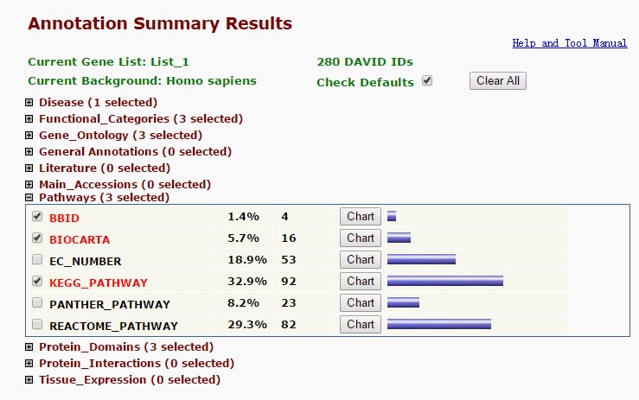
Gene Sets Enrichment Analysis
DAVID
Easy to use No programming

