Slide 1
Mibs setting
3.2GHz x86 Linux workstation with 19GB main memory
We first transform the knapsack interdiction problem into mps file, that can be detected as the interdiction problem in Mibs. (see next slide)
Command we use:
mibs -Alps_instance "$data_folder${file_name}.mps" -MibS_auxiliaryInfoFile "$data_folder${file_name}.txt" -Alps_timeLimit 600
we set the time limit to 600, otherwise the node will increase to be out of memory. (see the following slide)
I have uploaded several instances and shell script in Github

Slide 2
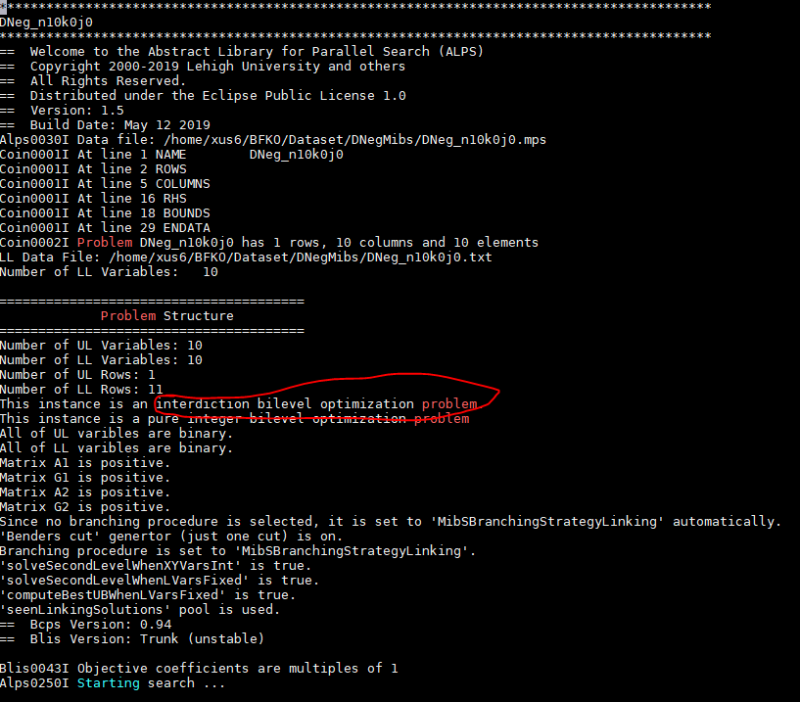
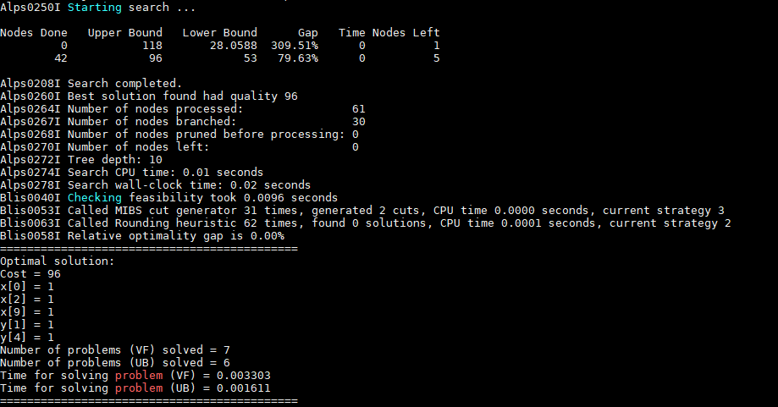

Slide 3
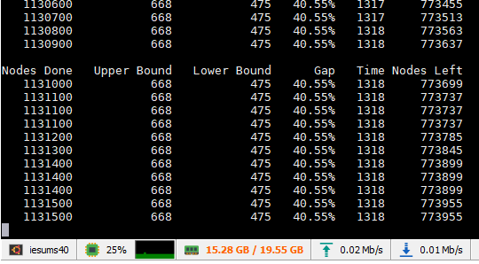
Out of memory of Mibs
Instance: DNeg_n50k3j4

Slide 4

Preliminary experiments to embed $BP_{k}$ into exact solution approach

Slide 5
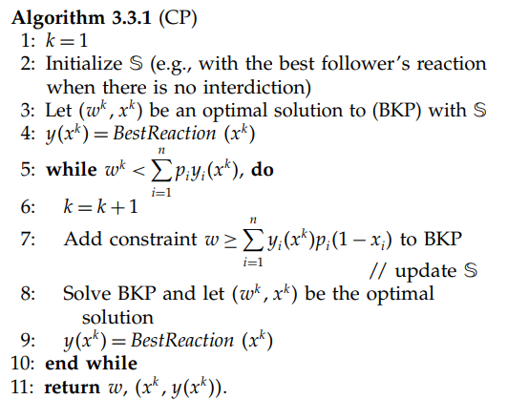
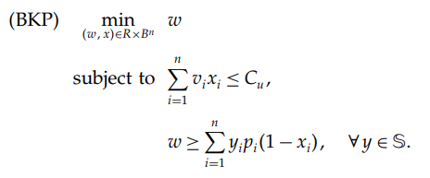
Knapsack interdiction problem

Slide 6
 |  | CP |  | CP_1 |  | CP_2 |  | CP_3 |  | CP_1_ext |  | CP_2_ext |  | CP_3_ext
n | r | Iters | Time | Iters | Time | Iters | Time | Iters | Time | Iters | Time | Iters | Time | Iters | Time
10 | 0 | 2.4 | 0.07 | 2.2 | 0.08 | 2.3 | 0.09 | 1.2 | 0.02 | 1.1 | 0.02 | 1 | 0.02 | 1 | 0.02
10 | 1 | 3.9 | 0.18 | 4.2 | 0.29 | 4.2 | 0.19 | 2.2 | 0.14 | 2.2 | 0.12 | 1.1 | 0.06 | 1.1 | 0.04
10 | 2 | 5.8 | 0.3 | 5.6 | 0.41 | 5.1 | 0.34 | 2.7 | 0.34 | 2.3 | 0.47 | 1 | 0.14 | 1 | 0.21
10 | 3 | 9 | 0.45 | 8.6 | 0.72 | 8.9 | 0.94 | 2.2 | 0.33 | 2.3 | 0.45 | 1.1 | 0.17 | 1.1 | 0.15
10 | 4 | 8.4 | 0.44 | 7 | 0.56 | 6.9 | 0.61 | 2.2 | 0.2 | 1.8 | 0.24 | 1 | 0.09 | 1 | 0.09
10 | 5 | 5.2 | 0.24 | 2.9 | 0.24 | 3 | 0.21 | 1.1 | 0.06 | 1.2 | 0.06 | 1.1 | 0.07 | 1.1 | 0.11
10 | 6 | 7.2 | 0.31 | 1.9 | 0.15 | 1.9 | 0.11 | 1.1 | 0.05 | 1.1 | 0.03 | 1 | 0.04 | 1 | 0.06
10 | 7 | 4.8 | 0.14 | 1 | 0.04 | 1 | 0.02 | 1 | 0.07 | 1 | 0.04 | 1 | 0.04 | 1 | 0.04
10 | 8 | 3 | 0.08 | 1 | 0.04 | 1 | 0.03 | 1 | 0.03 | 1 | 0.04 | 1 | 0.02 | 1 | 0.04
10 | 9 | 3.4 | 0.1 | 1 | 0.03 | 1 | 0.02 | 1 | 0.02 | 1 | 0.02 | 1 | 0.02 | 1 | 0.03
20 | 0 | 3.9 | 0.26 | 4.2 | 0.34 | 4.4 | 0.39 | 2.8 | 0.25 | 3 | 0.34 | 1.4 | 0.16 | 1.4 | 0.26
20 | 1 | 16.8 | 1.08 | 16.8 | 1.85 | 16.9 | 2.09 | 9.3 | 1.61 | 9.2 | 2.26 | 1.8 | 0.52 | 1.6 | 0.59
20 | 2 | 31.3 | 2.92 | 33 | 4.19 | 33.5 | 5.54 | 15 | 2.83 | 15.1 | 3.34 | 2.7 | 0.82 | 2.7 | 1.31
20 | 3 | 46.5 | 3.13 | 48.5 | 7.1 | 47.2 | 7.01 | 10.7 | 2.27 | 11 | 2.7 | 1.3 | 0.33 | 1.3 | 0.39
20 | 4 | 48.5 | 3.46 | 37.9 | 13.48 | 38.5 | 13.01 | 6.8 | 1.27 | 6.7 | 1.24 | 1.2 | 0.29 | 1.2 | 0.35
20 | 5 | 52.3 | 3.14 | 2.1 | 0.27 | 2.4 | 0.18 | 1 | 0.11 | 1 | 0.12 | 1 | 0.14 | 1 | 0.13
20 | 6 | 26.7 | 1.38 | 1.2 | 0.09 | 1.2 | 0.06 | 1 | 0.07 | 1 | 0.07 | 1 | 0.11 | 1 | 0.12
20 | 7 | 28.3 | 1.65 | 1 | 0.06 | 1 | 0.03 | 1 | 0.07 | 1 | 0.06 | 1 | 0.07 | 1 | 0.15
20 | 8 | 6.7 | 0.28 | 1 | 0.05 | 1 | 0.05 | 1 | 0.05 | 1 | 0.03 | 1 | 0.06 | 1 | 0.15
20 | 9 | 4.9 | 0.21 | 1 | 0.05 | 1 | 0.04 | 1 | 0.02 | 1 | 0.02 | 1 | 0.05 | 1 | 0.06
30 | 0 | 11.1 | 0.85 | 12 | 1.41 | 11.8 | 1.39 | 8.4 | 1.73 | 8.1 | 2.64 | 1.4 | 0.69 | 1.4 | 1.08
30 | 1 | 65 | 5.81 | 64 | 13.71 | 63.9 | 14.89 | 50.8 | 31.8 | 49.7 | 30.04 | 4.1 | 4.73 | 4.1 | 4.79
30 | 2 | 225.6 | 35.74 | 231.3 | 148.52 | 226.6 | 176.48 | 128.1 | 398.38 | 130.5 | 284.64 | 6.6 | 11.79 | 6.1 | 10.12
30 | 3 | 254.3 | 73.64 | 259.4 | 253.6 | 257.8 | 289.75 | 85.4 | 719.81 | 87.8 | 274.73 | 2.6 | 3.98 | 2.6 | 3.33
30 | 4 | 255.7 | 162.52 | 172.1 | 1590.75 | 176 | 964.85 | 4.9 | 2.46 | 5 | 2.2 | 1 | 0.51 | 1 | 0.38
30 | 5 | 196.4 | 47.06 | 1.6 | 0.37 | 1.7 | 0.22 | 1 | 0.15 | 1 | 0.17 | 1 | 0.35 | 1 | 0.25
30 | 6 | 88.8 | 26.69 | 1.3 | 0.37 | 1.3 | 0.19 | 1 | 0.16 | 1 | 0.19 | 1 | 0.21 | 1 | 0.25
30 | 7 | 46 | 5.23 | 1 | 0.1 | 1 | 0.06 | 1 | 0.11 | 1 | 0.06 | 1 | 0.13 | 1 | 0.22
30 | 8 | 11.5 | 0.5 | 1 | 0.07 | 1 | 0.03 | 1 | 0.06 | 1 | 0.07 | 1 | 0.08 | 1 | 0.2
30 | 9 | 4.9 | 0.2 | 1 | 0.03 | 1 | 0.04 | 1 | 0.06 | 1 | 0.03 | 1 | 0.09 | 1 | 0.22

