Slide 1
Outline
Add Section 4, two single-level formulations for minimum spanning tree interdiction problem (slide 2)
Add experiment results for bilevel vertex cover problem in Section 6.2 (page 19)
Two tables
The performance of Mibs and BP_k
The performance of BP_k that are affected by the degrees of graph (not finished yet)
More results are coming in the next meeting

Slide 2
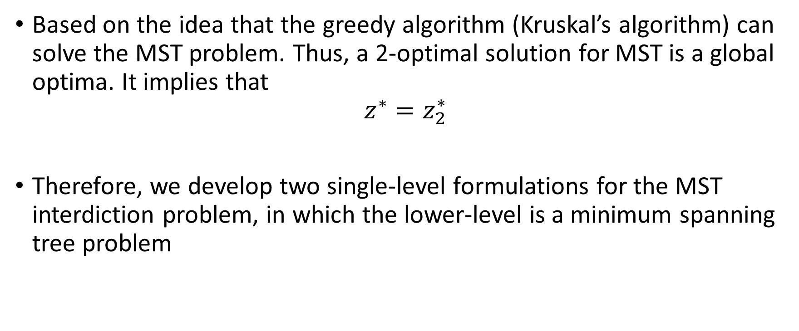
Minimum spanning tree interdiction problem
Based on the idea that the greedy algorithm (Kruskal’s algorithm) can solve the MST problem. Thus, a 2-optimal solution for MST is a global optima. It implies that
$${ z^{∗}=z}_{2}^{∗}$$
Therefore, we develop two single-level formulations for the MST interdiction problem, in which the lower-level is a minimum spanning tree problem

Slide 3
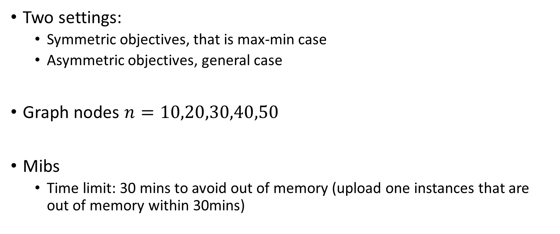
Experiments for bilevel vertex cover
Two settings:
Symmetric objectives, that is max-min case
Asymmetric objectives, general case
Graph nodes $n=10,20,30,40,50$
Mibs
Time limit: 30 mins to avoid out of memory (upload one instances that are out of memory within 30mins)

Slide 4
To do
Writing
Introduction part
Experiments:
Fixed Mibs with Dr. Ralphs
More detailed results for bilevel vertex cover
Get some better results through using cuts
Experiments for minimum spanning tree interdiction problem

