Slide 1
Does Pretraining Actually Help?
Transfer Learning for Breast Ultrasound Segmentation
XIAOYANG SU
Special Topics · Spring 2026

Slide 2
The Problem
Breast cancer is one of the most common cancers worldwide.
Ultrasound is a key screening tool — but identifying tumor boundaries by hand is slow and subjective.
Goal: Train a CNN to automatically segment tumor regions, supporting faster and more consistent diagnosis.
THE CHALLENGE
Medical datasets are small.
Expert annotation is expensive.
Can transfer learning compensate? And does pretraining on medical images work better than ImageNet?

Slide 3
The Task — Pixel-Level Segmentation
INPUT
MODEL
OUTPUT
128×128 RGB
→
U-Net
→
128×128 mask
ultrasound image
encoder-decoder CNN
1 = tumor, 0 = background
Each pixel gets a prediction. Ground-truth labels come from expert radiologists.
→ Helps radiologists assess tumor size, shape, and boundaries faster and more consistently.

Slide 4
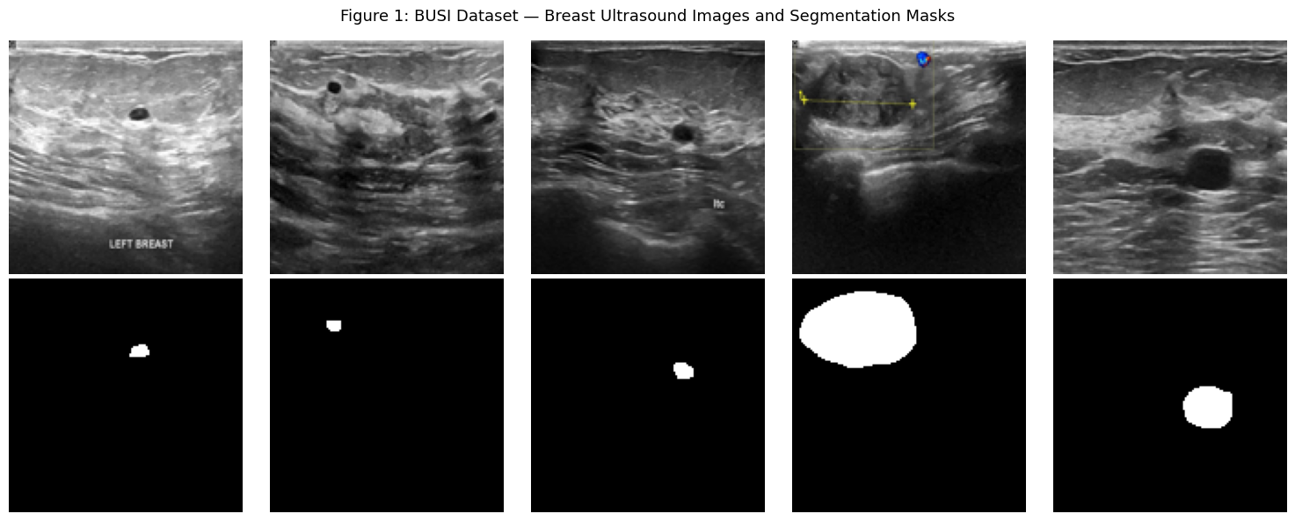
The Data — BUSI
Breast Ultrasound Images dataset (Kaggle)
647
452
97
98
Total images
Train
Validation
Test
Top: ultrasound images. Bottom: ground-truth masks (white = tumor).

Slide 5
Model Architecture — U-Net
Encoder-decoder CNN with skip connections, designed for medical segmentation
ENCODER (VGG16)
DECODER
128×128
16×16
64×64
32×32
32×32
64×64
16×16
128×128
8×8
Bottleneck (most abstract features)
Skip connections (preserve spatial detail)
ENCODER
SKIP CONNECTIONS
OUTPUT
VGG16 progressively compresses input via conv layers + max pooling
Pass fine spatial details directly to decoder — sharp boundaries
1×1 Conv + sigmoid → per-pixel P(tumor) ∈ [0, 1]

Slide 6
Loss Function — BCE + Dice
THE PROBLEM: CLASS IMBALANCE
Tumors take up only 10–20% of the image. A model predicting 'all background' would get 80–90% pixel accuracy — but miss every tumor.
BCE (Binary Cross-Entropy)
Dice Loss
Per-pixel classification loss.
Dice = (2 × |A ∩ B|) / (|A| + |B|)
✓ Good for pixel-level accuracy
✗ Dominated by background pixels
✓ Optimizes overlap directly
✓ Handles class imbalance
→ Combine: BCE + Dice gets pixel accuracy AND overlap optimization
Output activation:
sigmoid (binary segmentation, each pixel independent) — not softmax (would force classes to sum to 1).

Slide 7
Four Experiments
Systematically testing whether transfer learning helps
BASELINE
EXP A
Naive
Scratch
ENCODER None
ENCODER Random init
Single 1×1 Conv only.
No encoder, no decoder.
Train full U-Net from
scratch on BUSI.
EXP B
EXP C
ImageNet
ISIC Pretrain
ENCODER ImageNet (14M images)
ENCODER ISIC 2019 (8K medical)
VGG16 pretrained on natural
images, then fine-tuned.
VGG16 pretrained on skin lesion
classification, then fine-tuned.

Slide 8
Training Strategy — Two-Phase Fine-Tuning
How to fine-tune without destroying the pretrained weights (Experiments B and C)
PHASE 1
PHASE 2
Freeze encoder ❄️
Unfreeze all 🔓
→ Train decoder only
→ Learning rate: 1e-3
→ ~10–15 epochs
Why? Lets the random decoder stabilize first, so its untrained gradients don't destroy the pretrained encoder.
→
→ Fine-tune end-to-end
→ Learning rate: 1e-4 (10× lower)
→ Until early stopping triggers
Why? A small lr lets the encoder adapt to ultrasound features without overwriting useful pretrained patterns.
Early Stopping (patience = 7)
Training stops when validation loss hasn't improved for 7 consecutive epochs. Best weights are automatically restored to prevent overfitting.

Slide 9
Results — Test Set Dice Coefficient
KEY OBSERVATIONS
U-Net works.
0.72 vs 0.14 — the gap over the naive baseline is huge. The models genuinely learn segmentation.
But pretraining...
doesn't help. All three U-Net variants score within 0.01 of each other.
Surprising?
Yes. The next slides explain why this happens.

Slide 10
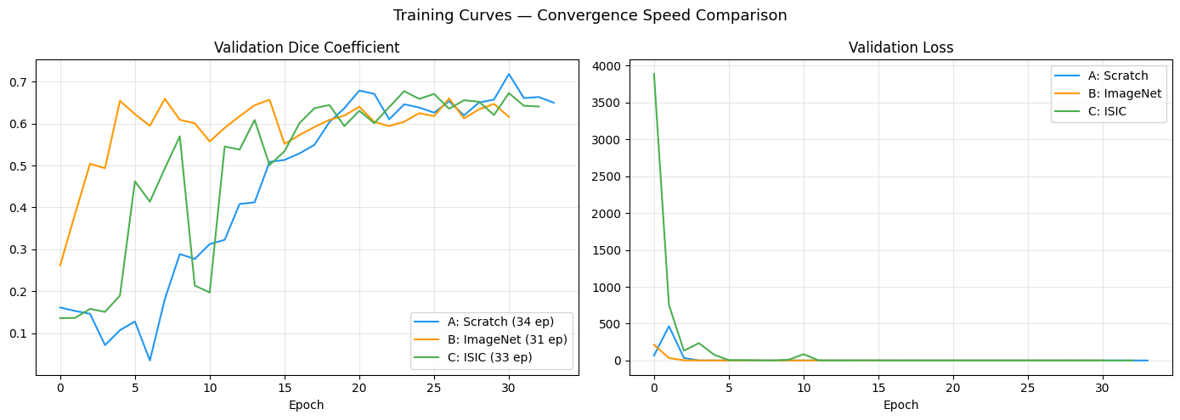
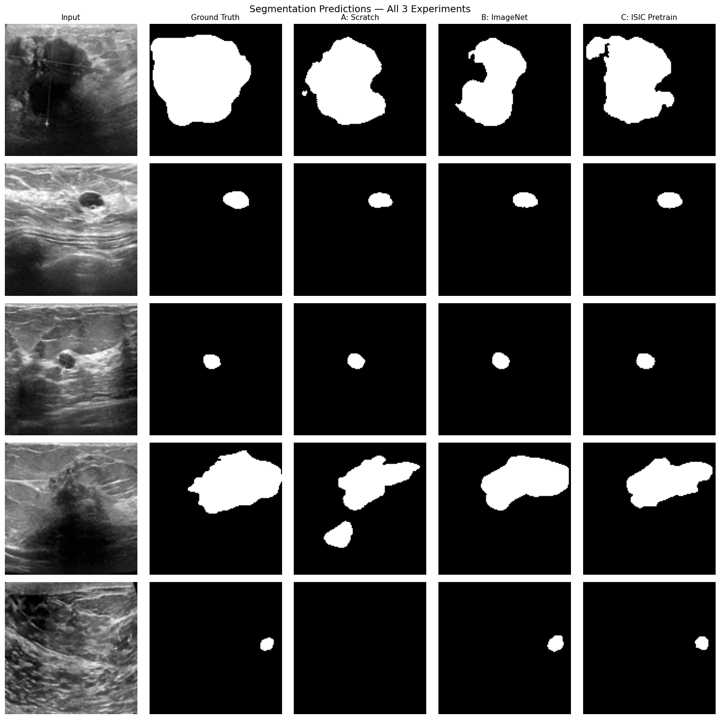
Training Curves & Predictions
All three U-Net variants converge to similar validation Dice
Validation Dice and loss over epochs. Early stopping triggered between epochs 27–34.
OBSERVATION Experiment A (scratch) converges slightly faster early on — it updates the entire network from epoch 1, while B and C spend their first 10–15 epochs with a frozen encoder.

Slide 11
Why Didn't Transfer Learning Help?
1
Domain gap is too large
2
U-Net is robust on small data
Ultrasound is grayscale, noisy, low-contrast — fundamentally different from natural photos (ImageNet) or dermoscopy (ISIC).
Skip connections let the decoder access spatial details directly, reducing dependency on the encoder's learned representations.
3
Task mismatch (Exp C)
4
Resolution ceiling
ISIC pretraining was classification (global features). The target task is segmentation (local features). Mismatch limits transfer.
All images at 128×128. Fine details that could differentiate models may be lost — all three may be hitting the same limit.
These reasons reinforce each other — together, they explain why pretraining didn't move the needle.

Slide 12
Conclusion
For breast ultrasound segmentation at this scale,
transfer learning does not outperform training from scratch.
WHAT THIS MEANS
WHAT I'D TRY NEXT
U-Net + skip connections is robust enough
to learn from just 452 training images.
Practitioners may not need complex pretraining pipelines for moderately-sized medical segmentation tasks.
Higher resolution (256×256)
to break the performance ceiling
Segmentation-based pretraining
(use ISIC masks, not classification labels)
Cross-validation
for more reliable comparisons

Slide 13
Thank you.
Xiaoyang Su · Special Topics · University of St. Thomas · Spring 2026

