Slide 1

MACHINE LEARNING
By: Hazel Becker & Xiong Yuan

Slide 2
Brief History
The term "machine learning" was coined in 1959 by Arthur Samuel.
Interest grew in the 80s...
...and the 00s...
...and the 20s!
"How can a computer perform a task without explicit programming?"

Slide 3
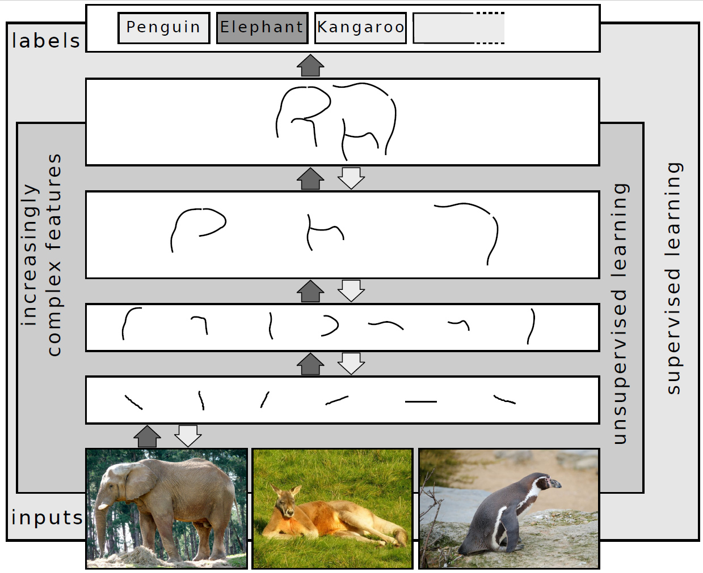
VARIETIES
SUPERVISED
UNSUPERVISED
REINFORCEMENT
DEEP

Slide 4
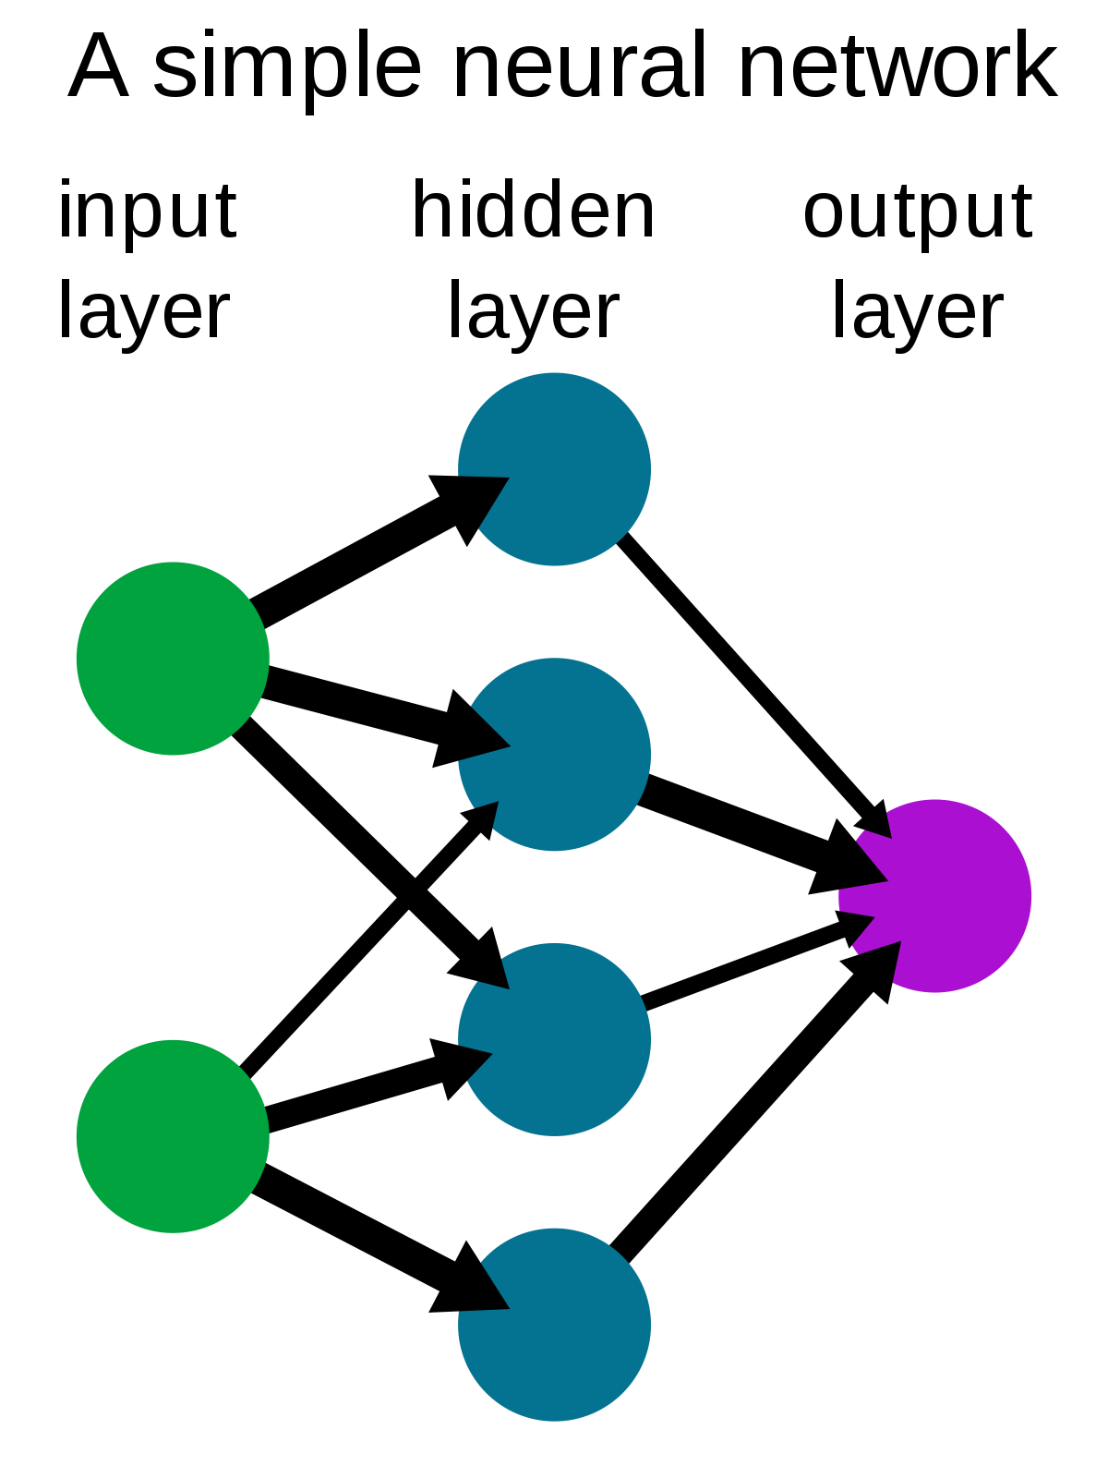
Neural Network
Artificial neural networks are used by most machine learning algorithms. They're a way to mimic the way the animal brain works, building patterns with what are essentially fake neurons.

Slide 5
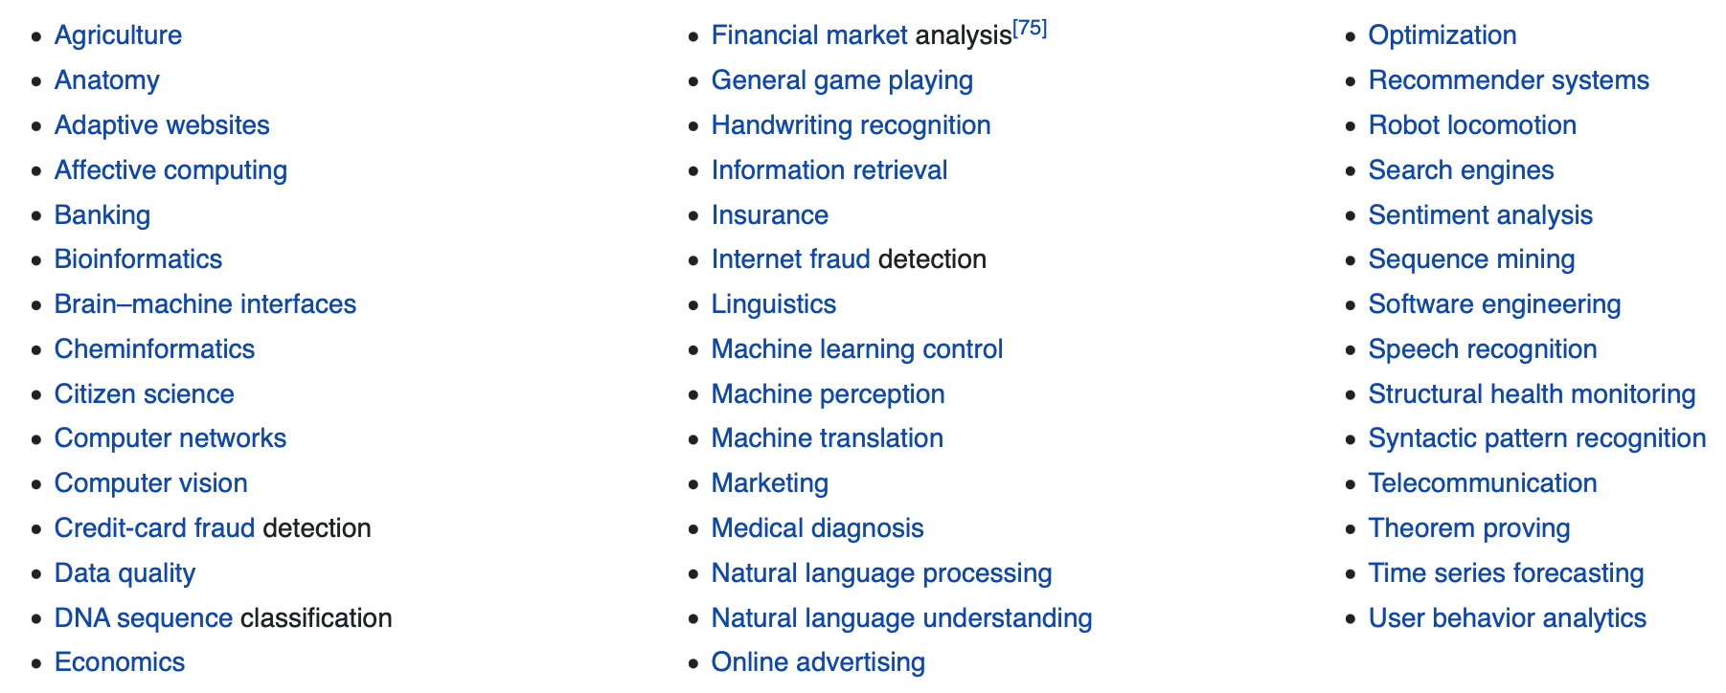
Used in...
Data mining!
Optimization
Generalization
Statistical patterns

Slide 6
Why Machine Learning?
Programs begin taking analytics and applying it without explicit programming
The algorithms are improving automatically through experience – like the name suggests the machines learn as they go
This is great for more complex tasks- imagine writing a Java program to interpret handwriting

Slide 7
Pros of Machine Learning
Easily identifies trends and patterns
Machine Learning can review large volumes of data and discover specific trends and patterns that would not be apparent to humans.
No human intervention needed
With ML, you don’t need to babysit your project every step of the way. Since it means giving machines the ability to learn, it lets them make predictions and improve the algorithms on their own.
Continuous Improvement
As ML algorithms gain experience, they keep improving in accuracy and efficiency. This lets them make better decisions.
Handling multi-dimensional and multi-variety data
Machine Learning algorithms are good at handling data that are multi-dimensional and multi-variety, and they can do this in dynamic or uncertain environments.
Wide Applications
ML has a wide variety of applications. This means that we can apply ML on any of the major fields.

Slide 8
Cons of Machine Learning
Possibility of High Error
Algorithm Selection
The selection of an algorithm in Machine Learning is still a manual job. We must run and test our data in all the algorithms and decide which algorithm to use based on result accuracy. This process is very time-consuming.
Data Acquisition
Machine Learning requires massive data sets to train on, and these should be inclusive/unbiased, and of good quality. There can also be times where they must wait for new data to be generated.
Time and Space
ML needs enough time to let the algorithms learn and develop enough to fulfill their purpose with a considerable amount of accuracy and relevancy. It also needs massive resources to function. This can mean additional requirements of computer power for you.
In ML, we can choose the algorithms based on accurate results. In order to do that, we must run the results on every algorithm, but the main problem occurs in training and testing the data. When data is huge, it’s sometimes impossible to remove errors.

Slide 9
Cool Applications of Machine Learning

Slide 10


Virtual Personal Assistants
Names like Siri and Alexa bring to mind the capabilities of virtual assistants. We can ask Siri to make a call for you or play music. You can request Alexa for today’s weather forecast. You can even set an alarm or send an SMS. Such assistants take note of how you interact with them and use that to make your next experience with them better.

Slide 11

Online Customer Support
Websites like educators and shopping platforms will often pop a live chat up to help you with your questions. A visitor with a head full of questions is more likely to leave than stay and possibly make a purchase. Some websites use a chatbot instead to pull information to the website and try to address the customer’s queries.

Slide 12
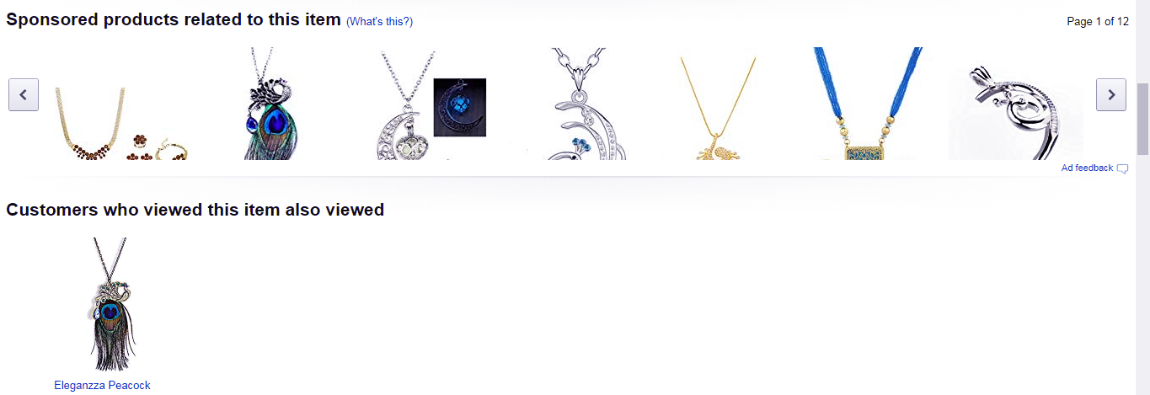
Product Recommendations
Shopping platforms like Amazon notice what products you look at and suggest similar products to you. If this gets a favorite product across to you and results in a purchase you make with them, it’s a win for them. For this, it also uses your wishlist and cart contents.

Slide 13
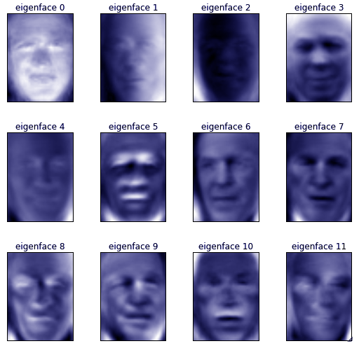
Face Recognition
Facilities like face detection are often something we see with Facebook. When we want to tag a photo, Facebook automatically suggests us a few names. Most of the times, the first name is accurate for the face it has detected. This has machine learning to credit.

Slide 14

Refining Search Engine Results
The searches you make in search engines like Google monitor your response. Do you visit a top listing and stick around for a while? Do you get to the third page and leave without clicking any link? Google makes note of the findings and aims to improve your search next time.

Slide 15


