Slide 1
SWE 304
Development and Operations DevOps
Week – 12
Kubernetes -Intro
Ahmet Özmen
2026

Slide 2
Overview
Objectives
Motivations behind container orchastration
Kubernetes, Minikube
Examples

Slide 3
Objectives
Who took this course can (should) answer the following questions:
How to deploy containerized applications using Kubernetes
Scalability

Slide 4
Kubernetes
What is it?:
Open source container orchestration tool
Developed by Google
Helps you manage containerized applications in different deployment environments:
Physical, virtual or cloud
Motivation:
Current trend is from monolith to microservices
Increased usage of containers
Demand for a proper way of managing those hundreds of conatiners
Benefits:
High availability or no downtime
Scalability or high performance
Disaster recovery – backup and restore
(https://www.youtube.com/watch?v=VnvRFRk_51k&ab_channel=TechWorldwithNana)

Slide 5
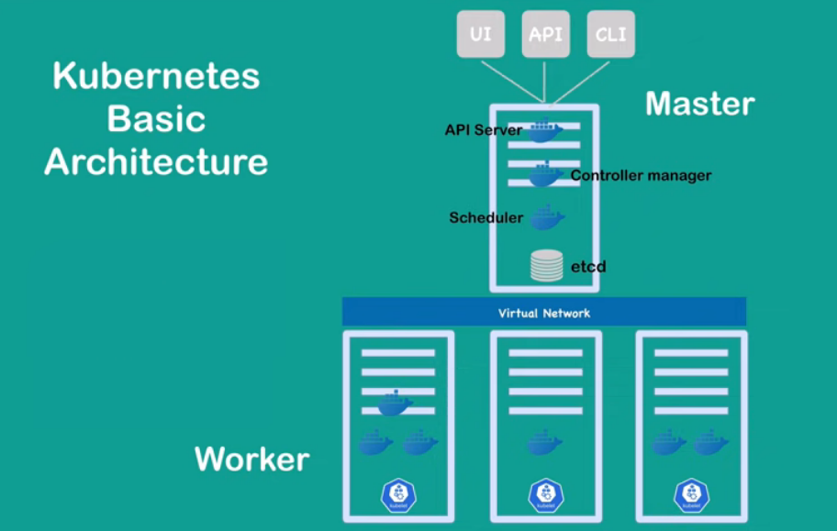
Architecture
(https://www.youtube.com/watch?v=VnvRFRk_51k&ab_channel=TechWorldwithNana)

Slide 6
Pod, Deployment, Service
Three important abstractions:
Pod: An abstraction over containerized process.
Deployment: An abstraction over pods. They can span across nodes.
Service: Communication abstraction that allows pods to communicate within cluster.
These units are described in YAML files, check yaml file basics:
https://www.mirantis.com/blog/introduction-to-yaml-creating-a-kubernetes-deployment

Slide 7
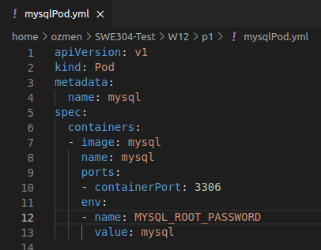
Pod
The pod is the smallest deployable unit that exists in Kubernetes.
Pods are simply a collection of containers with shared network and storage.
You can define and create pods manually using declarative YAML files.

Slide 8
Deployment
A deployment is a Kubernetes construct that controls the creation and destruction of pods.
This construct is particularly important because it is what keeps our application alive!
A deployment is essentially a contract you make with Kubernetes that states the running conditions of your application.
Deployment may span across nodes.

Slide 9
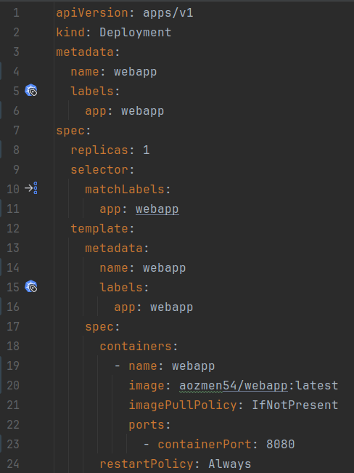
Deployment example
webapp-deploy.yaml

Slide 10
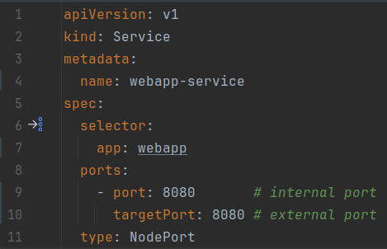
Service
A deployment ensures that our application is running inside the cluster, but we have no way to access it from outside!
A service is used to manage how network traffic makes it to pods running somewhere within a cluster.
https://medium.com/slalom-technology/5-constructs-you-must-know-to-get-started-with-kubernetes-85e0079f9ace#:~:text=The%20spec%20field%20is%20used,label%20app%3A%20hello%2Dkubernetes%20.

Slide 11

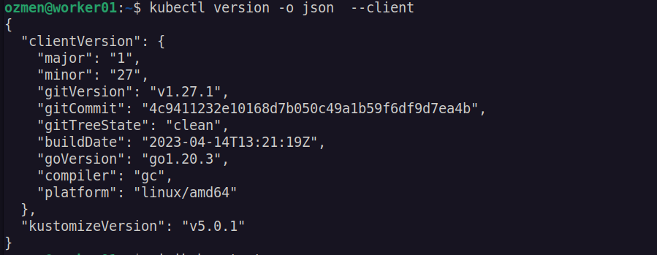
Minikube install on Ubuntu 22.04
Install KVM-hypervisor virtualization software:
Test if KVM is installed correctly:
Install Minikube:
Test minikube:

Slide 12
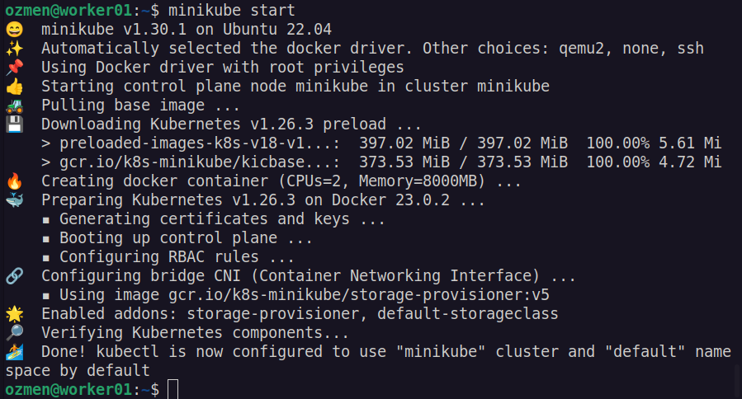
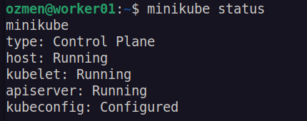
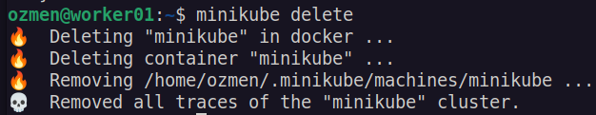
> minikube start
(https://computingforgeeks.com/how-to-install-minikube-on-ubuntu-debian-linux/)

Slide 13
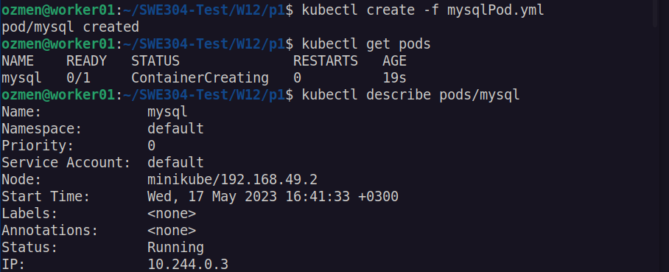
Deploying docker image on k8s cluster

Slide 14
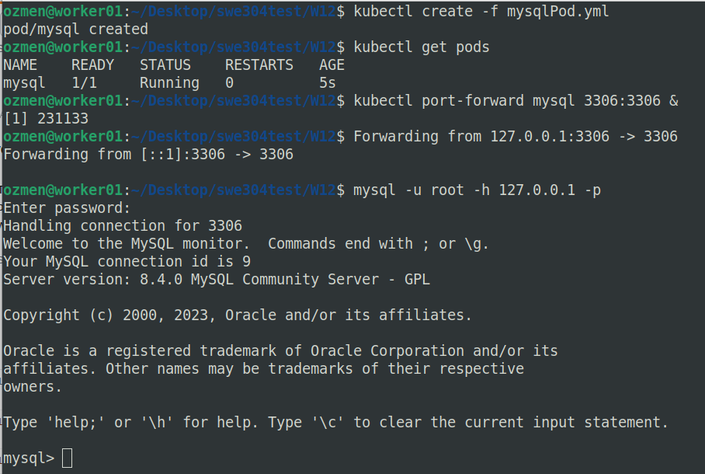
Accessing mysql pod from host computer
port-forward
Pods are low level, we will use Deployment instead!

Slide 15
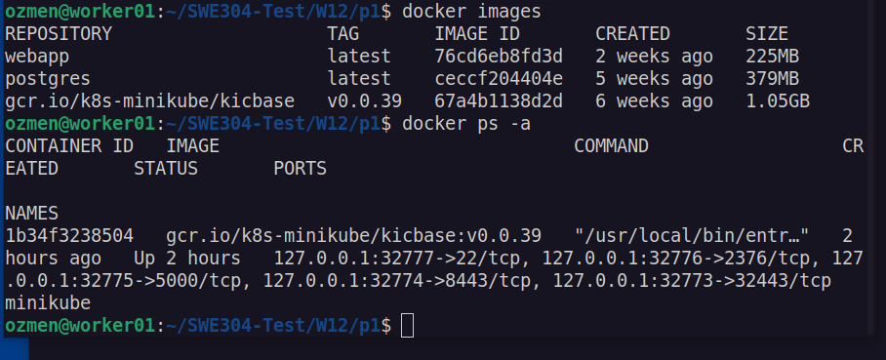
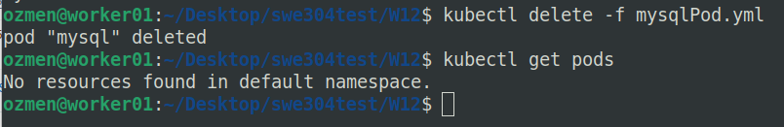
Running application on k8s
When we are done with a pod deployment, simply delete it!

Slide 16
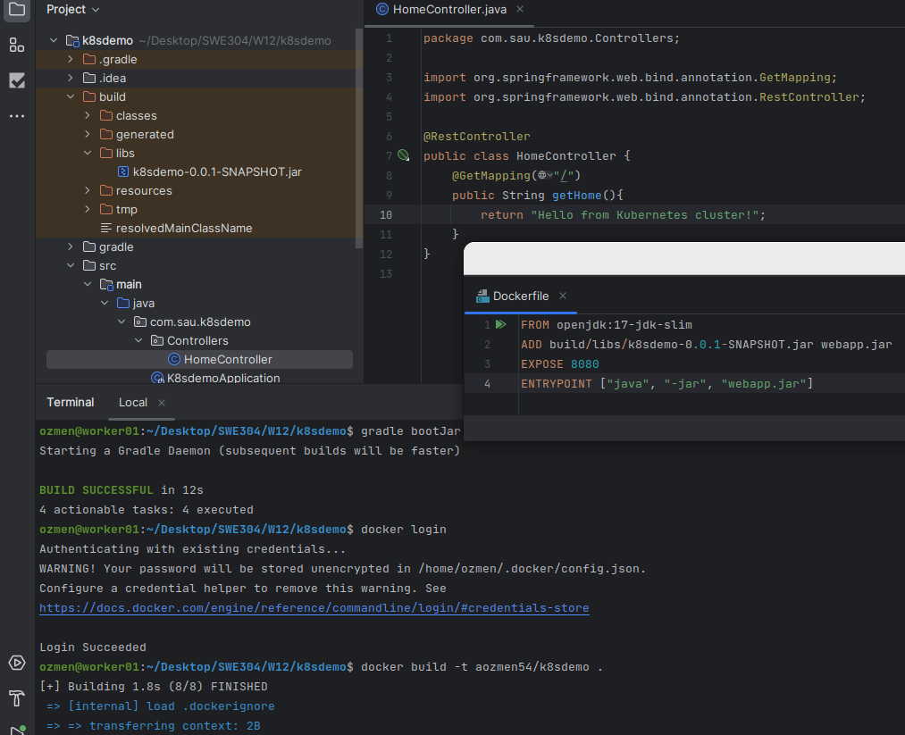
Simple web app, no database
Afterwards, the image (aozmen54/k8demo) is pushed to docker registry

Slide 17
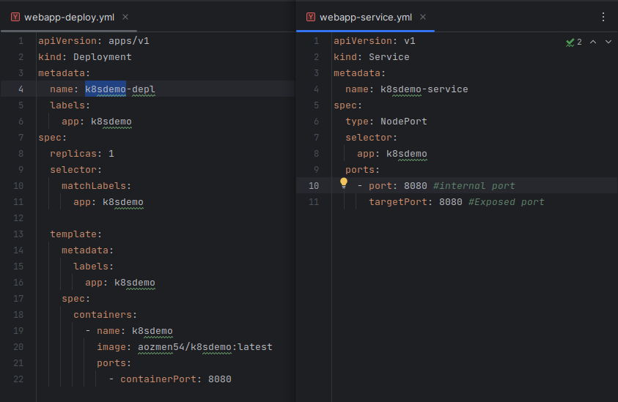
Yaml files

Slide 18
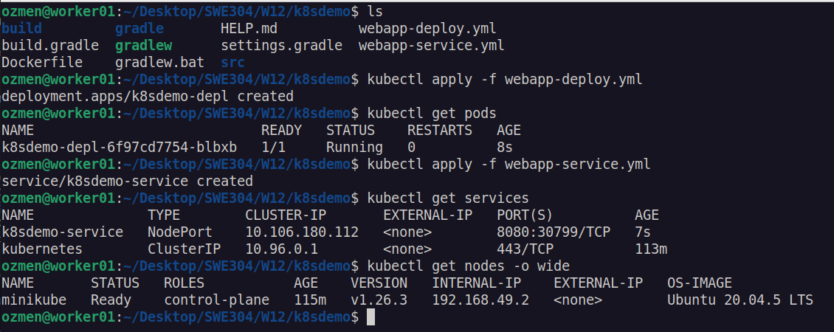
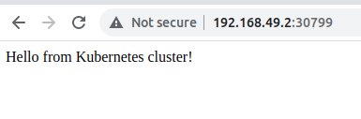
Running the application
IP
PORT

Slide 19

Questions?

