Slide 1
SWE 304
Development and Operations DevOps
Week – 13
Kubernetes -Local cluster
Ahmet Özmen
2026

Slide 2
Overview
Objectives
Motivations behind container orchastration
Kubernetes, Minikube
Examples

Slide 3
Objectives
Who took this course can (should) answer the following questions:
How to deploy containerized applications using Kubernetes
Scalability

Slide 4
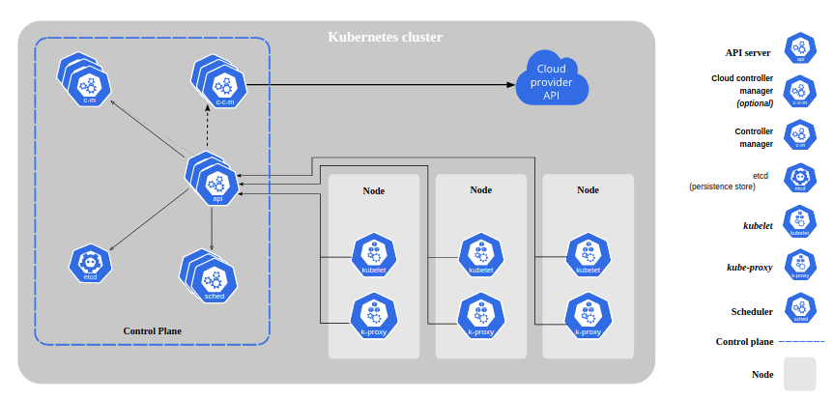
Kubernetes
(https://kubernetes.io/docs/concepts/overview/components/#:~:text=A%20Kubernetes%20cluster%20consists%20of%20a%20set%20of%20worker%20machines,the%20Pods%20in%20the%20cluster.)

Slide 5
Design of example
Node Ip: 192.168.49.2
Port: 31000
Node Ip: 192.168.49.2
Port: 31000
Cluster Ip: 10.101.198.19
Port: 3306
Webapp-service
mysql-service
Selector: webapp
Selector: mysql
Pod: webapp
Pod: mysql

Slide 6
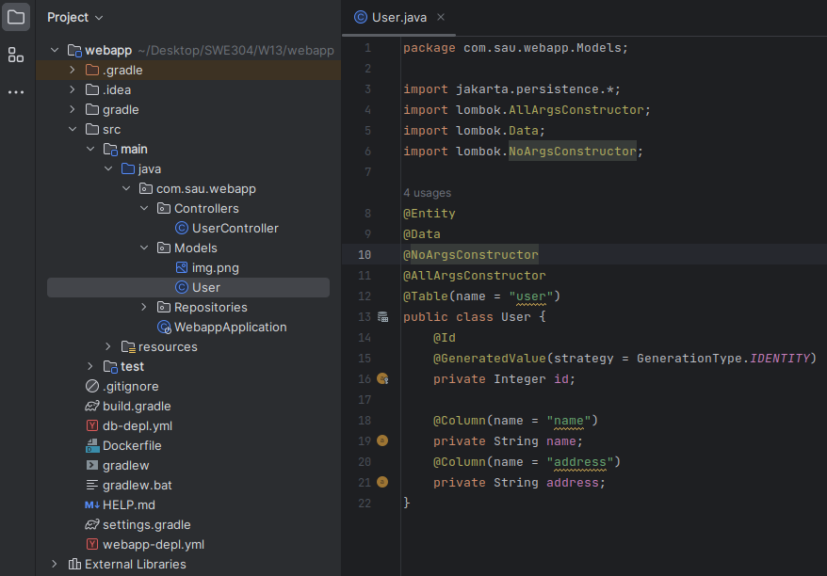
Example web application with DB

Slide 7
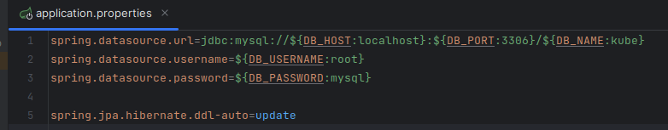
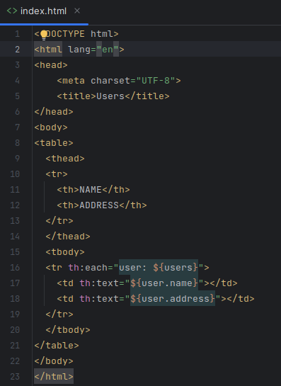
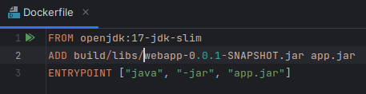
Example web application with DB

Slide 8
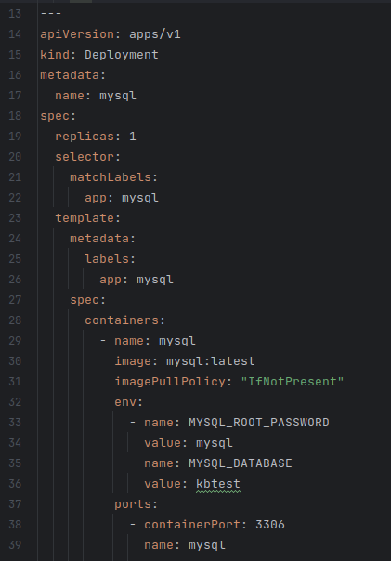
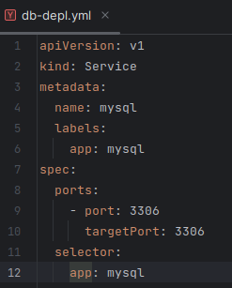
Mysql deployment and service

Slide 9
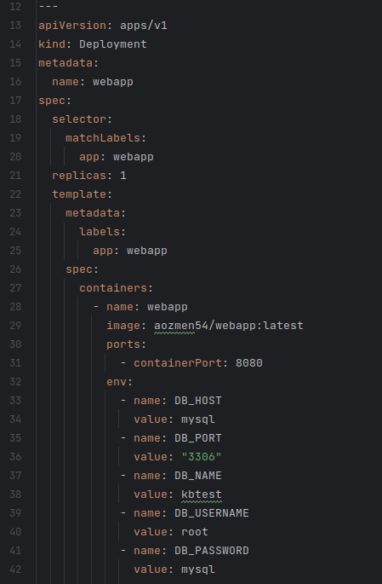
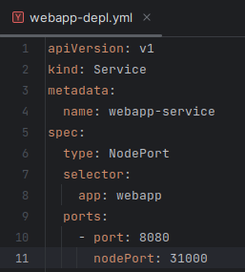
Webapp deployment and service

Slide 10
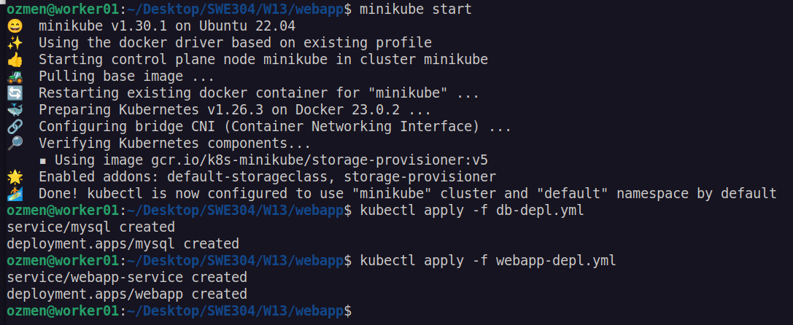
Application startup

Slide 11
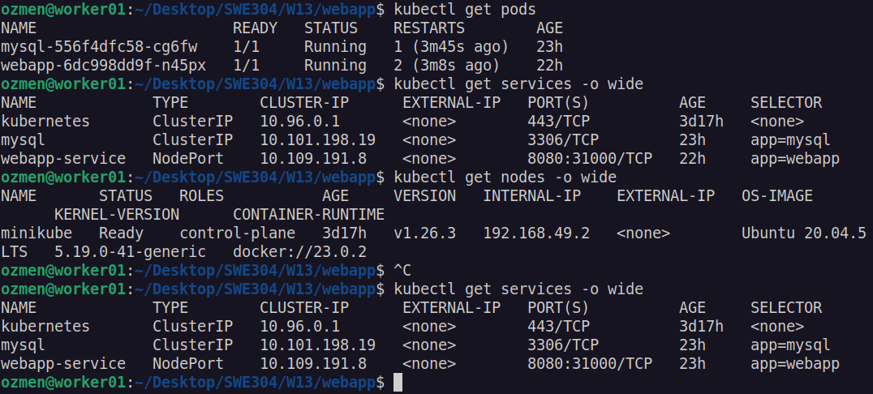
Running the application (2023)

Slide 12
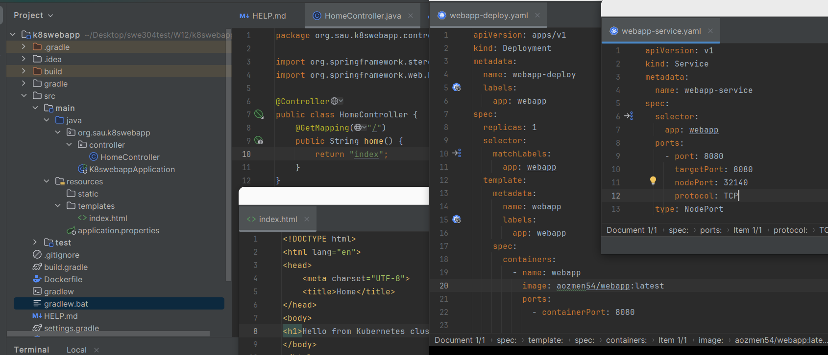
2024 Example

Slide 13
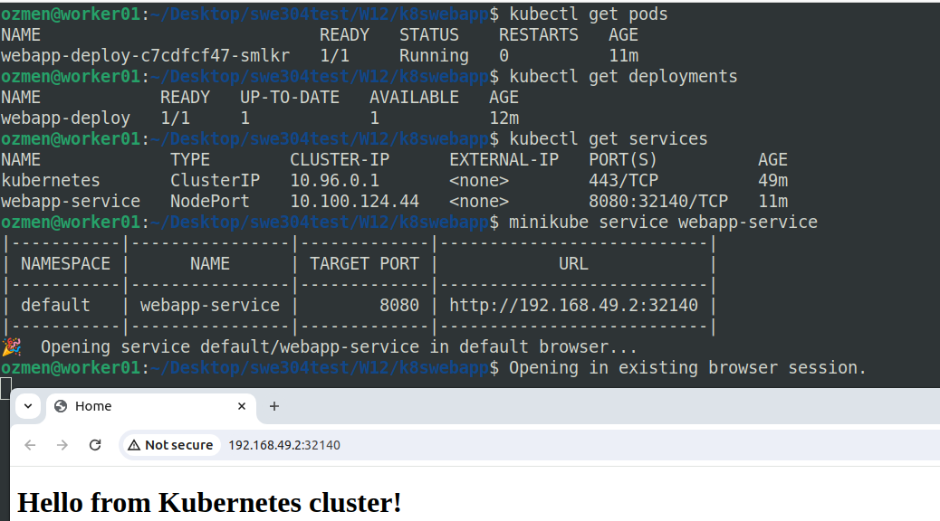
2024 example

Slide 14

Questions?

