Slide 1
SWE 304
Development and Operations DevOps
Week – 14
Kubernetes – Amazon (AWS) Cloud
Ahmet Özmen
2024

Slide 2
Overview
Objectives
Kubernetes Cloud deployment tools
EKS on Amazon
Deploying applications on EKS
Examples

Slide 3
Objectives
Who took this course can (should) answer the following questions:
Use of AWS EKS for web app deployment and monitoring

Slide 4
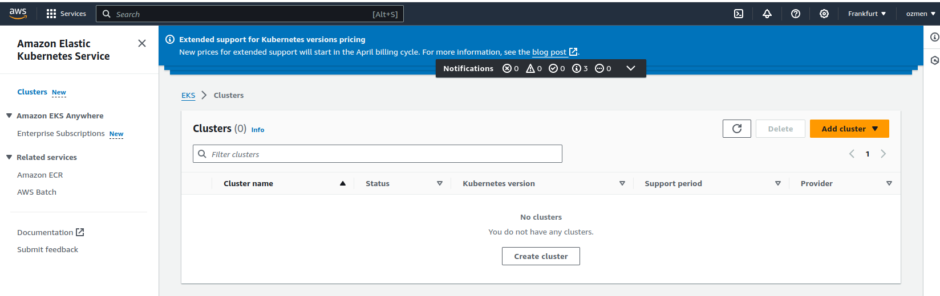
AWS EKS (Elastic Kubernetes Service)
You can create a Kubernetes cluster following guides step-by-step.

Slide 5
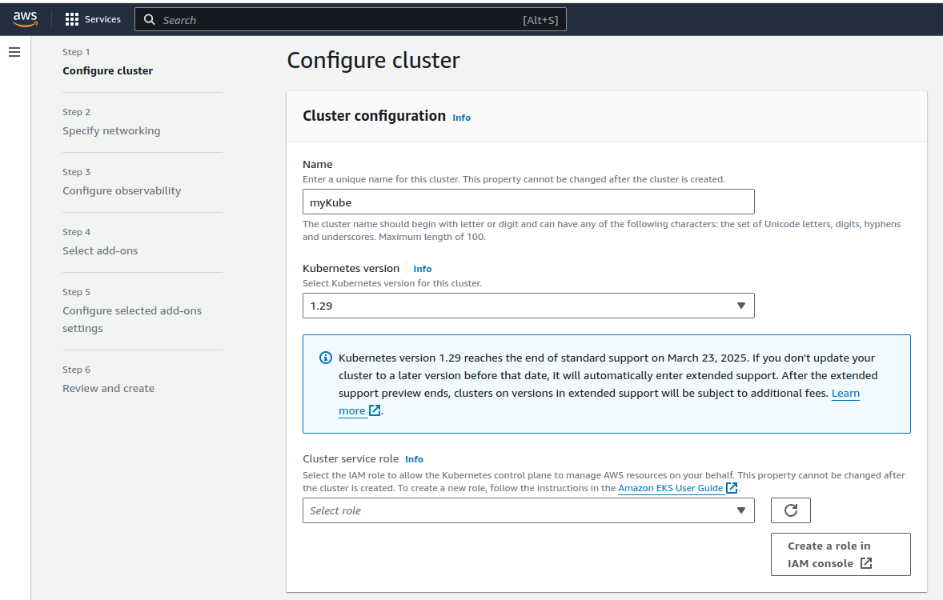
Configure Kubernetes Cluster
Give a name for your cluster
Select the latest Kubernetes version
Create a IAM (Identity Access Management) role
for EKS

Slide 6
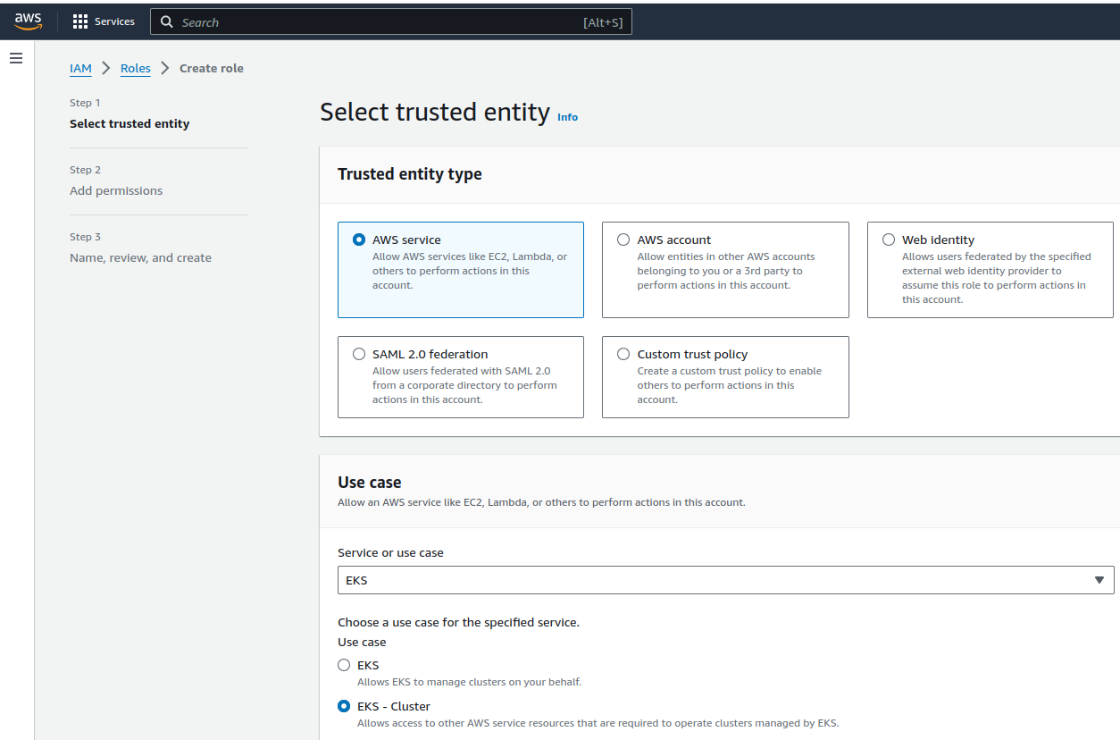
IAM Configuration
Click next

Slide 7
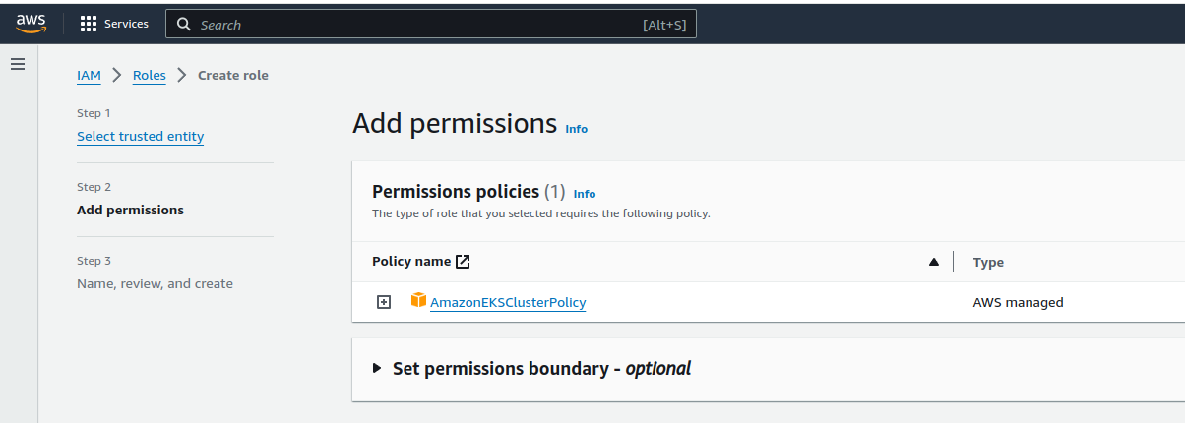
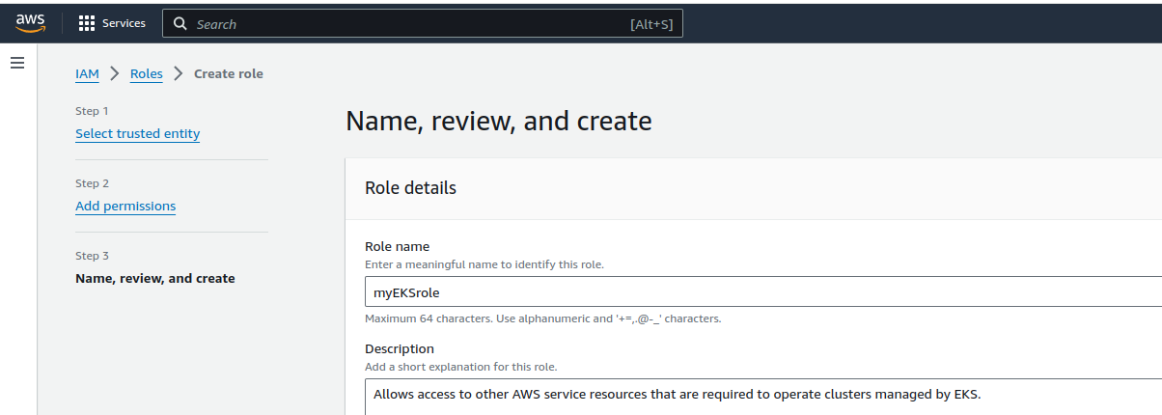
Add permissions
Click next
Give a name for the role
Review and click
to create the role

Slide 8
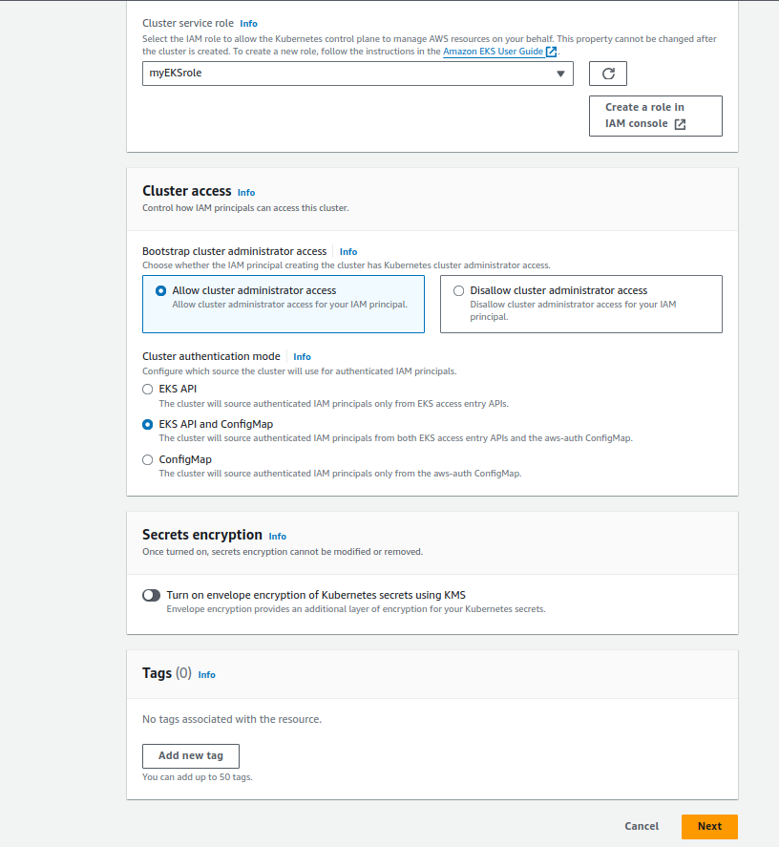
Go back to config page
Refresh the roles
and select the created
role
Click next

Slide 9
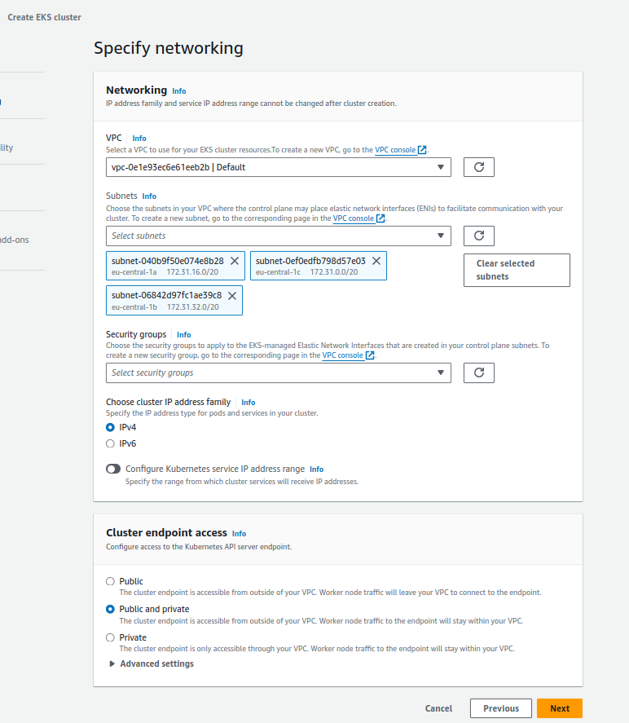
Cluster networking
Click next

Slide 10
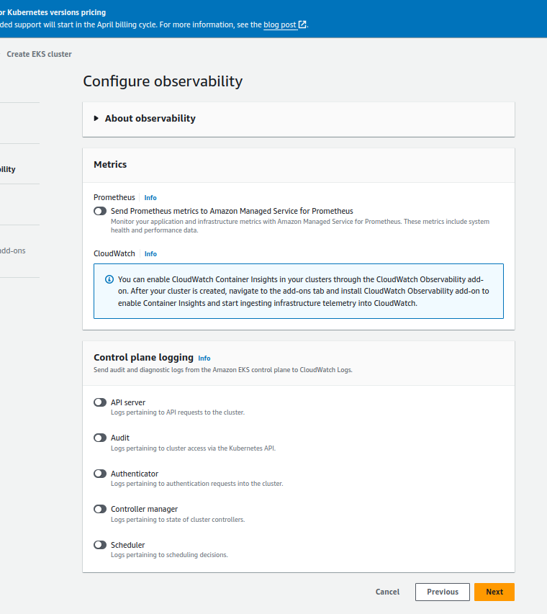
Monitoring
If you select monitoring,
you may have to pay for it
Click next

Slide 11
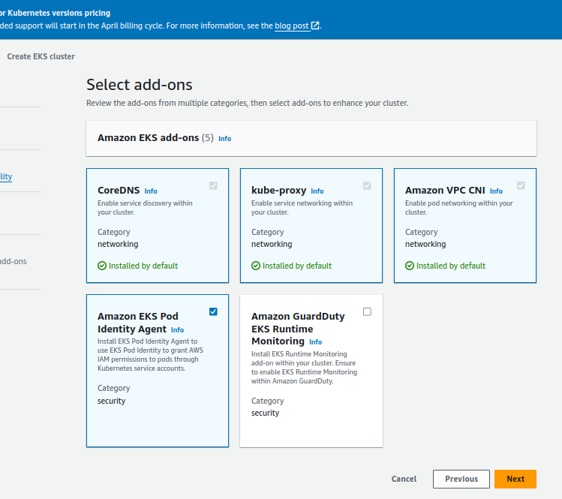
Add-Ons
Click next

Slide 12
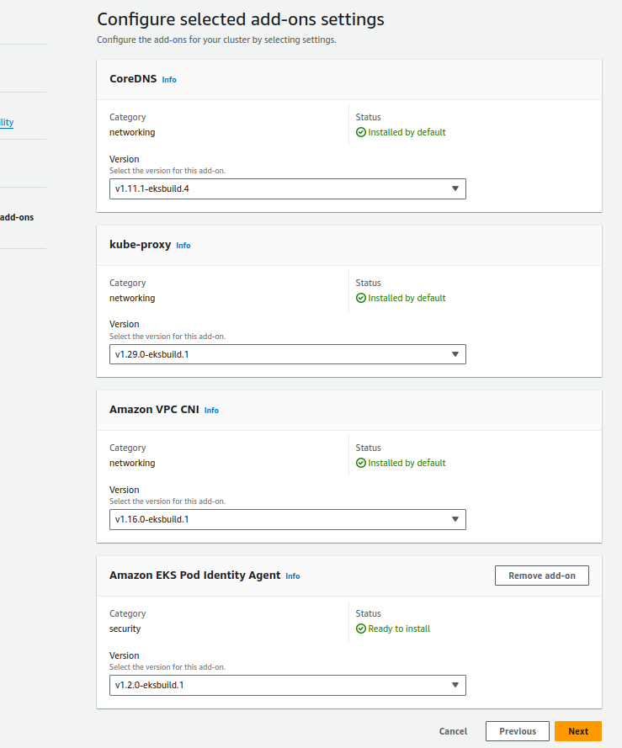
Click next

Slide 13
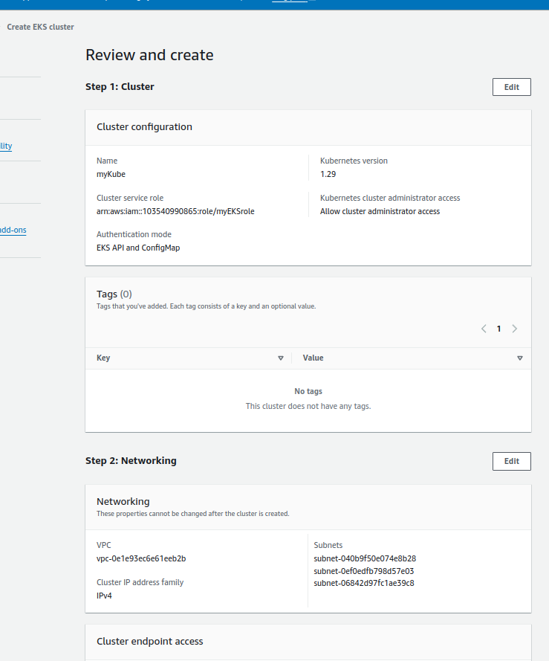
Review and create
Click to create

Slide 14
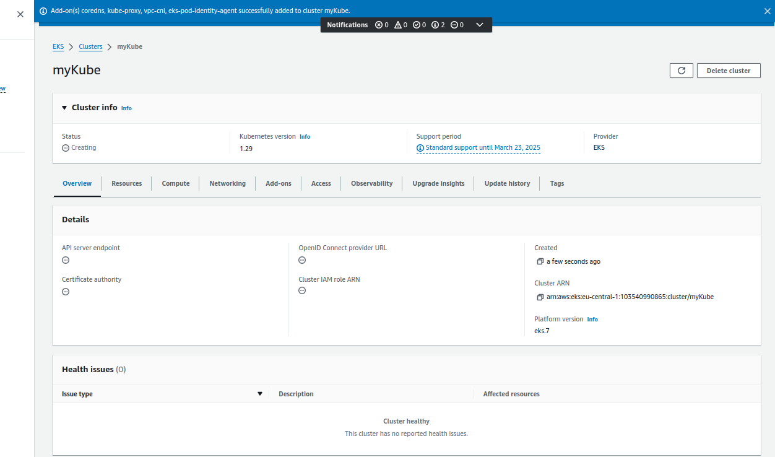
EKS Dashboard
You can delete the cluster at any time

Slide 15
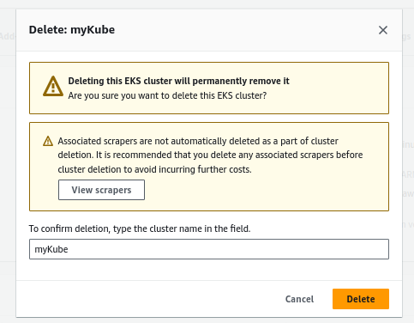
Deleting the Cluster

Slide 16
AWS CLI and EKSCTL
You can do everything from command line as well, which is also suitable for Jenkins
This is very similar to AZ tool on Azure
AWS cli and EKSCTL cli tools have to be installed on your local computer
Kubectl (that comes with minikube for example) must be installed on you local computer as well
Then you can manage your Kubernetes cluster on the cloud from your local computer as if it was running on your local computer

Slide 17
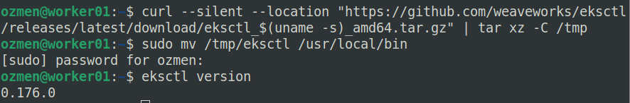
Install aws and eksctl CLIs
To control AWS Kube Cluster from local computer aws-CLI + eksctl have to be installed to your local computer:
Install aws:
> sudo apt install awscli
3) sudo mkdir -p /etc/apt/keyrings
Install eksctl:
https://eksctl.io/installation/, https://docs.aws.amazon.com/emr/latest/EMR-on-EKS-DevelopmentGuide/setting-up-eksctl.html
> curl --silent --location "https://github.com/weaveworks/eksctl/releases/latest/download/eksctl_$(uname -s)_amd64.tar.gz" | tar xz -C /tmp
> sudo mv /tmp/eksctl /usr/local/bin
7) echo "deb [arch=`dpkg --print-architecture` signed-by=/etc/apt/keyrings/microsoft.gpg] https://packages.microsoft.com/repos/azure-cli/ $AZ_REPO main" | sudo tee /etc/apt/sources.list.d/azure-cli.list
https://docs.aws.amazon.com/cli/latest/userguide/getting-started-install.html
https://docs.aws.amazon.com/eks/latest/userguide/setting-up.html

Slide 18
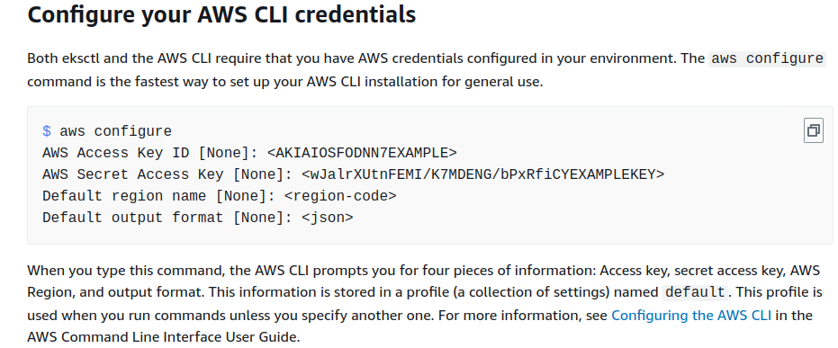
Credentials
https://docs.aws.amazon.com/emr/latest/EMR-on-EKS-DevelopmentGuide/setting-up-cli.html

Slide 19
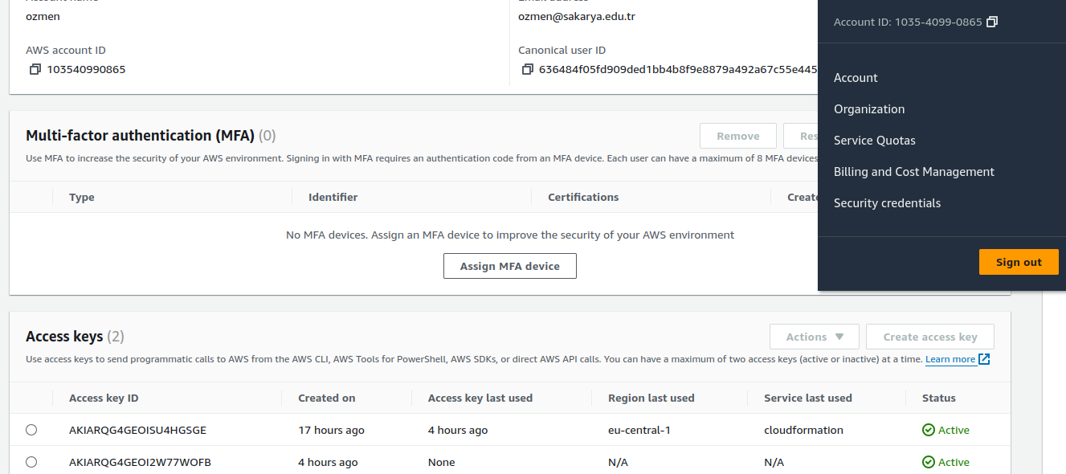
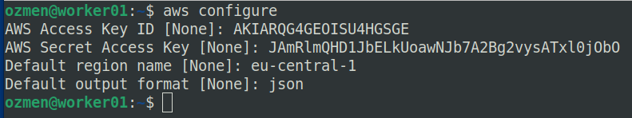
Click this
Create this

Slide 20
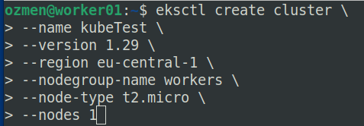
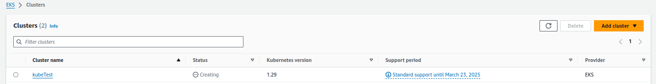
Create a Kube cluster using eksctl
$> eksctl create cluster \
> --name kubeTest \
> --version 1.29 \
> --region eu-central-1 \
> --nodegroup-name workers \
> --node-type t2.micro \
> --nodes 1
Creation of the cluster takes sometime
10 to 15 mins.
Watch the CLI and web dashboard.

Slide 21
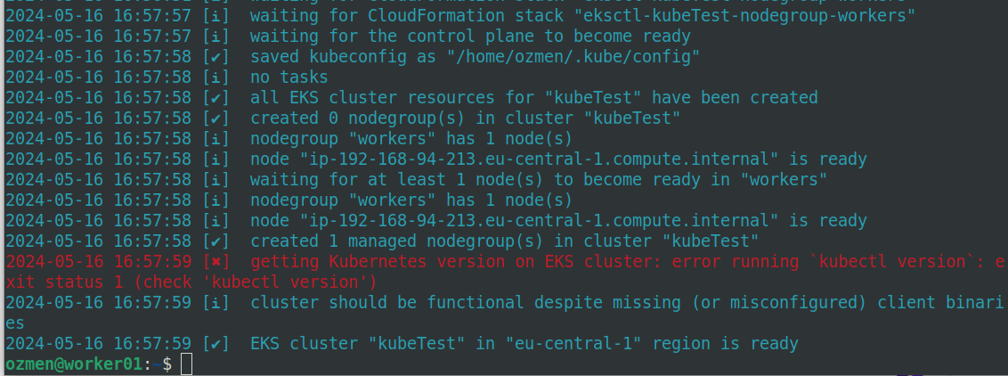
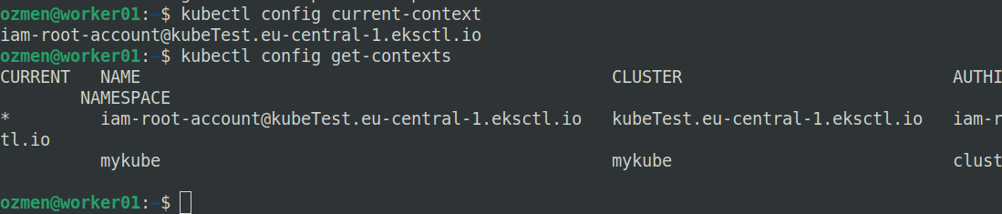
eksctl

Slide 22
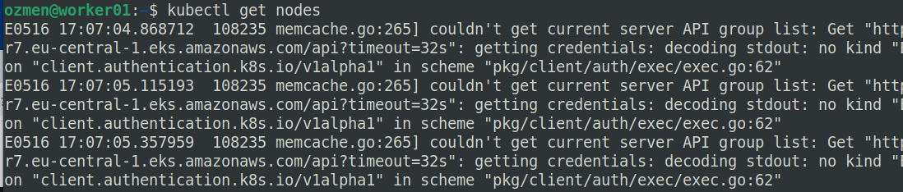
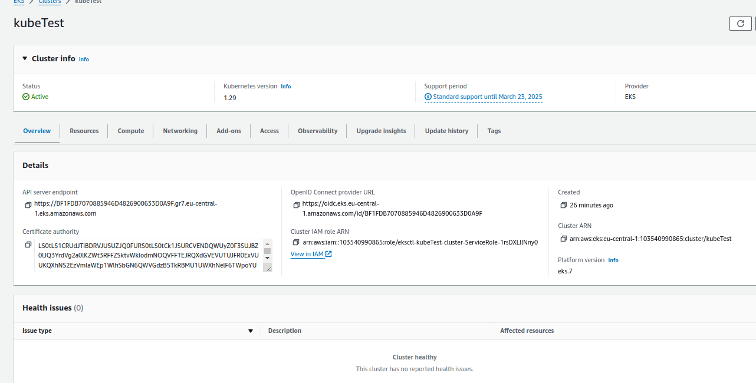
Get nodes
Credentials caused a problem! I will fix it later.

Slide 23
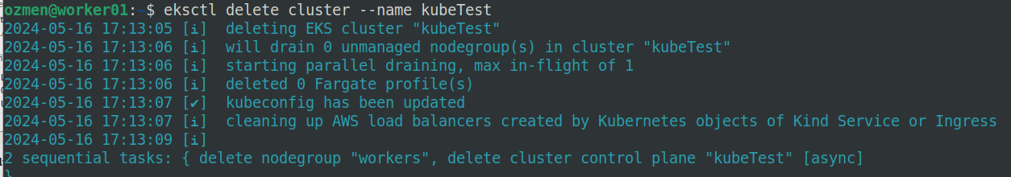
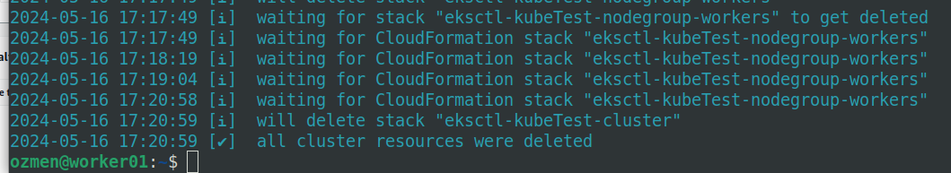
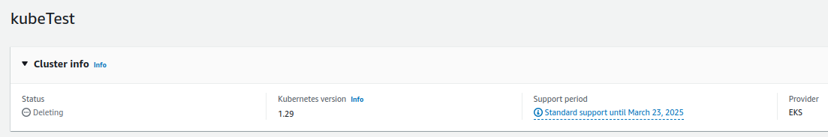
Delete cluster

Slide 24

Questions?

