Slide 1
SWE 304
Development and Operations DevOps
Week – 14
Kubernetes – Azure Cloud
Ahmet Özmen
2024

Slide 2
Overview
Objectives
Kubernetes Cloud deployment tools
AKS on Azure, EKS on Amazon
Deploying applications on AKS and monitoring
Examples

Slide 3
Objectives
Who took this course can (should) answer the following questions:
Use of Microsoft-Azure AKS for web app deployment and monitoring

Slide 4
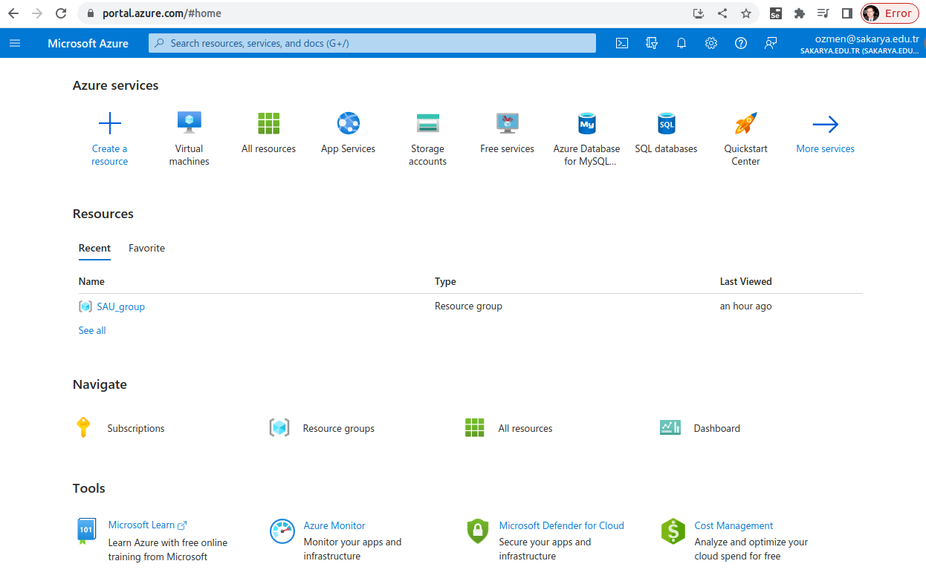
Microsoft Azure

Slide 5
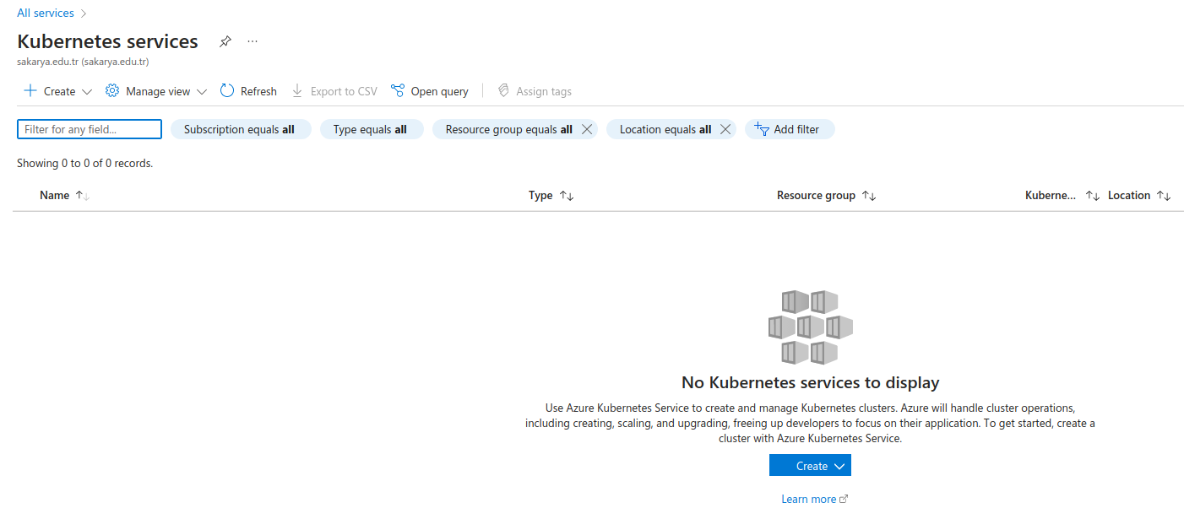
Creating Kubernetes Cluster

Slide 6
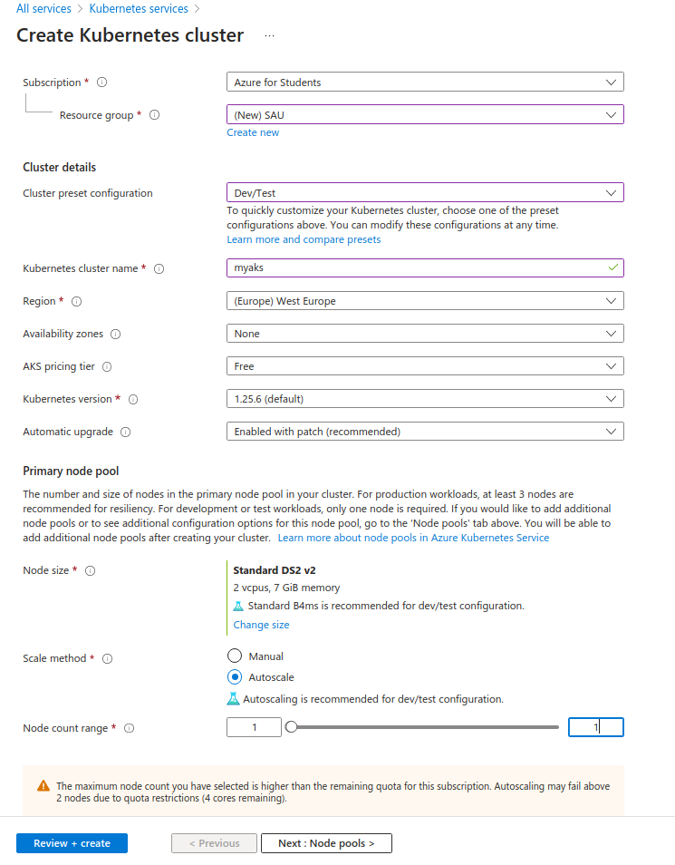

Slide 7
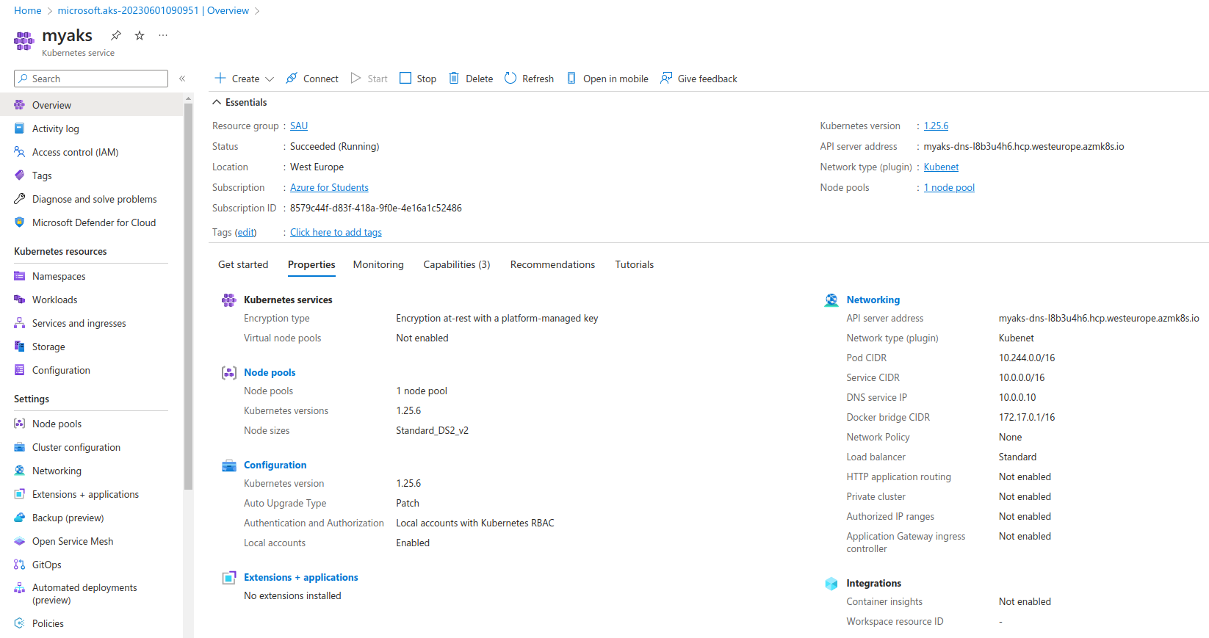
Azure Kubernetes Cluster

Slide 8
Install az CLI
To control Azure Kube Cluster from local computer Azure-CLI has to be installed to local
computer:
1) sudo apt-get update
2) sudo apt-get install ca-certificates curl apt-transport-https lsb-release gnupg
3) sudo mkdir -p /etc/apt/keyrings
4) curl -sLS https://packages.microsoft.com/keys/microsoft.asc | gpg --dearmor | sudo tee /etc/apt/keyrings/microsoft.gpg > /dev/null
5) sudo chmod go+r /etc/apt/keyrings/microsoft.gpg
6) AZ_REPO=$(lsb_release -cs)
7) echo "deb [arch=`dpkg --print-architecture` signed-by=/etc/apt/keyrings/microsoft.gpg] https://packages.microsoft.com/repos/azure-cli/ $AZ_REPO main" | sudo tee /etc/apt/sources.list.d/azure-cli.list
8) sudo apt-get update
9) sudo apt-get install azure-cli
(https://learn.microsoft.com/en-us/cli/azure/install-azure-cli-linux?pivots=apt)

Slide 9
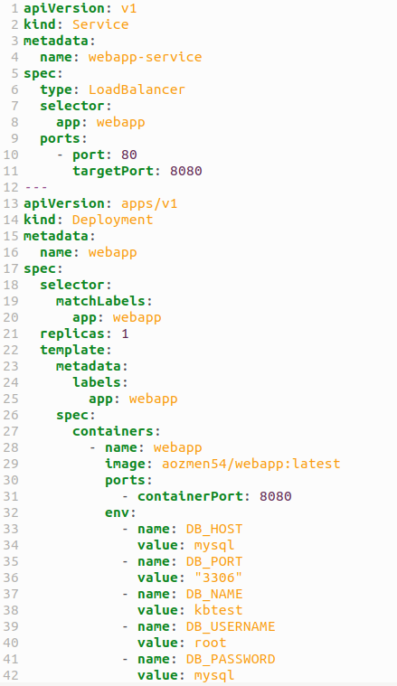
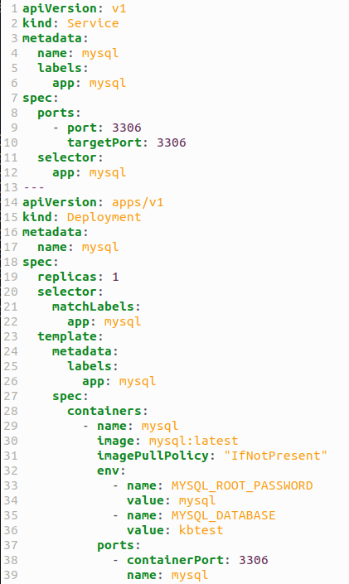
Webapp deployment and service
These changes
should be done
to access the app
No changes!
Regarding last
week example
webapp-depl.yml
db-depl.yml

Slide 10
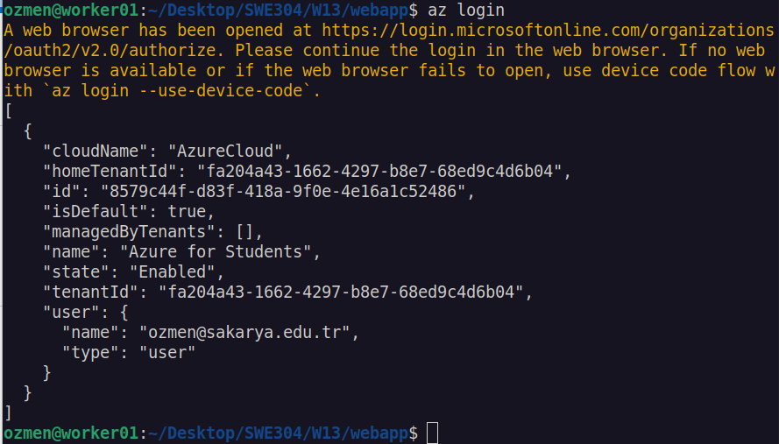
Azure login
You will be directed to web page for login process.

Slide 11
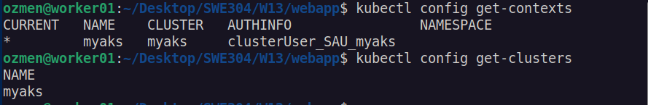
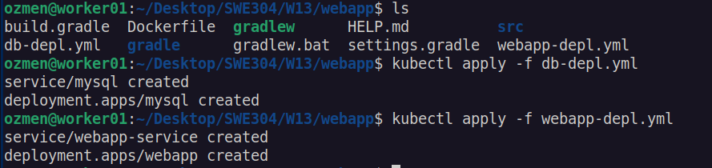

Use of Azure Kubernetes cluster
Deploy the
app
See the pods

Slide 12
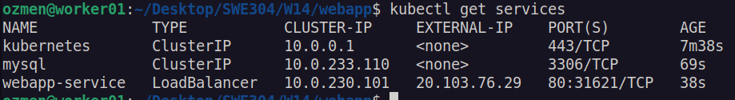

Test the running application
Web browser
Note: No data stored in database, hence table is empty!

Slide 13
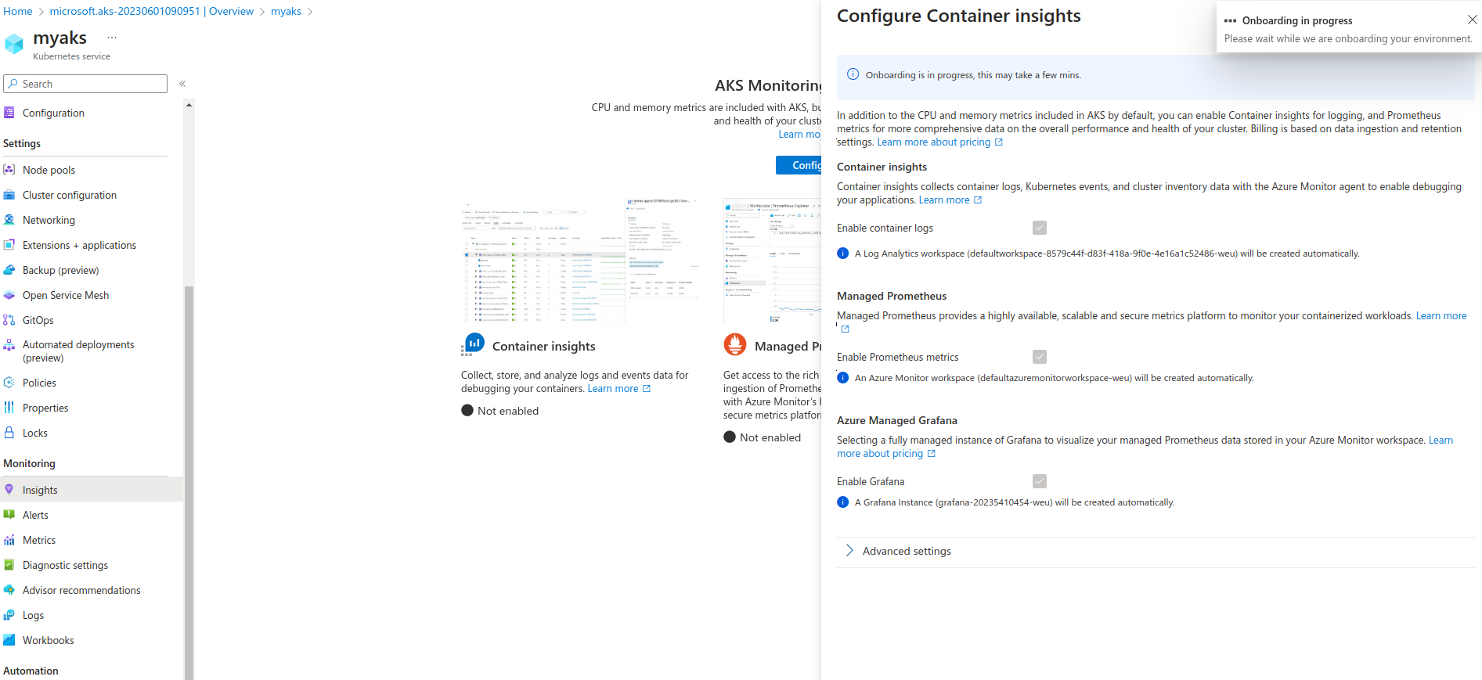
Monitoring

Slide 14
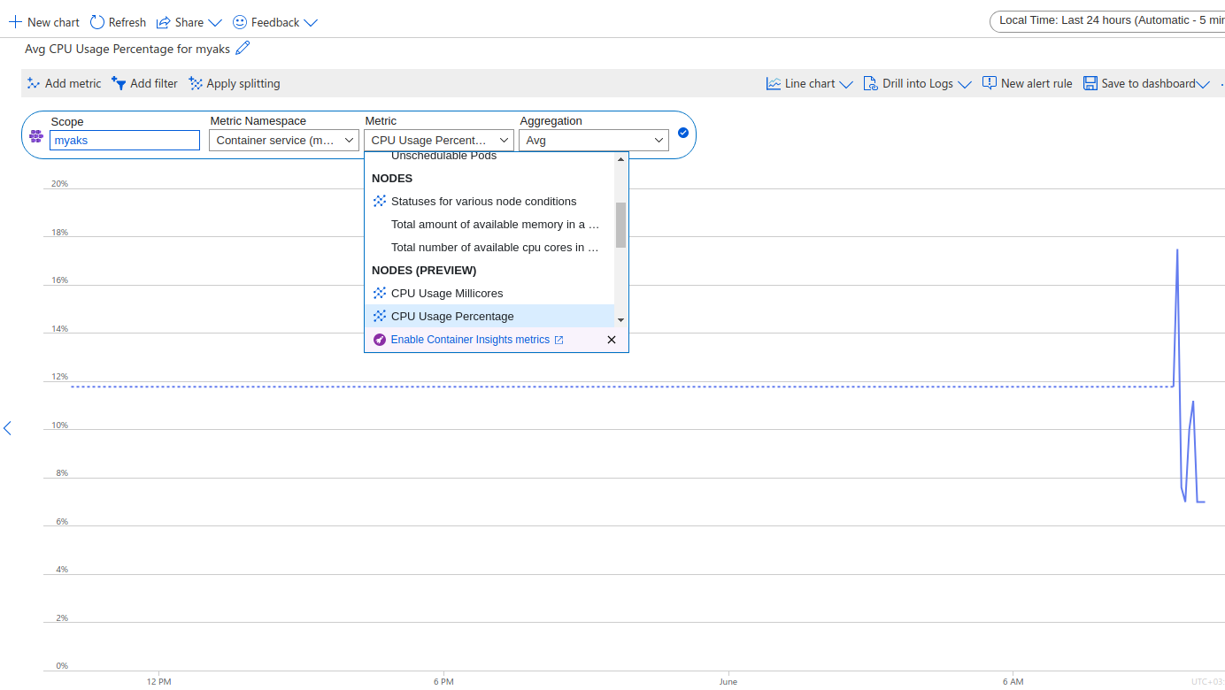
Monitoring

Slide 15
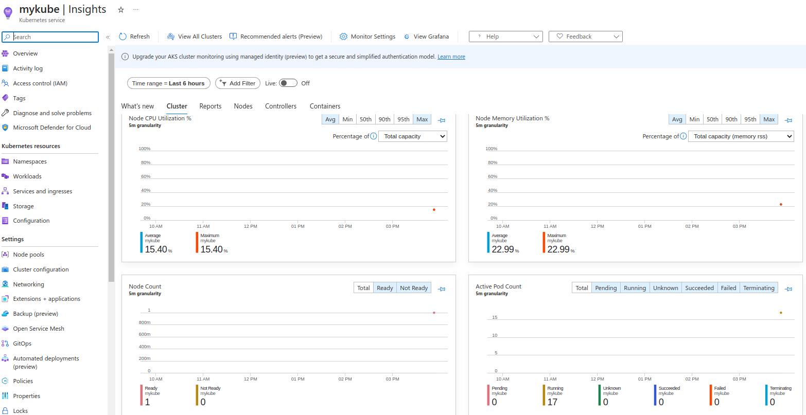
Nodes and utilization graphs

Slide 16

Questions?

