Slide 1

1，2

Slide 2
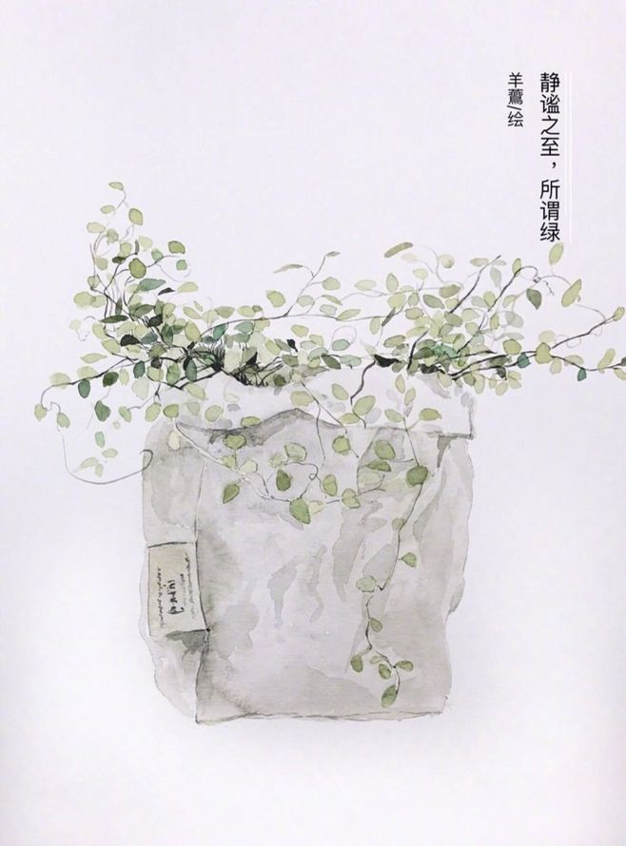
1
I remember a day some years back, one of the first days of a new semester in college. People were tossing balls, passing out catalogs, and handing out free stuff. I was completely charmed by all the activity. After all,a major feature of college life in the U.S. is limited finances, so free stuff is like gold. As a college student, I felt entitled to my share!

Slide 3

1
catalog
1.目录
(also catalogue)a complete list of things that you can look at,buy,or use,e,g.in a library or at an art show
2.为......编目录；把......列入目录中
(also catalogue)make a complete list of all the things in a group
entitle 使有权利；使有资格
give sb. the official right to do or have sth.

Slide 4

2
I moved closer to scout out the situation. In my mind, I heard my mother issue her famous line:"There is no such thing as free stuff!" as the student behind the table urged me to receive a brand-new dictionary. My mom's voice was quickly filtered out as I reached out to claim my gift. I was handed a form instead. Once I completed the credit card application I was told, I would receive a free dictionary With the confidence that a probe of my finances would reveal the sheer weakness of my profile, I completed the form and submitted it.

Slide 5

2
scout
1.对（某地）进行侦察(also~out)examine a place or area in order to get information about it
2.（在某地区）寻找(also~around/round)look for sth.in a particular area
issue
officially make a statement, give an order warning.ctc.发表(声明):颁布，发出(命令警告等)
a subject or problem that is often discussed or argued about, esp, a social or political matter that affects the interests of a lot of people议题， 争论的问题
filter
pass sth. through a filter to remove particular things contained in it过滤

Slide 6
2
probe
a complete and careful investigation of
sth.探究；详细调查
ask questions in order to find things out, esp.
things that other people do not want you to
know调查；打探；探究
sheer
(only before noun) used for emphasizing the amount or degree of sth.纯粹的；全然的；绝对的
profile
a short description that gives important details about a person, group of people, or place人物简介；传略；(某地方的)概况
write or give a short description of sb. or sth. 写...的传略(或概况)
submit
give a plan, piece of writing, etc. to sb. in authority for them to consider or approve 呈送，提交，呈递(计划等)
agree to obey a rule, a law, or the decision of sb.in authority(使)遵守；(使) 服从

Slide 7
感谢
您的观看
廖嘉懿

