Slide 1

Association of Low-Frequency and Rare Coding-Sequence Variants with Blood Lipids and Coronary Heart Disease in 56,000 Whites and Blacks
Gina M. Peloso, Paul L. Auer, Joshua C. Bis, Arend Voorman, Alanna C. Morrison, Nathan O. Stitziel, Jennifer A. Brody, Sumeet A. Khetarpal, Jacy R. Crosby, Myriam Fornage, Aaron Isaacs, Johanna Jakobsdottir, Mary F. Feitosa, Gail Davies, Jennifer E. Huffman, Ani Manichaikul, Brian Davis, Kurt Lohman, Aron Y. Joon, Albert V. Smith, Megan L. Grove, Paolo Zanoni, Valeska Redon, Serkalem Demissie, Kim Lawson, Ulrike Peters, Christopher Carlson, Rebecca D. Jackson, Kelli K. Ryckman, Rachel H. Mackey, Jennifer G. Robinson, David S. Siscovick, Pamela J. Schreiner, Josyf C. Mychaleckyj, James S. Pankow, Albert Hofman, Andre G. Uitterlinden, Tamara B. Harris, Kent D. Taylor, Jeanette M. Stafford, Lindsay M. Reynolds, Riccardo E. Marioni, Abbas Dehghan, Oscar H. Franco, Aniruddh P. Patel, Yingchang Lu, George Hindy, Omri Gottesman, Erwin P. Bottinger, Olle Melander, Marju Orho-Melander, Ruth J.F. Loos, Stefano Duga, Piera Angelica Merlini, Martin Farrall, Anuj Goel, Rosanna Asselta, Domenico Girelli, Nicola Martinelli, Svati H. Shah, William E. Kraus, Mingyao Li, Daniel J. Rader, Muredach P. Reilly, Ruth McPherson, Hugh Watkins, Diego Ardissino, Qunyuan Zhang, Judy Wang, Michael Y. Tsai, Herman A. Taylor, Adolfo Correa, Michael E. Griswold, Leslie A. Lange, John M. Starr, Igor Rudan, Gudny Eiriksdottir, Lenore J. Launer, Jose M. Ordovas, Daniel Levy, Y.-D. Ida Chen, Alexander P. Reiner, Caroline Hayward, Ozren Polasek, Ian J. Deary, Ingrid B. Borecki, Yongmei Liu, Vilmundur Gudnason, James G. Wilson, Cornelia M. van Duijn, Charles Kooperberg, Stephen S. Rich, Bruce M. Psaty, Jerome I. Rotter, Christopher J. O’Donnell, Kenneth Rice, Eric Boerwinkle, Sekar Kathiresan, L. Adrienne Cupples
The American Journal of Human Genetics
Volume 94, Issue 2, Pages 223-232 (February 2014)
DOI: 10.1016/j.ajhg.2014.01.009
Copyright © 2014 The American Society of Human Genetics Terms and Conditions

Slide 2
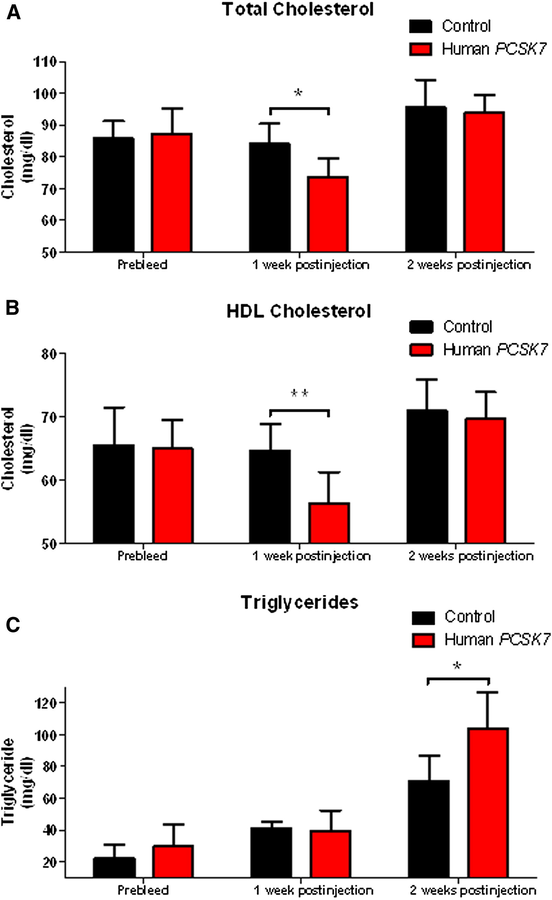
Figure 1
The American Journal of Human Genetics 2014 94, 223-232DOI: (10.1016/j.ajhg.2014.01.009)
Copyright © 2014 The American Society of Human Genetics Terms and Conditions
Notes:
Effects of Human PCSK7 Overexpression in Mouse Liver on Plasma Lipids
Plasma TC (A), HDL-C (B), and TG (C) were measured at baseline and at 7 and 14 days after injection of the human PCSK7 or control AAV8 vectors in C57BL/6J male mice. Error bars show standard deviations. ∗p < 0.05 and ∗∗p < 0.01, Student’s unpaired t test.

