Slide 1
GPU Architecture and Its Role in Deep Learning
Zhirui Hu
Department of Statistics
Oregon State University
04/22/2026

Slide 2
Graphics Processing Unit (GPU)
A GPU is a specialized electronic circuit designed for rapid mathematical calculations, originally designed for rendering images, videos, and 3D graphics, now used for modern AI development.
Unlike a CPU's few cores, GPUs have hundreds or thousands of smaller cores designed for parallel processing, execute the same operation on many data points simultaneously, called SIMD (Single Instruction, Multiple Data)
Handle data-intensive tasks like gaming, AI, video editing and scientific simulation.

Slide 3
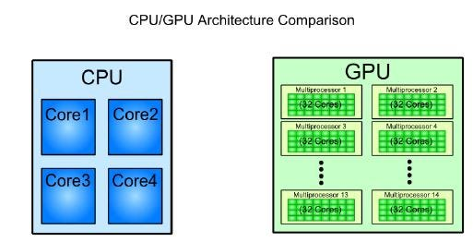
CPU: Has a few powerful cores that process tasks sequentially or with limited parallelism.
GPU: Contains thousands of smaller cores designed for massive parallelism.
a CPU is optimized for general-purpose computing, a GPU excels in handling thousands of smaller, independent computations simultaneously.
https://medium.com/ai-insights-cobet/understanding-gpu-architecture-basics-and-key-concepts-40412432812b

Slide 4
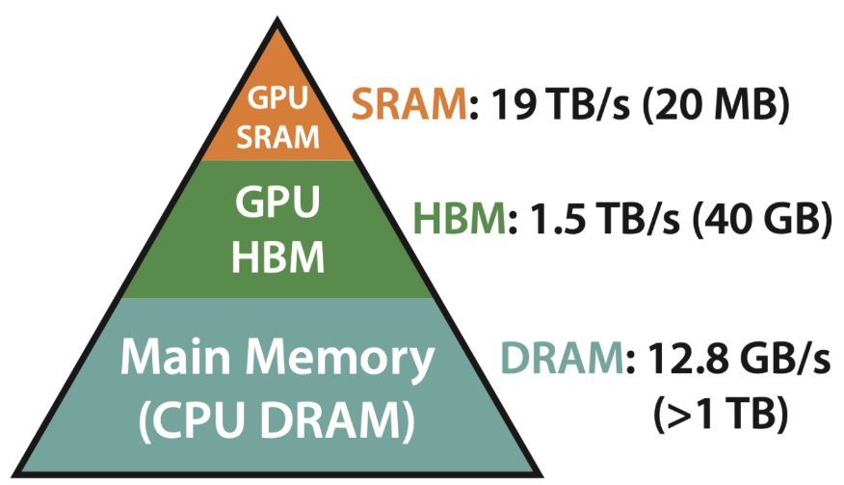
GPU memory hierarchy
SRAM (Static RAM) — Fastest Cache Memory
SRAM (Register/L1/L2 cache) helps GPUs process data much faster by reducing the need to fetch data from the slower global memory (VRAM/DRAM).
HBM: High Bandwidth Memory (Global memory)
(>> CPU Memory)
Optimizing how data is stored improves GPU performance
Notes:
To support these cores, how GPU memory is designed.
Reduce data transfer between GPU and CPU
to maximize computational efficiency

Slide 5
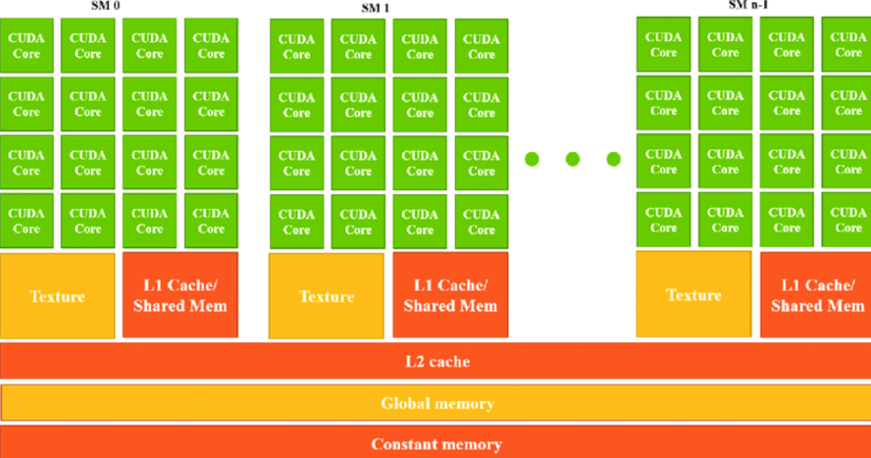
Streaming Multiprocessors (SMs)
SM schedules and executes multiple warps
All cores in a warp must execute the same instruction simultaneously but operate on different data, using multiples of 32 in tensor shapes ensures that all cores in a warp are utilized efficiently
Each GPU core can perform one Floating Point Operation (FLOP) per cycle.
Keep memory usage per program low to ensure more programs (PIDs) run per SM
Notes:
When a program runs on a GPU, it gets split across multiple SMs, and each SM works on a chunk of data.
Each SM contains multiple GPU cores, a small memory pool (SRAM), and `execution units.
Each SM operates independently, handling multiple programs in parallel, communicate with global memory (slower but larger)
A warp is a group of threads (typically 32) that execute in parallel

Slide 6
CPU vs GPU runtime in Monte Carlo Simulations
Estimating π with Random Points
Bootstrap Confidence Interval

Slide 7
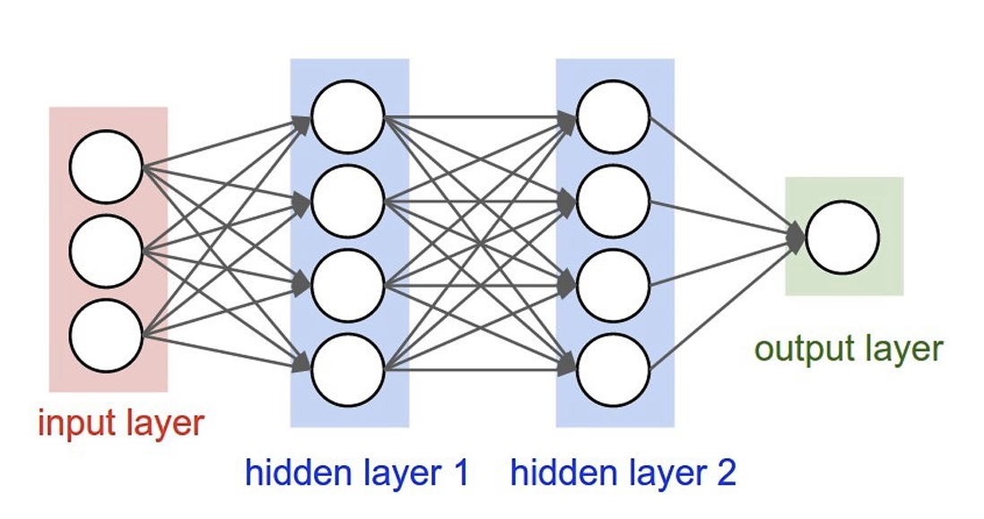
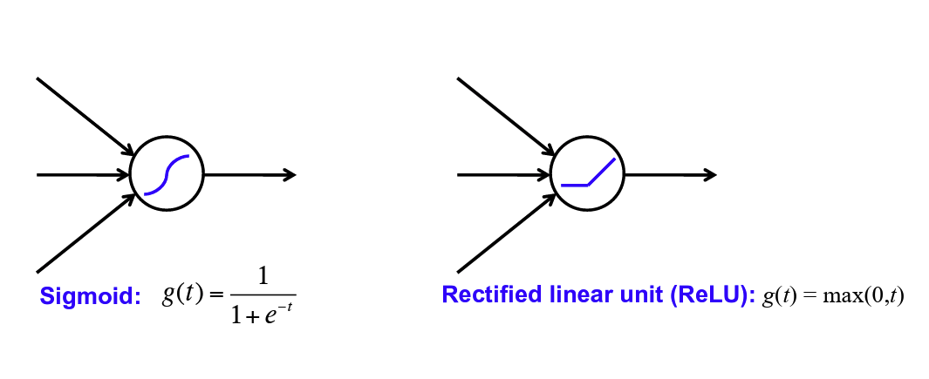
Neural networks
Perceptron -> Multi-layer perceptrons -> Deep Learning
Many crucial algorithms and innovations were developed in the 1980’s and 1990’s, but applications and development were limited by available computational power.
Notes:
The development of neural networks started with single perceptron, simplest case, linear classifier; MLP can solve complex problems (not linearly separable)

Slide 8
Deep Learning Boom & GPUs
massive datasets, high-performance computing power (GPUs), and advanced neural network architectures
Matrix multiplies (forward pass, backprop, weight updates) and convolution split into many independent tasks, turning simpler per-core performance into enormous aggregate throughput through massive parallelism. ​
Multiply of two 4096×4096 matrices involves ~34 billion floating-point operations, all of which are independent of each other and can run in parallel.
Data parallelism
Notes:
Deep learning boom starting 2010s: increase data set, better computing, better methods (architecture, activation functions, techniques for gradient descent, vanishing gradient problem in backpropagation), hierarchical learning
The vanishing gradient problem was resolved primarily by replacing sigmoid/tanh activation functions with ReLU, implementing smarter weight initialization (Xavier/He), using Batch Normalization, and adopting specialized architectures like ResNets (residual connections) and LSTMs/GRUs.

Slide 9
GPU vendors and models
NVIDIA:
Data Center/High-End: B200 (Blackwell) (best for massive AI), H200/H100 (standard for training), A100 (40GB/80GB).
Workstation/Value: RTX 6000 Ada, L40S, RTX A6000.
Consumer/Entry-Level: RTX 4090, RTX 4080, RTX 3090/3080 Ti.
AMD:
Data Center: AMD Instinct MI300X accelerators (used in top AI cloud platforms)
Google:
TPU v4/v5p (optimized for TensorFlow)
Apple M-Series:
M4: up to 80 Apple GPU cores
Consumer level: ML inference, no CUDA support
Notes:
Apple integrates GPUs directly into their chips
CUDA provides a way for programmers to write code that runs on those thousands of GPU cores at once
Most deep learning libraries don't natively support Metal (API for apple) as well as CUDA

Slide 10
Comparison of NVIDIA GPU models
Model | Arch. | VRAM | CUDA | BW (GB/s) | TDP (W) | FP32 (TF) | Price
RTX 4060 | Ada | 8 GB GDDR6 | 3,072 | 272 | 115 | 15.1 | $299
RTX 4070 | Ada | 12 GB GDDR6X | 5,888 | 504 | 200 | 29.1 | $599
RTX 4080 Super | Ada | 16 GB GDDR6X | 10,240 | 736 | 320 | 52.2 | $999
RTX 4090 | Ada | 24 GB GDDR6X | 16,384 | 1,008 | 450 | 82.6 | $1,599
RTX 5090 | Blackwell | 32 GB GDDR7 | 21,760 | 1,792 | 575 | 218 | $1,999
RTX 4000 Ada | Ada | 20 GB GDDR6 | 6,144 | 432 | 130 | 26.7 | $1,250
RTX 5000 Ada | Ada | 32 GB GDDR6 | 12,800 | 576 | 250 | 65.3 | $4,000
RTX 6000 Ada | Ada | 48 GB GDDR6 | 18,176 | 960 | 300 | 91.1 | $6,800
H100 SXM | Hopper | 80 GB HBM3 | 16,896 | 3,350 | 700 | 66.9 | $30k
H200 SXM | Hopper | 141 GB HBM3e | 16,896 | 4,800 | 700 | 66.9 | $40k
B200 SXM | Blackwell | 192 GB HBM3e | 20,480 | 8,000 | 1,000 | 40* | $70k
* B200 FP32 at 40 TF; AI/FP8 throughput is ~4× higher
Consumer
Professional
Data Center
TF: TFLOPS, one trillion floating-point calculations per second
Notes:
Ada Lovelace: first computer programmer
Grace hopper: first machine-independent programming languages
David Blackwell: contributions in information theory, statistics, Rao–Blackwell theorem
TDP = How much power the GPU consumes and how much heat it produces at maximum load

Slide 11
▲
Memory Bandwidth Leap
■
VRAM is the ML Bottleneck
AI inference is bandwidth-bound. Consumer GPUs tops at ~1.8 TB/s (RTX 5090). Data Center B200 reaches 8 TB/s, a 4× jump.
Most consumer GPUs cap at 8-24 GB, too small for large models. The RTX 4090's 24 GB makes it the go-to for local ML. Professional GPUs offer up to 48 GB; H200 delivers 141 GB.
●
Architecture Generations
◆
Price vs. Performance Tiers
Ada Lovelace (2022) dominates consumer & professional segments. Hopper (2022) powers H100/H200. Blackwell (2024–25) introduces B200 and RTX 5090 with massive gains in FP8 AI throughput.
Consumer GPUs offer best $/TFLOP for gaming and light ML. Professional add ECC memory and ISV certifications. Data Center cards cost 15–40× more but deliver unmatched memory capacity and bandwidth.

Slide 12
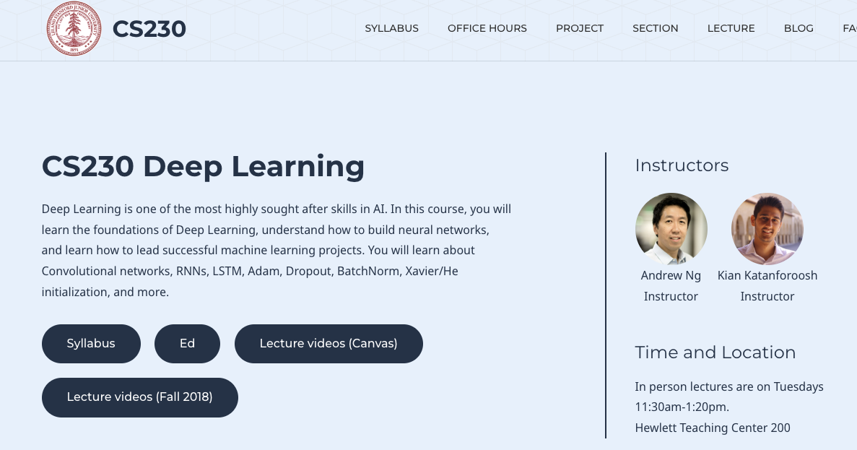

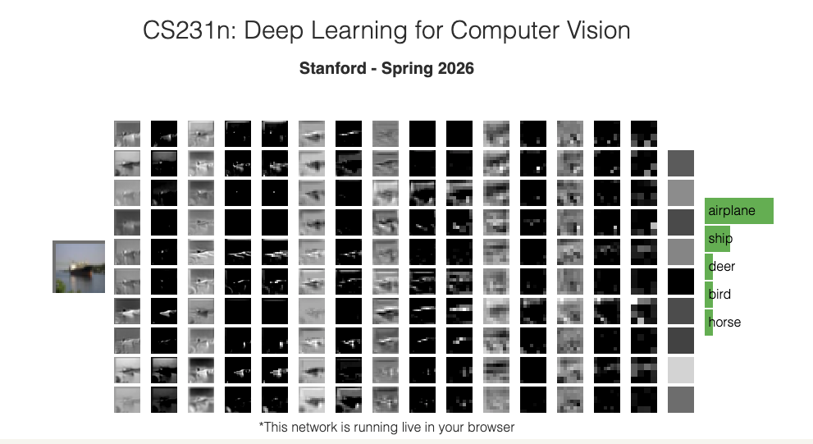
References
http://cs230.stanford.edu/
https://cs231n.github.io/
https://www.d2l.ai/chapter_multilayer-perceptrons/mlp.html

Slide 13
Course material & Communication
Github: https://github.com/xyz111131/AI-Tools-for-Statistical-Research
Slack: https://join.slack.com/t/ai-toolsgroup/shared_invite/zt-3uytyukau-d22XvRJznqomm779lehjtQ

Slide 14
Next lecture
Sign up for computing cluster access
Novus: https://arcs.oregonstate.edu/novus-cluster
COE: https://it.engineering.oregonstate.edu/hpc
Cisco Secure Client: https://mysupport.oregonstate.edu/esp?id=kb_article_view&sys_kb_id=9576db4883f632d4169bcae0deaad3fa
Google Colab account
https://colab.research.google.com/
Free Colab Pro for students and educators

