Slide 1
Accessing GPUs: Cloud and Clusters
Zhirui Hu
Department of Statistics
Oregon State University
04/24/2026

Slide 2
Where to find GPUs to use?
COS/COE computing clusters
Google Colab
Cloud computing:
AWS EC2, GCP compute engine, Azure ML
Dstack for self‑hosted AI environments and cloud
Notes:
Azure: `ai zhr
Dstack is an open-source platform that lets researchers request and run GPU workloads from any cloud provider or on-premise cluster

Slide 3
COS/COE computing clusters

Slide 4
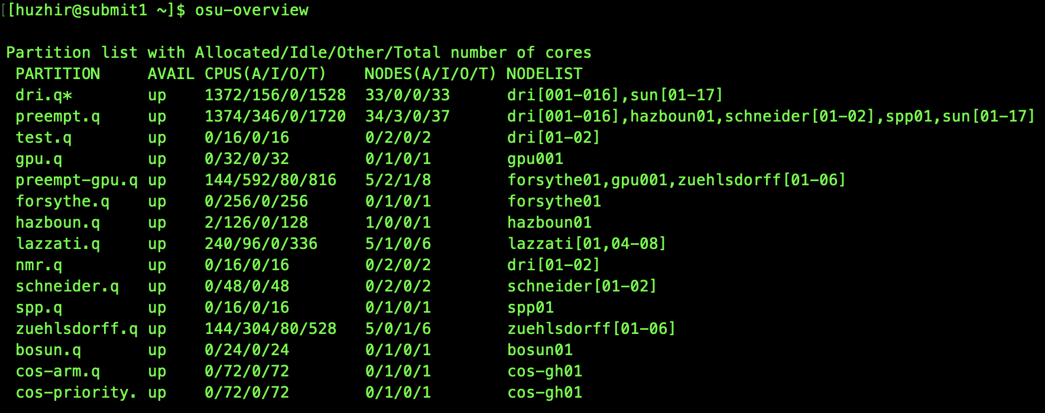
COS computing clusters
Novus HPC Cluster
Connect to VPN if off-campus (cisco)
ssh user@novus.dri.oregonstate.edu

Slide 5
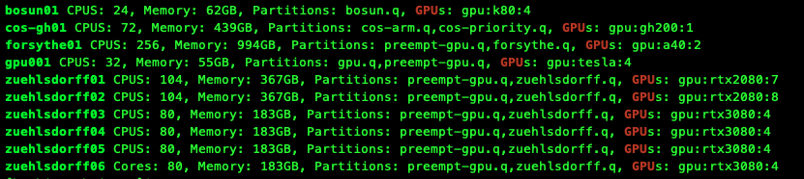
GPUs on Novus HPC Cluster
ssh gpu001
nvidia-smi

Slide 6
COE computing clusters
Connect to VPN if off-campus
Access: ssh user@submit.hpc.engr.oregonstate.edu
Data storage: hpc-share (medium term storage, no backup)
scp / rsync for transferring data
Load module:
module load python/3.10
module load cuda/12.2
module list (check current loaded modules)
https://submit.hpc.engr.oregonstate.edu
Notes:
Access: Interactive apps -> Basic Desktop
On the log in screen, shows quota, how much data storage space, home folder (small), TB on hpc-share
Some packages have already been installed on the server, but you have to load the modules you need to run the program

Slide 7
Partition | Description/Owner | Accounts | Features (e.g. OS / GPU / CPU)
share | Shared resources, open to all users | ALL | el8, el9 / m60, a40 / sandybridge/ivybridge, haswell/broadwell, skylake, epyc, avx2, avx512
dgxh | DGX-H systems | ALL | el9 / h100, h200, vram80g, vram140g / sapphire, avx512
dgx2 | DGX-2 systems | ALL | el9 / v100 / cascade, avx512
ampere | Resources for research group | ALL | el9 / a40 / epyc, avx2
preempt | Low priority queue with access to all resources, but subject to preemption by higher priority jobs | ALL | ALL
nodestat dgx2
https://it.engineering.oregonstate.edu/hpc/slurm-howto

Slide 8
GPU | Arch | FP32 (TFLOPS) ▾ | VRAM | Mem BW (GB/s) | TDP (W) | Primary use
Tesla K40 | Kepler | 4.3 | 12 GB | 288 | 235 W | Legacy HPC, research
M60 | Maxwell | 9.6 | 16 GB | 320 | 300 W | VDI, remote graphics
RTX 2080 | Turing | 10.1 | 8 GB | 448 | 215 W | Gaming, prosumer ML
V100 | Volta | 15.7 | 32 GB | 900 | 300 W | Deep learning, HPC
RTX 3080 | Ampere | 29.8 | 10 GB | 760 | 320 W | Gaming, prosumer ML
A40 | Ampere | 37.4 | 48 GB | 696 | 300 W | Pro vis, AI training
H100 | Hopper | 67 | 80 GB | 3350 | 700 W | LLM training, inference
H200 | Hopper | 67 | 141 GB | 4800 | 700 W | LLM training, inference
For AI/ML: H200 > H100 >> A40 > V100 by a wide margin in bandwidth and VRAM.
VRAM: fast, specialized type of RAM that sits directly on the GPU and stores data needed for immediate processing
Notes:
VRAM is like RAM on CPU (system RAM, slower data access)
VRAM > 40 GB for ML training
TFLOPS (Tera Floating Point Operations Per Second) , Tera: trillion

Slide 9
What model can we run for 48GB VRAM?
Model inference:
70B Models (Quantized): Llama 3.3 70B or Qwen2.5 72B will fit.
Smaller Models (High Precision/long Context): Llama 3.1 8B can run at FP16 with massive context windows (e.g., 100k+ tokens).
Model training/fine-tuning:
QLoRA (Fine-tuning): Llama 3.3 70B barely or Qwen 32B (small batch size).
LoRA (Fine-tuning): Llama 3.1 8B comfortably.
Full fine-tuning/Training: 1B model easily.
This slide is from AI, subject to validation on cluster
Notes:
LoRA (Low-Rank Adaptation) : Add trainable low-rank decomposition matrices (and) to specific layers (often attention modules).

Slide 10
Submitting jobs
Interactive job: srun -p dgx2 --gres=gpu:1 --time=1:00:00 --pty zsh
Batch job: sbatch myBatchFile.sh
View job: squeue -u {username}
Cancel job: scancel {jobid}
https://it.engineering.oregonstate.edu/hpc/slurm-howto

Slide 11
myBatchFile.sh
#!/bin/bash
#SBATCH -J helloWorld # name of job
#SBATCH -p share # name of partition or queue
#SBATCH -o helloWorld.out # name of output file for this submission script
#SBATCH -e helloWorld.err # name of error file for this submission script
#SBATCH -t 24:30:00 # time limit on job: 24 hours, 30 minutes (default 12 hours)
#SBATCH --gres=gpu:1 # number of GPUs to request per node (default 0)
#SBATCH --cpus-per-task=8 # number of cores/threads per task (default 1)
#SBATCH --mem=20G # request 20 gigabytes memory per node
# load any software environment module required for app (e.g. python, R, gcc, cuda)
module load software/version
# run my job (e.g. R, python)
mySoftwareExecutable

Slide 12
Cloud computing

Slide 13
Google colab
Cloud-based Jupyter notebook
Free access to GPUs and TPUs
Free Pro account for students and educators
File system: Temporary storage that clears when your session ends (you can mount Google Drive to persist files)
Libraries: Most common data science libraries are pre-installed
Notes:
Pip install

Slide 14
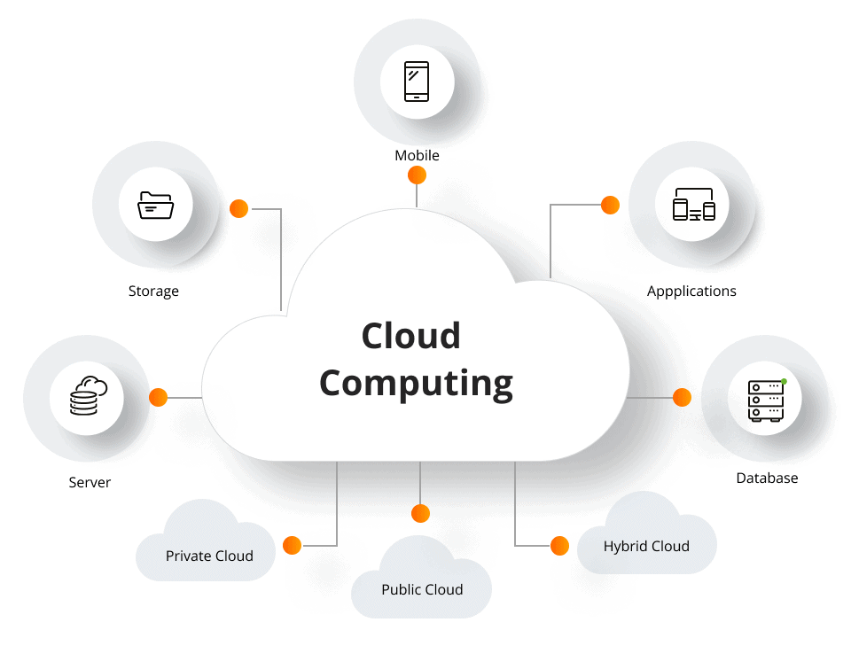
Why Cloud Computing
Run large statistical/ML workloads without managing physical hardware
Virtual machine (VM)
a software-emulated computer running on shared hardware
root access to a "computer" you never physically touch
Notes:
You program will be run on VM
As if using your own coputer

Slide 15
Pros & Cons of Cloud Computing
Pros:
Scalability: e.g. run 10,000 simulations overnight, pay only for that time
Access GPUs, high-memory machines without owning them
Reproducibility: environment snapshots ensure running the exact same setup (but can change over time due to updates)
Easy to share data and codes
Cons:
High (unexpected) cost: free tiers or trial credits
Data privacy and compliance
Steep learning curve
Notes:
Set up computing environment on Virtual machine, environment snapshots…
Stored in the cloud drive, Multiple users can access
Setup account and environment ,and learn the pricing model

Slide 16
Basic steps to run jobs on cloud
Launch a virtual server (called an instance)
Choose OS, CPU/GPU count, RAM, and storage.
SSH to virtual server
Install software and run jobs
Download results or save to cloud storage
Terminate instance
Azure ML workspace creates a jupyter notebook, no need ssh

Slide 17
Instances
AWS EC2
t3 — cheap, general purpose (dev work)
m6i — balanced CPU + memory
r6i — memory-optimised (large datasets)
p3/p4 — GPU instances for deep learning
On-demand — pay by the second, no commitment
Spot — up to 90% cheaper; instance may be interrupted
Reserved — 1–3 yr commitment, big discount
GCP Compute Engine
E2 — cost-optimised, good for light jobs
N2 — general purpose, balanced
M3 — memory-optimised (up to 12 TB RAM)
A2/A3 — NVIDIA GPU machines
Preemptible VMs — equivalent of Spot, ~80% cheaper
Notes:
Tiers of instances,
Spot, preempt, save checkpoint of your model during training often

Slide 18
Comparison of cloud service providers
Dimension | AWS EC2 | GCP Compute Engine | Azure ML
Abstraction level | Raw VMs | Raw VMs | Managed ML platform
Best for | Flexible, general purpose compute | Sustained use discounts, Google-ecosystem | End-to-end ML pipelines
Softwares | Install anything manually; Jupyter through SSH tunnel | Install anything; Vertex AI Workbench for Jupyter | Managed Jupyter; conda envs built-in
Strengths | Largest instance catalogue, mature ecosystem | Fastest network infrastructure for data-heavy workloads, gcloud CLI is cleaner for reproduciblility | log metrics in dashboard, auto model selection (AutoML)
Notes:
Integrate with Google-ecosystem
Vertex AI Workbench is a managed, unified Jupyter-based development environment on Google Cloud designed for the entire data science and machine learning (ML) workflow.
CLI: command liner interface
Azure ML: provides a full workspace for training, tracking experiments, and deploying models, MLflow integration — log metrics & models

Slide 19
Data storage
Tiers | Name (AWS/GCP/Azure)
Store large files or datasets | S3 / GCS / Blob
Fast read/write during a job, Disk attached to instance | EBS / Persistent Disk / Azure Disk
Share data across instances | EFS / Filestore / Azure Files
Relational database | RDS / BigQuery / Azure SQL

Slide 20





What is Dstack?
GPU-first design
Open-Source Orchestration
Request A100s, H100s, or any GPU with one line
Dstack is an open-source platform that lets researchers request and run GPU workloads from any cloud provider or on-premise cluster — through a simple CLI and Python SDK.
Container-based
Define your env with Docker or conda — reproducible
Multi-cloud & on-prem
Think of it as:
AWS, GCP, Azure, Lambda, or your own cluster
"Slurm for the cloud — but friendlier."
Python & CLI friendly
Works with Jupyter, PyTorch, R, and more
https://dstack.ai/docs/guides/migration/slurm/#dstack
Notes:
AI/ML engineers , manage GPU infrastructure
Jupter: dev environment

Slide 21
How Dstack Works — 3 Simple Steps
1
2
3
Define Your Task
Submit with CLI
Get Results
Write a YAML config specifying your GPU type, Docker image, and script.
One command provisions the GPU and runs your job on any backend.
Access outputs, attach VS Code or Jupyter, or pull artifacts locally.
type: task
image: pytorch/pytorch:2.2
gpu: 1
commands:
- python train.py
dstack run . \
-f train.dstack.yml
# Streams logs in
# real-time
dstack run . \
--ide vscode
# Opens remote
# VS Code session

