Slide 1
PyTorch Basics: Tensors & GPU Execution
Department of Statistics
Oregon State University
04/29/2026

Slide 2
What is Pytorch
PyTorch (https://pytorch.org/) is an open-source Python-based deep learning library, the most widely used since 2019
A replacement for NumPy to use the power of GPUs and other accelerators.
An automatic differentiation library (known as autograd) that is useful to implement neural networks.
Offers modular, flexible, and efficient building blocks (e.g. pre-trained models, loss functions, and optimizers) for designing and training deep learning models

Slide 3
Tensor
A mathematical concept that generalizes vectors and matrices to potentially higher dimensions.
From a computational perspective, tensors are multi-dimensional arrays
PyTorch tensors are similar to NumPy arrays but with additional features for deep learning (similar API and syntax)

Slide 4
TENSOR BASICS
Creating Tensors
From Python data
K Points
torch.tensor([1, 2, 3])
torch.tensor([[1,2],[3,4]], dtype=torch.float32)
Tensors are multi-dimensional arrays, similar to NumPy ndarrays
dtype controls precision (see Table in the next slide)
Use requires_grad=True to track gradients for autograd
GPU tensors created via device='cuda' argument
Zeros, Ones & Random
torch.zeros(3, 4)
torch.ones(2, 3)
torch.rand(3, 3) # Uniform [0,1)
torch.randn(3, 3) # Normal(0,1)
Ranges & Identity
torch.arange(0, 10, 2) # [0,2,4,6,8]
torch.linspace(0, 1, 5) # 5 evenly spaced
torch.eye(3) # 3x3 identity
Notes:
Data type
torch.distributions package

Slide 5
TENSOR BASICS
Tensor Data Types (dtype)
dtype | Bits | Common Use in Deep Learning
torch.float16 / half | 16-bit | FP16 mixed-precision training, inference on GPUs with limited VRAM
torch.bfloat16 | 16-bit | Mixed precision on TPUs & modern GPUs (A100+); wider range than FP16
torch.float32 / float | 32-bit | Default dtype — standard training, weights, activations, loss computation
torch.float64 / double | 64-bit | Rarely used; numerical precision testing, scientific computing
torch.int8 | 8-bit | Post-training quantization (PTQ), INT8 inference acceleration
torch.int16 / short | 16-bit | Uncommon; some audio processing or custom quantization
torch.int32 / int | 32-bit | Indexing tensors, class labels, token IDs
torch.int64 / long | 64-bit | Default integer — target labels, cross-entropy indices, embedding lookups
torch.bool | 1-bit | Masks (attention masks, padding masks), conditional logic
torch.complex64 | 64-bit | Spectrograms, FFT operations, signal processing in DL
💡 Default: torch.float32 for floats, torch.int64 for integers. Use torch.set_default_dtype() to change globally.
Notes:
Post-training quantization (PTQ) is a model compression technique where a trained neural network’s parameters are converted from high-precision numbers in training to lower-precision ones for inference.

Slide 6

TENSOR BASICS
Shape, Dimensionality
Shape & Dimensionality
x = torch.rand(2, 3, 4)
x.shape # torch.Size([2, 3, 4])
x.ndim # 3
x.numel() # 24 (total elements)
x.size(0) # 2 (first dimension)
Notes:
Broadcasting allows PyTorch to perform operations on tensors of different shapes without copying data. PyTorch follows NumPy's broadcasting rules.

Slide 7
TENSOR BASICS
Tensor Multiplication & Broadcasting
Element-wise ( * )
Broadcasting Rules
a = torch.tensor([1, 2, 3])
b = torch.tensor([4, 5, 6])
c = a * b # [4, 10, 18]
# Also: torch.mul(a, b)
1
Align dimensions from the right
Shapes must match or be broadcastable
2
Each pair must be equal or one of them is 1
Matrix Multiply ( @ )
3
Missing dims are treated as size 1
A = torch.rand(2, 3)
B = torch.rand(3, 4)
C = A @ B # [2, 4]
# Also: torch.matmul(A, B)
A shape | B shape | Result
[3, 4] | [3, 4] | [3, 4] ✓
[3, 1] | [1, 4] | [3, 4] ✓
[5] | [3, 5] | [3, 5] ✓
[2, 1, 3] | [4, 3] | [2, 4, 3] ✓
[3, 4] | [5, 4] | Error ✗
Inner dims must match: [m,k] @ [k,n] → [m,n]
Batched MatMul
A = torch.rand(8, 3, 4) # batch=8
B = torch.rand(8, 4, 5)
C = A @ B # [8, 3, 5]
# Also: torch.bmm(A, B)
Batch dims broadcast; last 2 dims follow matrix rules

Slide 8

TENSOR BASICS
Broadcasting
Broadcasting Rules
a = torch.rand(3, 1) # shape [3,1]
b = torch.rand(1, 4) # shape [1,4]
c = a + b # shape [3,4]
# Dims align right-to-left;
# size 1 stretches to match
Broadcasting Visualization
[3, 1]
[1, 4]
[3, 4]
a₁
b₁
b₂
b₃
b₄
a₂
+
=
a₃
Result
Notes:
Broadcasting allows PyTorch to perform operations on tensors of different shapes without copying data. PyTorch follows NumPy's broadcasting rules.

Slide 9
TENSOR BASICS
view(), reshape(), permute(), transpose()
view()
reshape()
Reshapes tensor without copying data. Requires contiguous memory layout.
Like view() but works on non-contiguous tensors — may copy data if needed.
x = torch.arange(12).view(3,4)
y = x.t() # non-contiguous
z = y.reshape(4, 3) # works!
# y.view(4,3) may raise error depends on version
x = torch.arange(12)
y = x.view(3, 4) # [3, 4]
z = x.view(2, -1) # [2, 6] inferred
permute()
transpose()
Reorders all dimensions at once. Returns a view (no data copy).
Swaps exactly two dimensions. Returns a view (no data copy). Alias: .T for 2D tensors.
x = torch.rand(2, 3, 4)
# [batch, height, width] -> [batch, width, height]
y = x.permute(0, 2, 1) # [2, 4, 3]
x = torch.rand(3, 4)
y = x.transpose(0, 1) # [4, 3]
z = x.T # same as above
Notes:
View(): zero_copy for performance
Reshape implicitly make a copy to make it contiguous and view

Slide 10
DEVICE TRANSFER
Moving Tensors Between Devices
CPU (Host)
GPU (Device)
# Default: tensors on CPU
x = torch.tensor([1.0, 2.0, 3.0])
x.device # device(type='cpu')
# Explicit CPU placement
x = torch.rand(3, 3, device='cpu')
# Move back from GPU
x_cpu = x_gpu.cpu()
x_cpu = x_gpu.to('cpu')
# Move to GPU
x_gpu = x.cuda()
x_gpu = x.to('cuda')
x_gpu = x.to('cuda:0') # specific GPU
# Create directly on GPU
x = torch.rand(3, 3, device='cuda')
# Check device
x.is_cuda # True
.to(device)
↔
System RAM • General computation
VRAM • Parallel computation
⚡ Best Practice: Minimize CPU↔GPU transfers — they are expensive. Use torch.cuda.is_available() before .cuda() calls.
Notes:
Parallel computation, move to GPU
Operations are memory intensive, move to CPU first

Slide 11
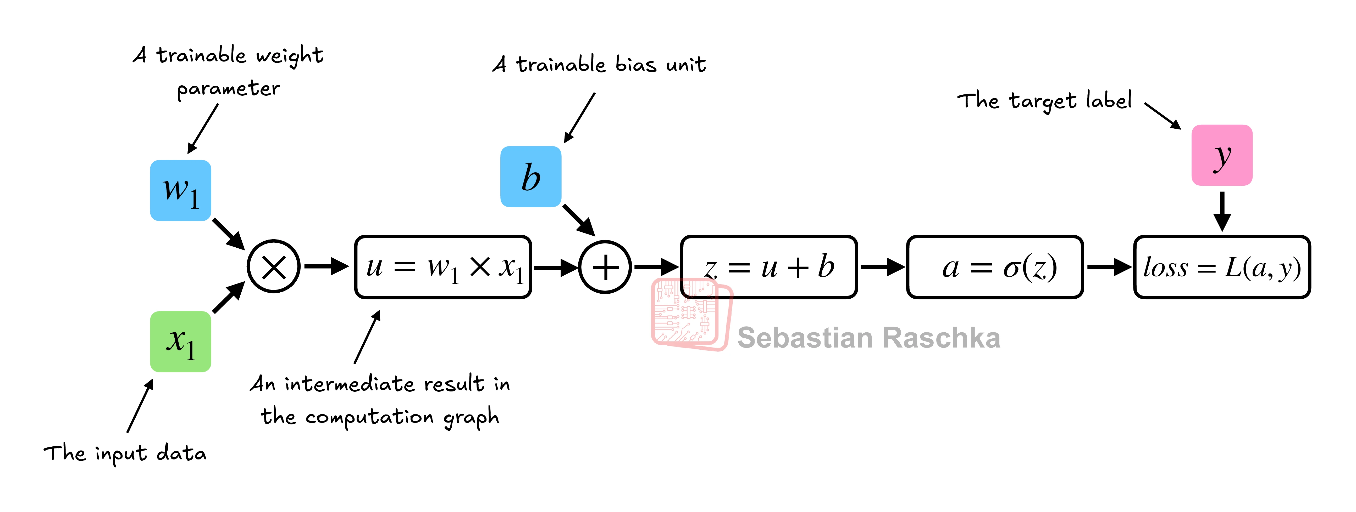
Computational graphs
logistic regression classifier
import torch.nn.functional as F
y = torch.tensor([1.0]) # true label
x1 = torch.tensor([1.1]) # input feature
w1 = torch.tensor([2.2], requires_grad=True)
) # weight parameter
b = torch.tensor([0.0], requires_grad=True)
) # bias unit
z = x1 * w1 + b # net input
a = torch.sigmoid(z) # activation & output
loss = F.binary_cross_entropy(a, y)
print(loss)
A computational graph is a directed graph that allows us to express and visualize mathematical expressions.
Forward pass

Slide 12
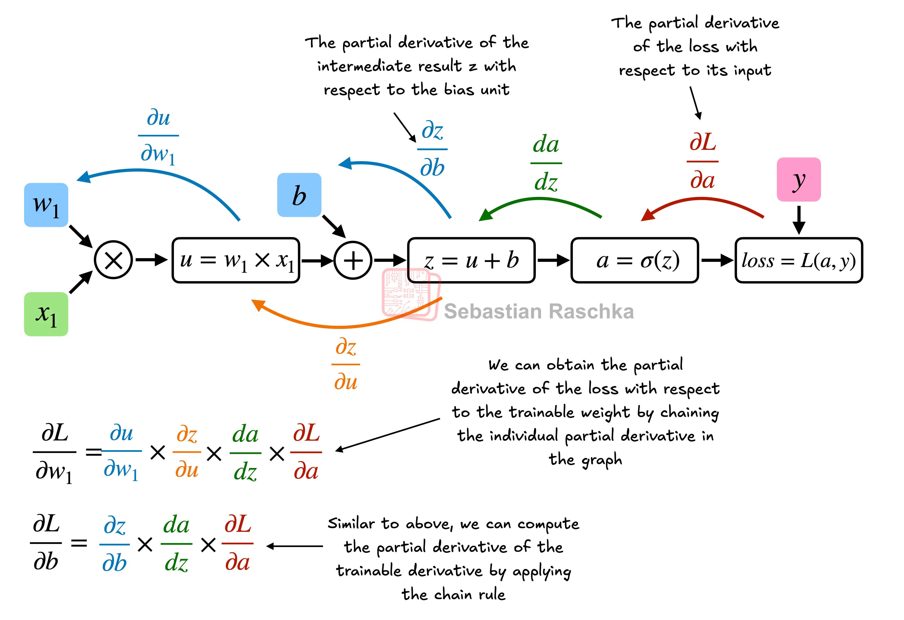
Backpropagation
Main training algorithm for neural networks
Calculate gradients of a loss function with respect to the model parameters by applying chain rules
PyTorch’s autograd provides functions to compute gradients in computational graphs automatically
loss.backward()
print(w1.grad)
print(b.grad)
Notes:
calculate gradients of a loss function with respect to the model parameters (here w1 and b) to train the model,

Slide 13

COMPUTATION GRAPH
Lazy Execution Concepts
Eager Execution (PyTorch default)
Lazy / Deferred Execution
Operations execute immediately as called
Each op returns a concrete tensor result
Easy to debug
Standard Python control flow works naturally
Builds a graph of operations first
Actual computation deferred until needed
Enables optimizations: operator fusion, reordering
e.g. torch.compile
torch.compile() — Best of Both Worlds
@torch.compile # JIT-compiles the function on first call, Python decorator
def train_step(model, x, y): # → builds optimized graph lazily
pred = model(x) # → fuses ops, eliminates redundancies
loss = F.cross_entropy(pred, y)
loss.backward()
return loss
train_step = torch.compile(train_step) # equivalent to the decorator
Notes:
operator fusion: combining multiple small ops into one GPU kernel, reordering operations for better memory access

Slide 14
Summary
Tensor Basics
Create, reshape, and manipulate multi-dimensional arrays with view, reshape, permute, transpose
Device Management
Move tensors between CPU and GPU with .to(), .cuda(), .cpu() — minimize transfers
GPU Performance
Use torch.cuda.synchronize() for accurate timing; GPU excels at large parallel ops
Computation Graphs
Autograd builds dynamic graphs during forward pass; .backward() computes all gradients automatically

Slide 15
Homework (Optional)
Implement linear regression with gradient descent
Compare CPU vs. GPU performance with different number of features/sample sizes
Use autograd directly not torch.optim
Notes:
N = 100,000, D = 1,000

