Slide 1
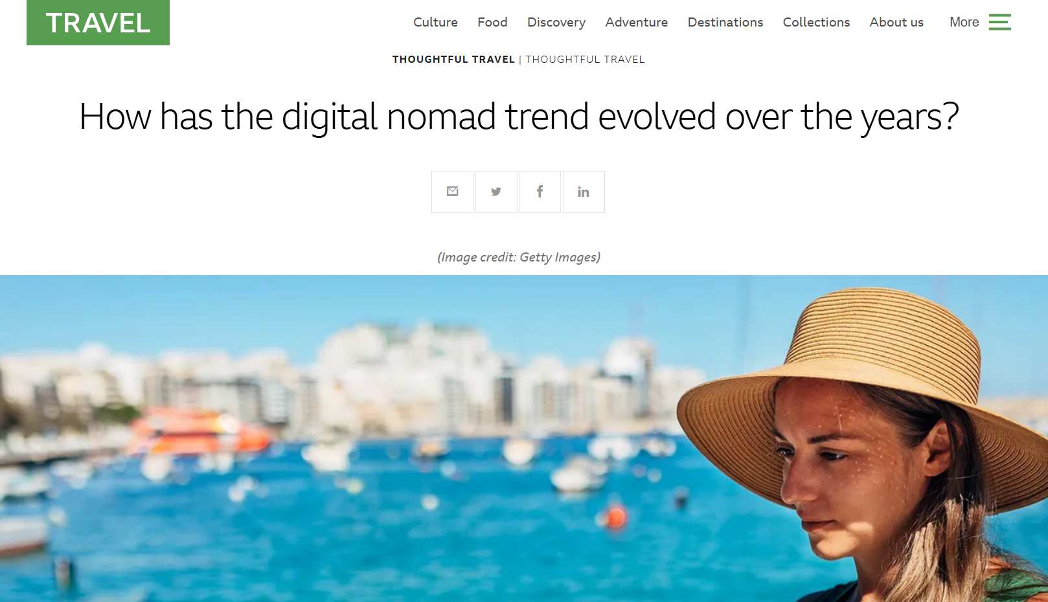
AI Nomads 2026: Why the World is Moving to “Satellite Cities”
EIE240xx
夏学长
Reference:https://www.bbc.com/travel/article/20240925-the-evolution-of-the-digital-nomad

Slide 2

Hello everyone. For years, 'Digital Nomad' meant a laptop and a beach in Bali. But in 2025, everything has changed. With the explosion of AI, digital nomads are moving again. Today, I’ll share how AI is reshaping their city choices based on a recent BBC report.

Slide 3
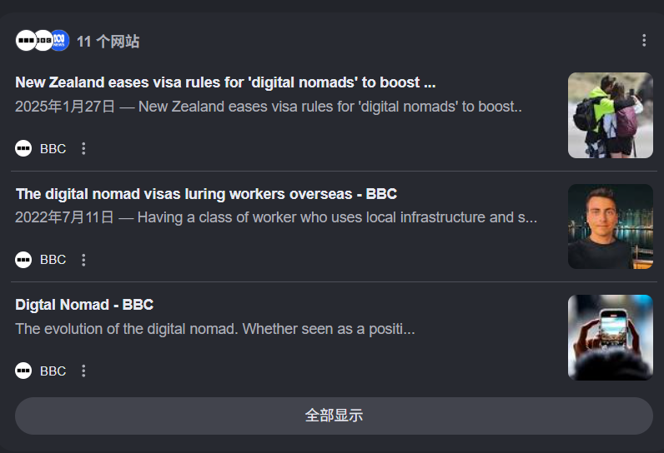
According to BBC, the 'Digital Nomad 2.0' era has arrived. In the past, people chose cities for fast Wi-Fi. Now, they choose cities for 'AI Ecosystems'. News highlights that cities like Tokyo, Bengaluru, and Lisbon are becoming top picks. Why? Because these cities offer high-tech networking. If you work in AI, you want to be where the developers are. The background is that AI has automated many remote tasks, so nomads now focus on 'high-value networking' rather than just cheap living."

Slide 4
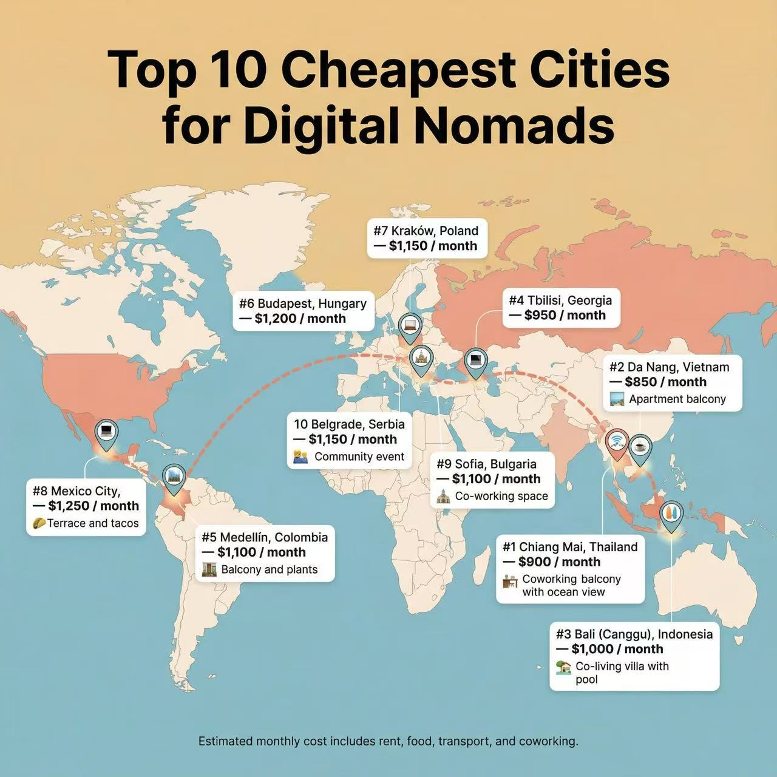
This shift has a huge impact. First, the rise of 'Tech Visas'. More countries are offering special visas to attract AI talent. Second, the 'Secondary City' trend. Instead of expensive San Francisco, nomads move to 'AI-ready' smaller cities with lower costs. As the BBC article mentions, the gap between 'Smart Cities' and 'Old Cities' is widening. If a city doesn't have good AI infrastructure, it loses the nomads."

Slide 5
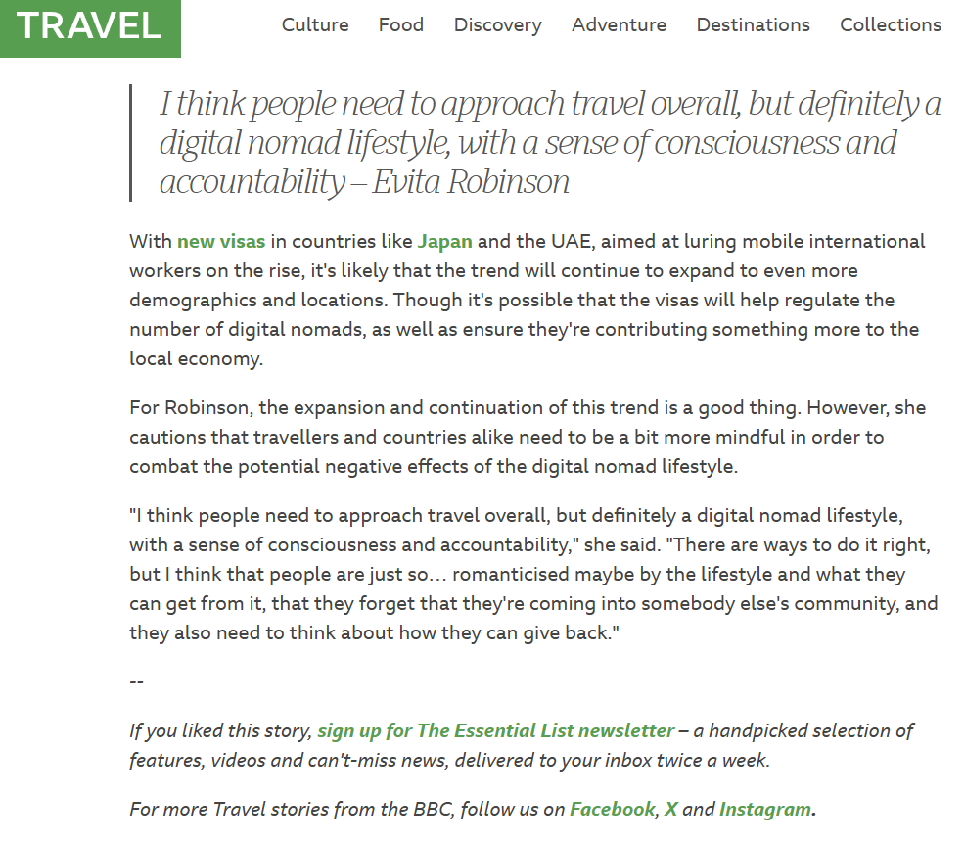
In my opinion, AI is making the world 'smaller' but 'smarter'. For us students, this means we don't just need to learn English, but also 'AI literacy'. Choosing a city is no longer about the view from the window, but the 'intelligence' of the community. I believe the future of work is not just 'remote', but 'intelligent'. We should all prepare for this 'AI-driven' freedom."

Slide 6
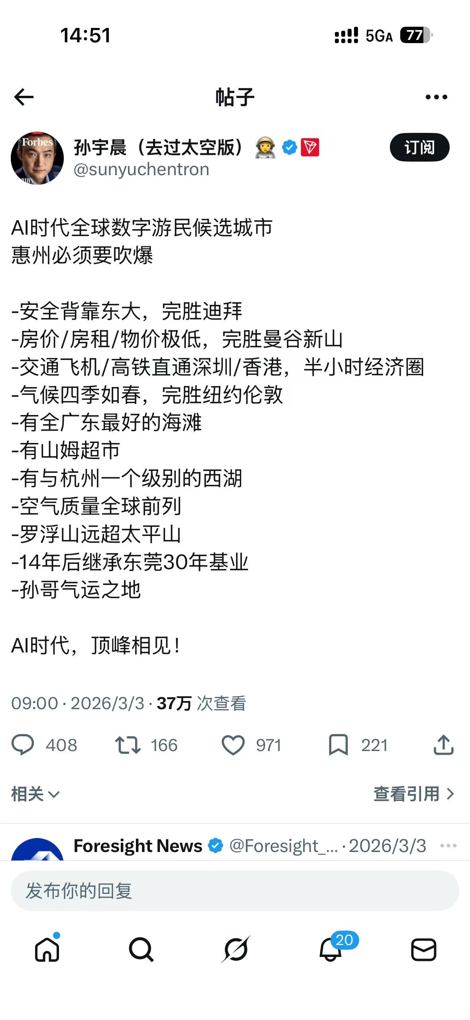
Finally, this is the advice given by my idol, Brother Sun.

Slide 7
THANKS!

