Slide 1
Loan EMI Calculator
A Simple App to Calculate Loan EMIs and View Amortization

Slide 2
Introduction
This presentation showcases the Finance Calculator app, a tool designed to assist users in calculating their loan EMIs effectively. The app is user-friendly and integrates advanced features that cater to both technical and semi-technical users.
It ensures high performance and consistent behavior across both Android and iOS devices. The app’s intuitive design and responsive layout provide a smooth user experience. Flutter’s hot reload feature also enabled rapid testing and iteration during development, making the process efficient and developer-friendly.

Slide 3
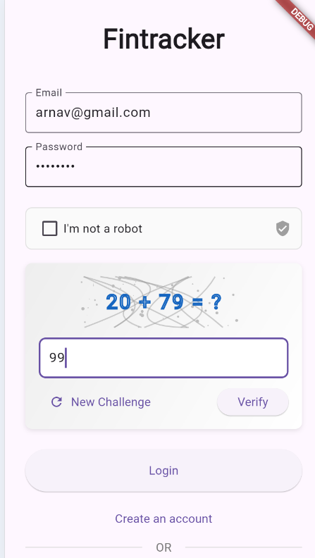
01
Tech Stack

Slide 4
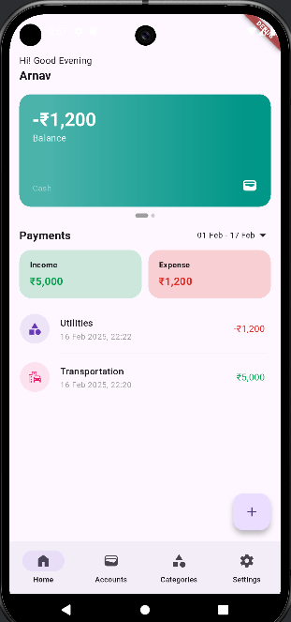
Frontend: Flutter
The Loan EMI Calculator app is developed using Flutter, a powerful UI toolkit created by Google for building natively compiled applications for mobile from a single codebase. This framework enables rapid development with beautiful UI components, making it an ideal choice for creating visually appealing applications.
Moreover, the app utilizes Flutter's third-party packages like fl_chart to render dynamic pie charts, providing users with a clear visual representation of the loan breakdown. With its cross-platform capabilities and performance efficiency, Flutter ensures that the Loan EMI Calculator app runs smoothly and looks polished on all supported devices

Slide 5
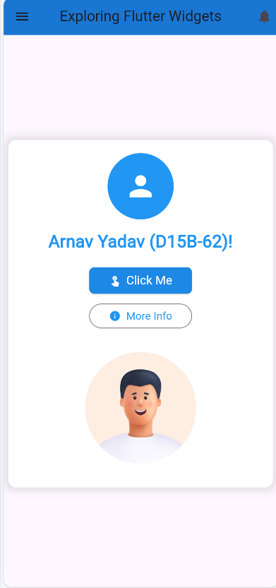
Programming Language: Dart
Dart is the programming language used in the development of the app. It is an object-oriented, class-based language with a strong foundation in asynchronous programming. Dart's syntax is easy to understand, which allows for effective collaboration and maintenance of the app's codebase.

Slide 6
Visualization: fl_chart
fl_chart is a powerful charting library for Flutter that enables the visualization of data through highly customizable charts. In the Loan EMI Calculator app, fl_chart is utilized to create pie chart visualizations that effectively display the proportion of principal versus interest in a loan. This feature enhances user understanding of their repayment structure and aids in financial planning.

Slide 7
02
Key Features

Slide 8
EMI Calculation
The EMI Calculation feature allows users to compute their monthly equated installment (EMI) based on the principal amount, interest rate, and tenure of the loan. Utilizing a straightforward formula, the app produces precise EMI figures, helping users assess their financial commitments.

Slide 9
Total Interest & Payment
Beyond calculating EMIs, the app provides insights into the total interest payable over the loan term and the cumulative amount to be repaid. This feature equips users with a comprehensive view of their financial obligations, enabling informed decisions.

Slide 10

Pie Chart Visualization
The Pie Chart Visualization presents a clear graphical representation of the breakdown of payments. It highlights the percentage of repayment that goes towards principal versus interest, visually engaging users and simplifying the understanding of loan dynamics.

Slide 11
Conclusions
In conclusion, the Loan EMI Calculator app is an invaluable tool for individuals seeking to understand and manage their loan payments effectively. With an intuitive interface and robust features, including EMI calculation, detailed financial insights, and visual data representations, it empowers users to make informed financial decisions.

