Slide 1



Vivekanand Education Society’s Institute Of Technology
Department Of Information Technology
Project Review I
Semester: IVReview: 4.1
Domain:
Group Members:
Member1 :Prathamesh Shetty
Member2:Arnav Yadav
Member3: Tarun Kumar Sharma
Member4: Arjun Silwal
TURF BOOKING SYSTEM
Intro
Objective
services
timeline
content
Requirement
Mentor Name: Mrs.Asma Praveen

Slide 2
Content
Gantt Chart
Introduction to the project
Problem Statement
Objectives of the project
Requirements of the system (Hardware, software)
Literature Survey
Front End
Implementation
Result & Analysis
Conclusion
References
content
services
Intro
Objective

Slide 3
GANT CHART

Slide 4
Introduction to Project
This Turf Booking System project addresses the challenges arising from the increasing demand for turf facilities, particularly for sports, The current process of locating, gathering information, and booking turfs has become complex and time-consuming.
The system aims to streamline this procedure by providing a user-friendly platform. Considering factors such as location, size, and amenities, users often face difficulties navigating through numerous options.
The project not only caters to individual needs but also contributes to the overall efficiency and growth of the turf industry
services
Objective
Intro
Requirement

Slide 5
Problem Statement
As the demand for Turfs is increasing rapidly, it is an ordeal for people to locate, fetch details and book a turf according to their requirements.
More and more people want to use turfs for sports, parties, and fun. But finding and booking one has become really hard. We need easier ways to find and book turfs. Technology can help by giving us all the info we need in one place and making booking simple.
This isn't just about making it easier for us; it helps the turf business grow too. So, finding and booking turfs should be easy and quick for everyone.
follow
Objective
content
follow
Problem
requirement
requirement

Slide 6


Objectives of the project
Simplify Booking Process with Wallet transaction :
Streamline the complex process of locating, gathering information, and booking turf facilities, making it user-friendly and efficient.
Time Efficiency:
ER Diagram
history
content
Objective
requrement
about
ER Diagram
requrement
Reduce the time-consuming nature of turf booking by offering a centralized system that facilitates quick and easy reservations.
Comprehensive Information:
Provide users with detailed and comprehensive information about available turfs, including location, size, amenities, and availability.
Reliability:
Ensure the reliability and accuracy of the information provided, fostering trust among users and turf facility owners.

Slide 7
Requirements of the system (Hardware, software)
Ram Requriement : 2GB+
Processor : Intel Core i3+
System Requriment :Windows 7/8/10/11
ER
services
history
teams
timeline
about
FRONT END :Tkinter
BACK END :Python,MYSQL,PostgreSql

Slide 8
Literture Survey
The research paper "GoPlay - Sports Facility Reservation Application" by O. Mendis and G. Rathnayake explores the significance of sports in modern society and the challenges faced in accessing sports facilities. It emphasizes the growing demand for online reservation systems, citing a rise in mobile booking trends and discussing drawbacks of manual processes.
The paper highlights the benefits of automated reservation systems for users and venue owners, emphasizing convenience and efficiency. Another study, "Sports Solutionz – A Court Reservation System" by Kiran H N and Rakshitha Kiran P, underscores the increasing demand for online platforms facilitating sports facility reservations and equipment purchases, emphasizing convenience, accessibility, and secure payment options.
Lastly, "A Review: Venue Booking System" by Shruti N. Ghule et al. focuses on internet-based platforms in the hospitality sector, proposing a centralized application for venue reservations to address inefficiencies associated with traditional manual booking processes.
Literature

Slide 9



PROPOSED SYSTEM
BOOKING
PLAYER
SEARCHER/FINDER
EVENTS
GROUP BOOKING

Slide 10
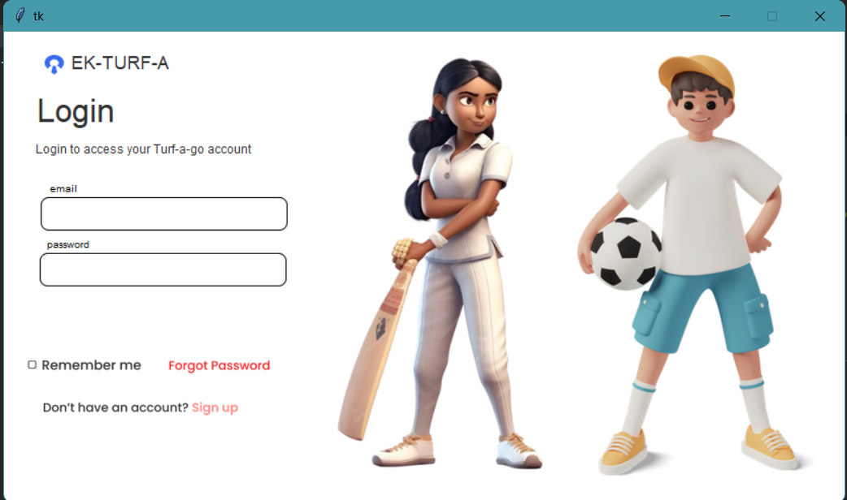
FRONT END DESIGN

Slide 11
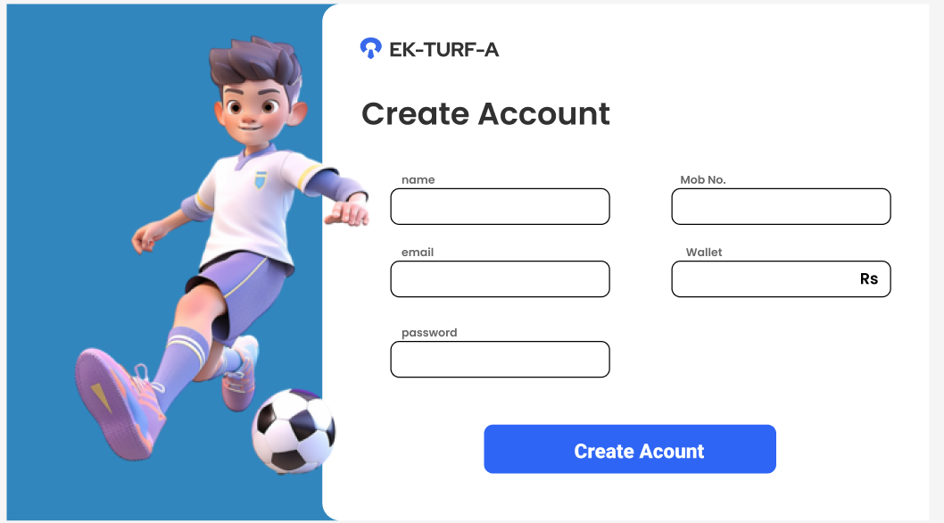
FRONT END

Slide 12
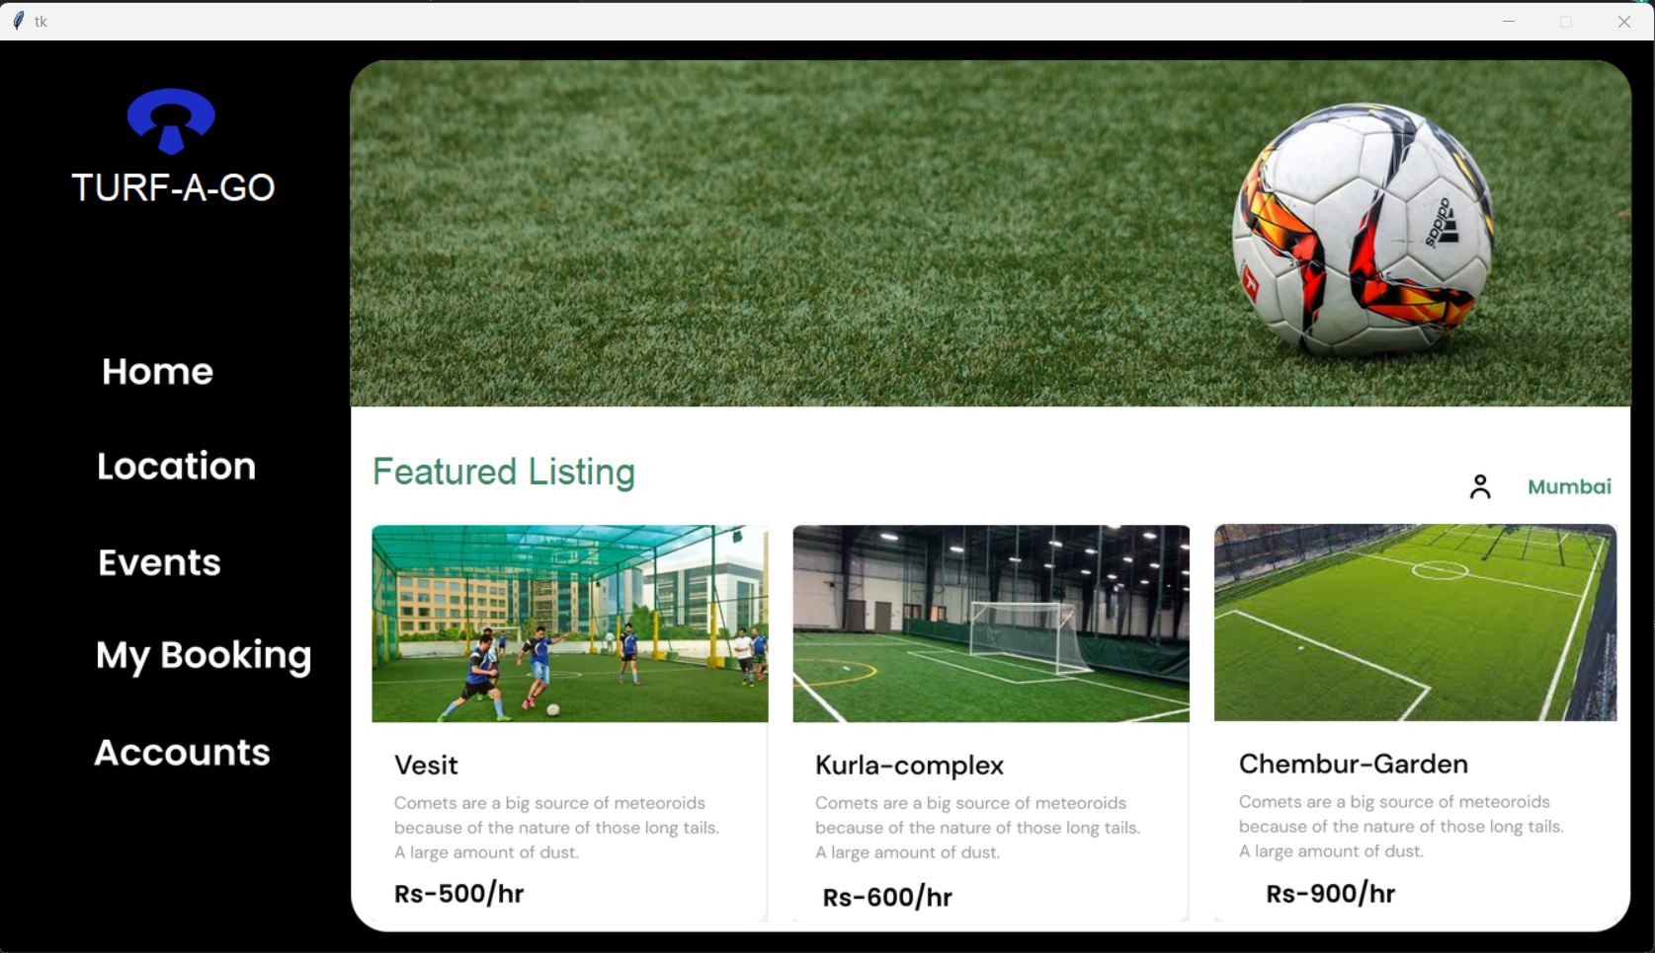
IMPLEMENTAION

Slide 13
RESULT AND ANALYSIS
Key Finding: There is a growing demand for online sports facility reservation systems due to several factors:
Convenience: Turf booking eliminates time-consuming phone calls and offers 24/7 access.
Efficiency: Automated systems streamline booking processes and improve user experience.
Accessibility: platform provide wider reach, enabling easier discovery and reservation of facilities and equipment.
Analysis of Emerging trends: Some studies mention:
Mobile app development and compatibility
Secure payment options
Comprehensive venue information and features
Order tracking and subscription services
User-friendly interfaces and efficient database management

Slide 14
CONCLUSION
Based on the research and design of this, it can be
concluded:
The Turf Booking System is designed to simplify and improve the process of reserving turf facilities. The project achieves this by offering a user-friendly platform that provides detailed information on available turfs.
The application is designed using python program and runs on computer that use the Windows operating system

Slide 15
REFRENCES
RESEACH DMAIN | AUTHORS AND PUBLICATIONS | DATE
Turf Reservation | Kiran Hn, Rakshitha Kiran P, 2023, Sports Solutionz – A Court Reservation System, INTERNATIONAL JOURNAL OF ENGINEERING RESEARCH & TECHNOLOGY (IJERT) NCRTCA – 2023 (VOLUME 11 – ISSUE 06), doi : 10.17577/NCRTCA-PID-019 https://www.ijert.org/sports-solutionz-a-court-reservation-system | December 2023
Venue Booking System | Shruti N. Ghule, Harish M. Mohurle, Akshay P. Shegaonkar, Zeba Parvin Abdual Saleem, Pradhnya S. Borkar, "A Review : Venue Booking System", International Journal of Scientific Research in Computer Science, Engineering and Information Technology (IJSRCSEIT), ISSN : 2456-3307, Volume 5, Issue 1, pp.491-494, January-February-2019. doi : 10.32628/CSEIT1951118 https://ijsrcseit.com/CSEIT1951118 | February 2019
Refrences

