Slide 1
Real-Time and Future Building Energy Prediction Using Machine Learning
Bowen Yang - Alexander Jordan
MATH 509 - Fall 2022

Slide 2
Project Introduction
Problem Statement

Slide 3
Methodology
Ideas I had in mind for this slide:
What models will be developed
How models will be compared (Performance criteria including MAPE and R2)
Feature selection, weights, introduction of correlation matrix with areas dropped?
Training data (80%) is used for development of model through adjusting weight and bias matrices. Testing data (20%) is used to determine performance criteria values and for tuning hyper parameters

Slide 4
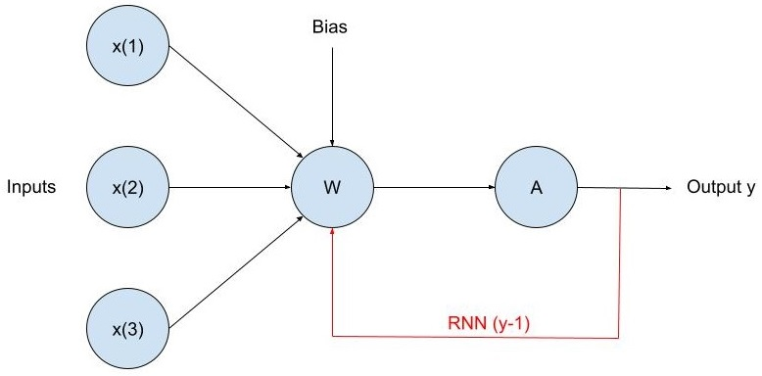
Non-Sequential vs Sequential Neural Networks
Non-Sequential
Sequential
- Uses matrices consisting of weights corresponding to each input and bias’ to model an equation based on a set of parameters used to calculate output y
- Model type used in this project is Artificial Neural Network (ANN)
- Same idea as sequential, however the output y is fed into the next calculation in a series of values to determine the next output
- Model types used in this project are Recurrent Neural Network (RNN) and Long-Short Term Memory (LSTM)

Slide 5
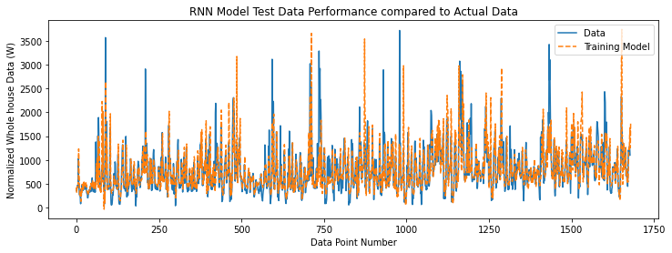
Future Prediction - RNN
Future Prediction | RNN | LSTM
Computation Time (s) | 36 | 31
MAPE (%) | 14.84 | ?
R² | 0.73 | ?
Note 1 about the thing
Part 2 about the thing

Slide 6
Future Prediction - LSTM
Future Prediction | RNN | LSTM
Computation Time (s) | 36 | 31
MAPE | 14.84 | ?
R2 | 0.73 | ?
Insert Notes here

Slide 7
Real Time Prediction - ANN
Future Prediction | ANN | LSTM
Computation Time (s) | ? | 42
MAPE | ? | 21.16
R2 | ? | 0.36

Slide 8
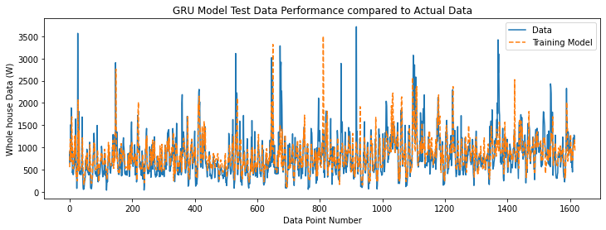
Real Time Prediction - LSTM
Future Prediction | ANN | LSTM
Computation Time (s) | ? | 42
MAPE (%) | ? | 21.16
R2 | ? | 0.36

Slide 9
Conclusion / Future Works

Slide 10
References

