Slide 1


Real-Time and Future Building Energy Prediction Using Machine Learning Techniques
MATH 509 Project Presentation
Presenter: Alexander Jordan& Bowen Yang
Instructor: Jay Newby

Slide 2

Contents
Background
Methodology
Machine learning model
Result
Future works
2

Slide 3


Background
Methodology
Results
Future works
ML model
40 %
Energy
Consumption
20% to 40% of the total energy consumption goes to air-conditioning
30 %
Greenhouse
gas emission
3

Slide 4








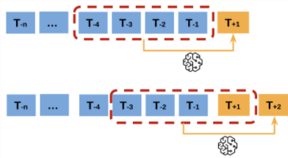
Background
Methodology
Results
Future works
ML model
Problem statement
Weather:
ML model
Many factors can make the development of a reliable ML model challenging
Time:
Occupancy:
Time-series data
Artificial neural network
Traditional ML models have limited ability to handle time series data for future prediction
Random forest
Support vector machine
4

Slide 5
Background
Methodology
Results
Future works
ML model
Research question & Objective
RQ1
Are the data from a single year sufficient to estimate real-time and future energy consumption?
Which machine learning technique is optimal in terms of prediction accuracy and computing cost for predicting energy usage in a smart home?
RQ2
Goal1
Build two future energy consumption prediction models and two real-time energy estimation models.
Compare models’ performance in terms of prediction accuracy and computation cost.
Goal2
5

Slide 6


Background
Methodology
Results
Future works
ML model
Data preprocessing
ML techniques
Model evaluation
Data cleaning
Feature creation
(Combined new features (i.e., furnace, kitchen) )
Data splitting
Random data splitting
Time series data splitting
(Using previous 1 hour dataset to predict next hour energy consumption)
R square
Mean Absolute Percentage Error
Long short-term memory
Recurrent neural network
Artificial neural network
6

Slide 7
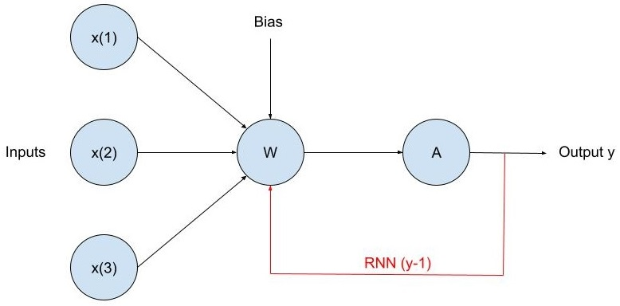
Background
Methodology
Results
Future works
ML model
Non-Sequential vs Sequential Neural Networks
Non-Sequential
Sequential
- Uses matrices consisting of weights corresponding to each input and bias’ to model an equation based on a set of parameters used to calculate output y
- Model type used in this project is Artificial Neural Network (ANN)
- Same idea as sequential, however the output y is fed into the next calculation in a series of values to determine the next output
- Model types used in this project are Recurrent Neural Network (RNN) and Long-Short Term Memory (LSTM)
7

Slide 8
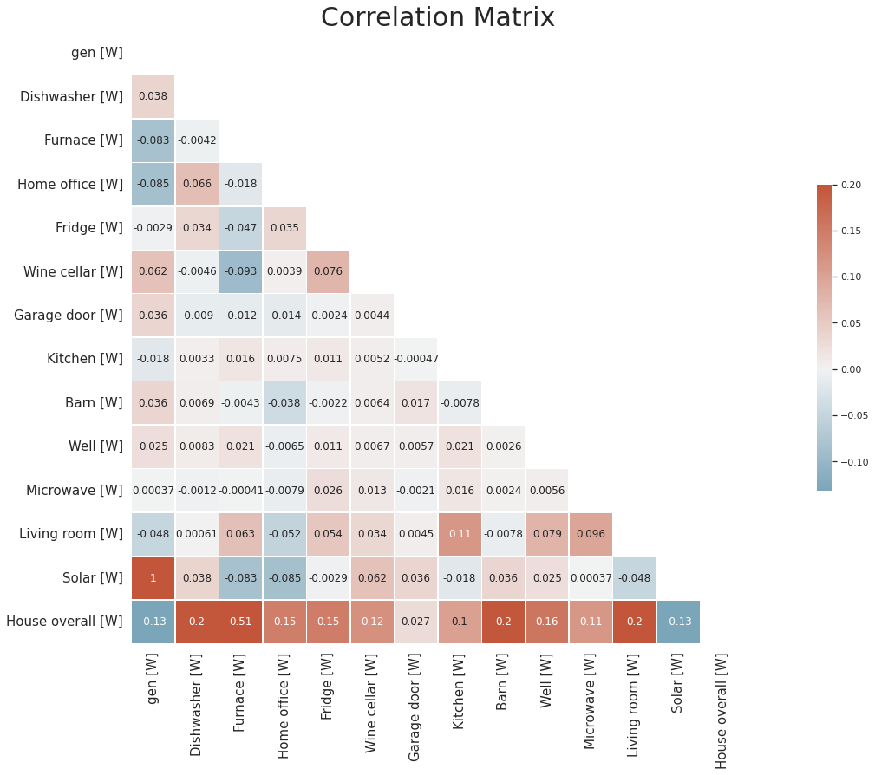
Background
Methodology
Results
Future works
ML model
Result 1: Exploratory data analysis
There is a strong correlation between furnace and the total energy consumption of the house
Solar and generation have an extraordinarily high correlation, indicating that they have identical values
8

Slide 9
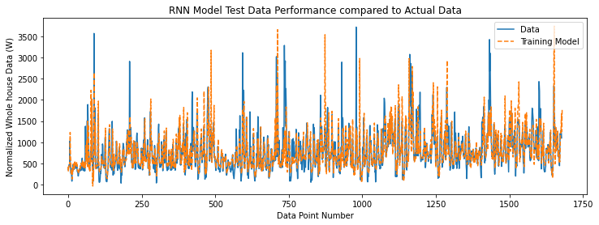
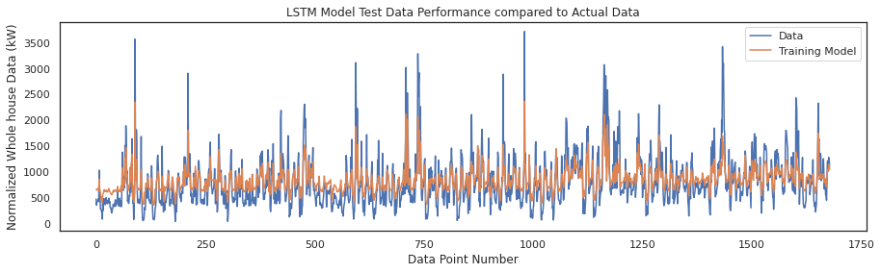
Background
Methodology
Results
Future works
ML model
Result 2: Future prediction – RNN & LSTM
Model | RNN | LSTM
Time (s) | 36 | 31
R square | 0.73 | 0.68
MAPE | 0.148 | 0.303
RNN outperforms LSTM model as indicated by R square score and MAPE
LSTM model is more stable than RNN model
Both models perform satisfactory at predicting future data, however performance could be improved
9

Slide 10
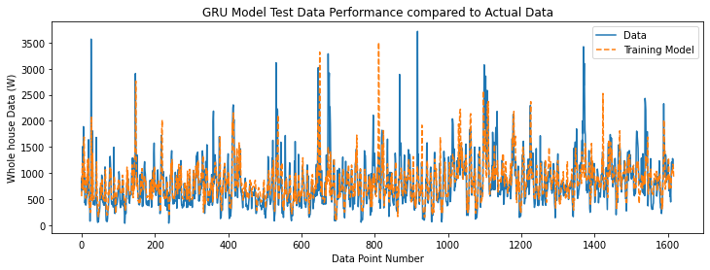
Background
Methodology
Results
Future works
ML model
Result 3: Real-time prediction – ANN & LSTM
Model | ANN | GRU
Time (s) | 383 | 42
R square | 0.403 | 0.36
MAPE | 0.189 | 0.216
Note for Real-Time prediction, ANN outperformed GRU with a higher R square score
Both models had high percentage error and low R square score, indicating poor performance. These issues could stem from data that is hard to fit, or from unnaturally collected data
10

Slide 11
Background
Methodology
Results
Future works
ML model
Implement feature selection/feature importance to choose the best feature combination to increase the prediction accuracy and reduce computational cost.
Investigate the capability of model robustness and generalizability for long-term predictions and the energy estimation of different buildings.
Integrate data-driven energy prediction model into further applications, such as model predictive and reinforcement learning control.
11

Slide 12

Thank You!
12

