Slide 1
the next big THING
Are you READY for
from the FCIII class
Carol Zhang
Long Zheng
Vincent Leung

Slide 2
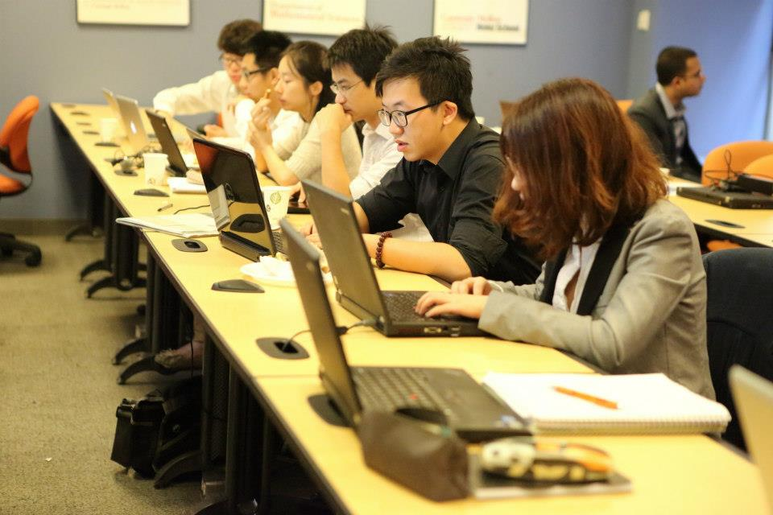
Usually …

Slide 3
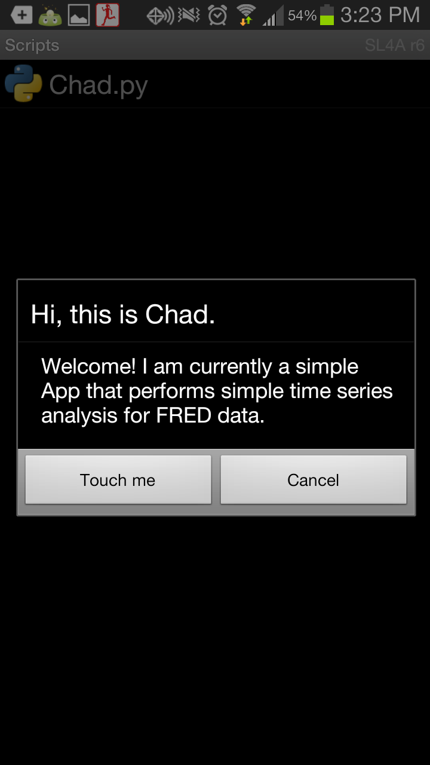
The big thing is HERE:

Slide 4



Installation
It can’t be easier.

Slide 5
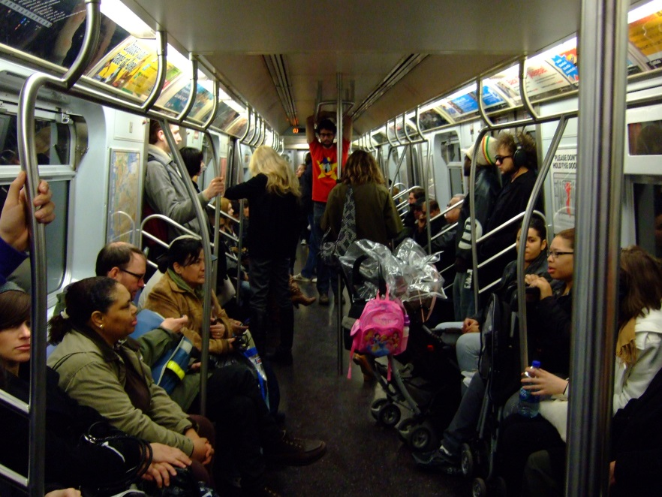


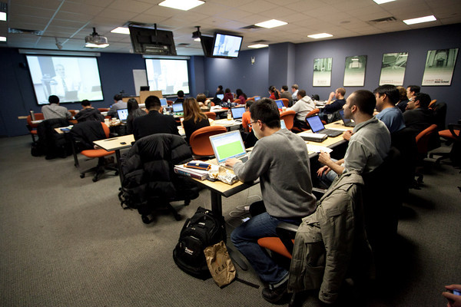
Everywhere!
Toilet
Subway
During class
On bed

Slide 6
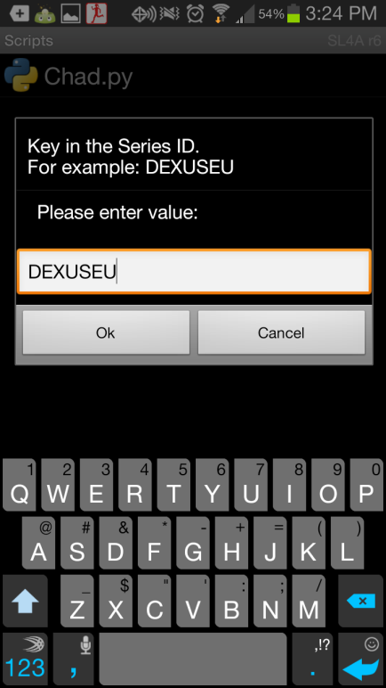
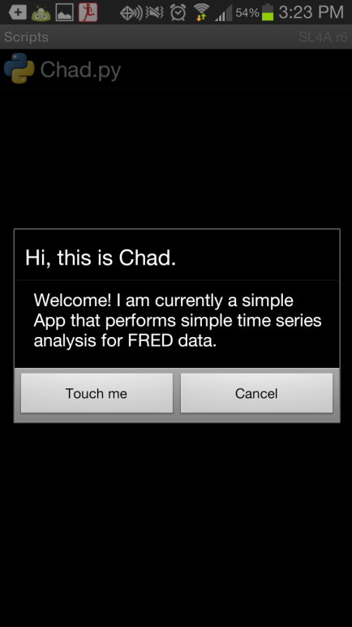
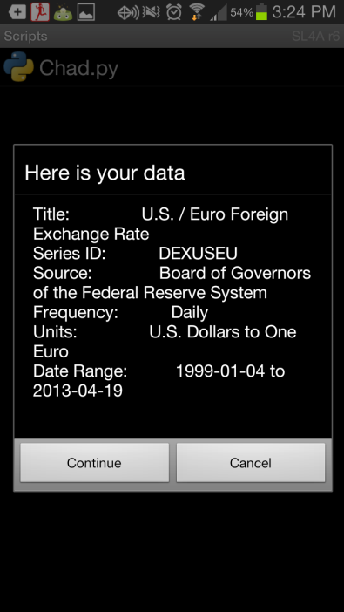
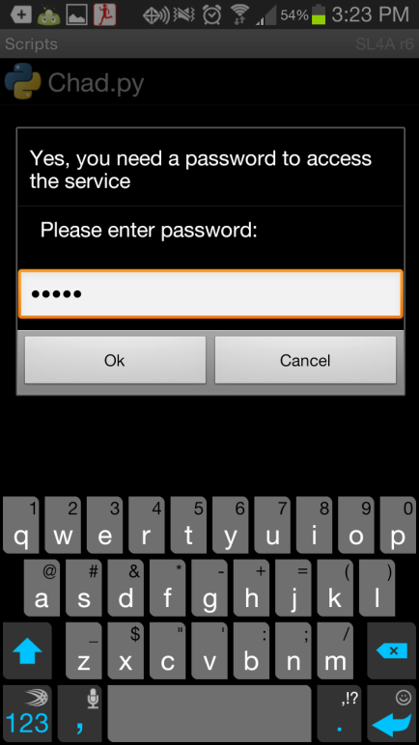
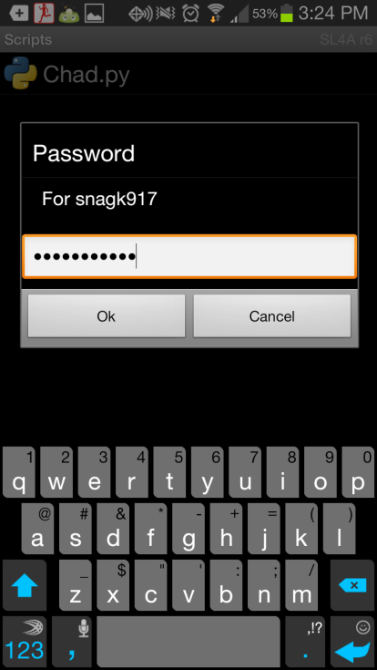
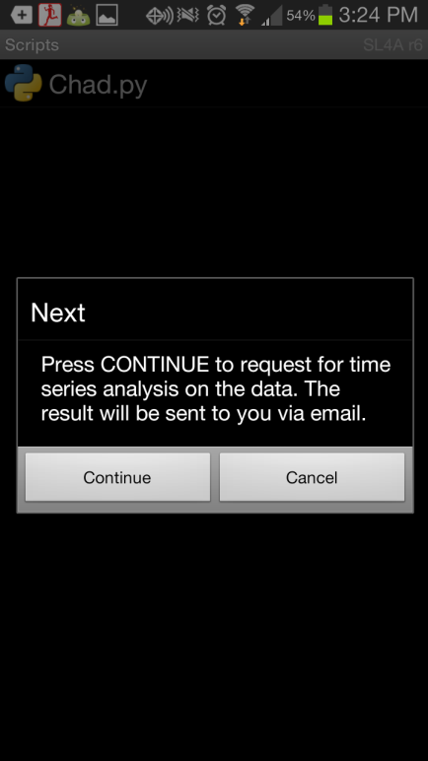
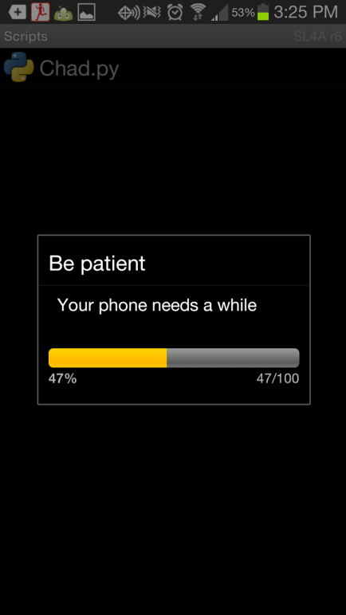
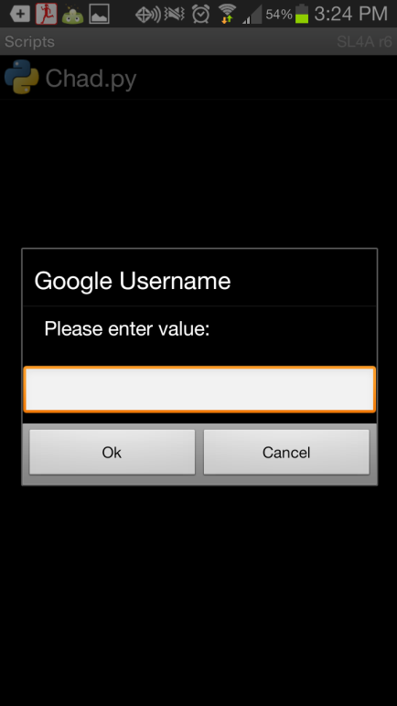

Slide 7
< 1 minute later…

Slide 8
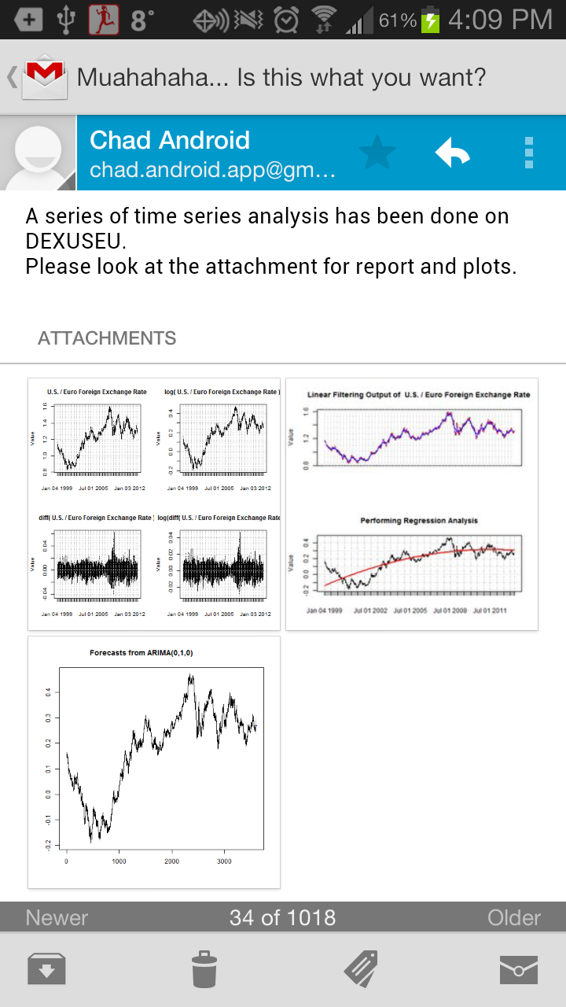
Magic Happens

Slide 9
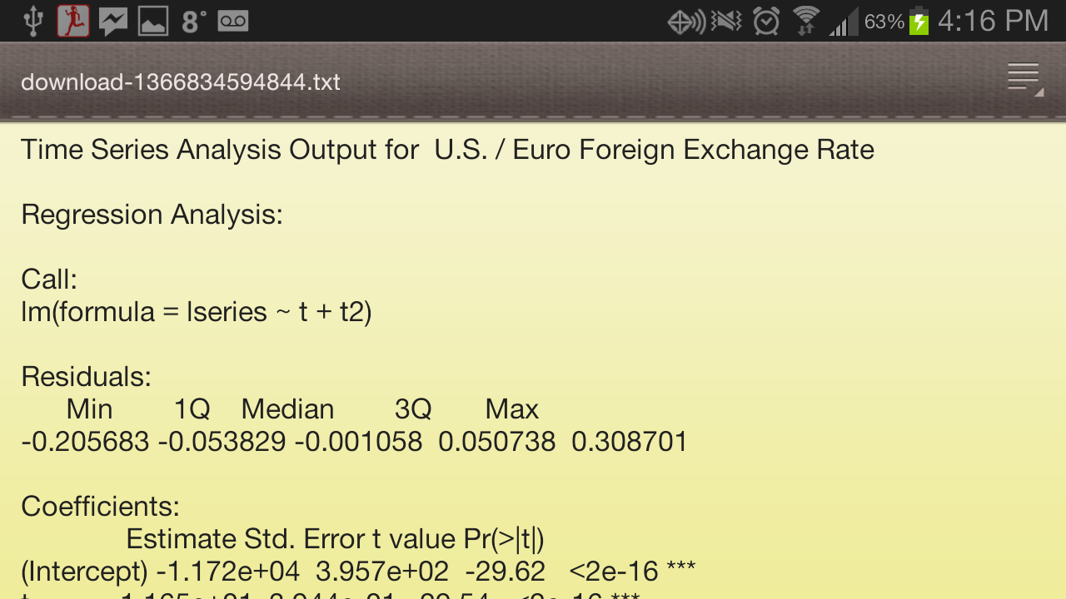
Magic Happens

Slide 10
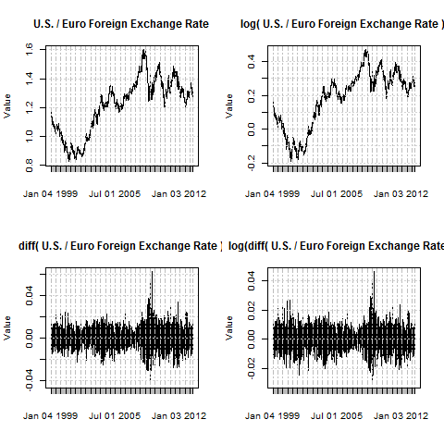
Magic Happens

Slide 11
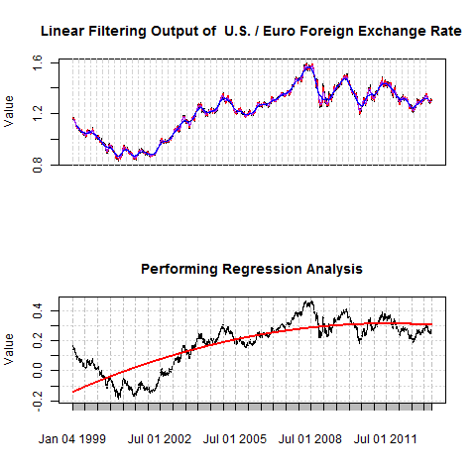
Magic Happens

Slide 12
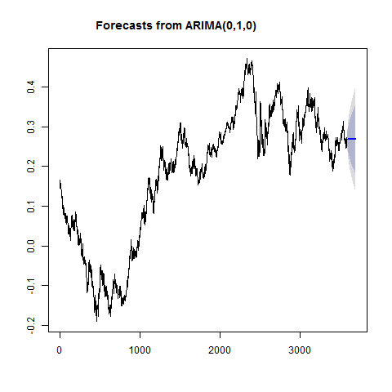
Magic Happens

Slide 13

THE NEXT BIG THING
Python
Website Scraping
Data Collection
VBA
Event Monitoring
Task Automation
R
Statistical Analysis
Time Series

Slide 14
“Be Smart! Stay Lazy!”
- an MSCF student

