Slide 1

Data Science in Duke Athletics Performance

Slide 2
Agenda
Business Understanding
Data Understanding and Processing
Modelling
Evaluation
Summary

Slide 3
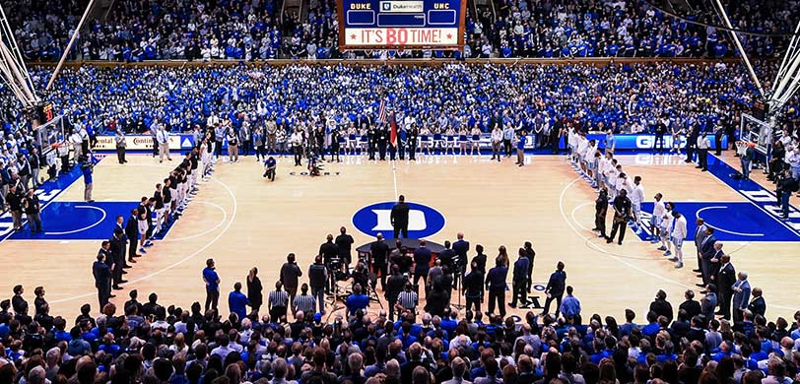
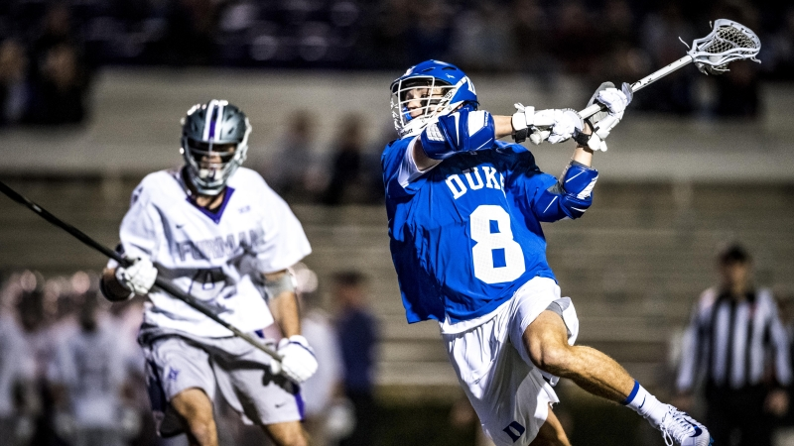
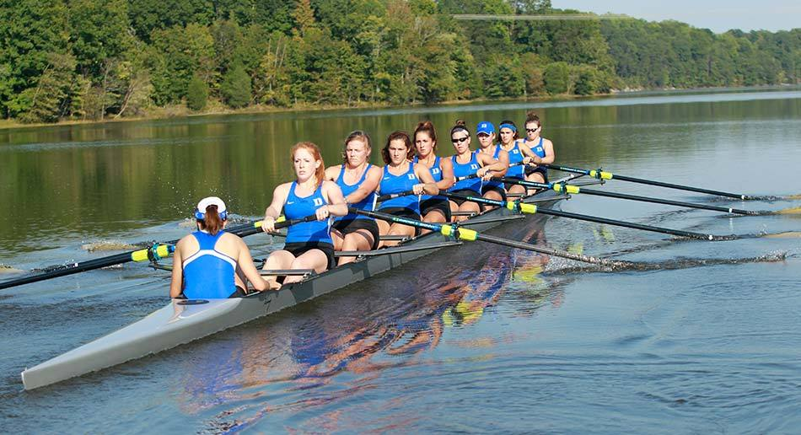
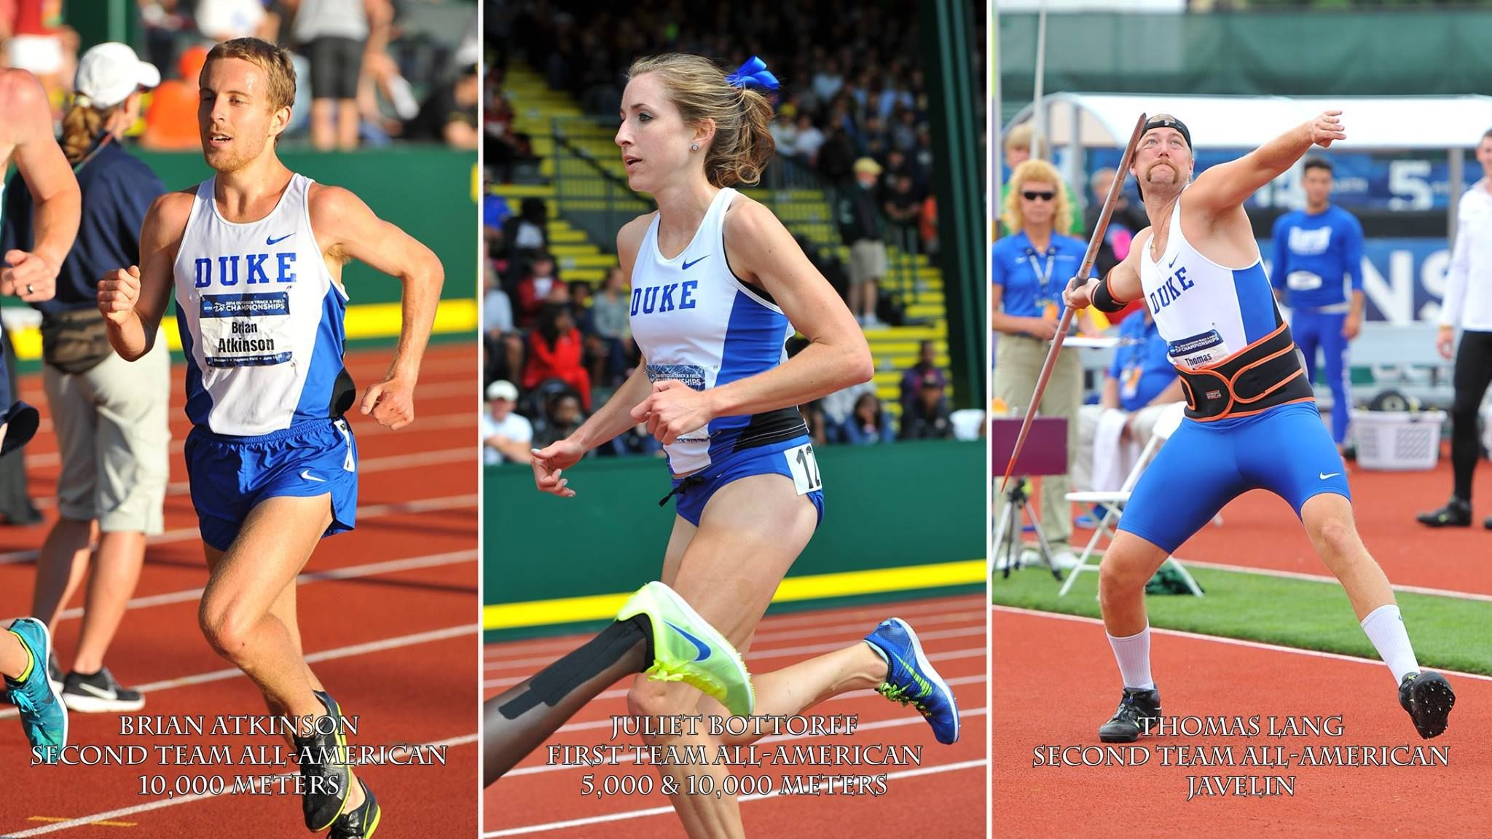
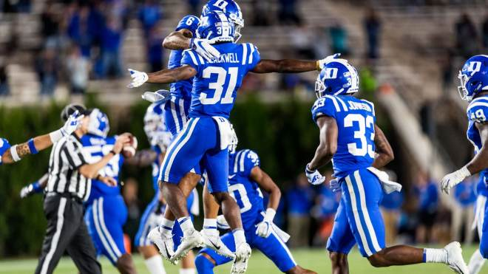
Business Understanding
Enable Duke Athletics to use the data they have, and improve the data they get

Slide 4
Business Understanding
Duke Athletics invested heavily in performance analytics collection
Specialized weightlifting platforms, monitors, cameras
Lots of data captured, but poorly managed and under-utilized
Department seeking standardized data best-practices that can drive actionable insight
Project Target
Use certain strength and speed variables to predict strength progression
Identify strength exercises that better predict on-field performance
Advise how to better structure, store, and use data going forward

Slide 5
Data Understanding and Processing
Duke Lacrosse as ideal partner :
High data collection ratio
Substantial time-series data available
Robust publicly-available game and season-specific data that easily matches
Two Data sources
Strength and speed performance data – collected and stored by Coaching Staff
On-field performance YoY data – collected by Sports Information Directors and available publicly
Strength Dataset
97 players
13 variables
on-field performance across six seasons (from 2013-2018)

Slide 6
Modeling - Data
Strength Performance
BODY WEIGHT - Weight of the player, in United States pounds
NO STEP VERTICAL - Vertical jump height without a running step
5-10-10 - LEFT - Agility Test. Variable dropped due to insufficient data
……
On-field Performance YoY data
Games Played - Number of games in which the player made an appearance
Goals while up - Number of goals scored while the team was up a player
Ground Balls - Number of ground balls retrieved
……
Three calculated variables
Turnover Efficiency: caused turnovers divided by turnovers committed
Start Percentage: The percentage of games played that player started in
Points per Game: Sum of Goals and Assists, divided by the total number of games in which that player played

Slide 7
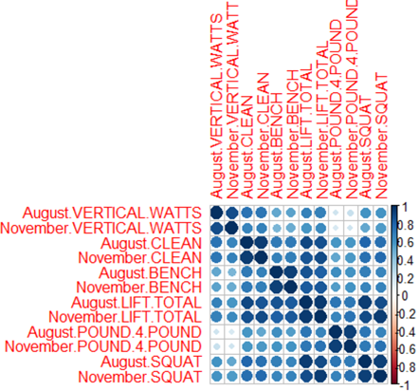
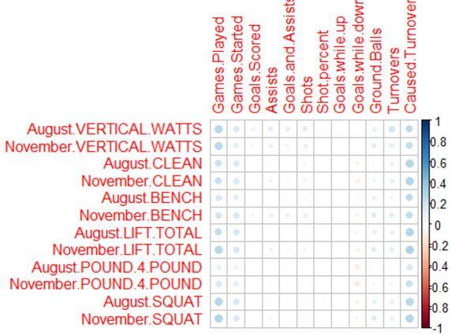
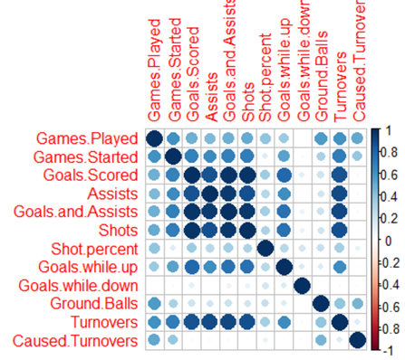
Modeling - Trends from intra- and inter-dataset correlations

Slide 8
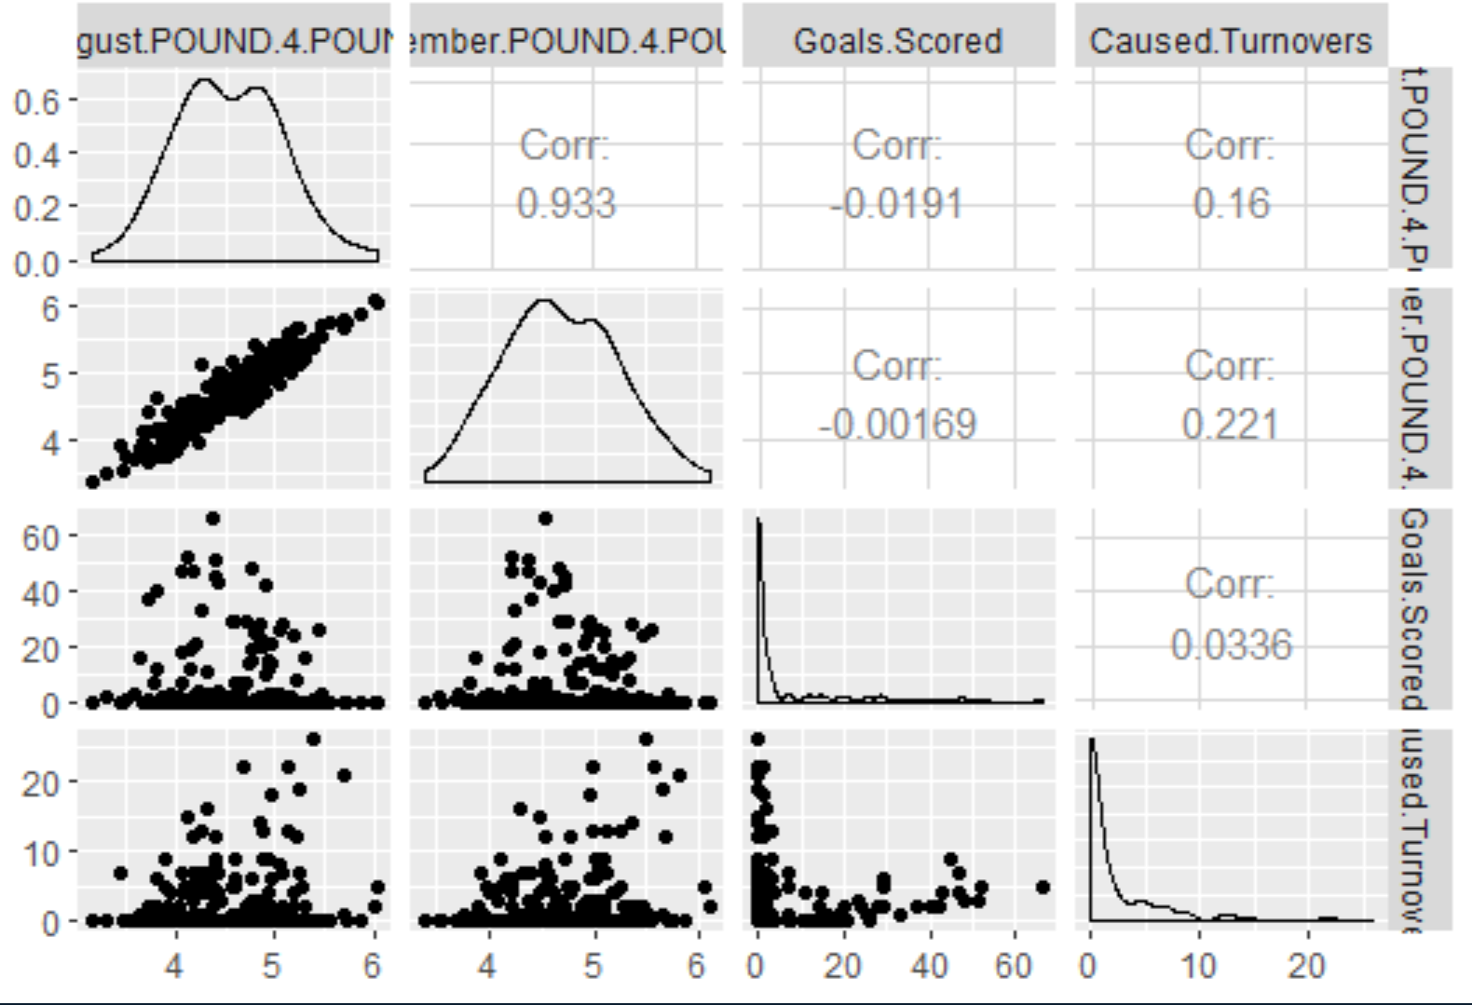
Modeling - Trends from intra- and inter-dataset correlations

Slide 9
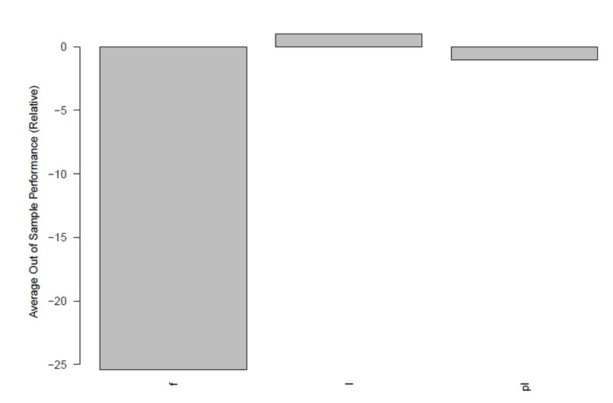
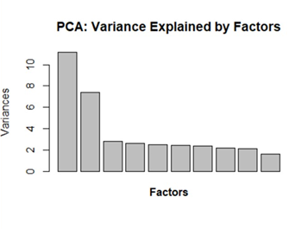
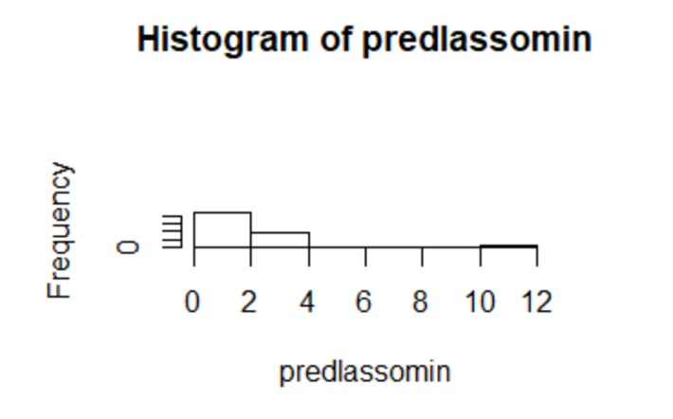
Modeling

Slide 10
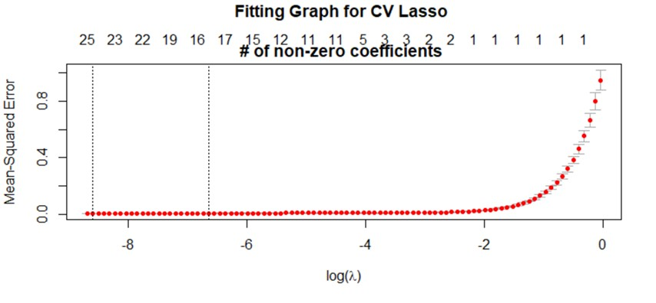
Modeling

Slide 11
Evaluation
Evaluation
OOS performance of our lasso model is 99.74%
The model can be used to predict which players we can expect will have more points per game, if they get playing time
Focused on athlete wellness and properly setting goals and expectations that are achievable
Future Action
Limitation of small sample size, more data for more players is needed
A monetary ROI calculation for deployment of model would help

Slide 12
Recommendations to Coach Staff, Admin
Data Availability
More robust dataset, standardized over years
Migrate from Excel to centralized and powerful database
Increase the frequency of data collection
More precise time-series for future models
Additional Variables for Consideration
Only calculated KPI is the “Pound for Pound” metric
Not an actionable insight
Variable naming conventions should also be established and adhered to, among and across all sports
Minutes played must be tracked more closely
The variables Duke Lacrosse is collecting now are not the correct type of data to drive actionable insights from a causal data study.

