Slide 1
PLANT CARE SCHEDULING SYSTEM
Sproutly
Small routines. Thriving plants.
A responsive, weather-aware personal garden.
Local implementation · Production setup pending
01

Slide 2
THE PROBLEM
Care should feel clear, not repetitive.
Before
Sproutly
Repeated full data and image loads.
Care notes confused with schedules.
Archived plants had no way back.
Change-only synchronization and stable images.
Explicit every-N-days routines.
Selective restore with fresh due dates.

Slide 3
CORE WORKFLOW
A routine with a reliable memory.
01
02
03
Add a plant
Set N days
Record and review
Light and location.
Separate care routines.
History and progress.

Slide 4
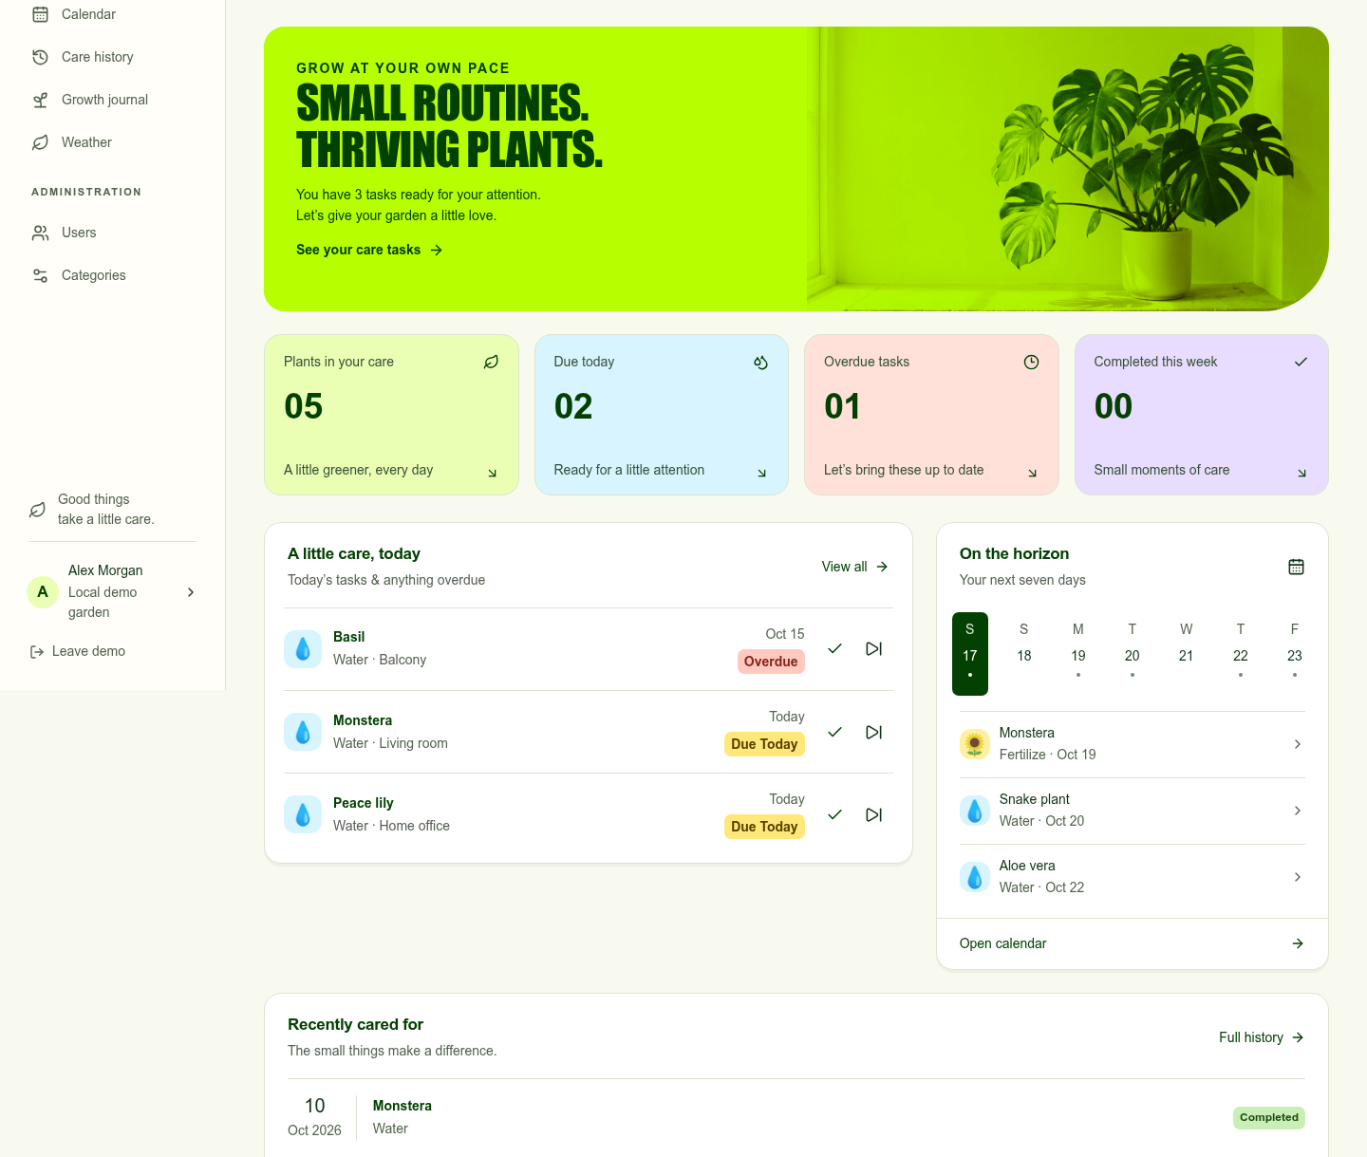
LIGHT, VIBRANT, RESPONSIVE
A garden at a glance.
Lime and forest contrast inspired by Sweet Tape.
Colourful task types and emoji categories.
No breadcrumbs; clear navigation and back links.
In-app inbox with opt-in open-tab reminders.
Local demo screenshot; fictional sample data.

Slide 5
ARCHITECTURE
Prisma without bypassing garden privacy.
01
Application boundary
02
Data boundary
Next.js and TypeScript.
Supabase verifies the session.
Prisma runs a transaction as authenticated.
Verified UID is transaction-local.
PostgreSQL RLS limits owner rows.
Composite foreign keys protect ownership.
Auth owns password hashing.
Private Storage uses owner folders.

Slide 6
CACHE AND CONNECTIVITY
Less reloading. Honest offline behavior.
While online
When offline
Keep workspace state across navigation.
Restore per-user same-tab cache.
Fetch changed rows and deletion IDs.
Use stable private image URLs.
Public service-worker fallback page.
Previously open views can remain visible.
No offline writes or queued task actions.
Never cache private pages in the worker.

Slide 7
WEATHER-AWARE, USER-CONTROLLED
Rain is a suggestion, not completed care.
A forecast never automatically marks watering done.
LOCATION
Permission-based or manual coordinates.
EVIDENCE
Fresh matching date, ≥60% chance and ≥1 mm.
SCOPE
Due outdoor watering only.
ACTION
User confirms “Skipped — rain”.

Slide 8
JOURNAL AND RESTORE
Keep the story. Restart safely.
01
Growth journal
02
Selective restore
Dated height and leaf observations.
Actual elapsed-day chart and exact table.
Captioned photo timeline/gallery.
Owner-scoped edit and delete.
Archive stops routines and retains history.
Choose routines explicitly on restore.
Next due starts one interval from today.
Ended routines remain stopped.

Slide 9
VERIFICATION
Evidence has a defined boundary.
Local tests are not production acceptance.
44 TESTS
Dates, validation, demo and actual SQL policies.
BROWSER SUITE
Desktop/mobile flows; deterministic weather fixture.
CHECKS
Strict TypeScript, lint and production build.
PENDING
Real Auth/email, Storage, Prisma and hosted-site tests.

Slide 10
NEXT: LIVE ACCEPTANCE
Ready for account-connected testing.
01
Connect authorized GitHub, Vercel and Supabase projects.
02
Apply migrations, configure environment and email redirects.
03
Verify two-user privacy, live uploads, caching and weather on HTTPS.
04
Rehearse the live presentation and keep the local demo as backup.

