Slide 1
Exercise 2
Basic Skills Continued & Microscopy

Slide 2
Goals
Understand and manipulate exponential numbers.
Become familiar with the units used for small concentrations and volumes and be able to make conversions between them.
Figure out concentrations of solutions or cell suspensions after dilution.
Understand what is meant by pH and know how to calculate the pH of a solution.
Understand how buffers work.

Slide 3
Exponential Numbers
Every number can be expressed as the product of two numbers, the second one being some power of ten.
For example, the number 100 can be expressed as
10 X 10 = 10²
The same rules are used to express numbers less than one.
10⁻² = 1/10 X 1/10 = 1/100

Slide 4
Practicing Calculations w/ Exponential Numbers
Addition/Subtraction
Rewrite all numbers so that all are raised to the same power of ten.
Example: (5 X 10⁵) – (3 X 10³) = 4.97 X 10⁵
Multiplication
Rewrite each number in scientific notation
Multiply the first numbers
Add the exponents
Example: 0.125 X 8000 = (1.25 x 10⁻¹) X (8 X 10³) = 10 X 10² or 1 X 10³
Division
Rewrite each number in scientific notation
Divide the first numbers by themselves
Subtract the bottom exponent from the top exponent
Example: 2500/500 = (2.5 X 10³) / (5 X10²) = (2.5/5 = 0.5) (10³-10² = 10¹) so the answer is 0.5 X 10¹ or 5.0

Slide 5
Units of Measurement
Common units
Mass
1 gram (g) = 10³ milligrams (mg)
= 10⁶ micrograms (µg)
= 10⁹ nanograms (ng)
Volume
1 liter (l) = 10³ milliliters (ml)
= 10⁶ microliters (µl)
1 ml = 1 cubic centimeter
Length
1 meter (m) = 10³ millimeters (mm)
= 10⁶ micrometers (µm)
= 10⁹ nanometers (nm)

Slide 6
Concentrations Expressed Differently
Grams per liter (g/l) same as milligrams per milliliter (mg/ml)
Cells per milliliter (cells/ml)
Moles/liter (M or molar). A 1 M solution of compound X is equivalent to the molecular weight of compound X made up to 1 liter of water.
Example: 1 M solution of NaCl (MW of 58.45) 58.45 g is dissolved in water and the volume made to 1 liter
Percent solutions for solids = grams / 100 ml
Example: 10 g/100 ml = 10% solution
Percent solutions for liquids when one is water = the volume of the second liquid divided by the total volume times 100%
Example: 70 ml ethanol per 100 ml is a 70% solution

Slide 7
Concentration
Expressed as C = P/V
C = concentration
P = number of particles (mass or number)
V = volume

Slide 8
Dilutions Practice
C₁V₁ = C₂V₂
Example: Given a 1 M stock solution of Tris buffer prepare 10 ml of 0.01 M Tris.
Solution:
The question you need to answer is "what volume of 1 M Tris do you need to dilute to give a total volume of 10 ml of 0.01 M Tris". Thus, you know C₁, C₂, and V₂.
(? ml x 1 M) = (10 ml x 0.01 M)
? ml = 10 ml x 0.01 M
(1 M)
Answer: 0.1 ml

Slide 9
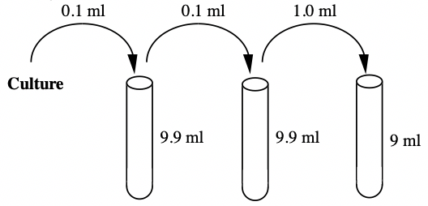
Dilution Factor The inverse of the dilution
C₁ = C₂ (DF)
If you start with a 3 X 10⁸ concentration of bacteria and need the concentration to be 3 X 10³ to plate, you can calculate your DF by rearranging DF = C₁/C₂
(3 X 10⁸)/(3 X 10³) = 10⁵

Slide 10
Practice using C₁ = C₂ (DF) formula
For practice, can you determine the missing numbers from this table?
 | # of colonies | DF | C₁ | Volume Plated
A | 132 | 10⁶ | ? | 0.1 ml
B | ? | 10⁴ | 3.5 X 10⁶ | 0.1 ml

Slide 11
Aqueous Solutions
An aqueous solution is one in which water is the solvent.
Water properties:
High surface tension
High boiling point
Good Solvent

Slide 12
Acids, Bases, pH and Buffer
Acids/Bases:
Bronsted Definition: an acid is a molecule that donates protons and a base is a molecule that accepts protons
pH:
Dependent upon the concentrations of H⁺ and OH⁻ ions
Buffers:
A molecule that allows the solutions to resist changes in the hydrogen ion concentration

Slide 13
pH
pH = -log[H⁺]
In water the concentration of H⁺ is 1 X 10⁻⁷, pH is 7
In HCl the concentration of H⁺ is 1 M, pH is 0
In 1M NaOH the H⁺ is 10⁻¹⁴, pH is 14
*Note the pH scale is logarithmic, meaning the values are exponential. A solution of pH 3 is 1000 times more acidic than one with a pH of 6

Slide 14
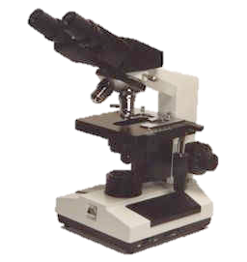
Microscopy
The basic compound microscope can be called a light microscope, because the background (field) appears light.
A light microscope consists primarily of a system of lenses that produce an enlarged specimen
A 1000-fold magnification is about the maximum that can be seen because of the nature of visible light
Objective lenses: (10X) scanning, (40X) high dry, (100X) oil immersion
Total magnification is product of ocular and objective

Slide 15
Mini Quiz 3
Friday, February 19
Students will take Mini Quiz 3 in Compass
The Mini Quiz will be open for 12 hours (9 AM – 9 PM CST)
Once you begin the quiz, you will have 30 minutes to complete it
Mini Quiz 3 covers:
Materials for this quiz were drawn from Basic Skills & Microscopy
Compass → Lab Exercises → Lab 2 (week of February 14)
Due to the number of calculations, I’ve increased the time allotment for this mini quiz to 30 minutes.

