Slide 1

Bacteria
Pages 71-93 in the Lab Manual

Slide 2

Lab Report: Bacteria is assigned today, and due by March 19 @ 5 PM (CST).
Quiz 2 will be March 26 after the three bacteria labs (Bacteria, pGlo, and UV Mutagenesis) are completed.

Slide 3
Bacteria Goals
Become familiar with the scientific process by generating hypotheses, making predictions and designing experiments
Determine potential sources of microbial contamination in the laboratory
Obtain a pure culture of bacteria by streaking for isolated colonies on solid media

Slide 4

Prokaryotes: lack a nuclear membrane
Small, single cell organisms
Exist in huge numbers in small amounts of material
Found almost everywhere

Slide 5

Look for contamination by testing for growth on medium.
Lab Video test four areas: countertop, computer keyboard, cell phone, and the bottom of a shoe

Slide 6

A population of cells, all of which are descended from a single cell.
Streak plating was done with a pure culture of E. coli

Slide 7

Liquid or Solid
Agar
Non-toxic
Remains solid at high temperatures
Not used as a nutrient
Defined or Complex

Slide 8
Sterilization Methods
To kill all living organisms
Autoclaving
Baking
Alcohol
Flaming
Filtration

Slide 9

Inoculating Loop
Serological Pipettes
Microliter Pipettes

Slide 10

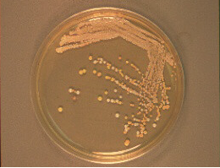
Cluster of cells visible to the naked eye
Facilitating:
Isolation of pure cultures
Enumeration of cell concentration in liquid suspensions
ID of bacterial species based upon the appearance of the colonies

Slide 11

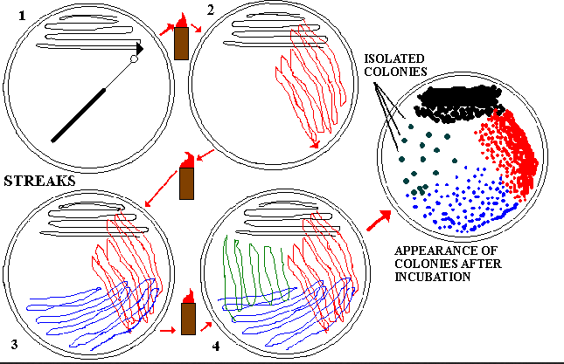
.

Slide 12

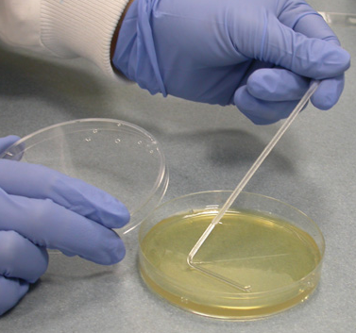
A diluted suspension is pipetted directly onto the surface of an agar plate and spread across the surface using a sterile glass spreader.

Slide 13

The number of colonies on a plate is assumed to be equal to the number of viable cells which were spread on the plate
Limiting Factors
No more than 0.2 ml of cell suspension should be spread on the plate
Resulting in 30 to 300 cells spread on the plate

Slide 14

The number of cells per ml is directly proportional to the mass of cells per ml
Using Spectrophotometers to measure Optical Density (OD)
Light is lost as it passes through the suspension because it is scattered and absorbed by the cells.
Data can be used to construct a standard curve.

Slide 15
A Standard Curve of Viable Cells Versus Turbidity

Slide 16

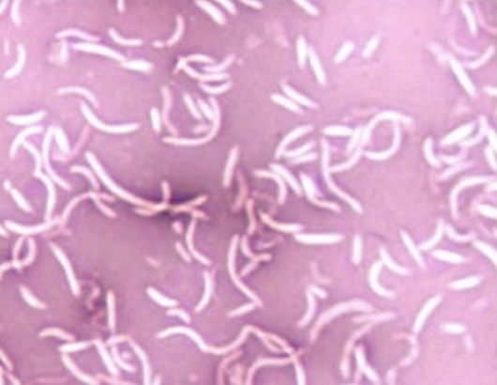
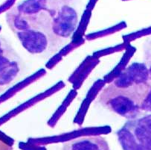
Positive Stains: cells pick up color
Negative Stains: background color, cells appear white

Slide 17
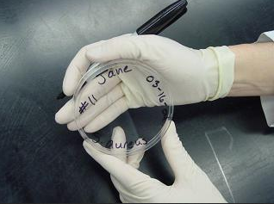
Procedure Part 1
Labeling plates
Label the bottom of the agar plate
Write on the periphery of the plate
Write your name, section, date, and location
Use the sterile swab to collect your contaminant and put it on the agar plate
Incubate plates for 36 hours at 37ºC

Slide 18
Procedure Part 2
Isolate Pure Cultures
Using Aseptic Technique
A pure culture of E. coli
Streaking Techniques

