Slide 1
pGLO Transformation
MCB 151

Slide 2
Announcements
Lab Report pGlo is due by 5 PM (CST) – March 26
Quiz 2 will take place on March 26.
Quiz 3 will take place on April 16.
Final Exam is May 7.
Same 9 AM – 9 PM (CST) window to take it.
Time allotment TBD based on exam question number.
Conflict Final Exam, must fill out the online form.

Slide 3
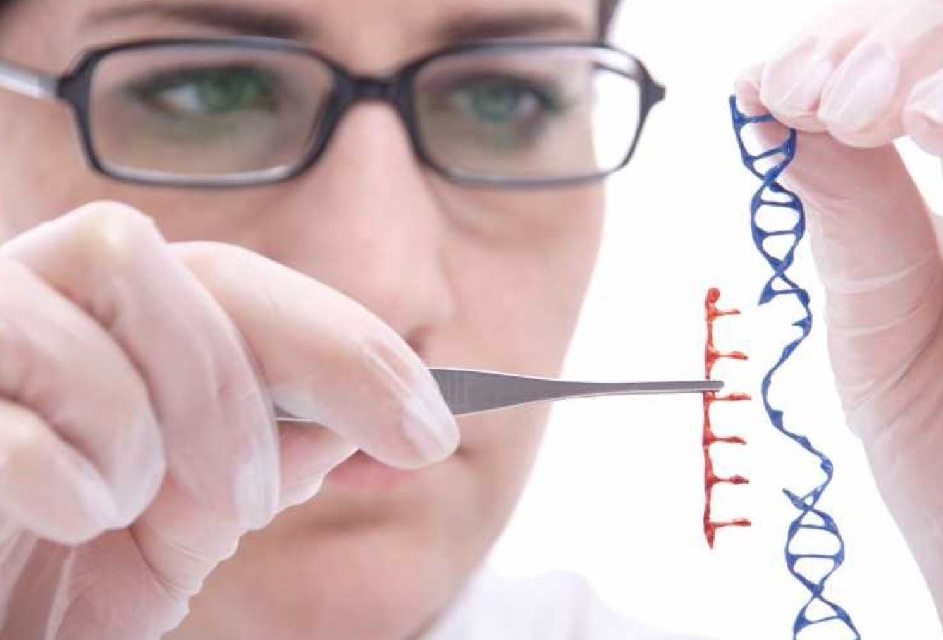
Genetic Engineering
The manipulation of an organism’s genetic material (DNA) by introducing or eliminating specific genes

Slide 4
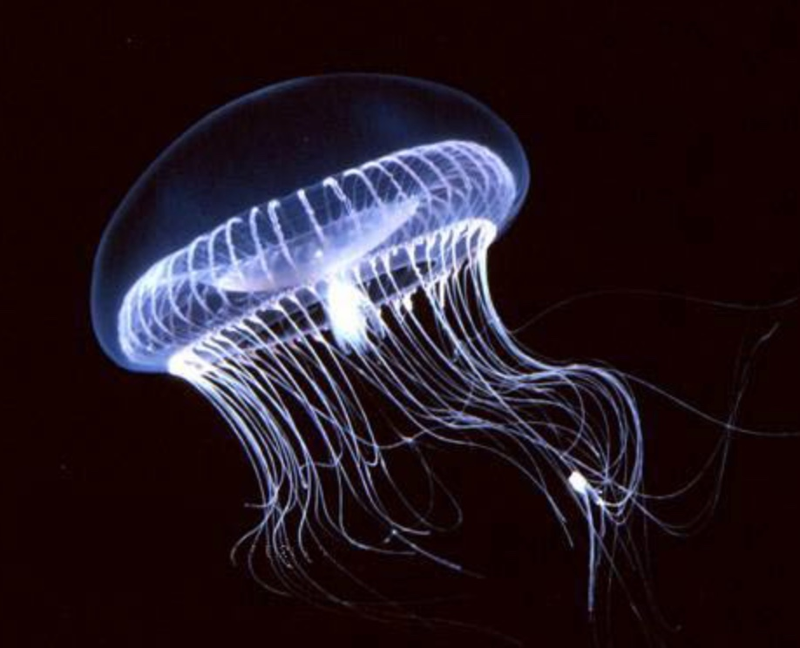
GFP (Green Fluorescent Protein)
Originates from the bioluminescent jellyfish
Allows the jellyfish to fluoresce and glow-in-the-dark
Following successful transformation your bacteria will express their newly acquired jellyfish gene and produce the fluorescent protein causing them to glow under UV light

Slide 5
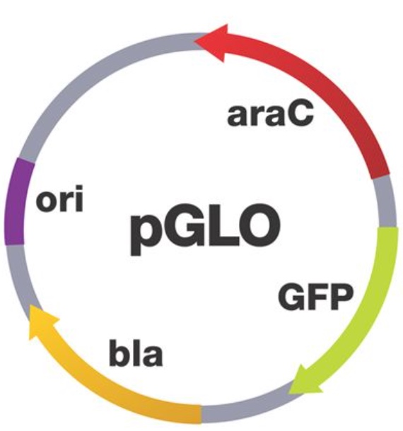
Plasmid DNA (pGLO Plasmid)
Beta Lactamase (bla) contains the ampicillin resistance gene
GFP from Aequorea victoria (jellyfish)
araC is a regulator protein. Regulating GFP transcription. If arabinose is present, then GFP is transcribed

Slide 6
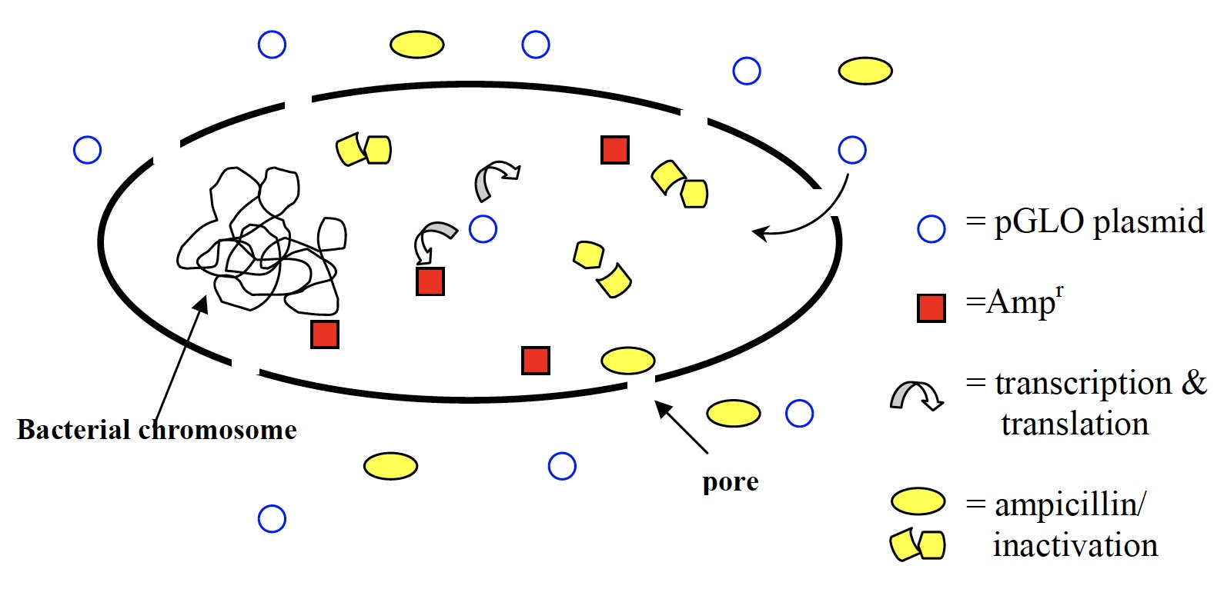
Transformation of E. coli
Move the pGlo plasmid DNA through the cell membrane using CaCl₂
Ice treatment
Heat shock @ 42°C
Ice treatment

Slide 7
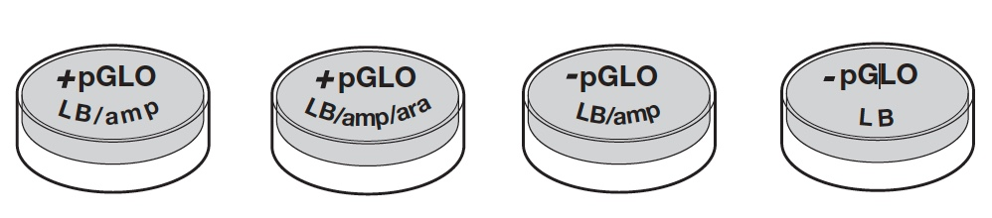
Plate Labeling

Slide 8
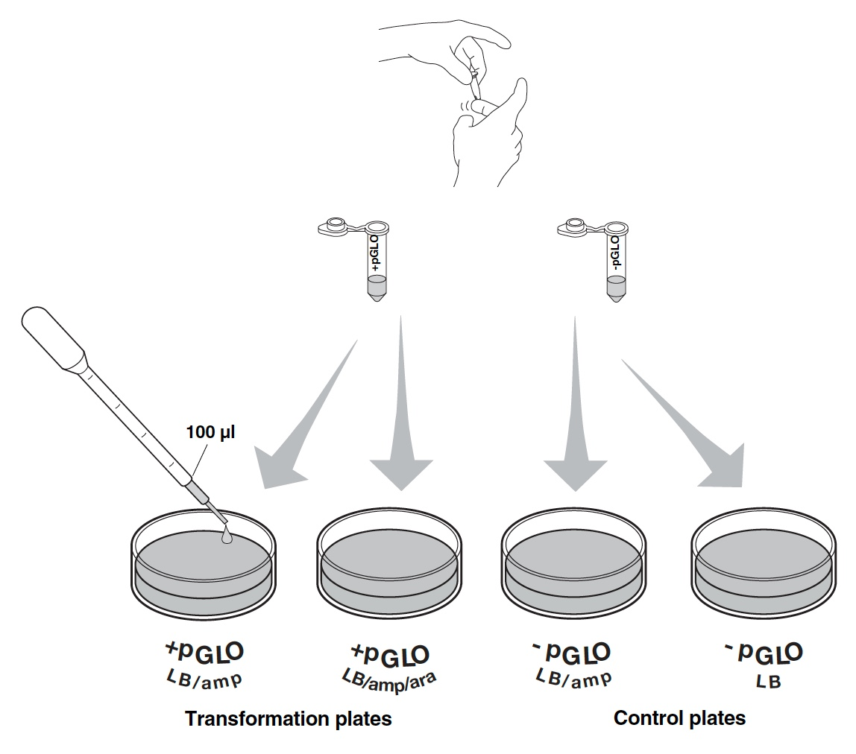
Spread Plating Transformed Cells

Slide 9
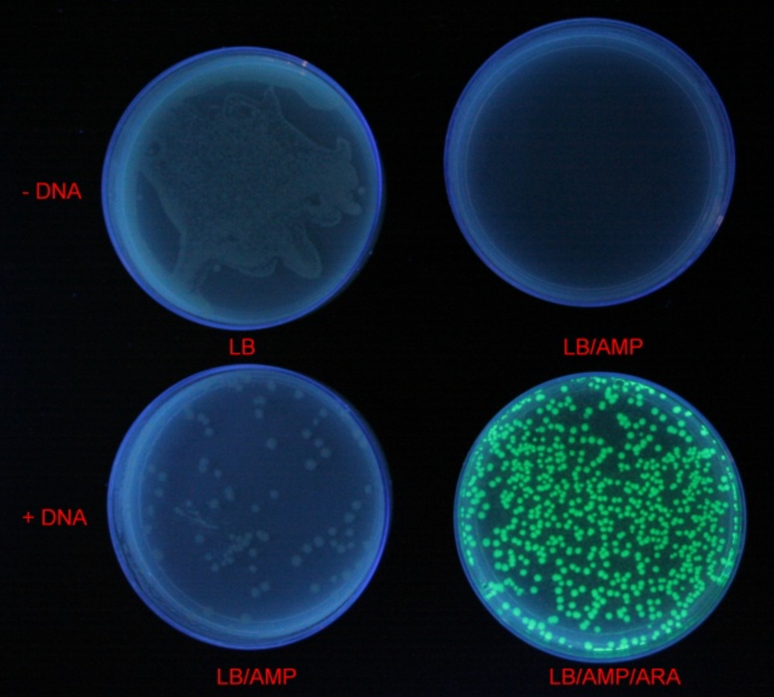
Expected Results *results are shared with you in this format as well

Slide 10
Transformation Efficiency
Total number of cells growing on the agar plate
Amount of DNA spread on the agar plate

Slide 11
Observations and Completion of LNAs
Students have access to the results/photos in Compass based on last name, first letter. Observations and colony counts will need to be completed from these photos.

Slide 12
Key Points
Students should be able to explain the process of creating competent cells (reagents used and treatments), the plasmid used in this experiment (as well as understanding the principles of the plasmid if a new plasmid were described to you), what selection media is and how it was used here (as well as if a different plasmid was used).

