Slide 1
UV Damage and Mutagenesis

Slide 2
Announcement
Quiz 2 March 26, 9 AM – 9 PM CST
  Covers Bacteria, pGlo, UV Mutagenesis
Lab Report UV Mutagenesis is due by 5 PM, April 2

Slide 3
Goals
Examine the effect of UV irradiation upon the viability of bacterial cells and the repair of UV damage by photoreactivation.
Continue to work with the scientific process by generating hypotheses, making predictions, and designing experiments.

Slide 4
UV light can:
Cause DNA damage
Kill cells

Slide 5
DNA Damage
DNA strongly absorbs UV light, forming thymine dimers.

Slide 6
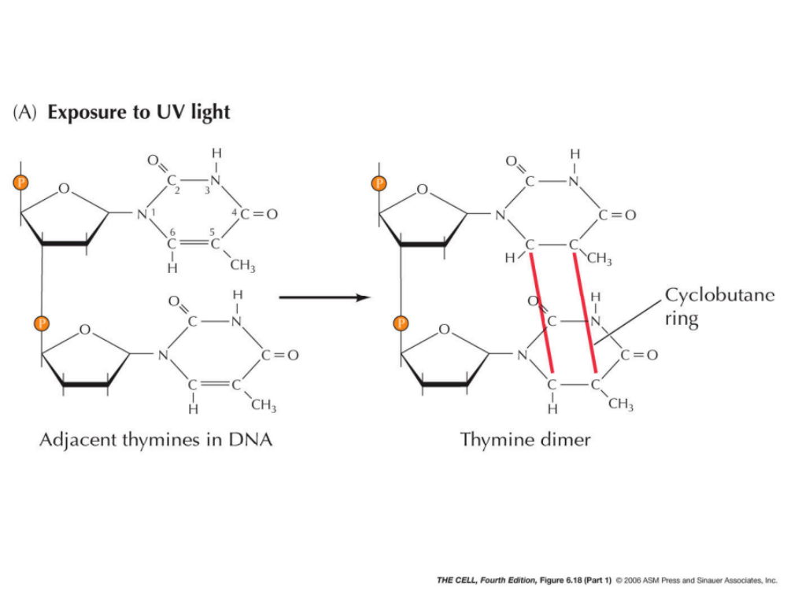
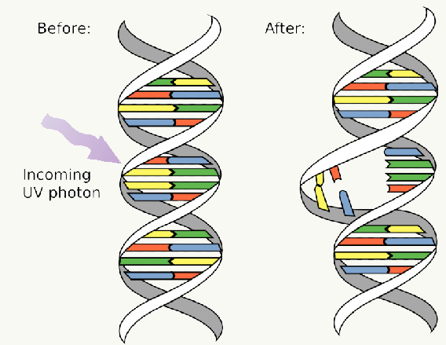
Formation of Thymine Dimers

Slide 7
T-T Dimers
Prevent replication and stop cell division.
Outcomes for the cell:
  Cell division may stop while the cell repairs the damage, and begin again once the damage is corrected (bacteriostatic effect)
  Cell loses viability and can no longer replicate (bacteriocidal effect)
  Cell makes a mistake in its repair, and carries a mutation in a gene

Slide 8
Repair of DNA Damage
(in E.coli)
Photoreactivation
Excision repair
Recombination repair
SOS-repair

Slide 9
Repair of DNA Damage
(in E.coli)
Photoreactivation
Excision repair
Recombination repair
SOS-repair

Slide 10
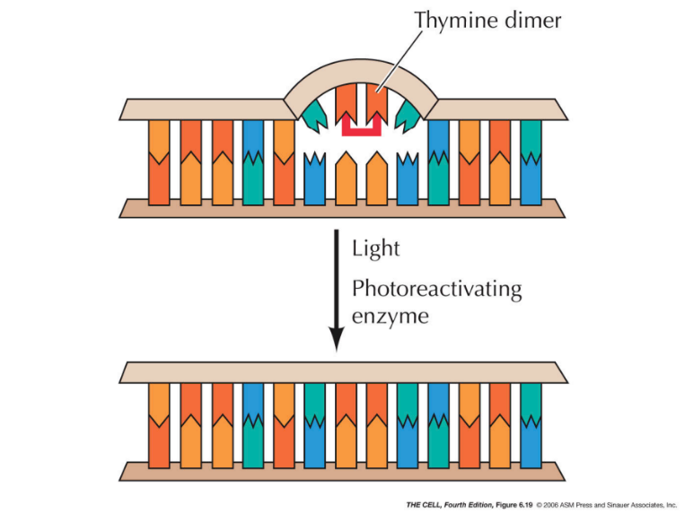
Photoreactivation
The enzyme photolyase binds T-T dimers. When the complex is excited by visible light it breaks the bonds forming the cyclobutane ring.

Slide 11
Repair of DNA Damage
(in E.coli)
Photoreactivation
Excision repair
Recombination repair
SOS-repair

Slide 12
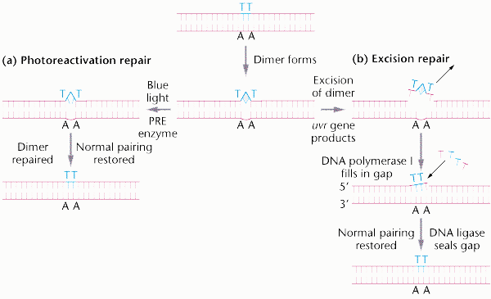
Excision Repair
A repair endonuclease recognizes the T-T dimer and cuts the DNA on both sides of it.
DNA Polymerase I then synthesizes new DNA to fill the gap.

Slide 13
Repair of DNA Damage
(in E.coli)
Photoreactivation
Excision repair
Recombination repair
SOS-repair

Slide 14
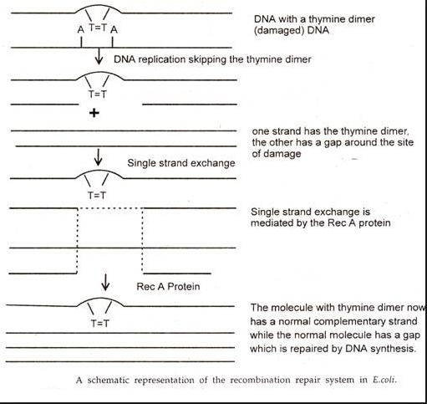
Recombination Repair
DNA Polymerase cannot replicate across the dimer
Instead it begins synthesizing on the other side of the dimer, resulting in a gap
These gaps are repaired by recA-mediated recombinations with the sister strand

Slide 15
Repair of DNA Damage
(in E.coli)
Photoreactivation
Excision repair
Recombination repair
SOS-repair

Slide 16
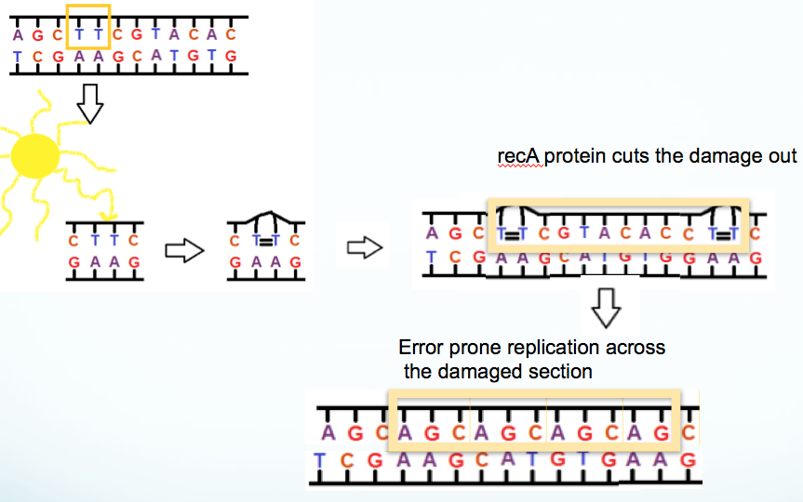
SOS-repair
A recA-dependent repair system induces error-prone replication across for the T-T dimers.
Probably the repair mechanism of most UV-induced mutations.

Slide 17
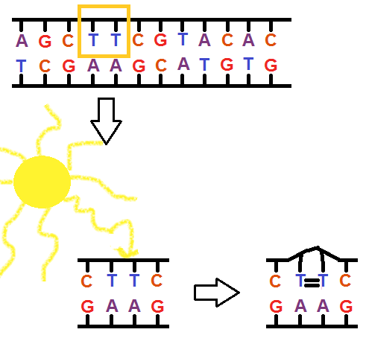

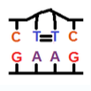



recA protein cuts the damage out
Error prone replication across
the damaged section

Slide 18
Survival of Bacterial Populations
The probability that a cell will die depends upon the amount of damage and the efficiency of DNA repair.
N_{s} = (1-α) N
N_{s}=number of cells that survive
= probability that one cell will be killed
N = total number of cells present

Slide 19
α
Depends on Dosage:
  The intensity of the physical bacteriocidal agent such as UV light
  The time of treatment

Slide 20
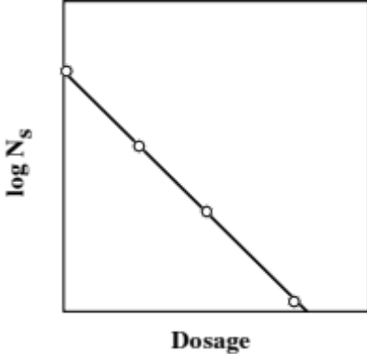
Effects of Dosage on Survival

Slide 21
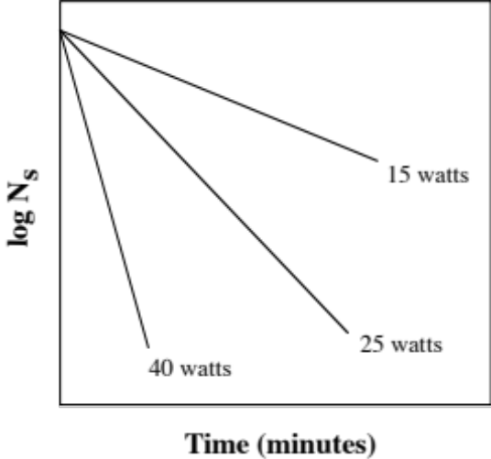
Effect of UV Intensity on Survival

Slide 22
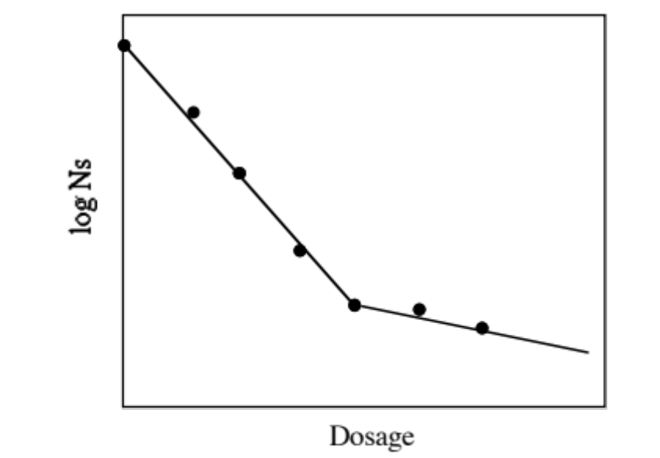
Survival of Heterogeneous Populations

Slide 23
Secondary Factors
Temperature: higher temperatures cause faster rates of cell death
pH: extremes cause faster rates of cell death
Organic materials: can protect cells, but may also yield toxic compounds

Slide 24
UV Lamps
We use a 15 watt germicidal lamp
Not effective in liquid suspensions b/c UV doesn’t penetrate very far into water.

Slide 25
The Experiment
Label 10 plates
Spread cell suspension on each plate
Place each pair of plates in UV boxes, remove the lids, leave in for the desired time
Place one of the plates from the pair in a paper bag
Place the remaining five plates under the blue lamp for 10-15 minutes, then into a paper bag
Incubate at room temperature for 72 hours
Examine the plates and record the number of colonies per plate

