Slide 1
AIDS Simutest
MCB 151

Slide 2
Announcements
HIV ELISA is the final lab period (report is due April 30 by 5 PM CST)
The Final Exam is scheduled for May 7 (9 AM – 9 PM open, 1 hour to complete it)
Conflict Final Exam Requests must be submitted by 5 PM on May 5
https://www.life.illinois.edu/mcb/151/course/forms.html
Reasons for Final Exam Conflicts (from Student Code)
3 exams scheduled in 24 hours
Verified reason with documentation from the ODOS or DRES
Time conflict: another exam scheduled at the same time as the MCB 151
This cannot happen since the window is 12 hours for our exam

Slide 3
Goals
Understand the epidemic of HIV/AIDS
Know the symptoms of HIV/AIDS
Be aware of the modes of transmission
Understand the rate of diagnosis in the United States
Perform a simulated ELISA test to test samples for HIV
Understand how a sandwich ELISA works

Slide 4
AIDS
Acquired Immunodeficiency Syndrome
Origin: Africa
Discovered in US in 1981
Statistics of 2019
38 million living with HIV/AIDS
1.7 million newly infected
US statistics have shown a 7% decline in diagnosis from 2014-2018

Slide 5
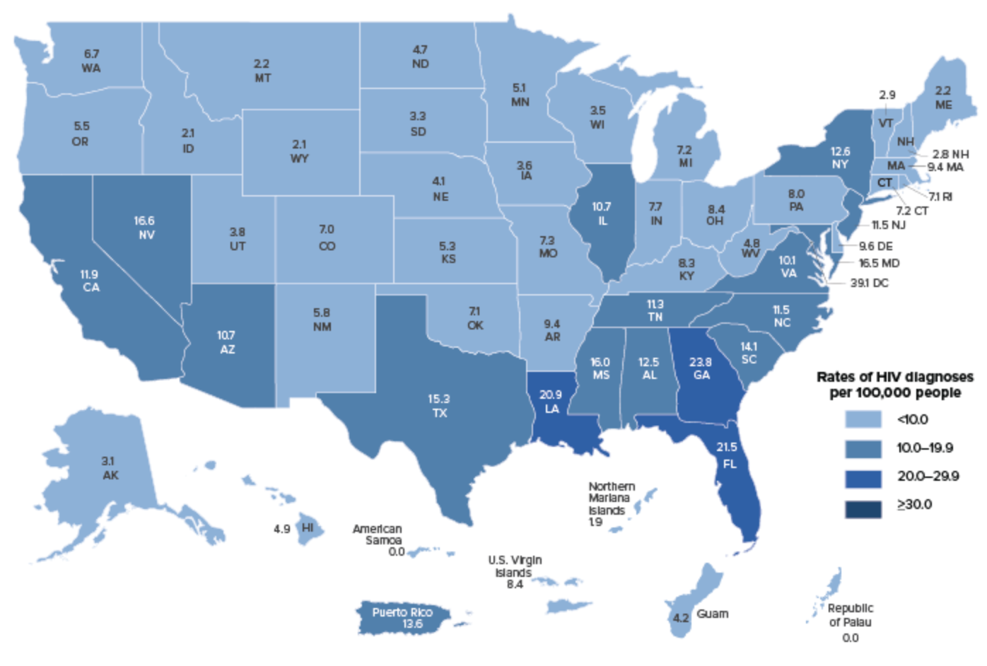
HIV Diagnosis in 2018

Slide 6
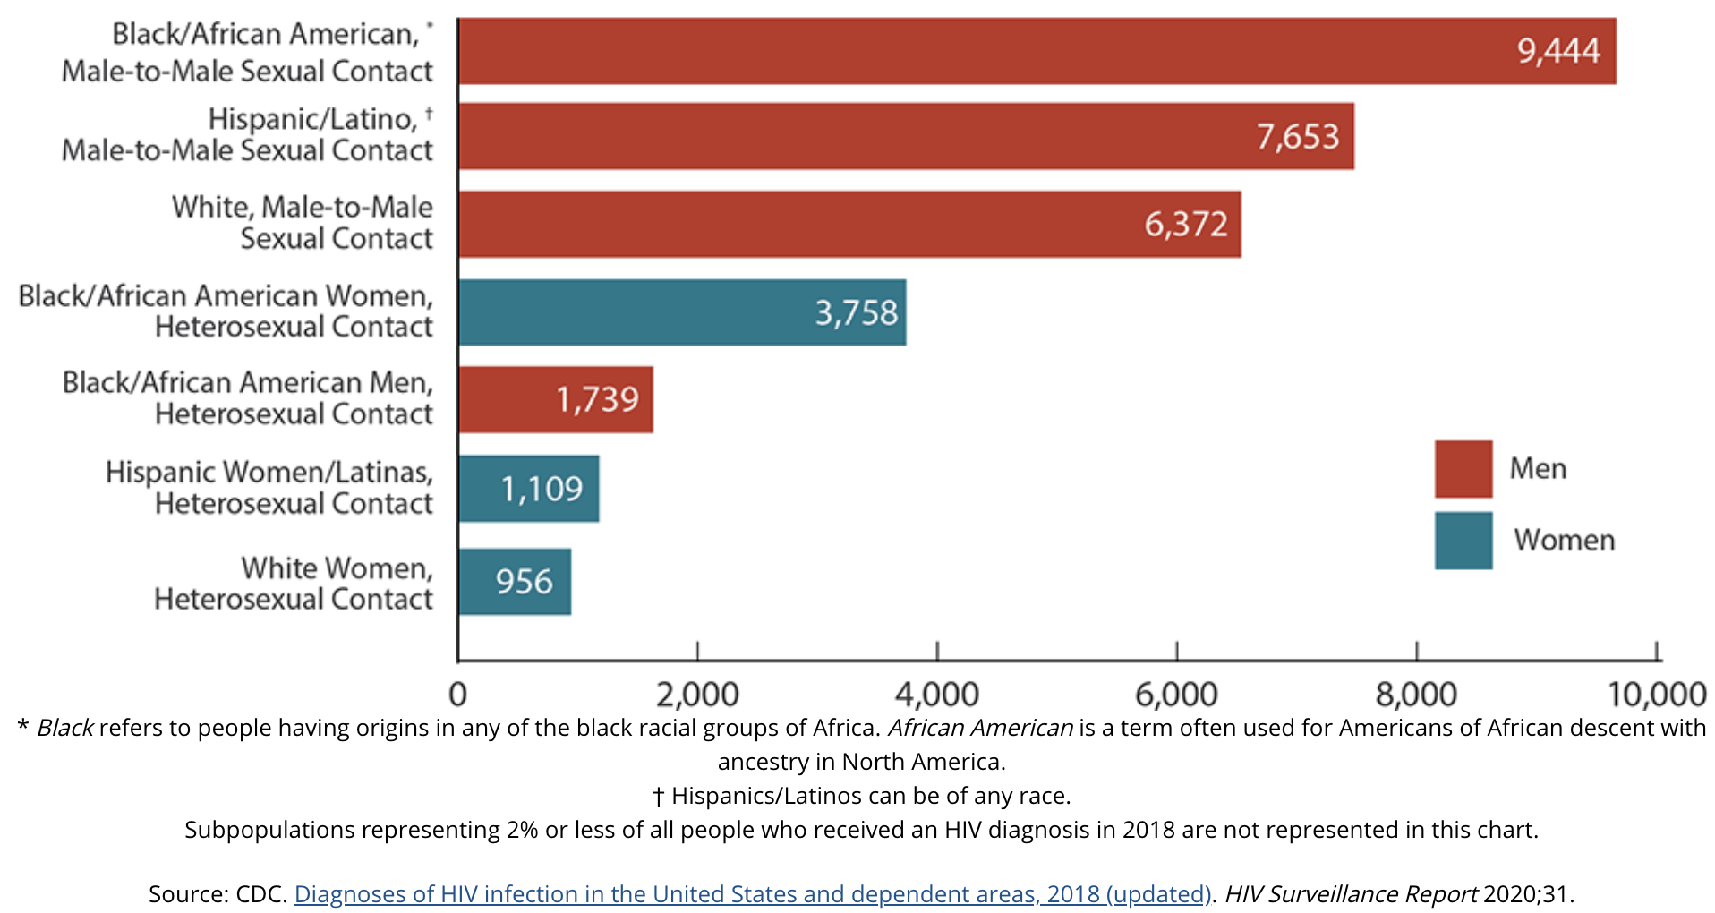
Race and ethnicity of diagnosed in us (2018)

Slide 7
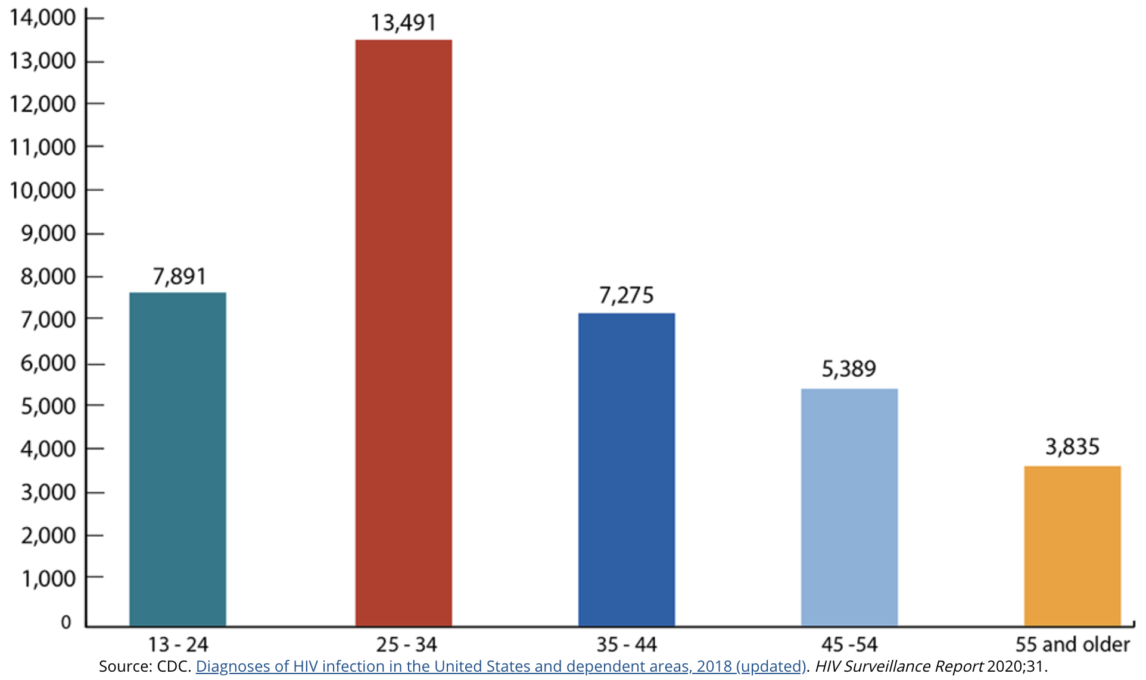
Age Diagnoses (2018)

Slide 8
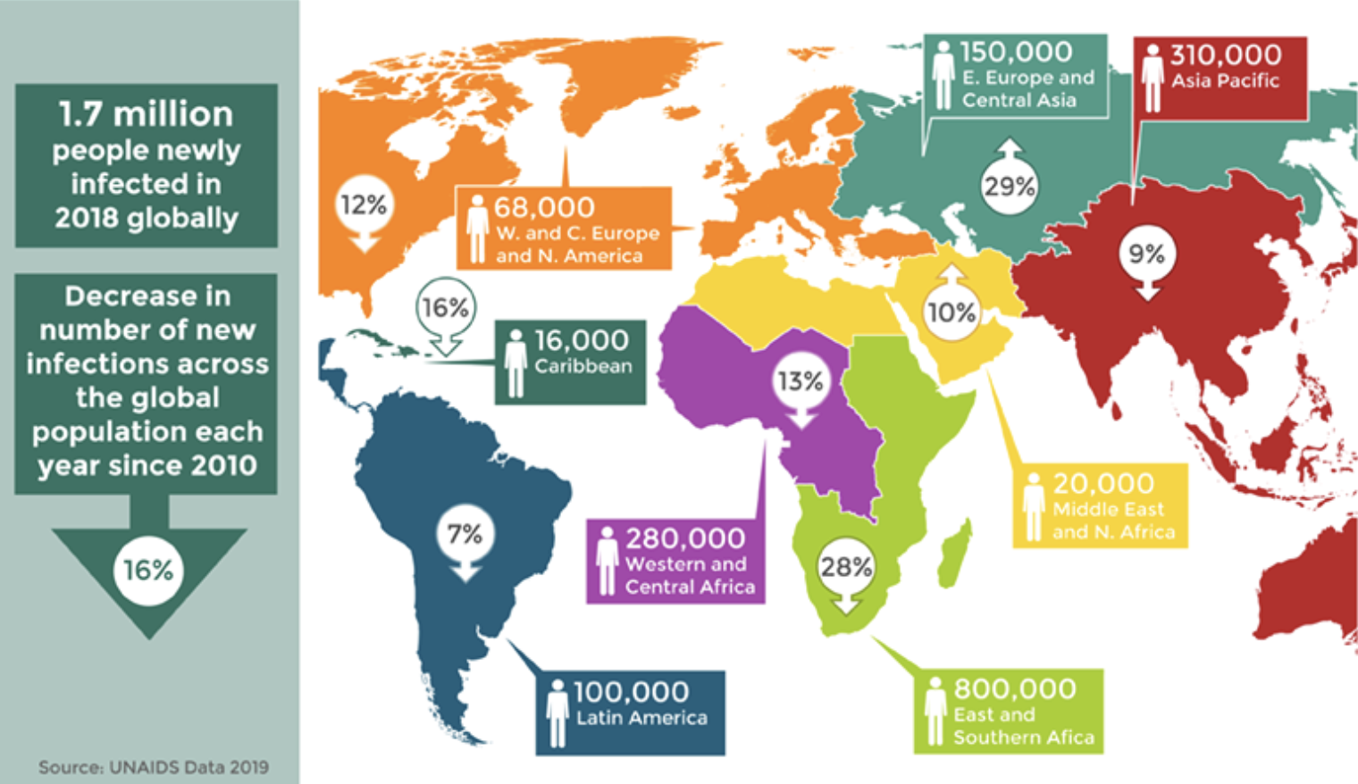
Global Decline in New cases Seen since 2010

Slide 9
Cause of AIDS
Virus: Human Immunodeficiency Virus (HIV)
Transmitted from chimpanzees in equatorial Africa
Lentivirus (slow virus)

Slide 10
How the virus replicates
Glycoprotein on the surface of the virus mimics an antigen in the host that thinks it is “self”
It hides and multiplies inside the cell
It targets white blood cell group – CD4⁺ T cells
Once it replicates it ruptures the cell, releasing new viruses ready to invade other cells
The immune system is destroying them, but HIV hides in the form of a provirus in the memory of CD4 and T4 lymphocytes and it slowly gains the advantage
A drop in the CD4⁺ T cells marks the final phase of the disease and is used to follow the progress of the disease

Slide 11
How the Virus spreads

Slide 12
How the Virus does not spread
Eating utensils
Drinking containers
Kissing*
Nasal fluid, sweat, tears*
Mosquito bites
*If there is blood in these modes of transmission the risk of spreading the virus does increase

Slide 13
symptoms
“Worst Flu Ever”
Free of symptoms for ~10 years (known as clinical latency)
When T cell counts drop, the immune system has succumbed to the virus
Fever
Sweats
Frequent and Persistent Infections
Skin Rashes
AIDS Symptoms Appear
Weight loss
Severe opportunistic infections and cancers

Slide 14
Testing for AIDS
ELISA: Enzyme-Linked Immunosorbant Assay
Two ELISA tests for confirmation followed by Western Blot = 99.5% accurate diagnosis
Both tests depend on infected patient forming antibodies to HIV
Can take a few days/weeks for the patient to produce specific antibodies to the virus

Slide 15
ELISA
(1) Use a microtiter plate with rows of wells that have HIV coat protein bound at the bottom.
(2) Serum sample added and any antigen present binds to the coat protein
(3) Detecting antibody (conjugate) is added and binds to the antigen
(4) Enzyme-linked secondary is added and binds to detecting antibody
(5) Substrate (chromagen) is added and is converted by enzyme to detectable form

Slide 16
Experimental Protocol
Review Biographical Sketches and procedure for the ELISA from the manual was followed in the video.
Helpful Tips:
Be sure to label pipets so there is no cross contamination
Carefully complete the dilution steps, moving samples to the appropriate wells in the correct volume

