Slide 1
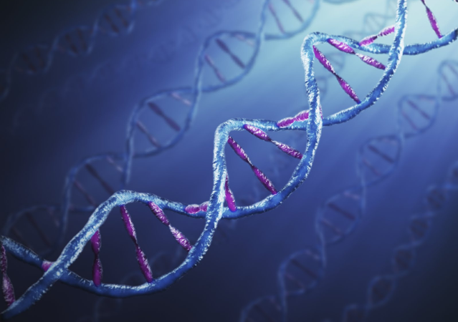
Lab 9 & 10:
DNA & Electrophoresis
Week of April 4 & 12

Slide 2
Goals
Part 1: Purify chromosomal DNA from E. coli.
Part 2: Plasmid Preps Using pBR322
Part 3: Electrophoresis & Mapping the sites for the restriction endonucleases BamHI and HindIII on plasmid pBR322 DNA.

Slide 3
Part 1: Purification of Chromosomal DNA (E. coli)

Slide 4
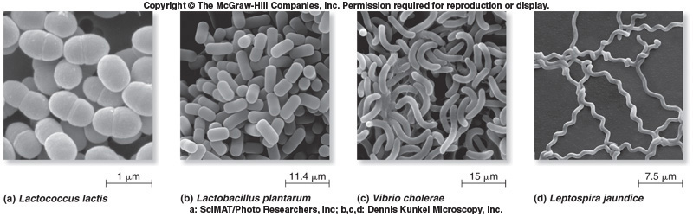
Notes:
Life8e-Fig-26-02-0RL.jpg

Slide 5
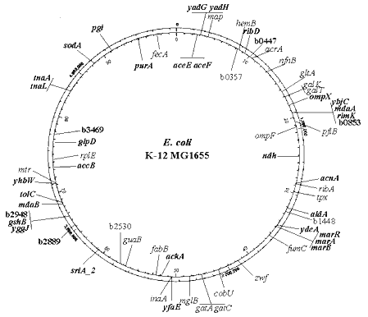

Slide 6
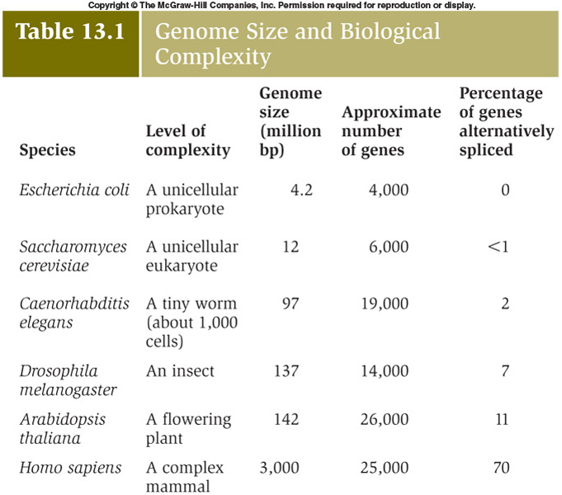
Genome Size Varies Widely

Slide 7
Purification of Chromosomal DNA
Step:
Disrupt the cell membrane, lysing the cells.
DNA molecules become susceptible to shear force which break the DNA into linear fragments. (20-30 kb)
Precipitate the DNA.

Slide 8
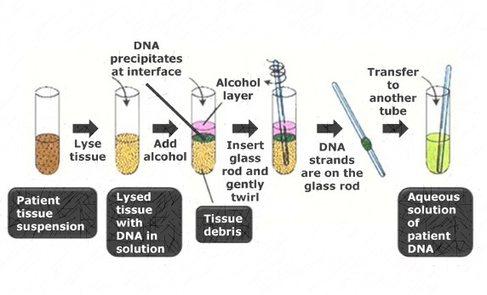
Reagents for Isolating Chromosomal DNA from E. coli
Lyse cells with sodium dodecyl sulfate.
Degrade proteins with Proteinase K.
Extract DNA with chloroform.
Precipitate DNA with 95% EtOH.
Collect DNA by winding fibers around a glass rod.
Dissolve the DNA in Tris-HCl buffer + EDTA.
Analyze by gel electrophoresis.

Slide 9
Part 2: Plasmid Preps Using pBR322

Slide 10
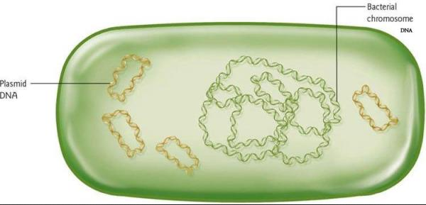
Plasmids
Self-replicating, extrachromosomal DNA
Most are double stranded
Circular DNA
Supercoiled
Size: 2 kb - several hundred kb
Vary in the number of copies/cell

Slide 11
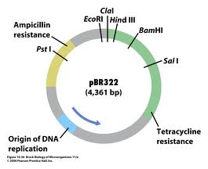
Map of pBR322

Slide 12
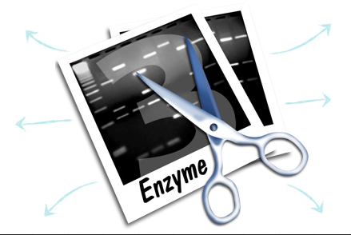
Restriction Enzymes
Recognize and cut specific sequences in double-stranded DNA.
The longer the recognition sequence the lower the probability of finding that specific sequence.
Since there are 4 bases, the probability of finding a specific sequence is 1/4^{n}
Where n is the number of nucleotides.

Slide 13
Naming of Restriction Enzymes
Named for the organism of origin.
  BamHI was isolated from Bacillus amyloliquefaciens
  NdeI was isolated from Neisseria denitrificans

Slide 14
Restriction Enzymes may require specific buffers:
Buffers adjusted to optimal:
  pH
  Ionic strength
  Mg concentration

Slide 15
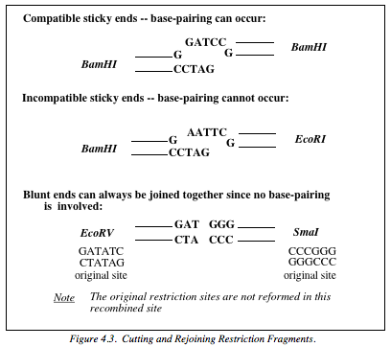
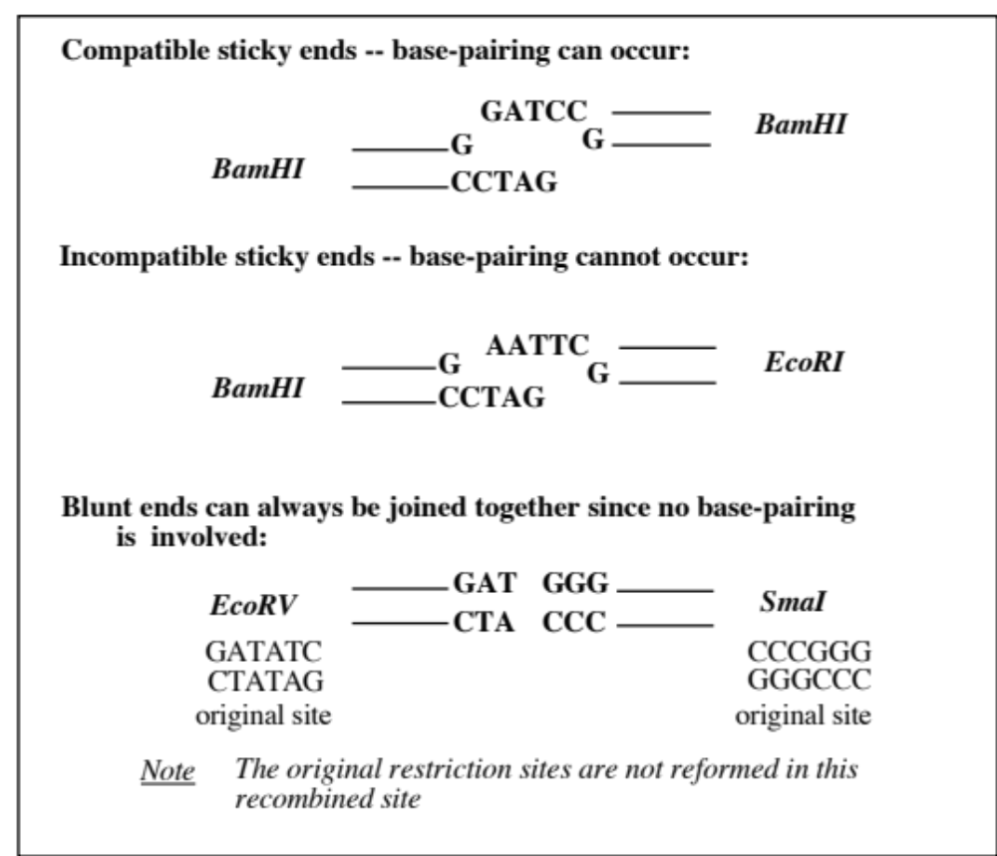
Joining Restriction Fragments
Restriction fragments can be joined by the enzyme DNA ligase

Slide 16
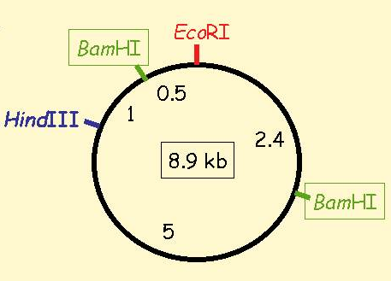
Restriction Maps
Used to tell which regions of a cloned gene could be sub-cloned for over-expression of a particular protein.

Slide 17
Making a Restriction Map
(double digests)
Take 3 aliquots of purified DNA and treat with two different enzymes.
  Treat aliquot #1 with enzyme #1 (digest)
  Treat aliquot #2 with enzyme #2 (digest)
  Treat aliquot #3 with enzymes #1 and #2 (double digest)
  Compare the resulting sets of fragments by gel electrophoresis

Slide 18
Nucleases
Purified DNA is very sensitive to nucleases, and can degrade rapidly if a nuclease is present.
Where gloves to prevent your own nucleases from degrading your sample.

Slide 19
Part 3: Gel Electrophoresis & Plasmid Map Construction

Slide 20
DNA Gel Electrophoresis
Negatively charged DNA is pulled toward the anode
Large pieces/fragments of DNA do not move as fast as smaller ones

Slide 21
-
C
B
BN
N
+

Slide 22
-
C
B
BN
N
+

Slide 23
-
C
B
BN
N
+

Slide 24
-
C
B
BN
N
+

Slide 25
-
C
B
BN
N
+

Slide 26
-
C
B
BN
N
We can convert migration distances into fragment size (kB) by using a standard curve
(Size versus migration distance)
+

Slide 27
-
λ
C
B
BN
N
Measure
Known
23.13 kB
9.416 kB
6.557 kB
4.361kB
2.322 kB
2.027 kB
0.564 kB
0.125 kB
+

Slide 28
-
λ
C
B
BN
N
Known
23.1 kB
9.4 kB
6.5 kB
4.3 kB
2.3 kB
2.0 kB
Standard kbases | Distance mm
23.1 | 4
9.4 | 6
6.5 | 8
4.3 | 9
2.3 | 10
2.0 | 13
0.5 | 19
0.1 | 24
0.5 kB
B (mm) | BN (mm) | N (mm)
9 | 10 | 9
 | 12
0.1 kB
+

Slide 29

















Standard Curve
Size (kBases)
Measured
Known
4 mm
23.1 kB
6 mm
9.4 kB
8 mm
6.5 kB
9 mm
4.3 kB
10 mm
2.3 kB
Size (Kb)
13 mm
2.0 kB
19 mm
0.5 kB
24 mm
0.1 kB
Distance Migrated (mm)

Slide 30

















B
BN
N
B
BN
N
mm
mm
mm
mm
mm
mm
9
10
9
Size (kBases)
12
Measured
Known
4 mm
23.1 kB
6 mm
9.4 kB
8 mm
6.5 kB
9 mm
4.3 kB
10 mm
2.3 kB
Size (Kb)
13 mm
2.0 kB
19 mm
0.5 kB
24 mm
0.1 kB
Distance Migrated (mm)

Slide 31
Size of this fragment?
You need to make a “map” like this for your plasmid.
B
N
What map do you expect? (B, N, BN)
Be sure to include plasmid size on your map.
Size of this fragment?
Plasmid Size = ? kBases

