Slide 1
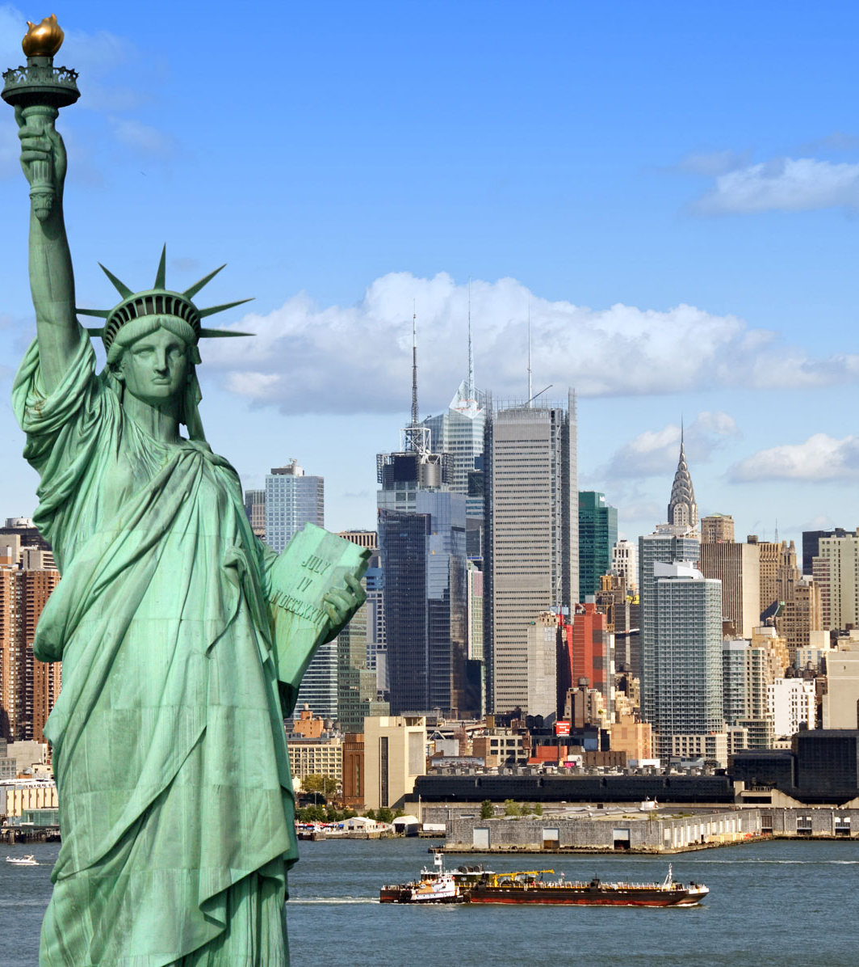
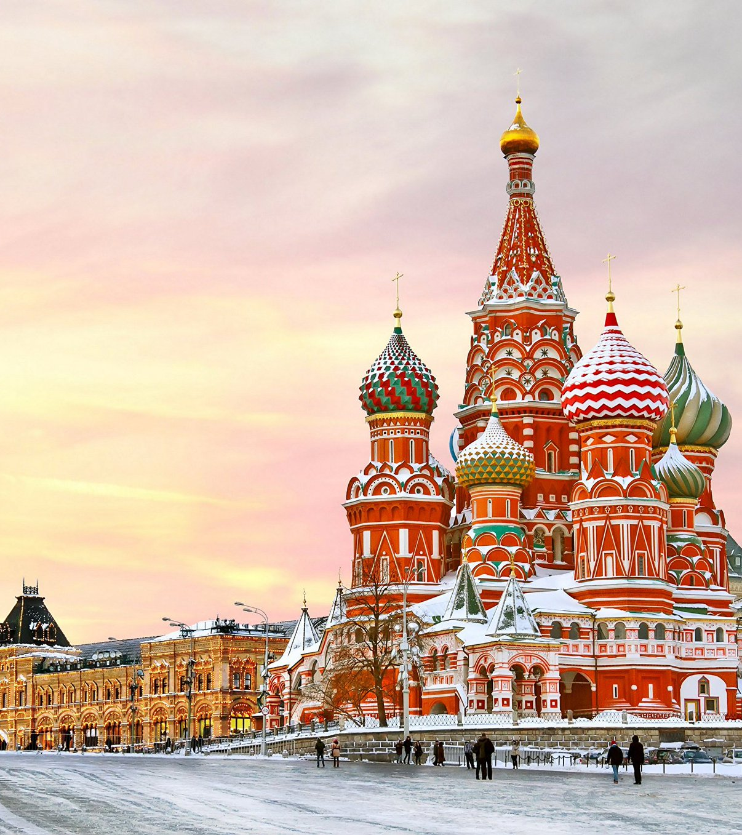
The Battle of Neighborhoods

Slide 2
Introduction
Sometimes we have to change our location because of many reasons: work, study, family… This project will help someone to understand how similar two areas from different cities are. As an example, we will try to compare two areas of two cities: Moscow and New York. Similarity of two areas can help to make a decision about migration from one city to another or about business expansion or just can provide some interesting information about two areas from different sides of the globe.

Slide 3
Data
All data for this project was taken from free and open sources on the internet. Most of initial information will be scraped from Wikipedia - free and open data source. Most detailed information about every location will be obtained using Foursquare API.

