Slide 1

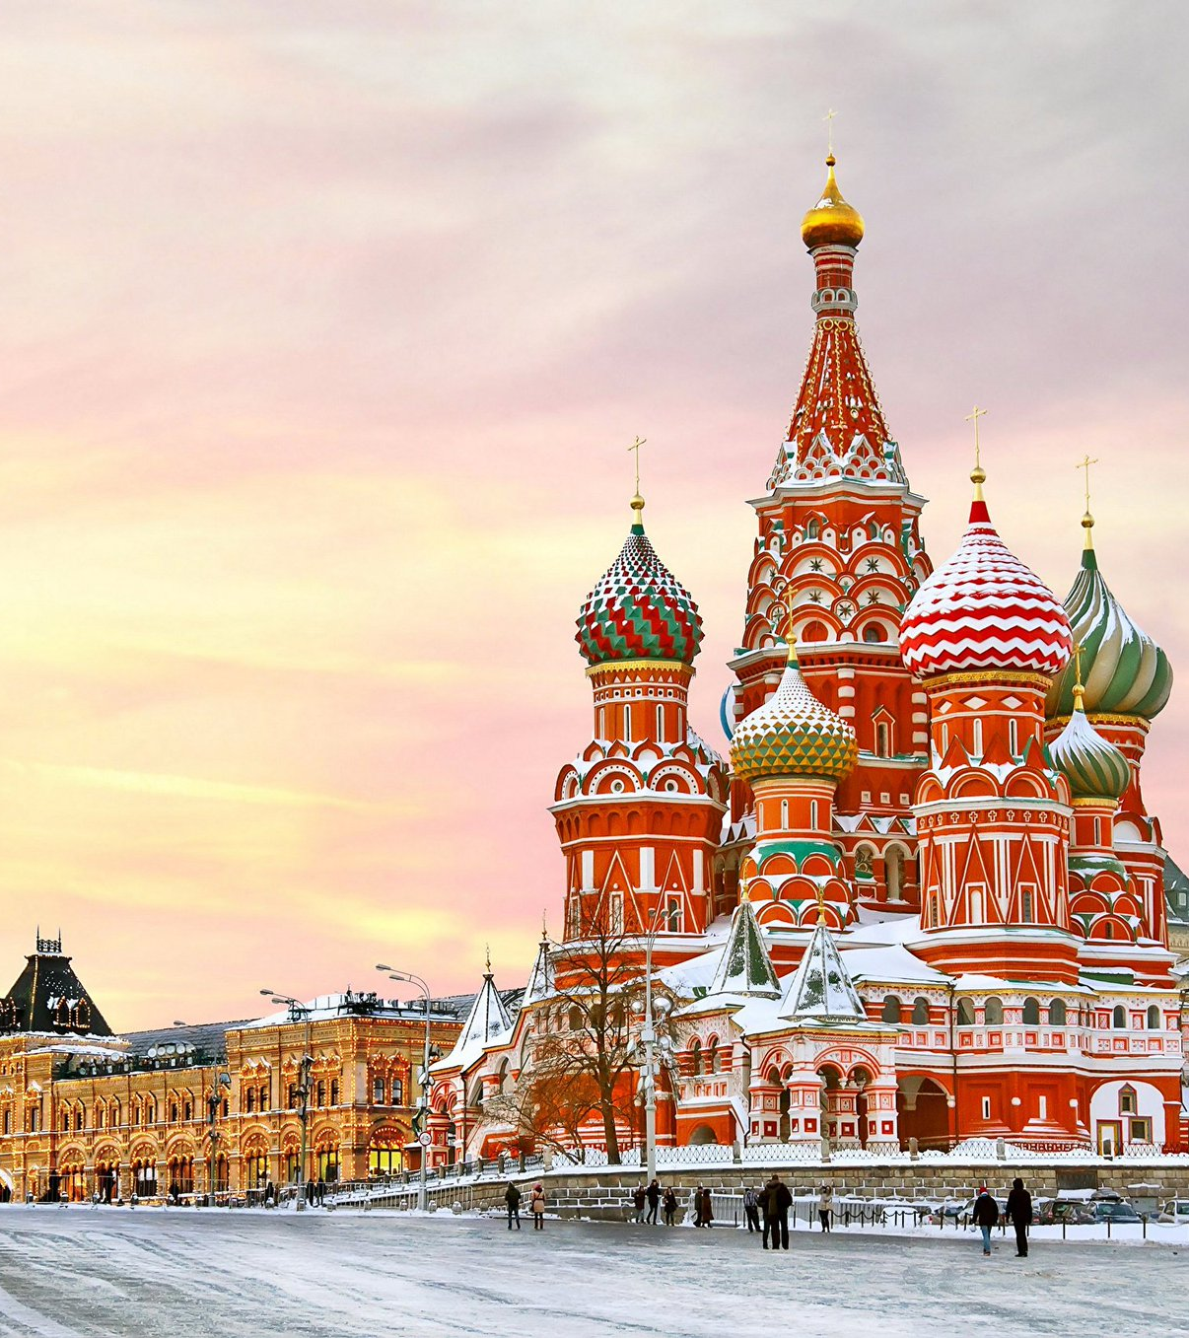
The Battle of Neighborhoods

Slide 2
Introduction
Sometimes we have to change our location because of many reasons: work, study, family… This project will help someone to understand how similar two areas from different cities are. As an example, we will try to compare two areas of two cities: Moscow and New York. Similarity of two areas can help to make a decision about migration from one city to another or about business expansion or just can provide some interesting information about two areas from different sides of the globe.

Slide 3
Data
All data for this project was taken from free and open sources on the internet. Most of initial information was scraped from Wikipedia, OpenStreetMap. Most detailed information about every location was obtained with Foursquare API. Data was cleaned and processed locally.

Slide 4
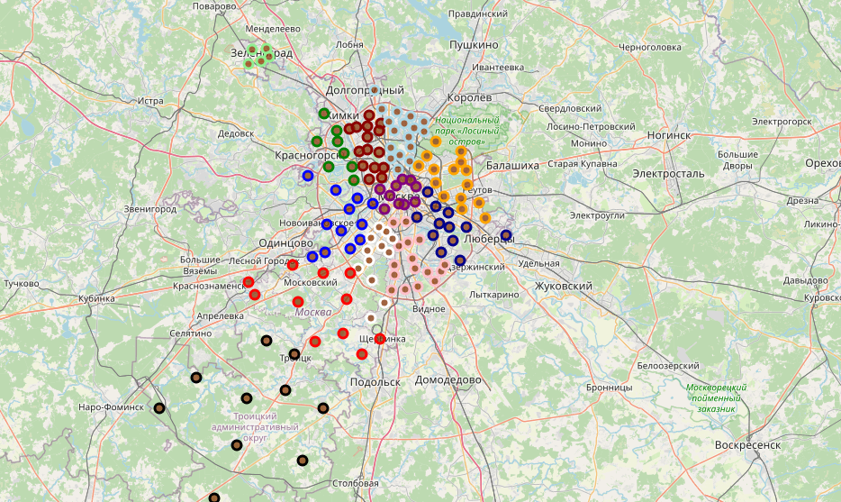
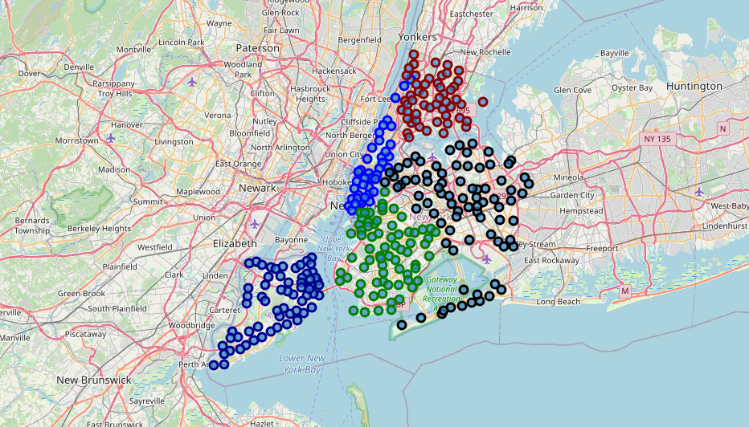
Everything begins from understanding territory division of every city. Moscow divided in 12 Administrative Okrug and New York City divided in 5 Borough. After getting some information about every Administrative Okrug and Borough we can decide which areas we will use for comparison. There are districts and neighborhoods inside of each Administrative Okrug and Borough.

Slide 5

From Wikipedia data the most similar areas are
Name | Land area km² | % of all area | Place by area | Population | % of all population | Place by population | Density pers/km² | Place by density
South-Eastern | 117.56 | 23833 | 6 | 1433828 | 11628 | 5 | 12196.59 | 4
The Bronx | 109.04 | 13.91 | 4 | 1418207 | 43847 | 4 | 13006.00 | 3

