Slide 1
DevOps CA-2 Case Study
From Monolith to Microservices — a DevOps transformation, built and run live
Case studies: Q1 Netflix · Q2 Amazon Tasks: 1–4 implementation evidence + reflection
Group members:
1. ____________________ [PRN] 2. ____________________ [PRN]
3. ____________________ [PRN] 4. ____________________ [PRN]
5. ____________________ [PRN]

Slide 2
Case Study 1 – Amazon (Q2): The Challenge
• Early 2000s: rapid growth overwhelmed Amazon's monolithic architecture
  – Frequent outages and slow feature releases
  – Directly impacted customer satisfaction and revenue
• The Goal: adopt a microservices architecture supported by DevOps automation to enable rapid, reliable deployments

Slide 3
Amazon (Q2): Challenges of the monolith
• Challenge 1 — Frequent outages: downtime directly hit customer satisfaction and revenue
• Challenge 2 — Slow, risky releases: the massive, tightly coupled codebase made every update slow and difficult to deploy
• Challenge 3 — Scaling everything together: impossible to handle traffic spikes on specific features efficiently
• Challenge 4 — Cascading failures: a single bug in one module could break unrelated functions across the platform
• Impact: the monolith became a severe bottleneck — a fundamental architectural and cultural shift was needed

Slide 4
Amazon (Q2): DevOps solutions & impact
• Solution 1 — Two-pizza teams (cultural shift): small autonomous teams own their services end-to-end → ownership, accountability, faster decisions
• Solution 2 — Microservices (architectural shift): independent, loosely coupled services → independent scaling and deployment, smaller blast radius
• Solution 3 — Continuous deployment & automation (CI/CD): automated build, test and deployment pipelines → rapid, safe releases
• Overall result: a culture of continuous innovation — code deployed on average every 11.7 seconds
• Massive scalability and resilience, directly boosting customer satisfaction and revenue

Slide 5
Case Study 2 – Netflix (Q1): The Challenge
• 2008: a major database corruption halted DVD shipments for 3 days
• Monolithic architecture = a single point of failure — one corrupted database took everything down
• Scaling and deploying changes was difficult
• The Goal: build a resilient, scalable and fault-tolerant system using DevOps practices

Slide 6
Netflix (Q1): Challenges of the monolith
• Challenge 1 — Single point of failure: one corrupted database brought down the entire system, not just one feature
• Challenge 2 — Cascading failures: a bug in one module (e.g., shipping) crashed the whole application
• Challenge 3 — Slow recovery: fixing anything required rebuilding and redeploying the entire massive codebase
• Challenge 4 — Scaling bottlenecks: the entire app had to scale to serve demand on a single feature
• Impact: 3 days of lost revenue and damaged trust — the wake-up call that forced the migration to cloud and microservices

Slide 7
Netflix (Q1): DevOps solutions & impact
• Solution 1 — Microservices: hundreds of independent, loosely coupled services → a failure in one does not crash the others
• Solution 2 — Chaos Engineering (Chaos Monkey): proactively injects failures in production → systems must recover automatically
• Solution 3 — CI/CD & small autonomous teams: small rapid deployments reduce risk; teams own their service end-to-end
• Overall result: massive resilience (survives AWS outages) and near-infinite scalability (enabled global streaming)
• Continuous innovation without compromising uptime

Slide 8
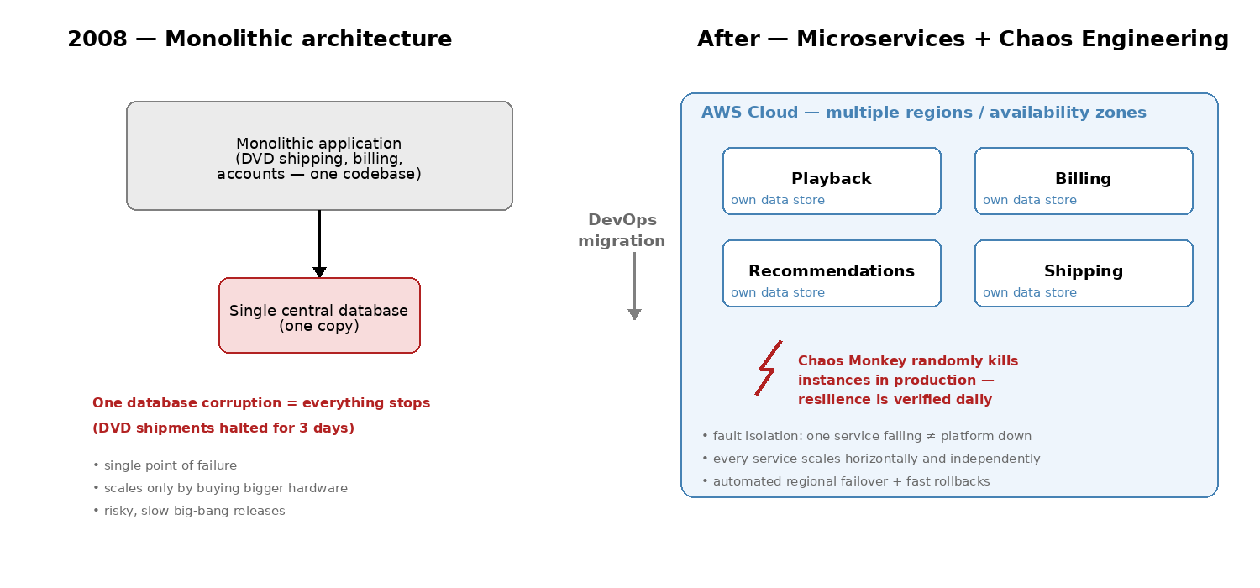
Netflix (Q1): architecture shift
Monolith + single database vs. microservices on AWS with Chaos Engineering

Slide 9
Our implementation — technology stack & versions
• Application: Java 21 — zero-dependency HTTP service (/, /health, /metrics)
• Containerization: Docker — multi-stage build (JDK compiles, JRE-only runtime, non-root)
• Orchestration: Kubernetes v1.36 (k3s, single node) on a Debian VM — 192.168.1.109
• CI/CD: GitHub Actions → GHCR → SSH deploy with verified rolling update
• Configuration Management: Ansible (ansible-core 2.19, agentless over SSH)
• Monitoring: Prometheus + Grafana (kube-prometheus-stack via Helm) + ServiceMonitor
• Repository: github.com/xzeyo/devops-ca2
• Everything below ran LIVE on the cluster — evidence captured from the real session

Slide 10
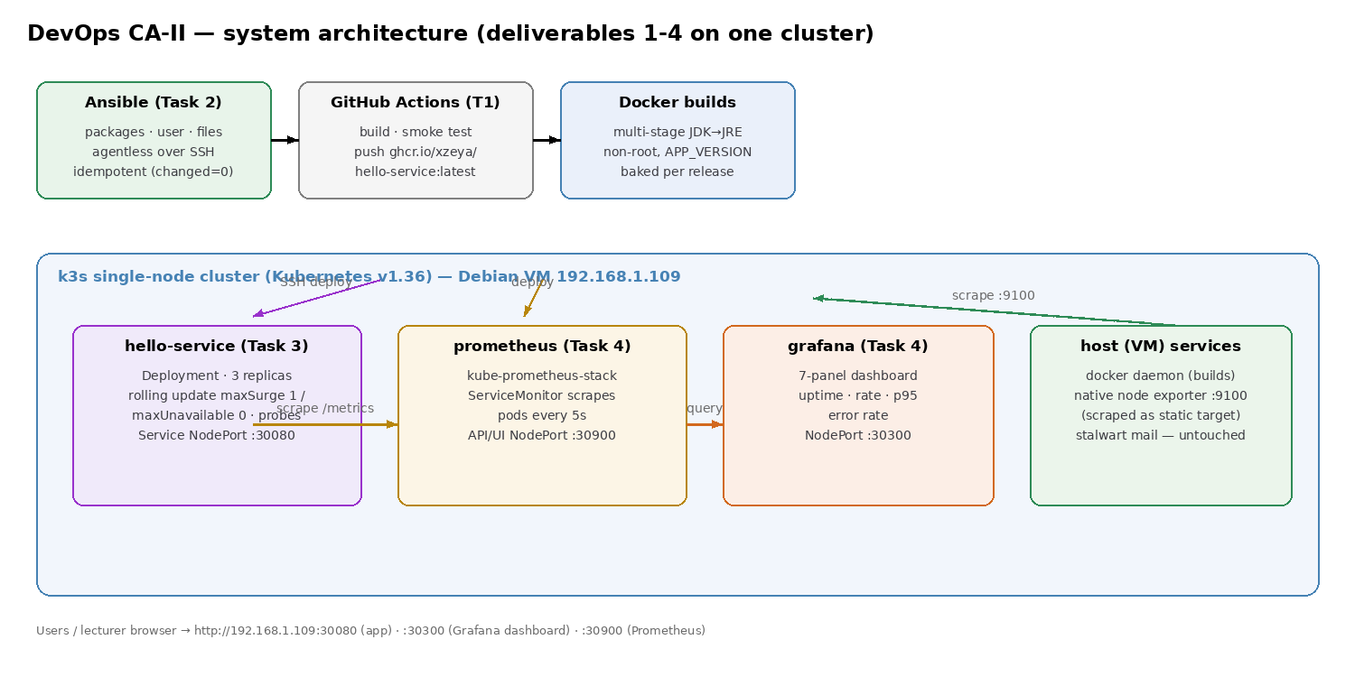
Our architecture

Slide 11
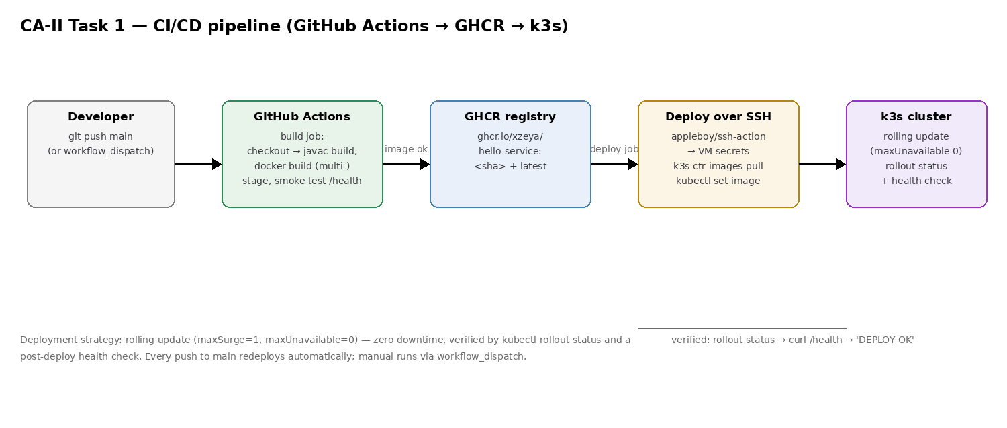
Task 1 — Deployment Strategy: GitHub Actions
• Workflow: compile → docker build (multi-stage) → container smoke test (/health) → push GHCR → SSH deploy → kubectl rollout status → post-deploy health check
• Submitted: deploy.yml + pipeline diagram. Deploy job runs on a self-hosted runner on the VM; verified end-to-end: push to build, GHCR, rolling update, health check

Slide 12
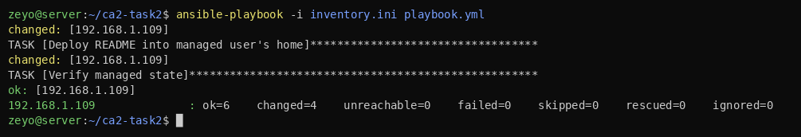
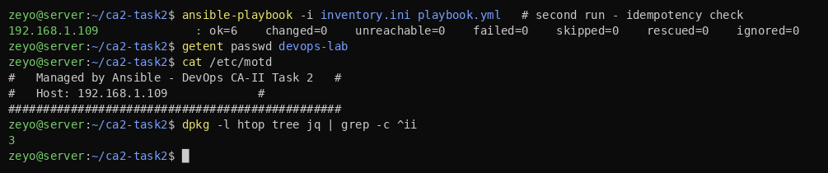
Task 2 — Configuration Management & IaC: Ansible
• Playbook installs packages (htop, tree, jq), creates a managed user (devops-lab), manages /etc/motd + home README
• 1st run: ok=6, changed=4, failed=0 — desired state applied
• 2nd run: changed=0 — idempotent (core IaC property)
• Agentless over SSH; submitted: playbook.yml + inventory

Slide 13
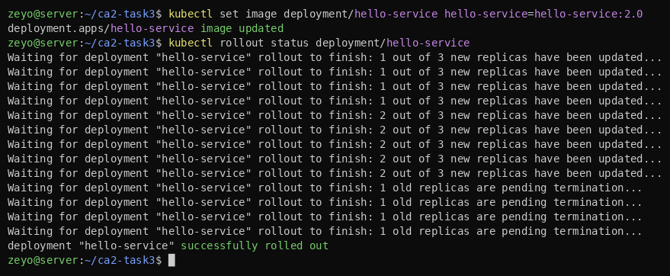
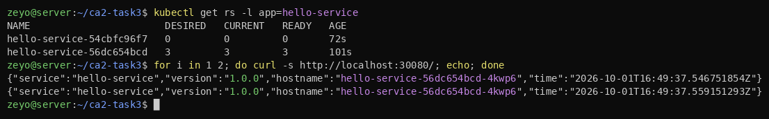
Task 3 — Containerization & Orchestration (live)
• Deployment: 3 replicas, RollingUpdate maxSurge=1 / maxUnavailable=0, readiness+liveness probes
• NodePort Service :30080 load-balances across pods
• Rolling update v1→v2 with zero downtime, then rollback — all performed live; YAMLs + 8 screenshots submitted

Slide 14
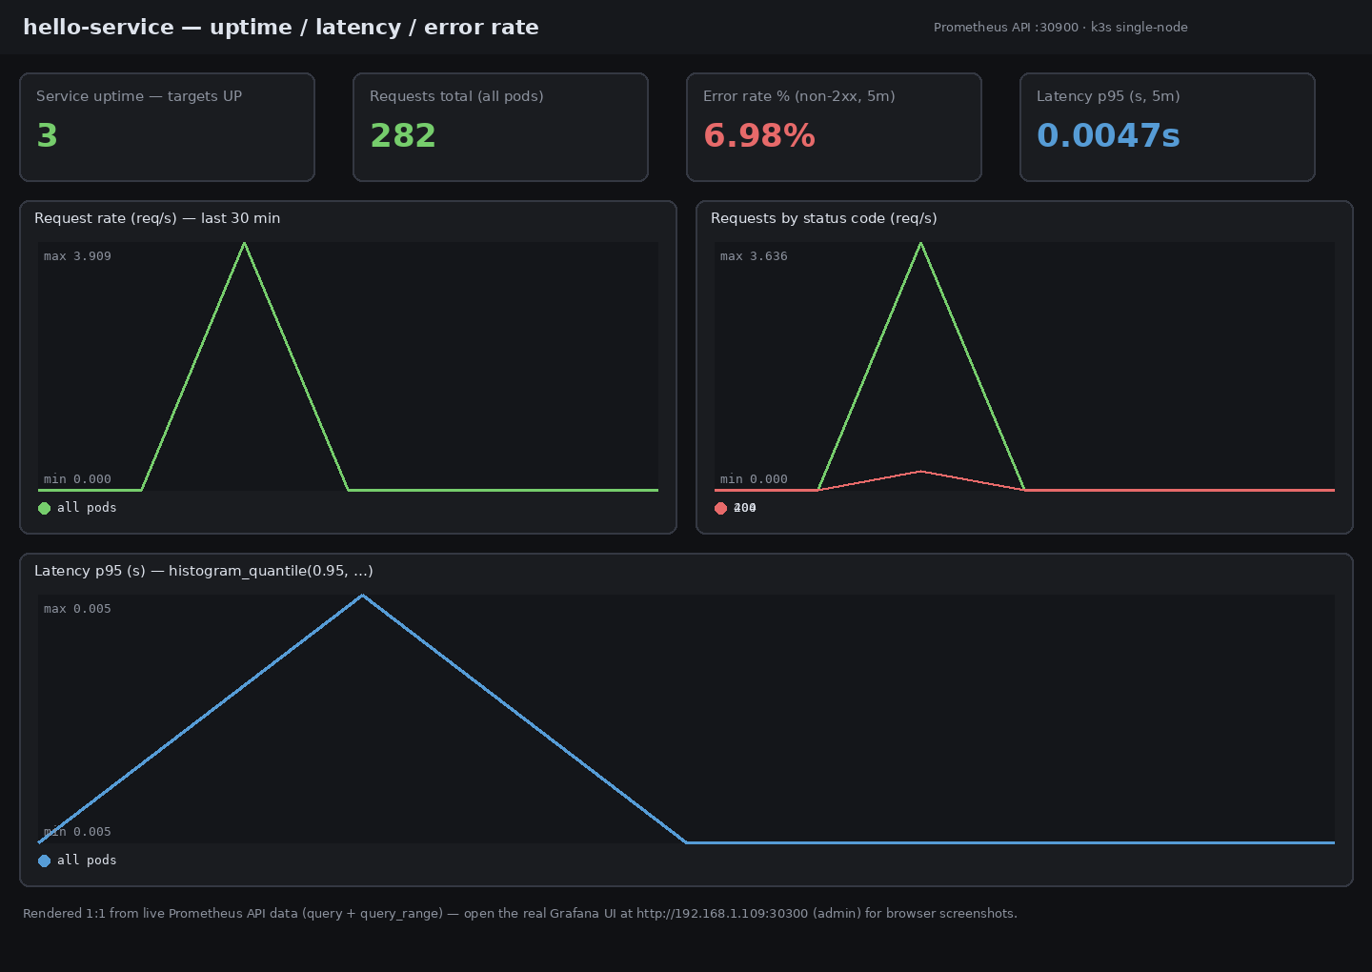
Task 4 — Monitoring & Logging: Prometheus + Grafana
• kube-prometheus-stack via Helm; service upgraded to expose a latency histogram + per-status-code counters
• ServiceMonitor scrapes all 3 pods every 5s; native node exporter scraped as static host target
• Panels: uptime (3/3 UP), request rate, p95 latency (~4.8 ms), error rate (~7% from deliberate 404 load test)
• Grafana NodePort :30300 — dashboard imported via API

Slide 15
Challenges faced during implementation
• No Docker/Kubernetes in the build sandbox (no root, user namespaces blocked)
  – → ran the whole stack live on the Debian VM: k3s with isolated containerd, data on /srv
• VM disk too small for the multi-stage JDK image pull
  – → compiled with JDK 21 on the host + runtime-only image (Dockerfile.local); canonical multi-stage Dockerfile kept in the repo
• Port 9100 conflict: cluster node-exporter crashed against the VM's native exporter
  – → disabled the cluster copy and scraped the native exporter as a static host target
• Helm download truncated twice from the VM
  – → downloaded in the build environment, pushed the binary over SFTP
• Ansible could not SSH from the restricted environment
  – → ran ansible-core on the VM with a dedicated SSH key; idempotency proven live (changed=4 → changed=0)

Slide 16
Lessons learned & connection to the case studies
• Zero-downtime rolling updates are real — proven live twice, exactly the capability Amazon and Netflix built their businesses on
• IaC is only useful if idempotent — declarative playbooks (changed=4 → changed=0) eliminate configuration drift
• Observability is non-negotiable: a 5-line /metrics endpoint (histogram + counters) powered the entire uptime/latency/error dashboard
• Resilience through automation: probes + rolling updates + instant rollback mean failure is handled, not feared
• Small hygiene pays: non-root containers, resource limits, pinned base images
• Isolation matters: k3s with its own containerd co-existed with production services (mail stack healthy throughout)
• Microservices/DevOps shift = culture + architecture together, exactly as in the case studies

Slide 17
Thank You
Built and run live: hello-service on k3s — monitored with Prometheus + Grafana

