Slide 1
Galactic Grease Monkey
Group 1
Jason Grill
Ryan Taban
Zihao Xie
Luan Nguyen
2022.11.30

Slide 2

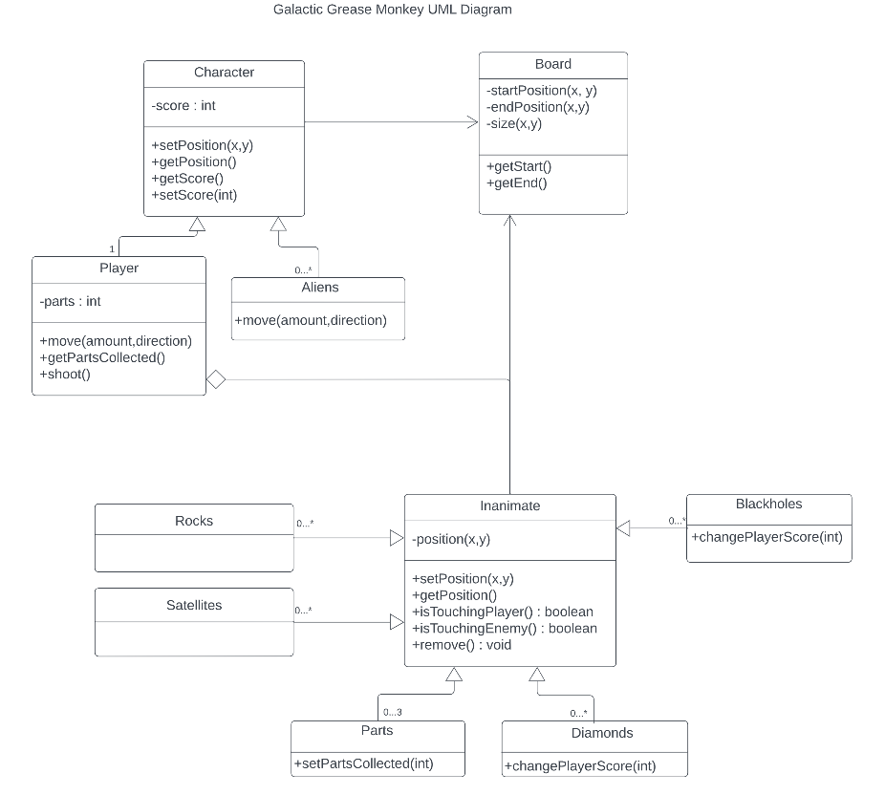
Original UML

Slide 3
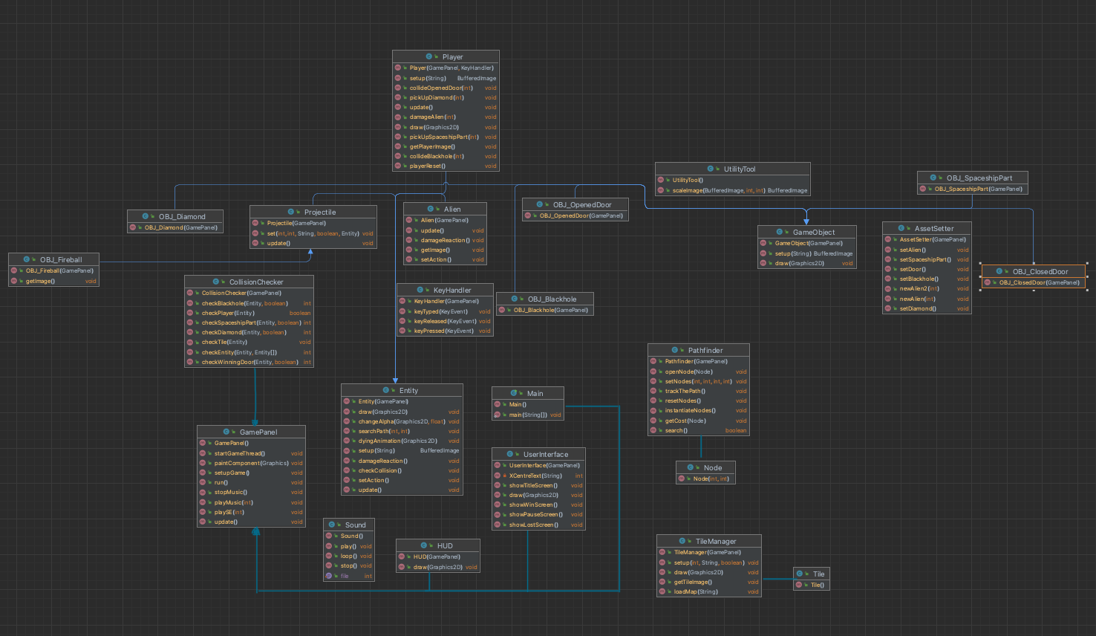
Final UML

Slide 4
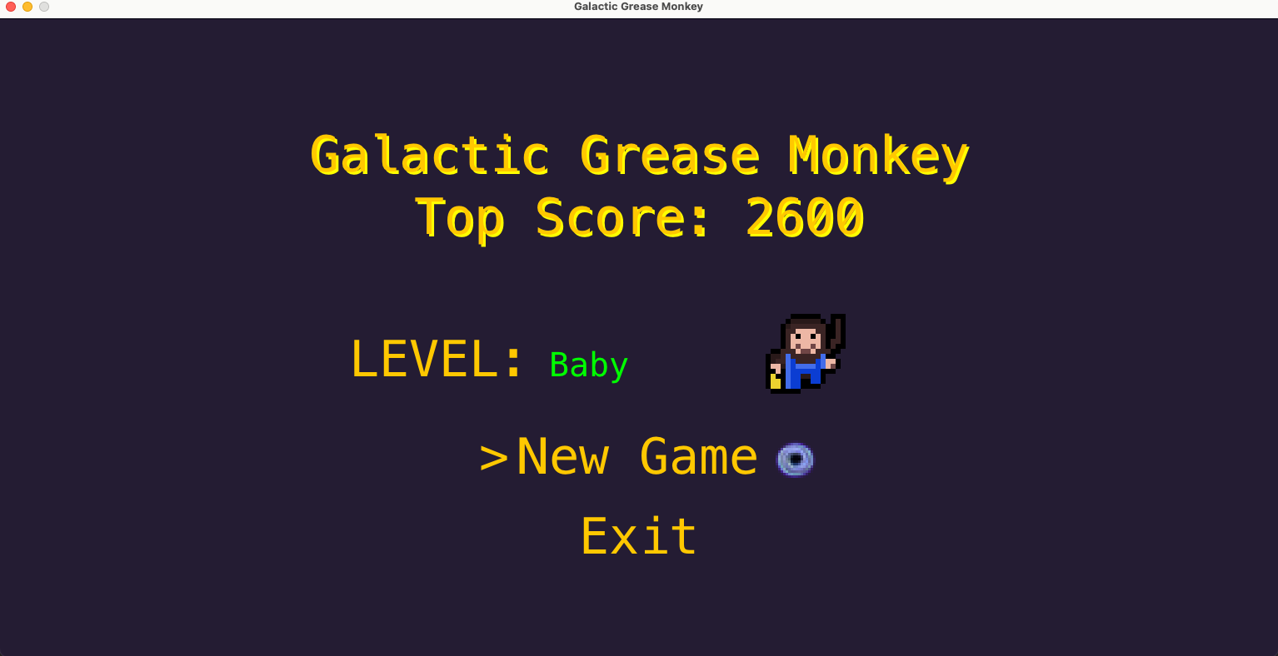
Game Design

Slide 5
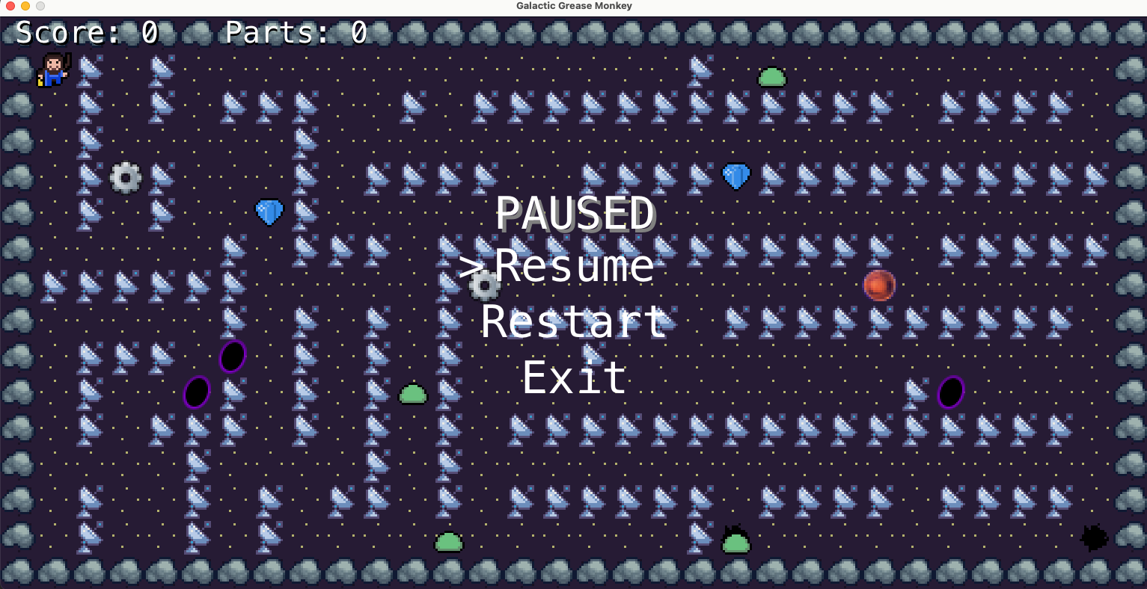
Game Design

Slide 6
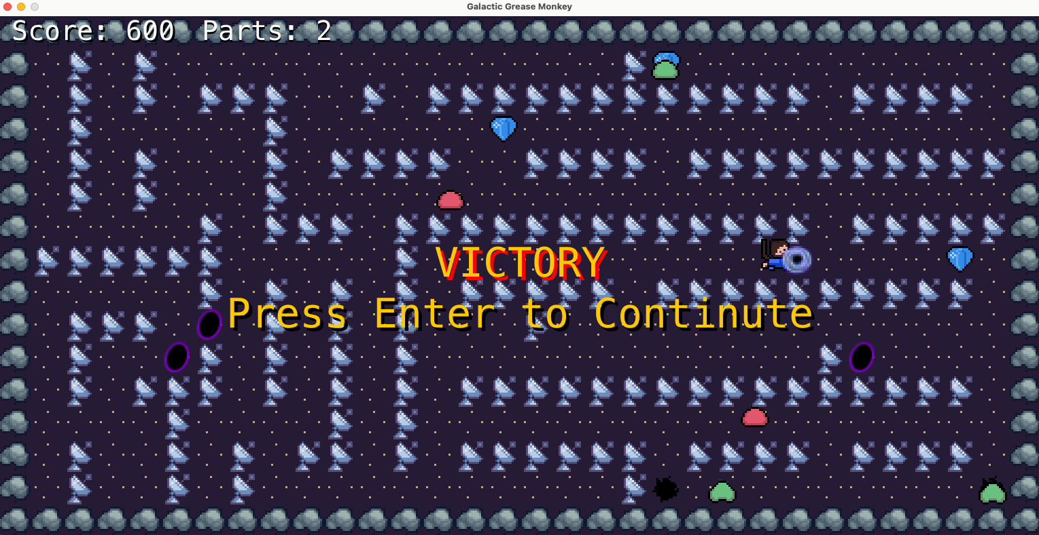
Game Design

Slide 7
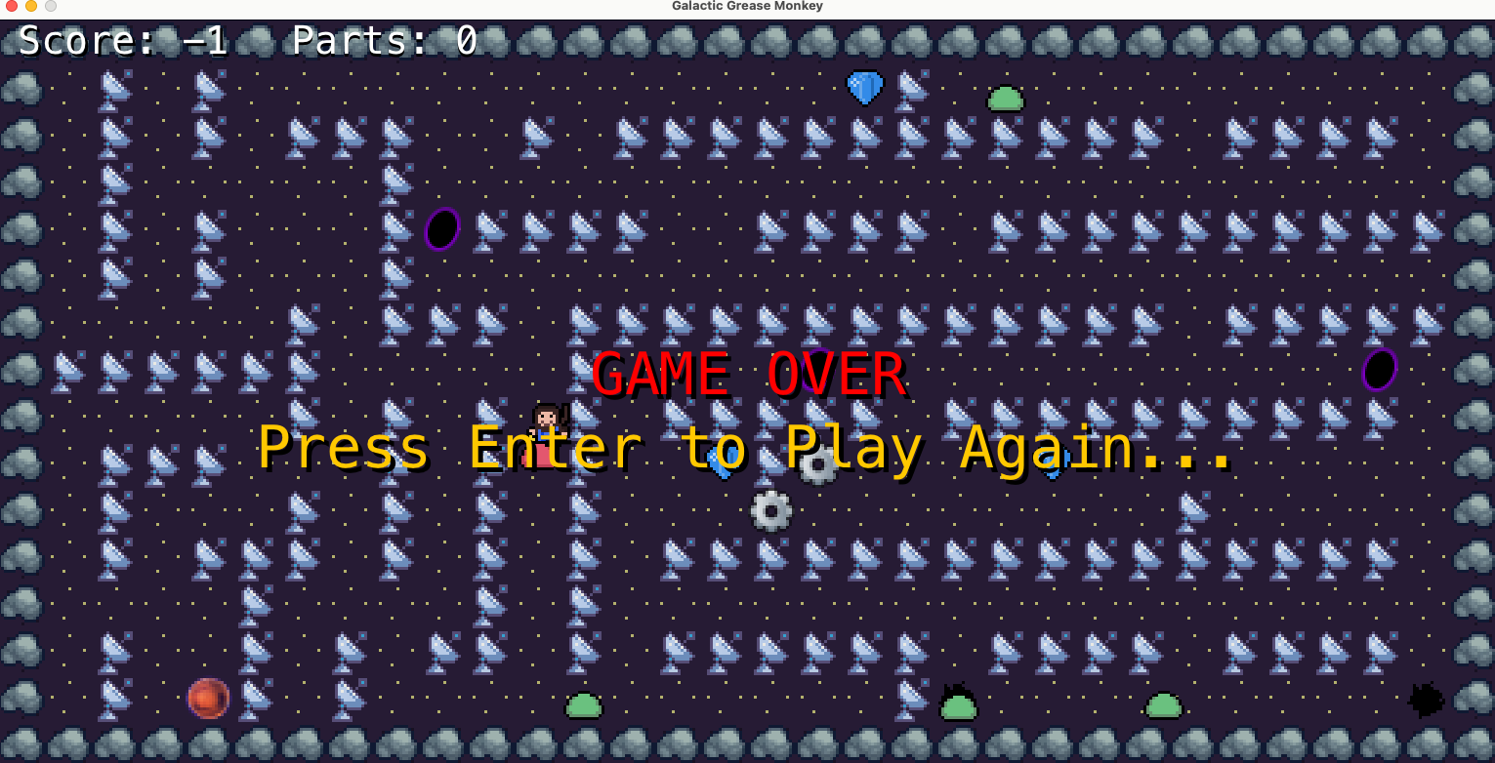
Game Design

Slide 8
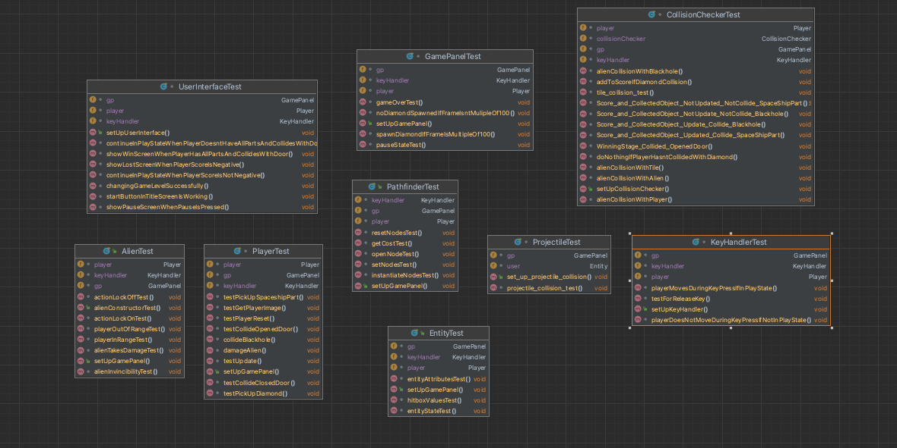
implementation and Test

Slide 9
Team Management
Get your group's contact info right away
Stay positive and do the work you’re assigned
Adequate communication
Help each other
Set realistic deadlines and include buffer time
Understand different roles and personalities

Slide 10
Challenges
Implementation and Cooperation
Cooperation:
Scheduling conflicts
lack of experience in game development
Self learning
Implementation:
Fixing buggy collision detection
AI implantation

Slide 11
Lessons learned
Improvements and Changes to our Code
Bugs That we Fixed
Self learning
Cooperation

Slide 12
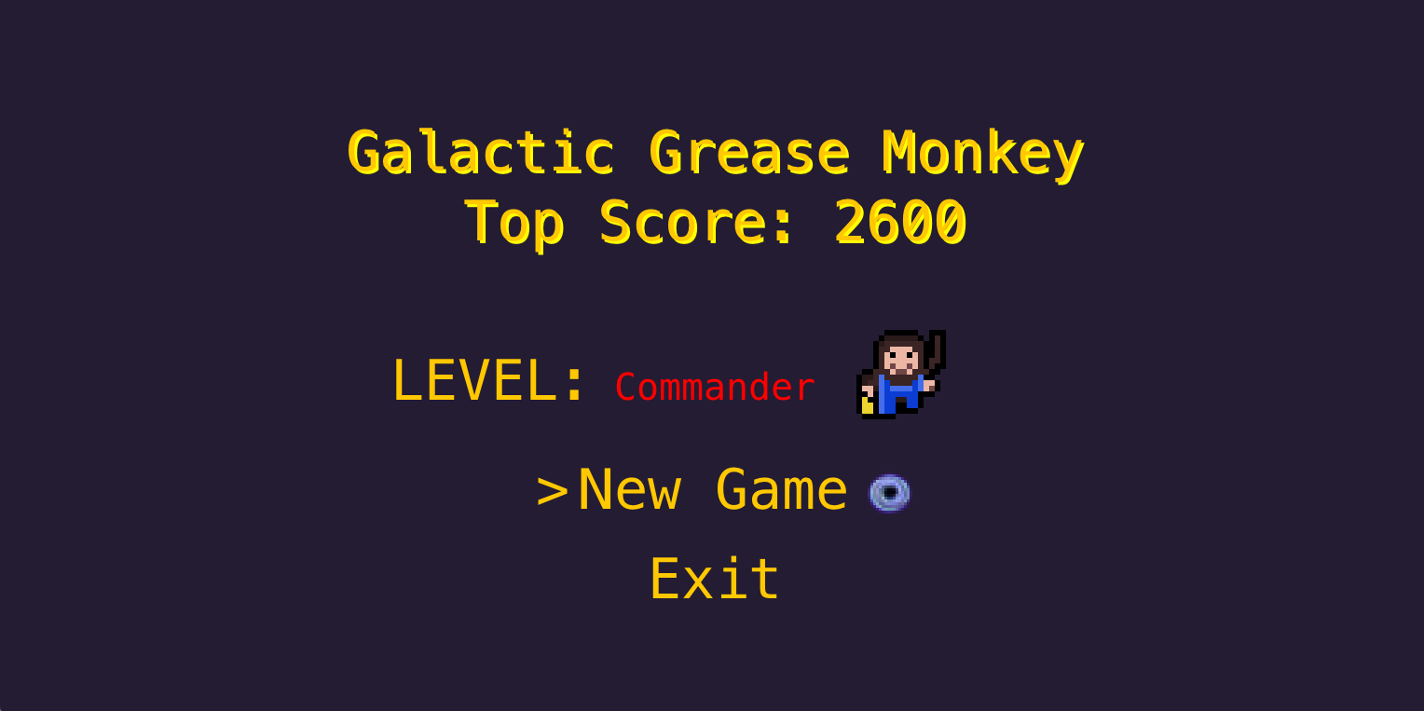
Thank you

