Slide 1

Data Synthesis For Object Recognition
Xi Zhang
Advisor: Professor Agam
xzhang22@hawk.iit.edu
Computer Science Department
Illinois Institute of Technology

Slide 2
Overview
Motivation.
Introduction and novel contributions.
Data synthesis in data space.
Learning from synthetic data.
Eliminating synthetic gap.
Data synthesis in feature space.
Conclusion

Slide 3
Motivations and Importance of the problem.
Introduction and novel contributions.
Data synthesis in data space.
Learning from synthetic data.
Eliminating synthetic gap.
Data synthesis in feature space.
Conclusion.

Slide 4
Motivation
1) To gain a good performance of a machine learning process, more high quality data is always desired.
a. Rare cases (absolute rarity)
b. Rare classes (relative rarity)
Notes:
****Rare cases:
--in an absolute sense.
--Difficult to detect regularities with in rare data.
--Researches in the past shown that rare cases have a much higher misclassification rate than common cases.
****Rare classes:
--objects are rare relative to other objects. Like a needle in a haystack.
--mining this kind of data is hard is because, rare objects are not easily located using greedy search heuristics and more global methods are, in general, not tractable.
****Problems of rarity learning:
--Improper evaluation metrics.
Metrics are used to guide the data mining algorithm and to evaluate the results of data mining. If the metric does not take care of rarity, then data mining is not likely to handle rare classes very well.
--Inappropriate inductive bias
Bias is crucial to data mining performance. Many learners utilize a general bias to avoid over-fitting, however, this bias can adversely impact the ability to learn rare cases.
–Noise
Noise has a greater impact on rare cases than on common cases. Because for common cases, learner has a better ability to generalize when having noise.

Slide 5
1) To gain a good performance of a machine learning process, more high quality data is always desired.
a. Rare cases (absolute rarity)
b. Rare classes (relative rarity)
Chi c a go
San Francisco
1%
1%
1 0%
21%
FLAT
FLAT
2 3%
3%
SHED
SHED
HIP
HIP
2%
39%
HEX
HEX
3%
GAB LE
GABLE
1 0%
PYR AMID
28%
PYRAMID
7%
UNKNOWN
UNKNOWN
2%
M ANSARD
MANSARD
2%
CUR VED
CURVED
23%
1%
22%
3%

Slide 6
2) Supervised learning requires high quality labeled data
a. Time consuming, expensive.
b. Sometimes, impossible

Slide 7
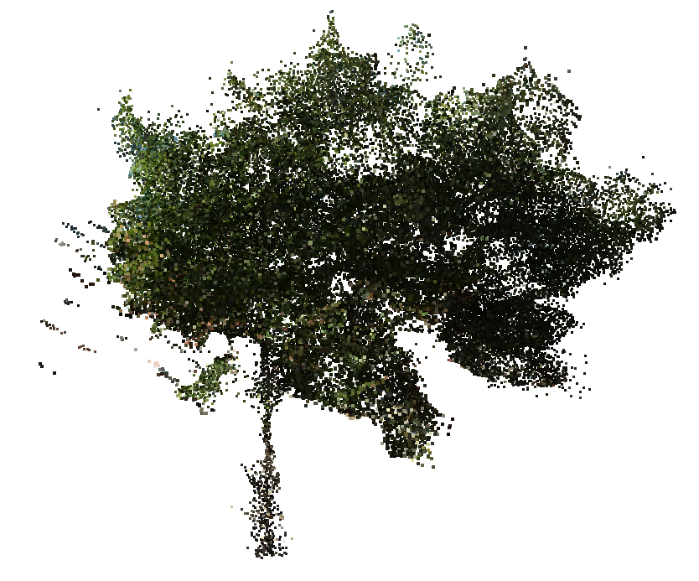
2) Supervised learning requires high quality labeled data
a. Time consuming, expensive.
b. Sometimes, impossible

Slide 8
Motivations and Importance of the problem.
Introduction and novel contributions.
Data synthesis in data space.
Learning from synthetic data.
Eliminating synthetic gap.
Data synthesis in feature space.
Conclusion.
Notes:
****Instead of solving these mentioned problems and challenges from point of view of learning algorithm itself, we focus on data synthesis. Simply put, I create synthetic data, on one hand, to ease data labeling work in a supervised learning algorithm, on the other hand, to boosting performance of a learning algorithm.
****The topic is very challenging and there are many problems we need to solve. For example, how synthetic data should be generated, how to learning the synthetic data, so the learner later on can be used to recognize actual data.

Slide 9
Introduction & Novel Contribution
Solution: Data synthesis
Notes:
****Instead of solving these mentioned problems and challenges from point of view of learning algorithm itself, we focus on data synthesis. Simply put, I create synthetic data, on one hand, to ease data labeling work in a supervised learning algorithm, on the other hand, to boosting performance of a learning algorithm.
****The topic is very challenging and there are many problems we need to solve. For example, how synthetic data should be generated, how to learning the synthetic data, so the learner later on can be used to recognize actual data.

Slide 10
Challenges:
  Where to synthesize.
  How to synthesize.
Notes:
****Instead of solving these mentioned problems and challenges from point of view of learning algorithm itself, we focus on data synthesis. Simply put, I create synthetic data, on one hand, to ease data labeling work in a supervised learning algorithm, on the other hand, to boosting performance of a learning algorithm.
****The topic is very challenging and there are many problems we need to solve. For example, how synthetic data should be generated, how to learning the synthetic data, so the learner later on can be used to recognize actual data.

Slide 11
Novel contributions:
  Data synthesis in data space.
  Learning from synthetic data.
  Eliminating synthetic gap.
  Data synthesis in feature space.
Notes:
****Instead of solving these mentioned problems and challenges from point of view of learning algorithm itself, we focus on data synthesis. Simply put, I create synthetic data, on one hand, to ease data labeling work in a supervised learning algorithm, on the other hand, to boosting performance of a learning algorithm.
****The topic is very challenging and there are many problems we need to solve. For example, how synthetic data should be generated, how to learning the synthetic data, so the learner later on can be used to recognize actual data.

Slide 12
Motivations and Importance of the problem.
Introduction and novel contributions.
Data synthesis in data space.
Learning from synthetic data.
Eliminating synthetic gap.
Data synthesis in feature space.
Conclusion.

Slide 13
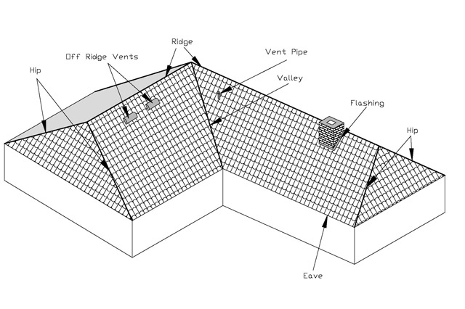
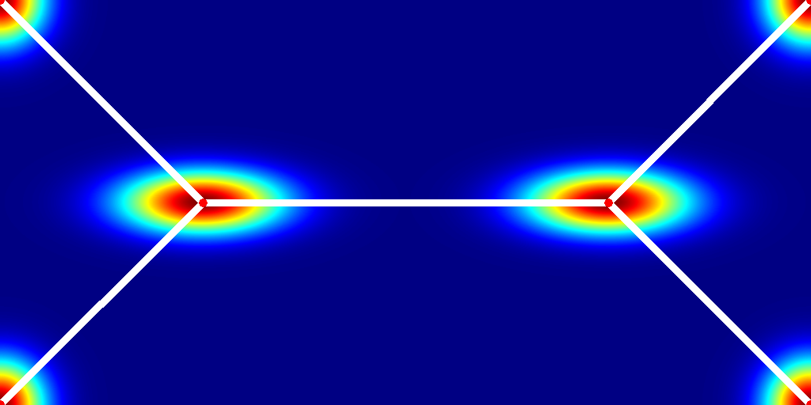
Data Synthesis in Data Space
Why in data space?
    Most intuitive.
    Sometime, easiest way.
Notes:
****intuitive
--what you have is what you saw. Concrete representation of data, all information are envolved in the original data.
****easiest
--with some pre-knowledge about the data, for example, we know how people design and build a building roof. one can easily derive more data to increase coverage of the data.

Slide 14
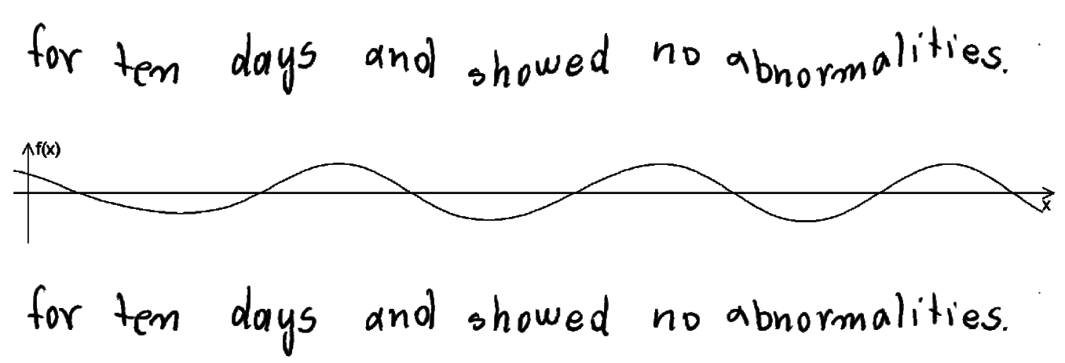
Data Synthesis in Data Space
Existing methods.
    Geometric transformation. [89][90]
Notes:
****geometric transformation
–rotation, change scale, stretch image.
****image degradation
--adding noises, create occlusion, blurring and so on.

Slide 15
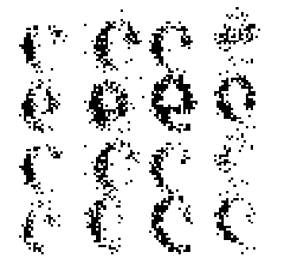

Existing methods.
    Geometric transformation. [89][90]
    Image degradation. [4][65]

Slide 16
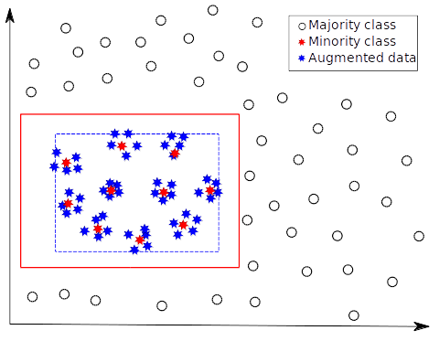
Disadvantage of existing methods.

Slide 17
The Proposed Approach
In contrast to existing methods, my approach:
Generate templates/prototypes from data.
    Automatically.
    Semi-automatically.
Synthesize more data using templates.

Slide 18
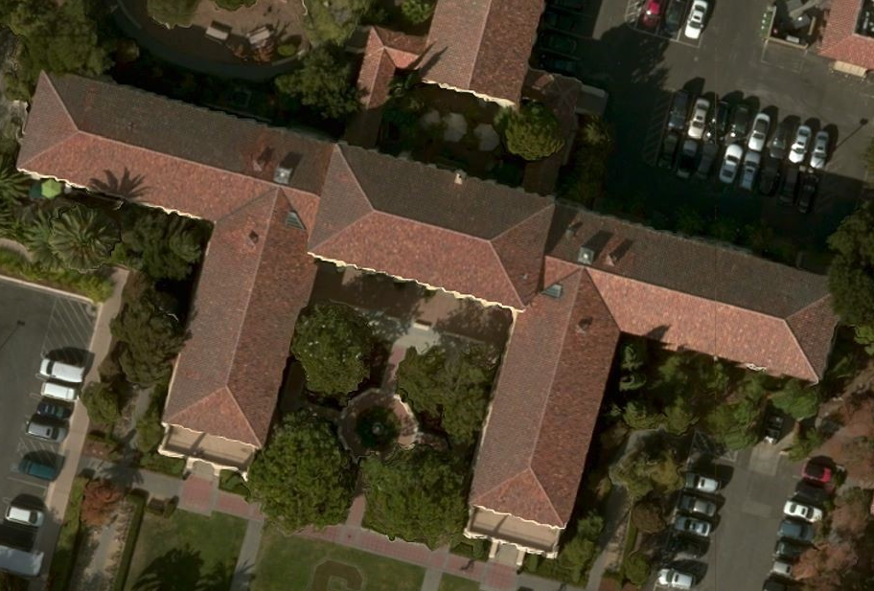
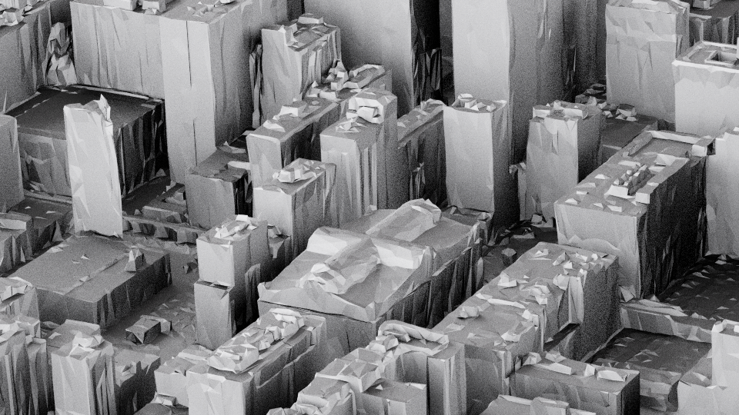
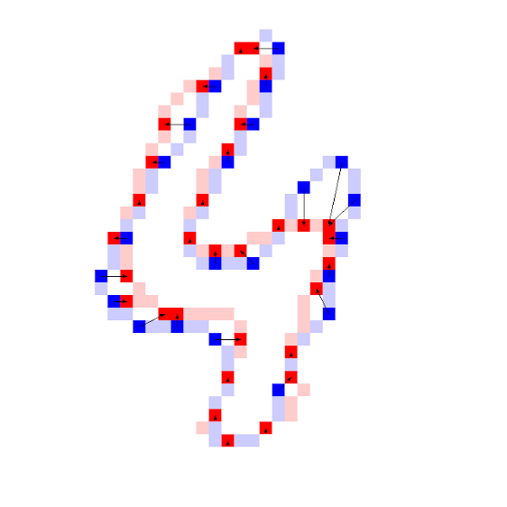
Satellite image roof style classification [100][105]
Aerial LiDAR roof style classification [106]
Handwritten digits recognition [105]

Slide 19
Aerial LiDAR roof style classification [106]
Handwritten digits recognition [105]

Slide 20
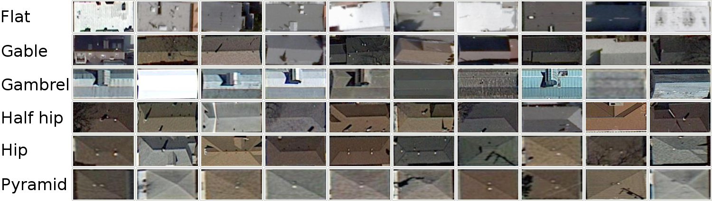
Showcase One
Satellite image roof style classification.

Slide 21
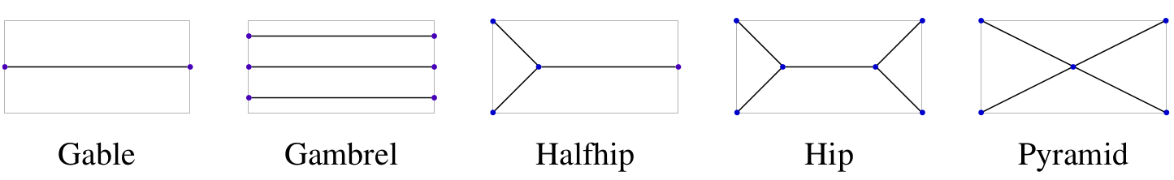
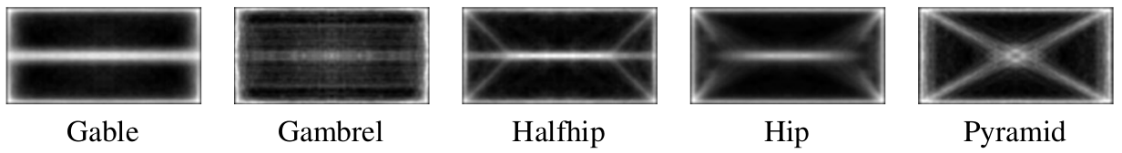
Showcase One
Prototype by design.
    In [100], I manually designed prototypes.
Prototype by computation.
    Identification of control points done automatically.

Slide 22
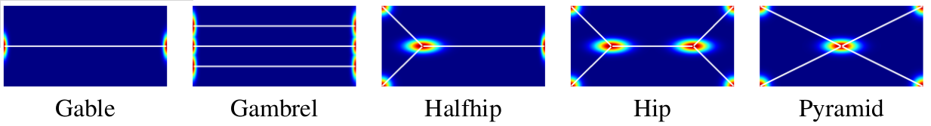
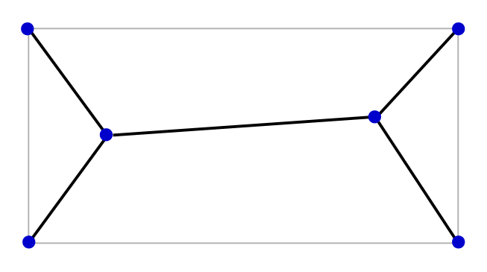
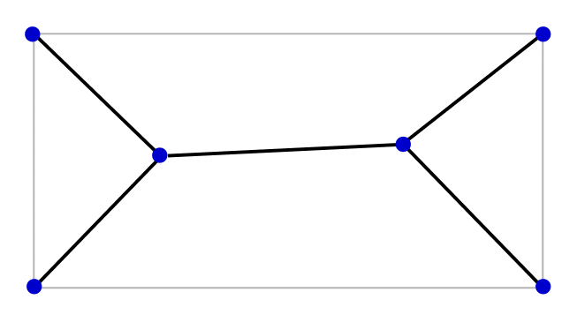
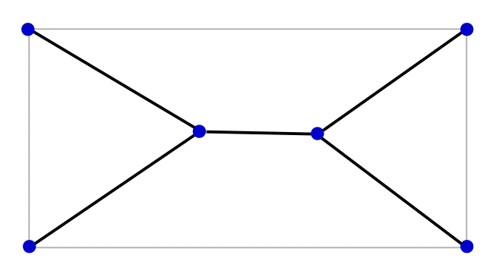
Showcase One
Data synthesis by distribution of control points.
Data synthesis by interpolation/extrapolation between nearest neighbors.
Source 1
Synthetic
Source 2

Slide 23
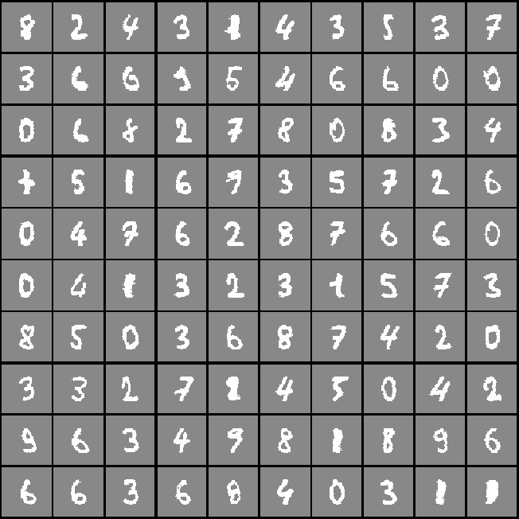
Showcase Two
Absolute rarity, digit from 0 ~ 9, each has around 200 samples.

Slide 24


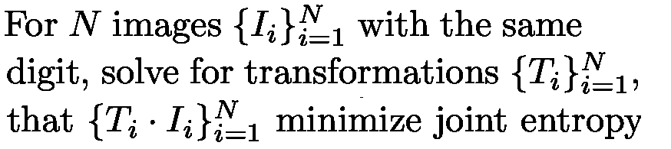
Showcase Two
Generate prototype by congealing.

Slide 25

Showcase Two
Building correspondence among data.
    Set control points on prototype.

Slide 26
Showcase Two
Building correspondence among data.
    Set control points on prototype.
    Find corresponding control points on each data.

Slide 27
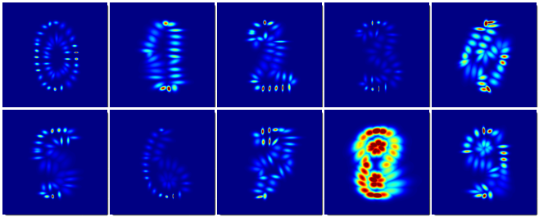
Showcase Two
Data synthesis by distribution of control points.
Data synthesis by interpolation/extrapolation between nearest neighbors.

Slide 28
Showcase Two
Boost the performance by adding synthetic data.
 | Real | Syn | Real+Syn
CNN | 0.65 | 0.68 | 0.70
SVM | 0.77 | 0.78 | 0.80
F1 score of classification results

Slide 29
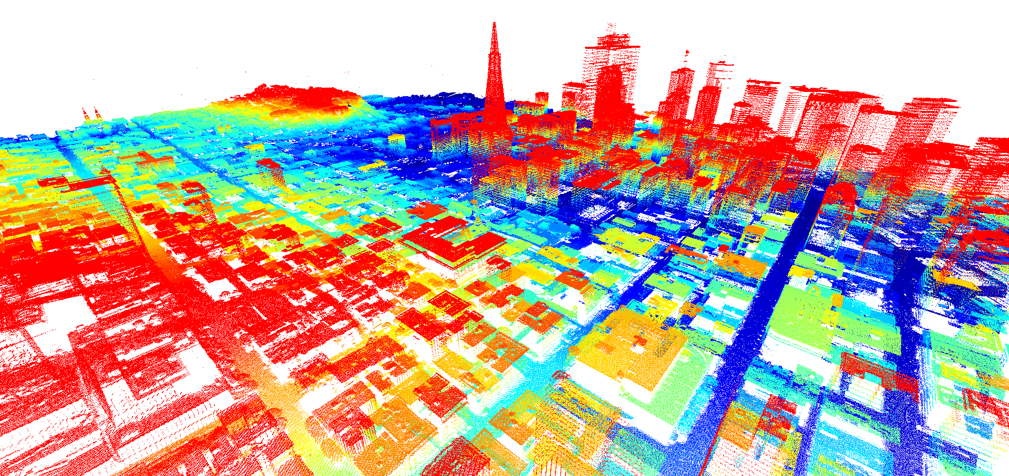
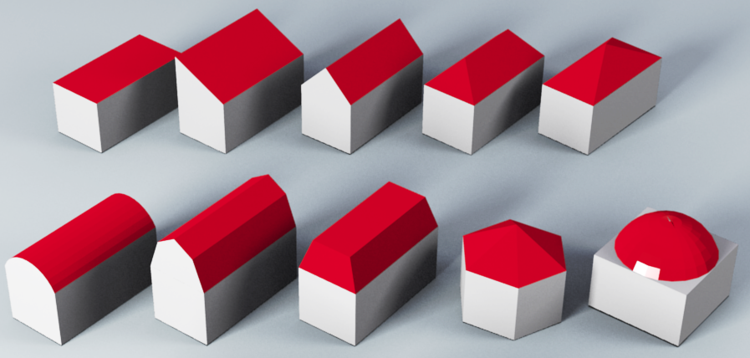
Showcase Three
Aerial LiDAR
Downtown San Francisco
Candidate roof styles

Slide 30
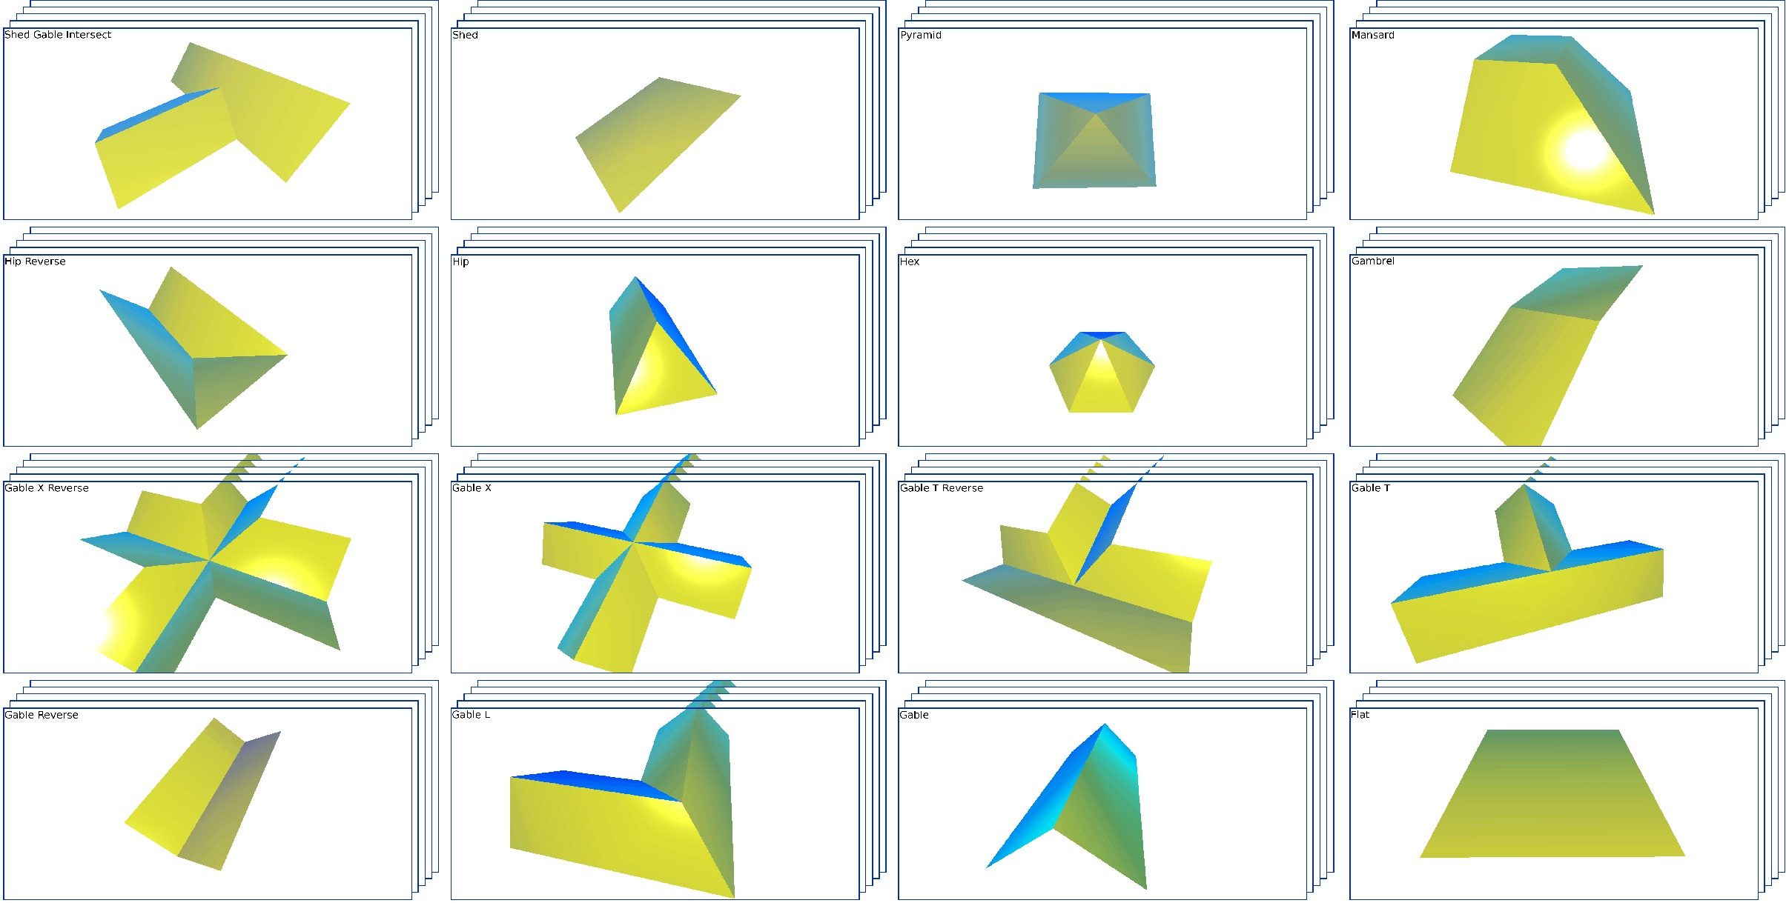
Showcase Three
Build prototypes.

Slide 31
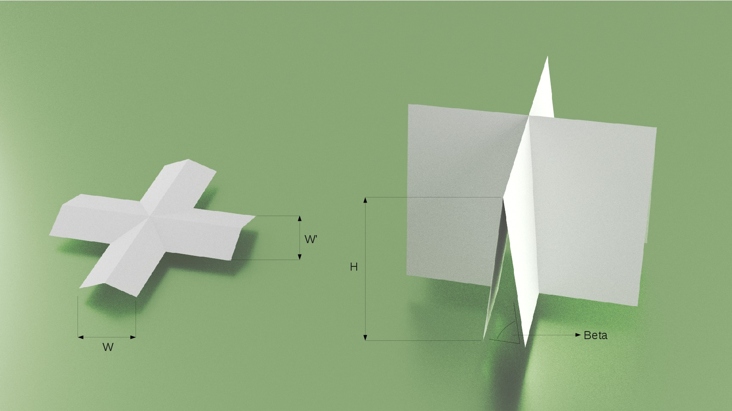

Showcase Three
Derive more data.
Dimension change
Simulation of erosion

Slide 32
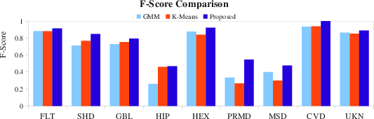
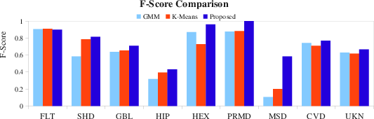
Showcase Three
Boost recognition rate by adding synthetic data.
Chicago
San Francisco

Slide 33
Motivations and Importance of the problem.
Introduction and novel contributions.
Data synthesis in data space.
Learning from synthetic data.
Eliminating synthetic gap.
Data synthesis in feature space.
Conclusion.

Slide 34
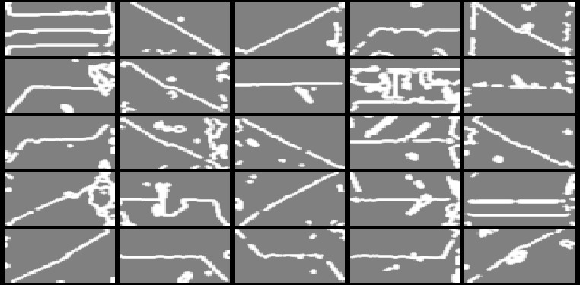
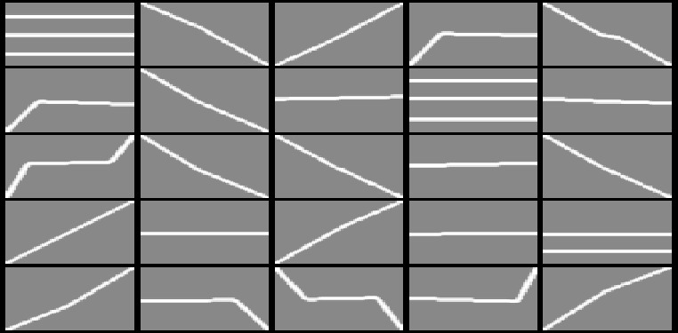
Learning from Synthetic Data
Challenging task.
Actual data
Synthetic data

Slide 35
Challenging task.

Slide 36
Previous work.
They all treat synthetic data as actual ones.[39][87][66][89][90][65]

Slide 37
The proposed approaches.
I build features that contain equivalent amount of information between synthetic data and actual data.
Two types of features
    Type I: Ignore additional information in actual data.
    Type II: Compensate additional information for synthetic data.

Slide 38
Showcase One
Satellite image roof style classification.
Actual data
Synthetic data
Features expected:
    Ignore small blobs in actual data.
    Highlight the most evident structure of roofs.

Slide 39
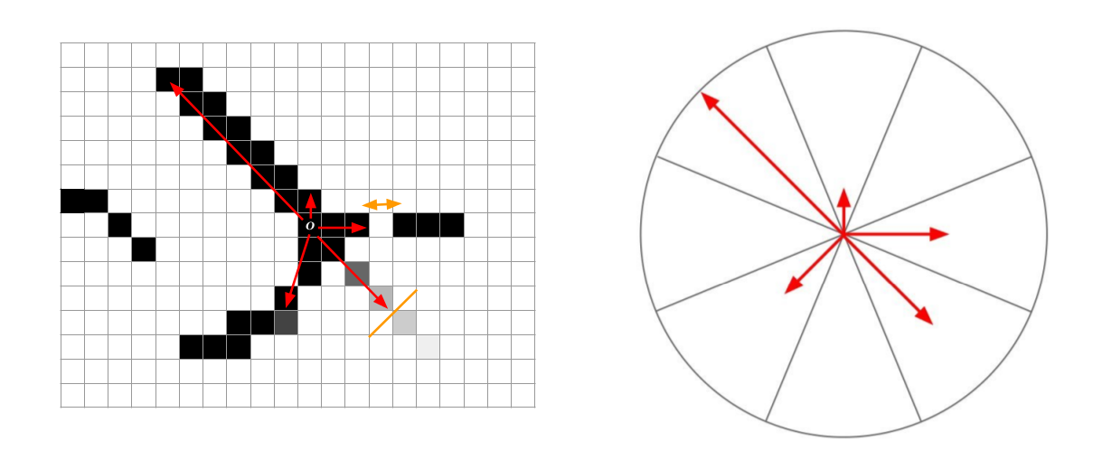
Showcase One
We proposed a feature called Histogram of Ray (HOR) in [100]
    Highlight edge length and direction in [100].
    Translation, scale, rotation invariant.

Slide 40
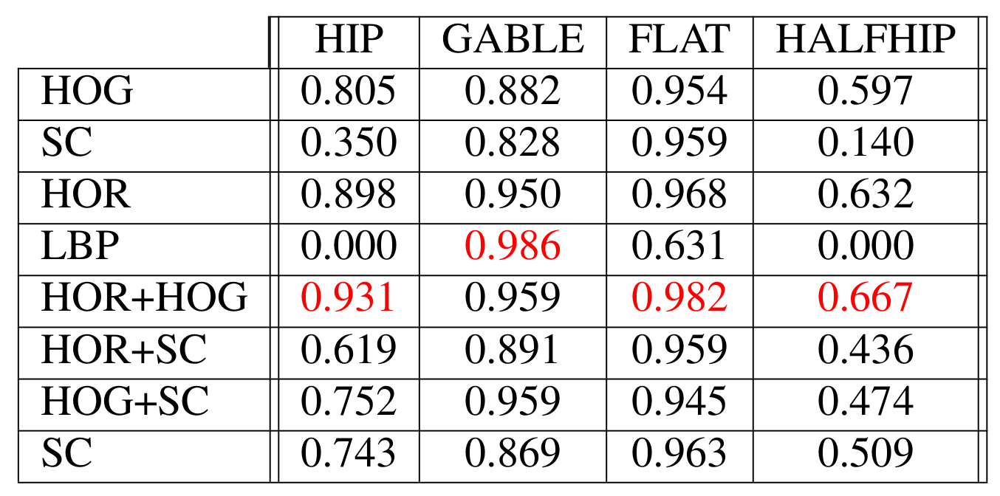
Showcase One
Compare with several well-known image features:
F1 score of classification results

Slide 41
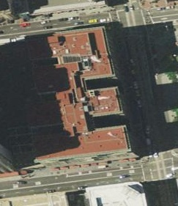
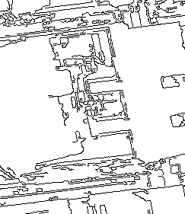
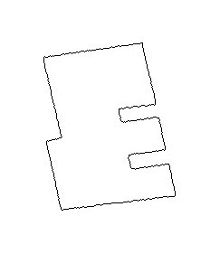
Showcase Two
Retrieve the most matching satellite building image for synthetic building footprint. [104]
Challenges: Noise, occlusion and shape difference.
Original actual image
Edge extracted
Synthetic building footprint

Slide 42

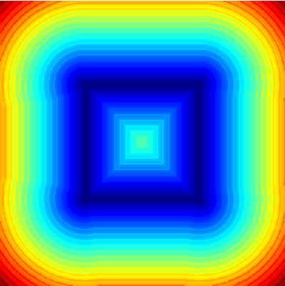
Showcase Two
Matching metric is derived from classic Chamfer matching.

Slide 43
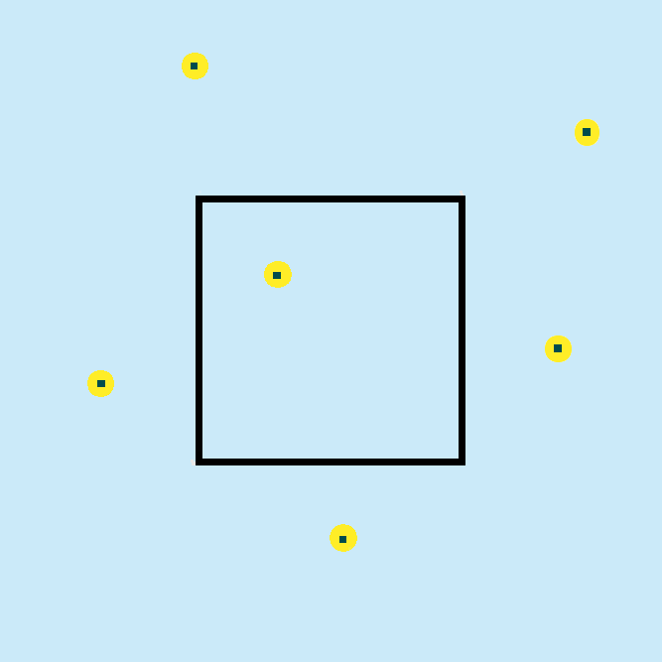

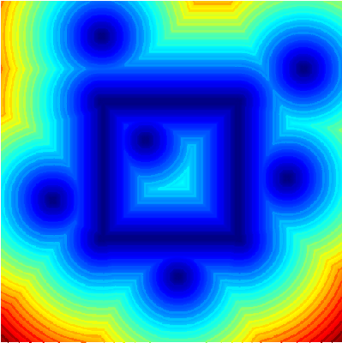
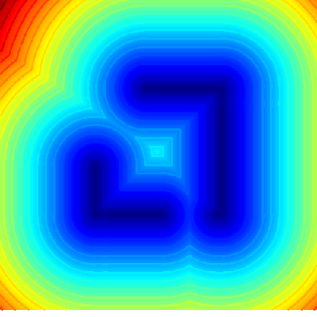
Showcase Two
Matching metric is derived from classic Chamfer matching.
However

Slide 44
Showcase Two
I extend Chamfer matching from three aspects.
    Add edge orientation to distance metric.
    Add edge distance variance to distance metric.
    Mechanism to matching incomplete targets.

Slide 45
Showcase Two
0.91
0.91
Average Ratio of Liu et al CVPR 2010
0.9
Average Ratio of Proposed Method
0.9
0.89
0.88
0.87
0.89
0.86
0.85
0.88
Average Ratio of Liu et al CVPR 2010
0.84
Average Ratio of Proposed Method
0
0.1
0.2
0.3
0.4
0.5
0.6
0.7
0.8
0.9
1
0.83
Lambda
0
0.1
0.2
0.3
0.4
0.5
0.6
0.7
0.8
0.9
1
Chicago
Lambda
San Francisco

Slide 46
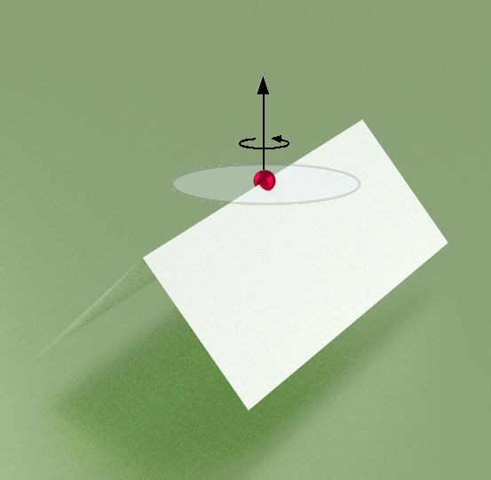
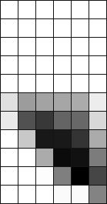
Showcase Three
Extract features that characterize local geometry.
Spin image

Slide 47
Showcase Three
Extract features that characterize local geometry.
However, too regular and smooth.

Slide 48
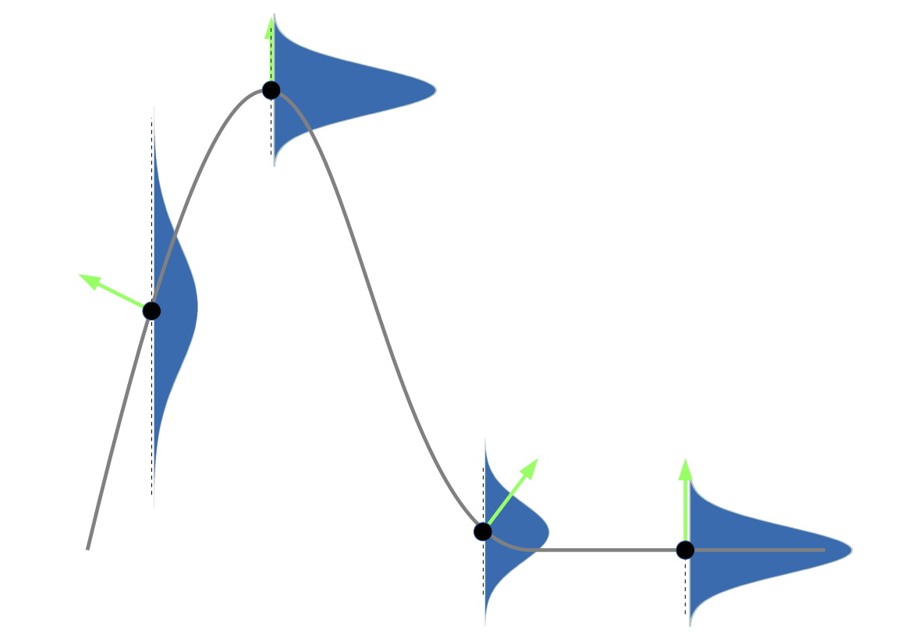
Showcase Three
Extract features that characterize local geometry.
However, too regular and smooth.
Learning bumpiness as a function of surface slope.

Slide 49
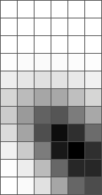
Showcase Three
Extract features that characterize local geometry.
However, too regular and smooth.
Learning bumpiness as a function of surface slope.
Add random noise to synthetic data using knowledge learned.
Spin image

Slide 50

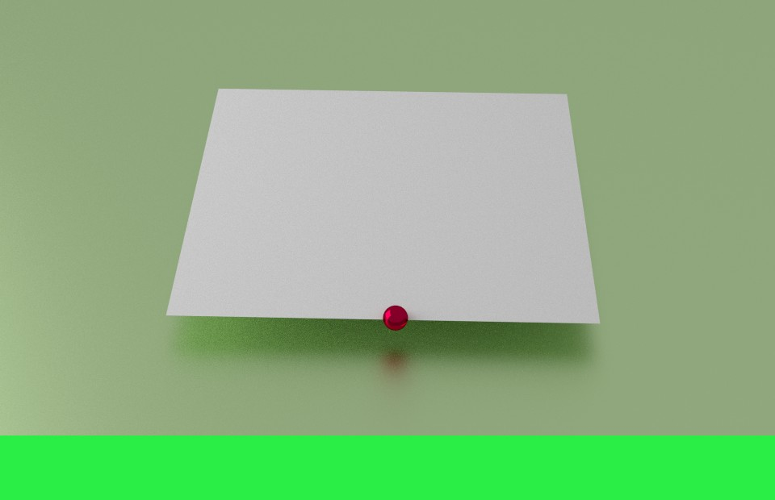

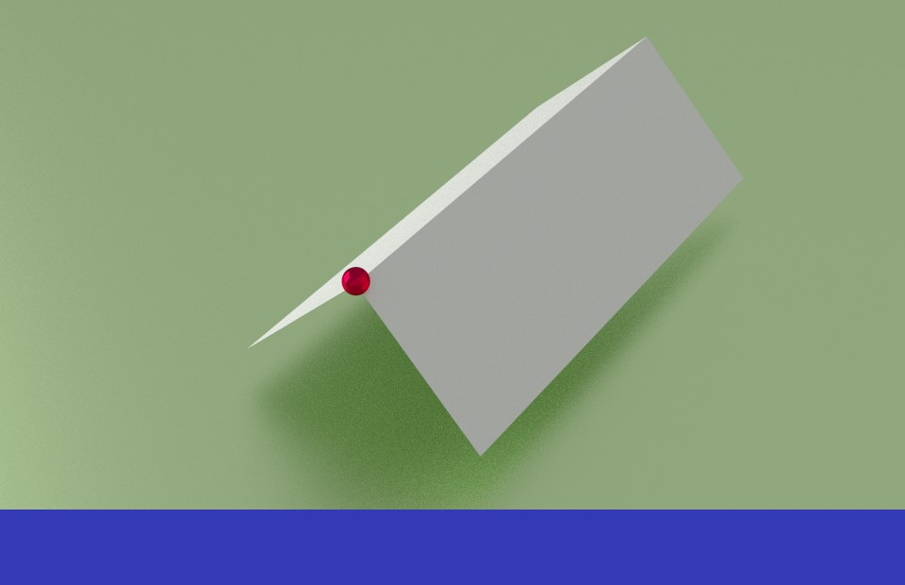






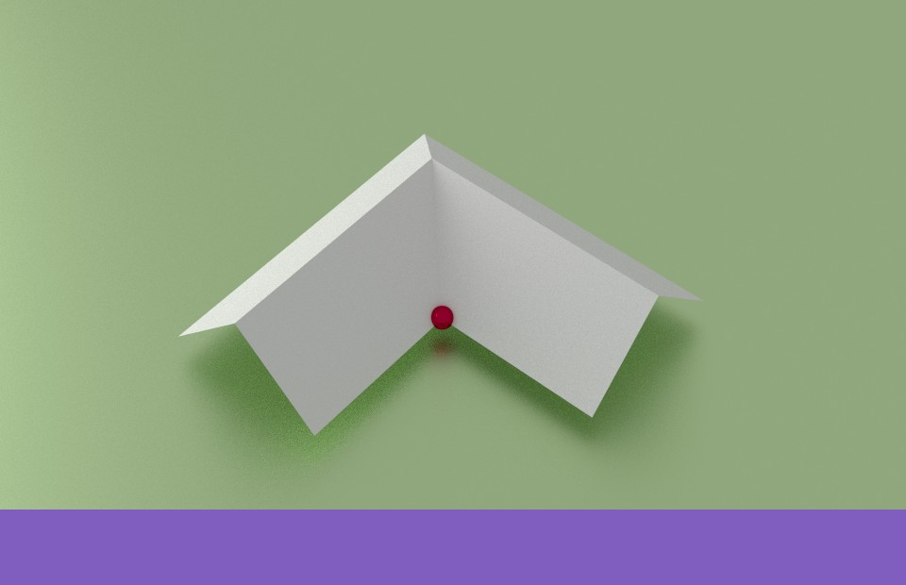




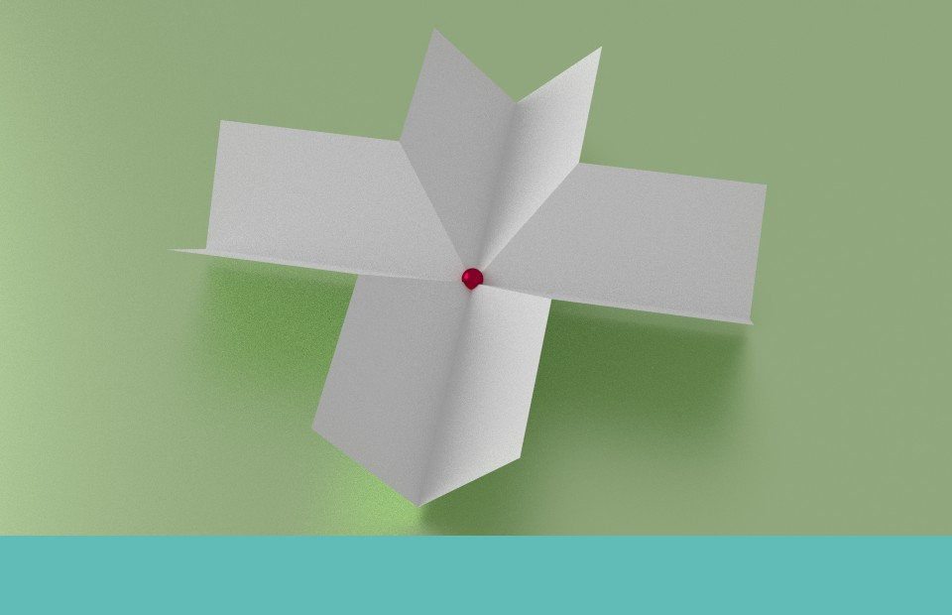
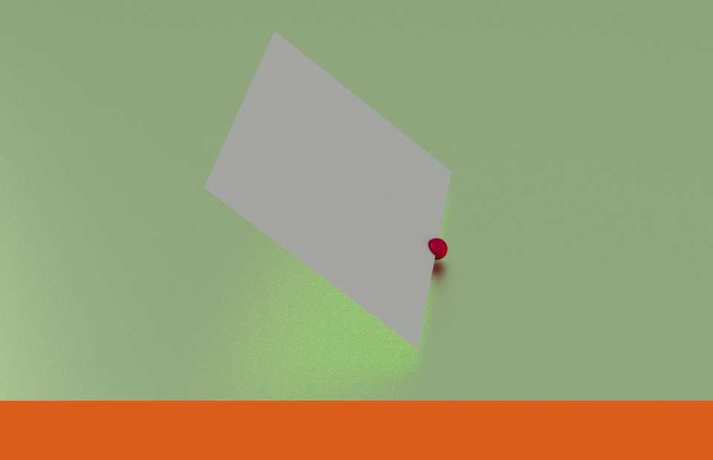
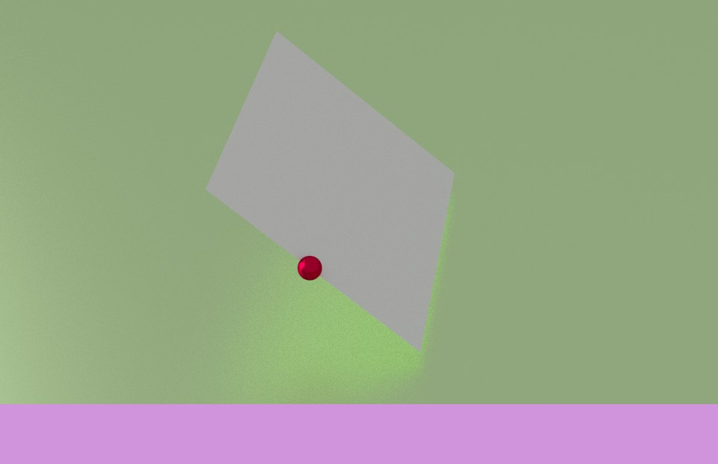
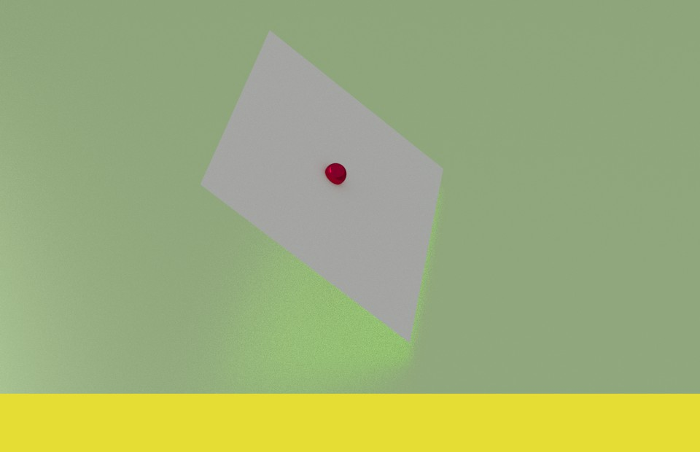
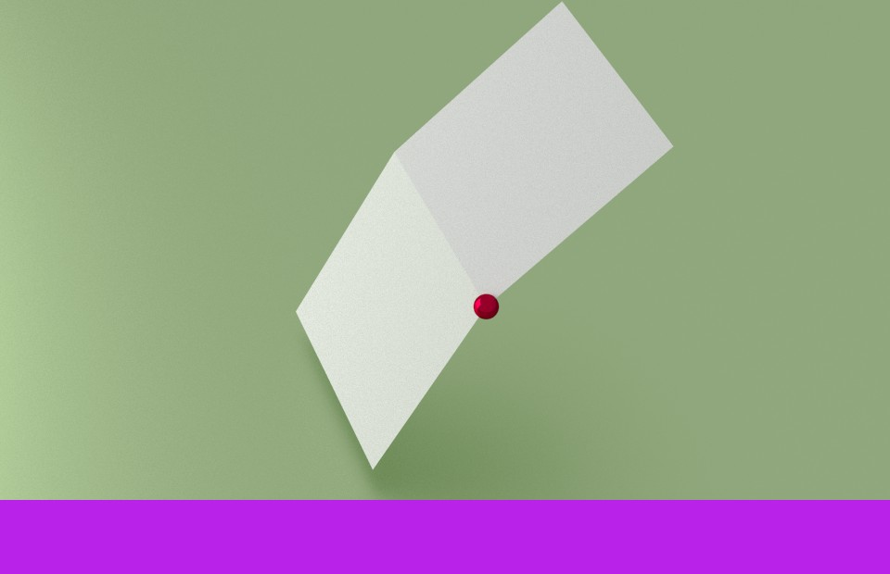

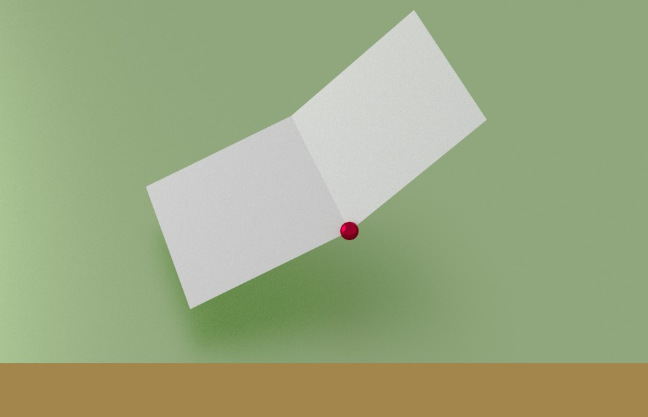

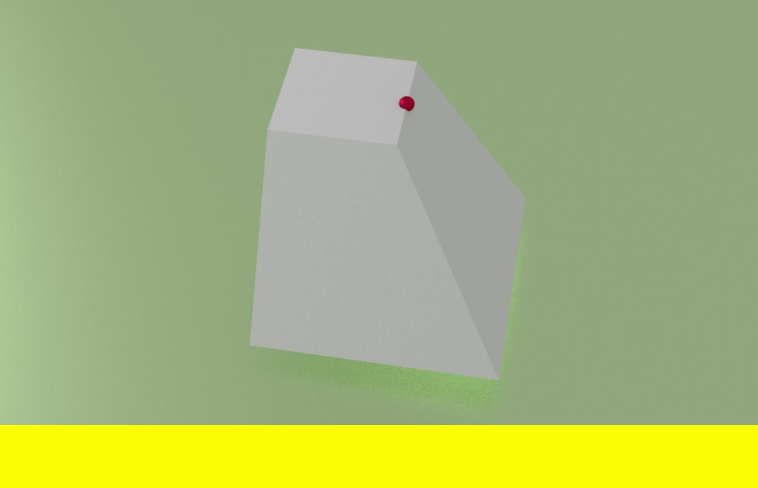









Showcase Three
Flat
Flat Edge
Ridge
Ridge Corner
Valley
Valley Corner
Flat
Flat
Gable
Gable
Gable
Gable
Slop Ridge Corner
Slop Ridge
L-Joint
Slop Valley
Slop Valley
Reverse L Joint
L-Joint
L-Joint
L-Joint
L-Joint
Corner
L-Joint
L-Joint
T-Joint
Reverse T Joint
X-Joint
Reverse X Joint
Slop Edge I
Slop Edge II
T-Joint
T-Joint
X-Joint
X-Joint
Slop
Slop
Slop
Gambrel Corner I
Gambrel Ridge I
Gambrel Corner II
Gambrel Ridge II
Mansard Ridge I
Slop
Gambrel
Gambrel
Gambrel
Gambrel
Mansard
Mansard Corner I
Mansard Corner II
Mansard Ridge II
Loft Joint
Pyramid Joint I
Pyramid Joint II
Mansard
Mansard
Mansard
Loft
Pyramid
Pyramid
Hex Joint
Reverse Hip Joint
Hip Joint
Hex
Hip
Hip

Slide 51

Showcase Three
Point semantics classification results.

Slide 52

Showcase Three
Roof style classification results compared to unsupervised approaches.

Slide 53
Motivations and Importance of the problem.
Introduction and novel contributions.
Data synthesis in data space.
Learning from synthetic data.
Eliminating synthetic gap.
Data synthesis in feature space.
Conclusion.

Slide 54

Eliminate Synthetic Gap
Synthetic gap.

Slide 55
Previous work.
    Eliminate distribution means in Kernel Reproducing Hilbert Space (KRHS). [12][46]
    Subspace alignment. [35][24]
    Deep neural network using KRHS as domain loss. [32][19]

Slide 56
The proposed approach.
    Multi-Channel Autoencoder (MCAE)

Slide 57


Traditional autoencoder

Slide 58
The proposed MCAE
D
e
c
θ
L
θ
R
o
d
d
d
i
n
g
E
θ
e
n
c
o
d
i
n
g
task one
task two
Basic structure
Stacked up

Slide 59

MCAE
Jointly learn two tasks, left and right, together.
where

Slide 60

Configuration of MCAE
Actual Data
Actual Data
Domain adaptation
Actual Data
Synthetic Data

Slide 61

Visualization of domain adaptation.

Slide 62


Without domain adaptation
With domain adaptation

Slide 63


Classification results
Roof style dataset
Handwritten digit dataset

Slide 64
Motivations and Importance of the problem.
Introduction and novel contributions.
Data synthesis in data space.
Learning from synthetic data.
Eliminating synthetic gap.
Data synthesis in feature space.
Conclusion.

Slide 65
Data Synthesis in Feature Space
Why in feature space:
    Limitation for data synthesis in data space.
    An universal approach for most problems.
    Sometimes easier to detect patterns and relationship between data.
Challenges:
    Data representation is too abstract in feature space. To derive more data has to look at entire dataset.

Slide 66

Previous work.
    Creating identical samples.

Slide 67

Previous work.
    Creating identical samples.
    Synthetic minority oversampling technique (SMOTE)

Slide 68




Example 1
Example 2

Slide 69
The proposed approach.
    Up-sampling by keeping global structure of the dataset.
    Suppose we are given a dataset called D, the goal is to find out a dataset Ds which is a up-sampled version of D

Slide 70

The proposed approach.

Slide 71

The proposed approach.

Slide 72

The proposed approach.

Slide 73

The proposed approach.

Slide 74

The proposed approach.
    Down-sampling: Minimize Kullback-Leibler divergence between two datasets.

Slide 75

Down-sampling
Minimize Kullback-Leibler divergence between two datasets.

Slide 76

Sampling adaptively

Slide 77


Comparison of classification results.

Slide 78
Down-sampling
Minimize Kullback-Leibler divergence between two datasets.
Up-sampling:
.

Slide 79
Conclusion
Goal:
    Boost performance of object recognition.
    Ease ground truth labeling process.
Solution:
    Data synthesis.
Novel contributions:
    Data synthesis in data space.
    Learning from synthetic data.
    Eliminating synthetic gap.
    Data synthesis in feature space.

