Slide 1


貝加圈圈|大讲堂
资深IT人士为你解读Cloud Computing和DevOps
主讲嘉宾：Jack zhang，jeff wang
貝加圈圈 微信公众号
It讲座微信群

Slide 2


What is Cloud Computing

Slide 3




About me
2009 年进入加拿大黑莓手机公司实习，以 Software Tools Developer 开始了在互联网公司的第一份工作。2011年大学毕业后，加入爱立信，从事电信支付和订单系统的研发和测试，对互联网各类产品开发和测试工具有较为深刻的认识。2016年中旬离职爱立信 加入加拿大CGI团任职IT实施顾问，负责加拿大各大银行项目的业务开发。目前在BMO BANK, 为客户提供DevOps and Agile transformation 的实施方案

Slide 4
Table of Content
1. History of cloud computing? （云计算的历史和演变）
2. What is cloud computing? (什么是云计算)
3. Cloud Service Delivery Models （云计算的服务模式）
4. Cloud Deployment Models （云计算的部署模式）
5. Cloud computing biggest challenges (Security Privacy) （云计算最大的挑战）
6. Future Trends （未来趋势）

Slide 5

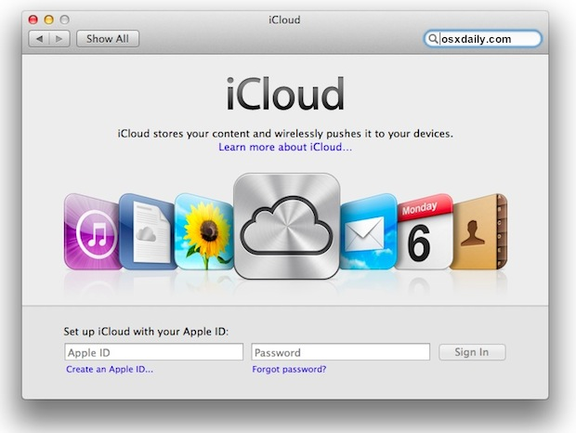
What is cloud computing?

Slide 6
History of cloud computing
One of the first questions asked with the introduction of a new technology is:
“When was it invented?”
Other questions like
“When was it first mentioned?”
and
“What are the prospects for its future?” are also common.

Slide 7
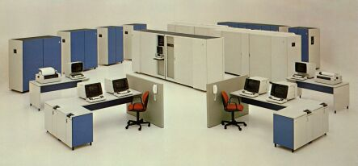
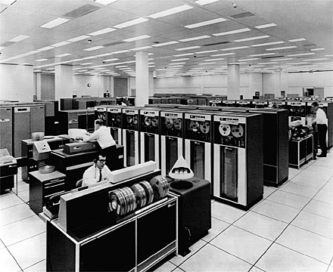
History of cloud computing
1950s – IBM introduce mainframe (大型商业服务) computing which is used to process various applications, including bulk data processing, process control, industry and consumer statistics, enterprise resource planning, and financial transaction processing.

Slide 8
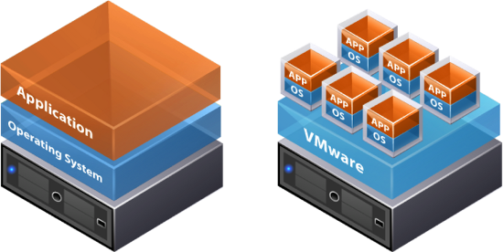
History of cloud computing
1970 - The concept of virtual machines (VMs) (虚拟机) was created. The VM operating system took the 1950s’ shared access mainframe to the next level, permitting multiple distinct computing environments to reside on one physical environment.

Slide 9
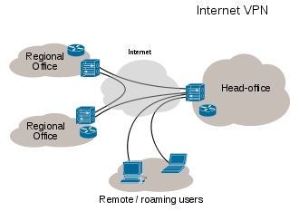
History of cloud computing
In the 1990s, telecommunications companies started offering virtualized private network (虚拟网络) connections. Instead of building out physical infrastructure to allow for more users to have their own connections, telecommunications companies were now able to provide users with shared access to the same physical infrastructure.

Slide 10
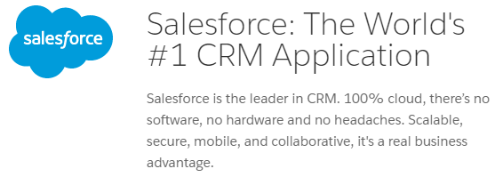
History of cloud computing
One of the first milestones in cloud computing history was the arrival of Salesforce.com in 1999, which pioneered the concept of delivering enterprise applications via a simple website software as a service (SaaS)

Slide 11

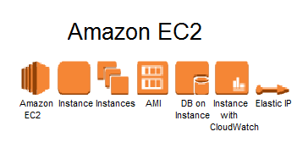
History of cloud computing
Then in 2006, Amazon launched its Elastic Compute cloud (EC2) as a commercial web service that allows small companies and individuals to rent computers on which to run their own computer applications. (IaaS and PaaS)

Slide 12
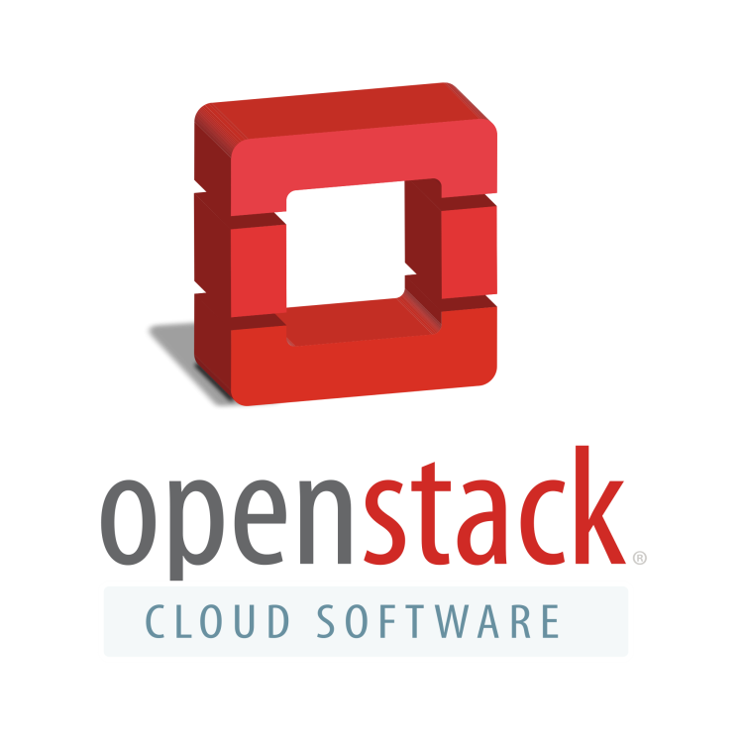

History of cloud computing
In July 2010, Rackspace Hosting and NASA jointly launched an open-source cloud-software initiative known as OpenStack. The OpenStack project intended to help organizations offering cloud-computing services running on standard hardware

Slide 13
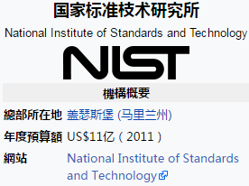
The definition of Cloud Computing
Cloud computing is a model for enabling ubiquitous, convenient, on-demand network access to a shared pool of configurable computing resources (e.g., networks, servers, storage, applications, and services) that can be rapidly provisioned and released with minimal management effort or service provider interaction. This cloud model is composed of five essential characteristics, three service models, and four deployment models

Slide 14
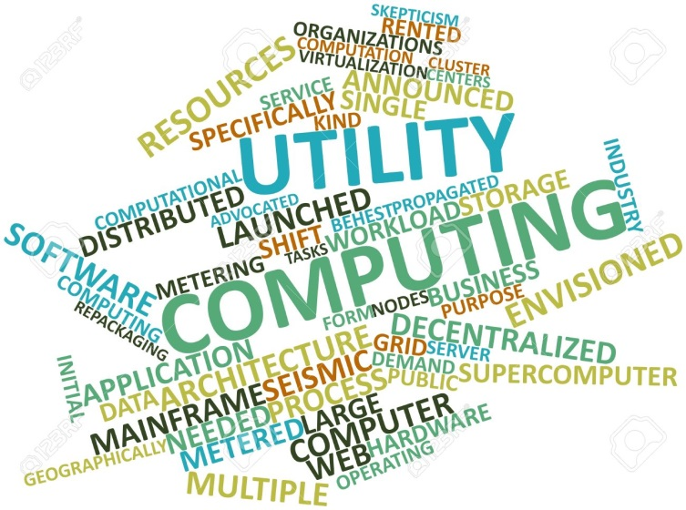
History of cloud computing
Utility computing 效用计算 involves the renting of computing resources such as hardware, software and network bandwidth on an as-required, on-demand basis.
Distributed Computing 分布式计算 is an environment in which a group of independent and geographically dispersed computer systems take part to solve a complex problem, each by solving a part of solution and then combining the result from all computers
Cluster Computing (集群计算)
Grid Computing (网格计算)

Slide 15
云计算（Cloud Computing）是分布式计算（Distributed Computing）、网格计算（Grid Computing）、效用计算（Utility Computing）、 网络存储（Network Storage Technologies）、虚拟化（Virtualization）、负载均衡（Load Balance）、数据中心（Data Center）等传统计算机和网络技术发展融合的产物。

Slide 16
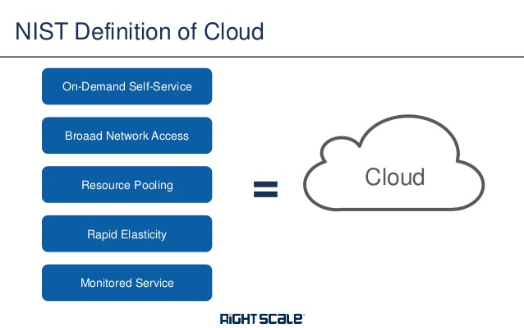
Five characteristics of cloud computing
On-demand self-service （按需服务）
Broad network access （范接接入）
Resource pooling （资源池化）
Rapid elasticity （弹性服务）
Measured service (可测量服务)

Slide 17
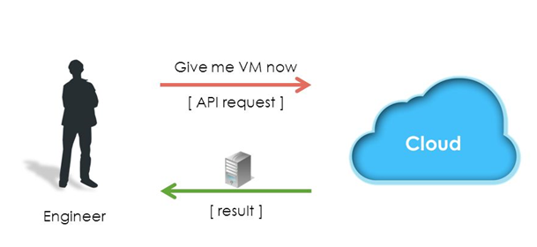
On-demand self-service （按需服务）

Slide 18
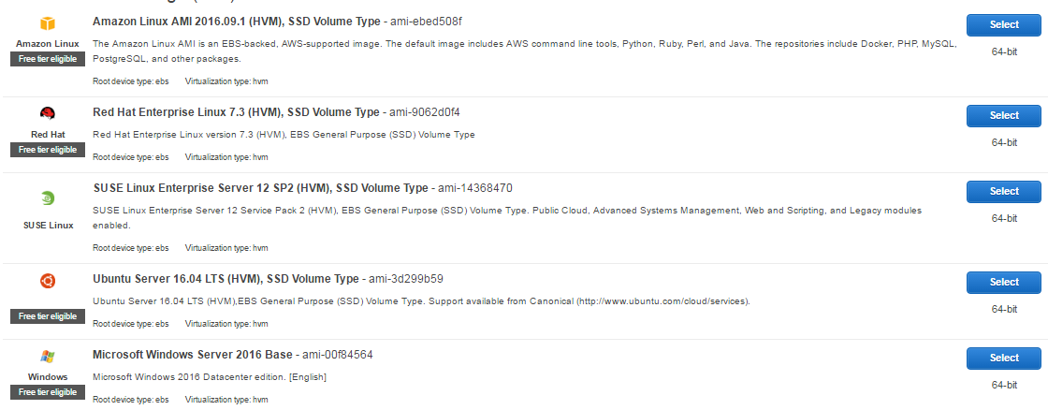
On-demand self-service （按需服务）

Slide 19
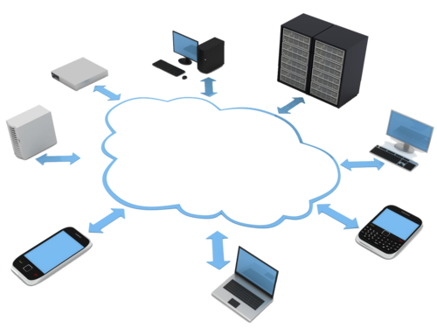
Broad network access （范接接入）

Slide 20
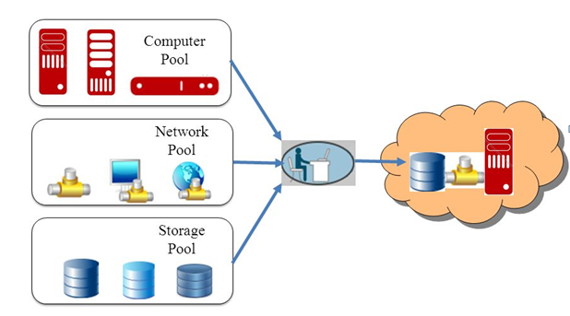
Resource pooling （资源池化）

Slide 21
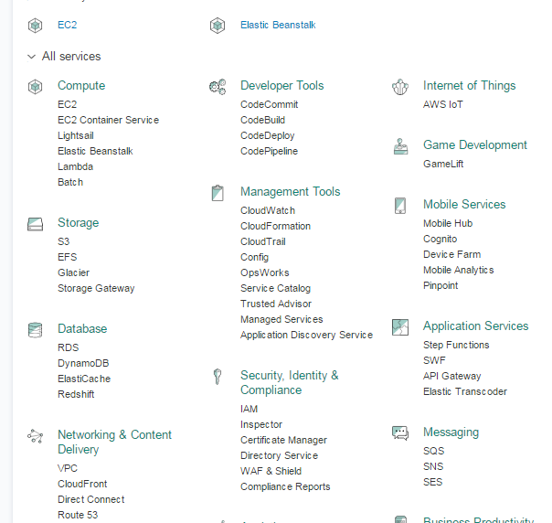
Resource pooling （资源池化）

Slide 22
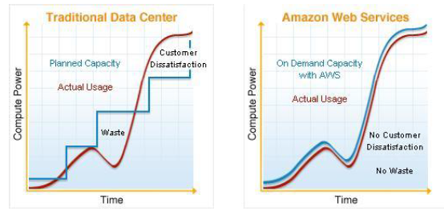
Rapid elasticity （弹性服务）

Slide 23
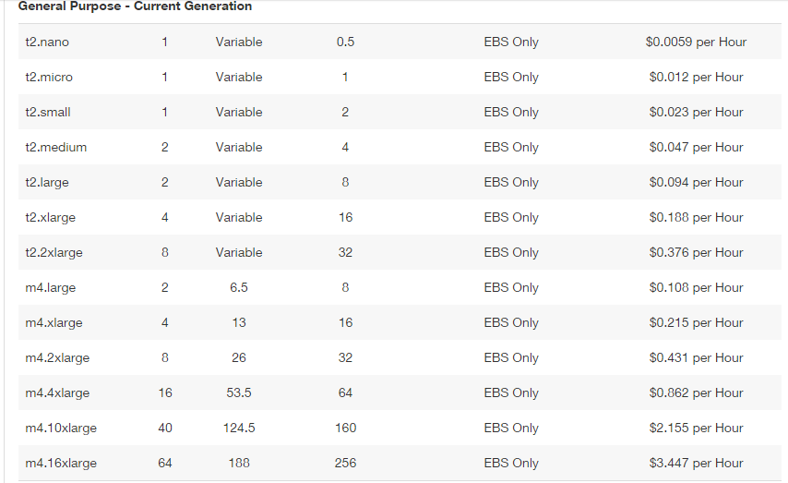
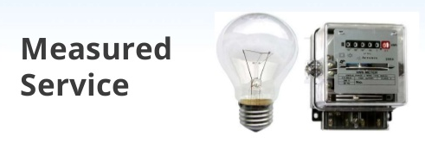
Measured service (可测量服务)

Slide 24
Cloud Service Delivery Models （云计算的服务模式）
IaaS(Infrastructure-as-a- Service)：基础设施即服务。消费者通过Internet可以从完善的计算机基础设施获得服务。例如：硬件服务器租用。
PaaS(Platform-as-a- Service)：平台即服务。PaaS实际上是指将软件研发的平台作为一种服务，以SaaS的模式提交给用户。
SaaS(Software-as-a- Service)：软件即服务。它是一种通过Internet提供软件的模式，用户无需购买软件，而是向提供商租用基于Web的软件，来管理企业经营活动。

Slide 25
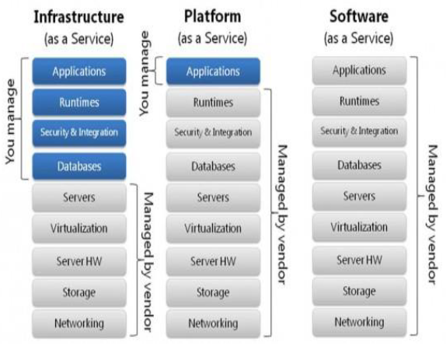
Cloud Service Delivery Models （云计算的服务模式）

Slide 26
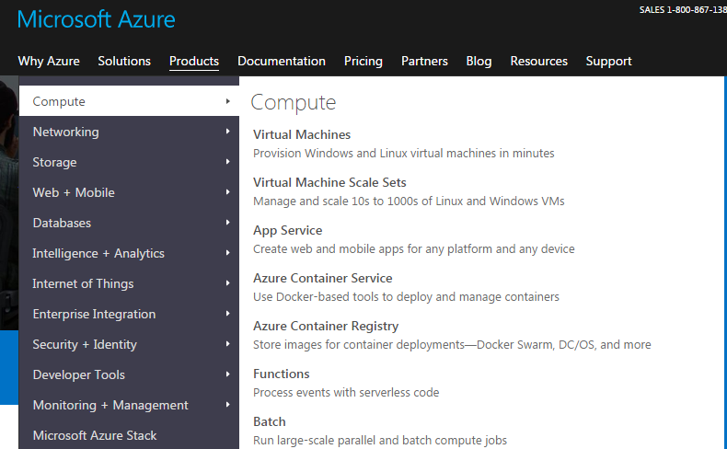
IaaS(Infrastructure-as-a- Service)：基础设施即服务

Slide 27
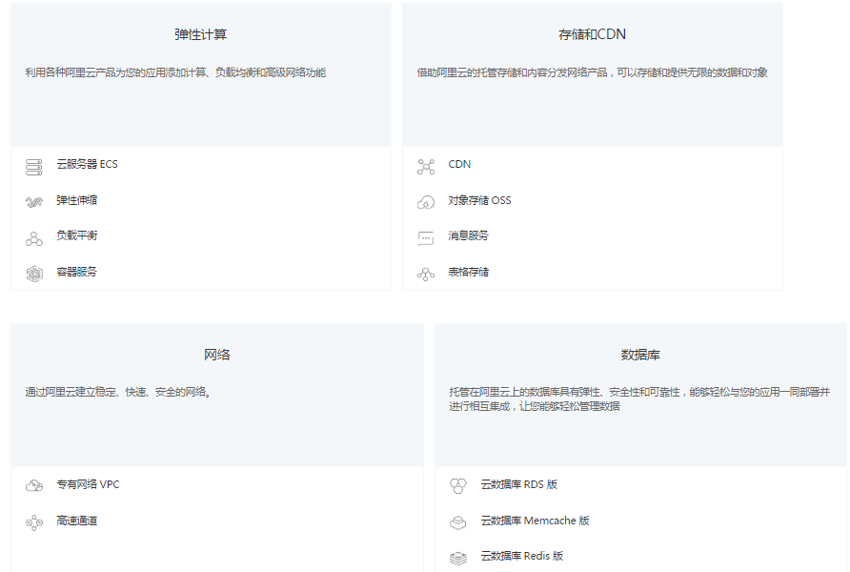
IaaS(Infrastructure-as-a- Service)：基础设施即服务

Slide 28
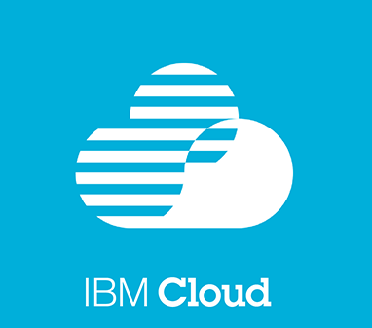






IaaS(Infrastructure-as-a- Service)：基础设施即服务

Slide 29
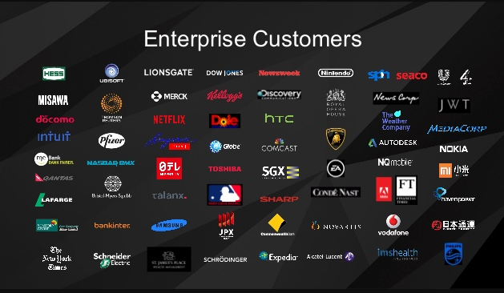
IaaS(Infrastructure-as-a- Service)：基础设施即服务

Slide 30
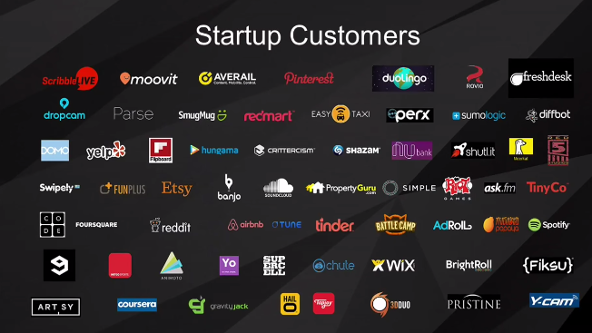
IaaS(Infrastructure-as-a- Service)：基础设施即服务

Slide 31
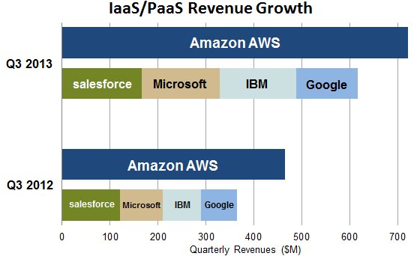
IaaS(Infrastructure-as-a- Service)：基础设施即服务

Slide 32
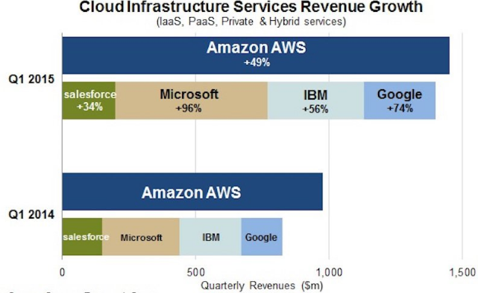
IaaS(Infrastructure-as-a- Service)：基础设施即服务

Slide 33

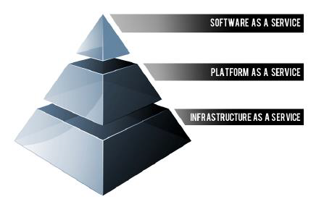
PaaS(Platform-as-a- Service)：平台即服务
平台即服务(PaaS) 是一种基于云的环境，您可以在此环境中开发、测试、运行并管理您的应用程序。 这种方式可为您提供您所需的开发环境，免去了购买、构建或管理底层基础架构的复杂性。

Slide 34
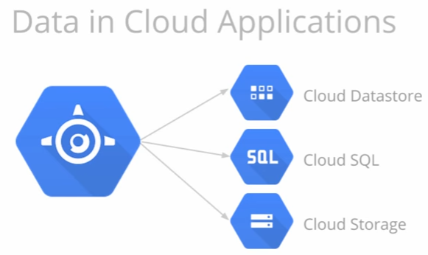
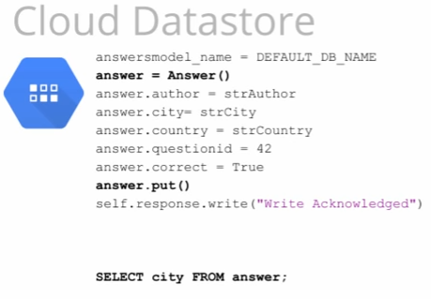
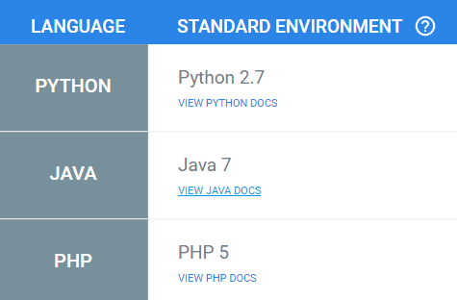

Slide 35
SaaS(Software-as-a-Service)
SaaS(Software-as-a- Service)：软件即服务。它是一种通过Internet提供软件的模式，用户无需购买软件，而是向提供商租用基于Web的软件，来管理企业经营活动

Slide 36

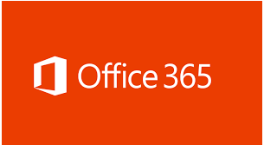



Slide 37
Cloud Deployment Models （云计算的部署模式）
Public Cloud (公有云)
Private Cloud (私有云)
Community Cloud (社群云)
Hybrid Cloud (混合云)

Slide 38

Public Cloud (公有云)
建构于网络上并提供给公众免费或付费的软硬件服务
office365，Gmail, Dropbox

Slide 39

Private Cloud (私有云)
又称为内部云（Internal Cloud）
将云端基础设施与软件硬件资源建立在防火墙之内，已提供企业机构内各部门单位共享资源
通常利用云端运算原则来构建企业机构的资料中心，只限企业员工合作伙伴存取

Slide 40
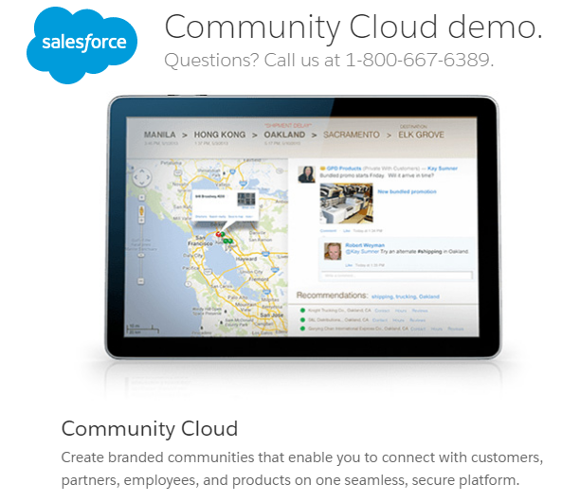
Community Cloud (社区云)
社区云是指由多个组织共享资源池，较适合拥有特定目而需共享资源的数个机构，例如共享研究资料需求的学研单位合资可建置社区云

Slide 41
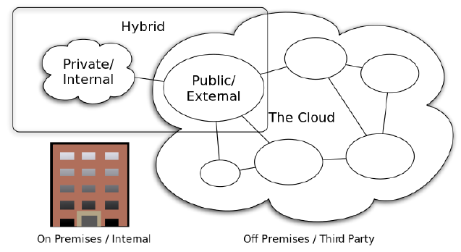
Hybrid Cloud (混合云)
混合云融合了公有云和私有云，是近年来云计算的主要模式和发展方向。

Slide 42
Google Data Center
https://www.youtube.com/watch?v=XZmGGAbHqa0&t=225s

