Slide 1
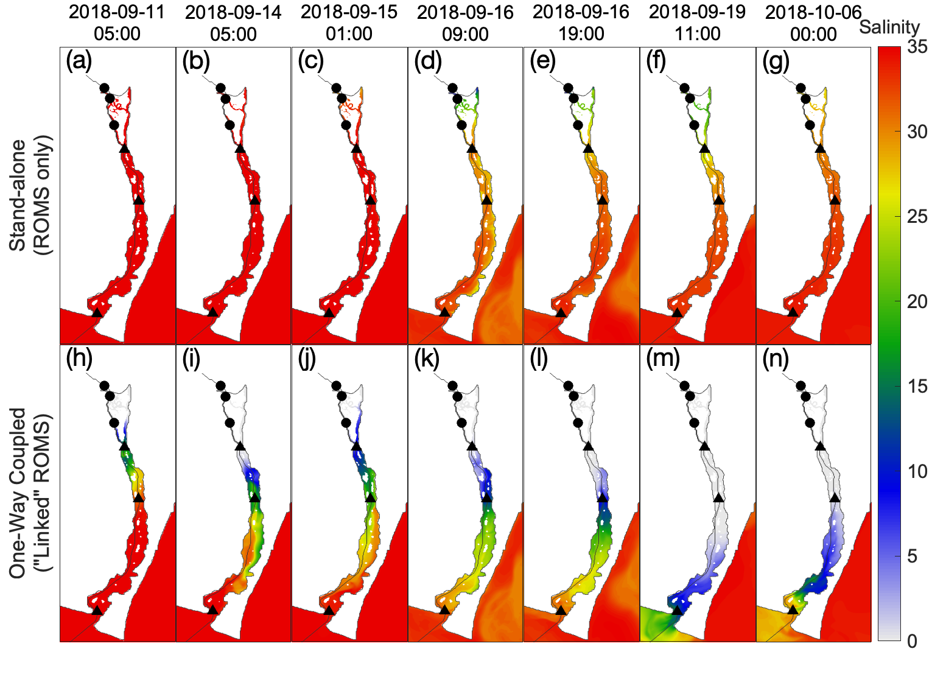
Figure S1
LE1
LE2
LE3
ES1
ES2
ZB
ES3
ZB

Slide 2
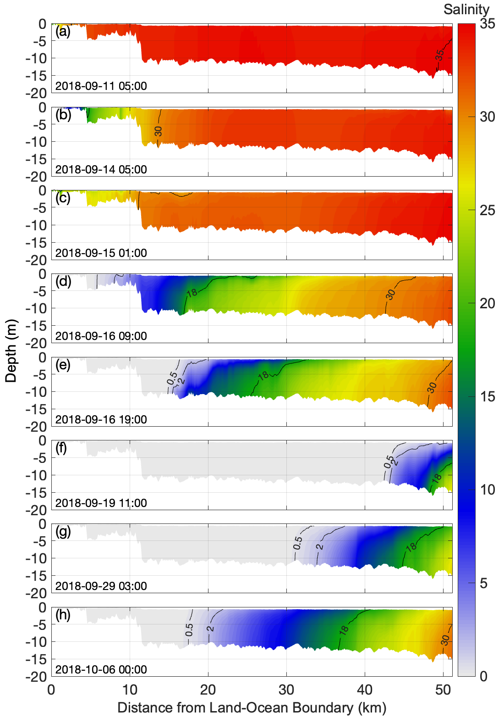
Figure S2

Slide 3
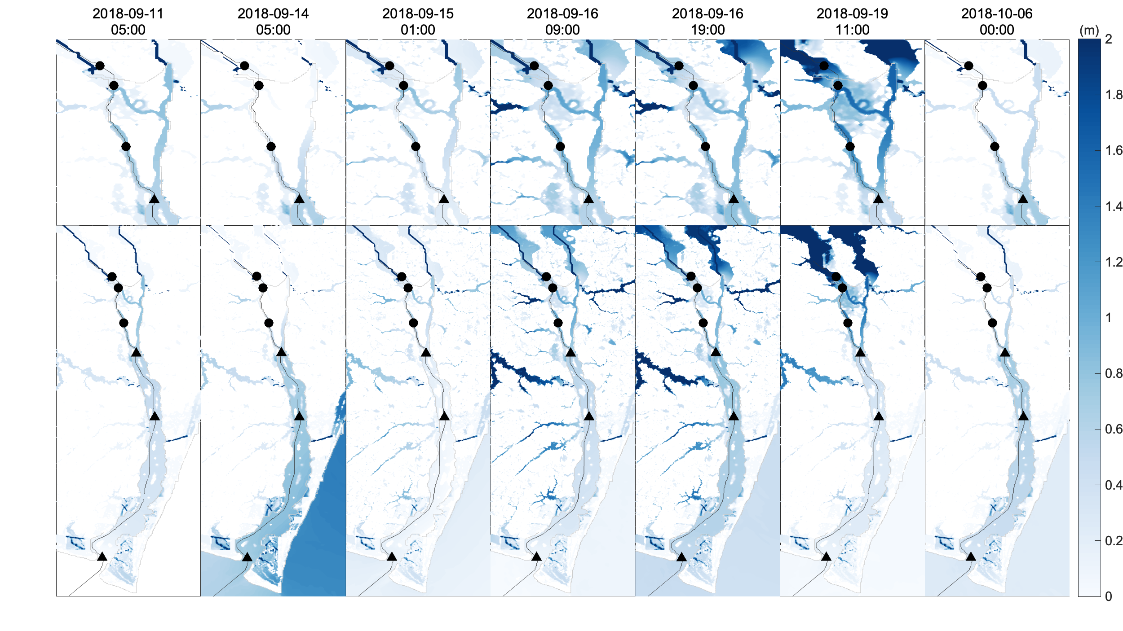
Figure S3
LE1
LE2
LE3
ES1
(a)
(b)
(c)
(d)
(e)
(f)
(g)
LE1
LE2
LE3
ES1
ES2
ES3
(h)
(i)
(j)
(k)
(l)
(m)
(n)

Slide 4
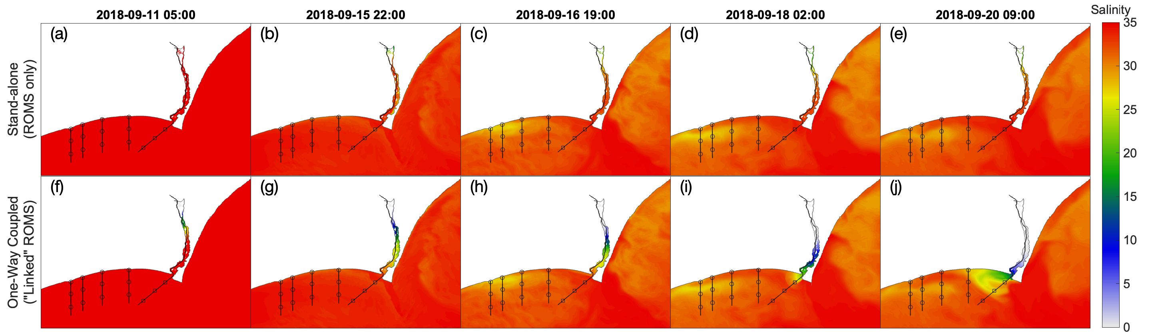
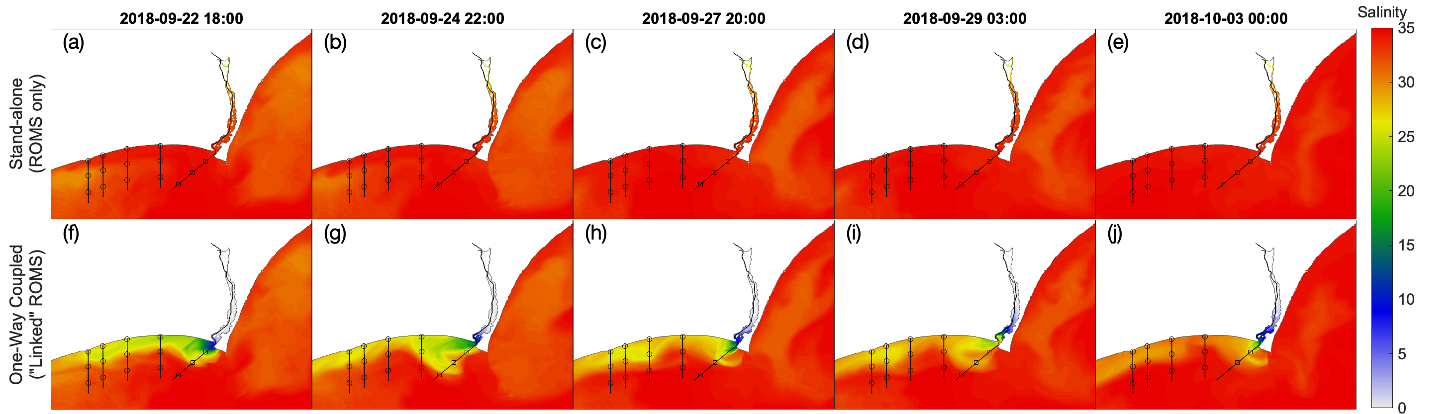
Figure S4
Inlet 1
Inlet 2
Inlet 3
Inlet 4
EO1
EO2
EO3
Figure S5
Inlet 1
Inlet 2
Inlet 3
Inlet 4
EO1
EO2
EO3

Slide 5
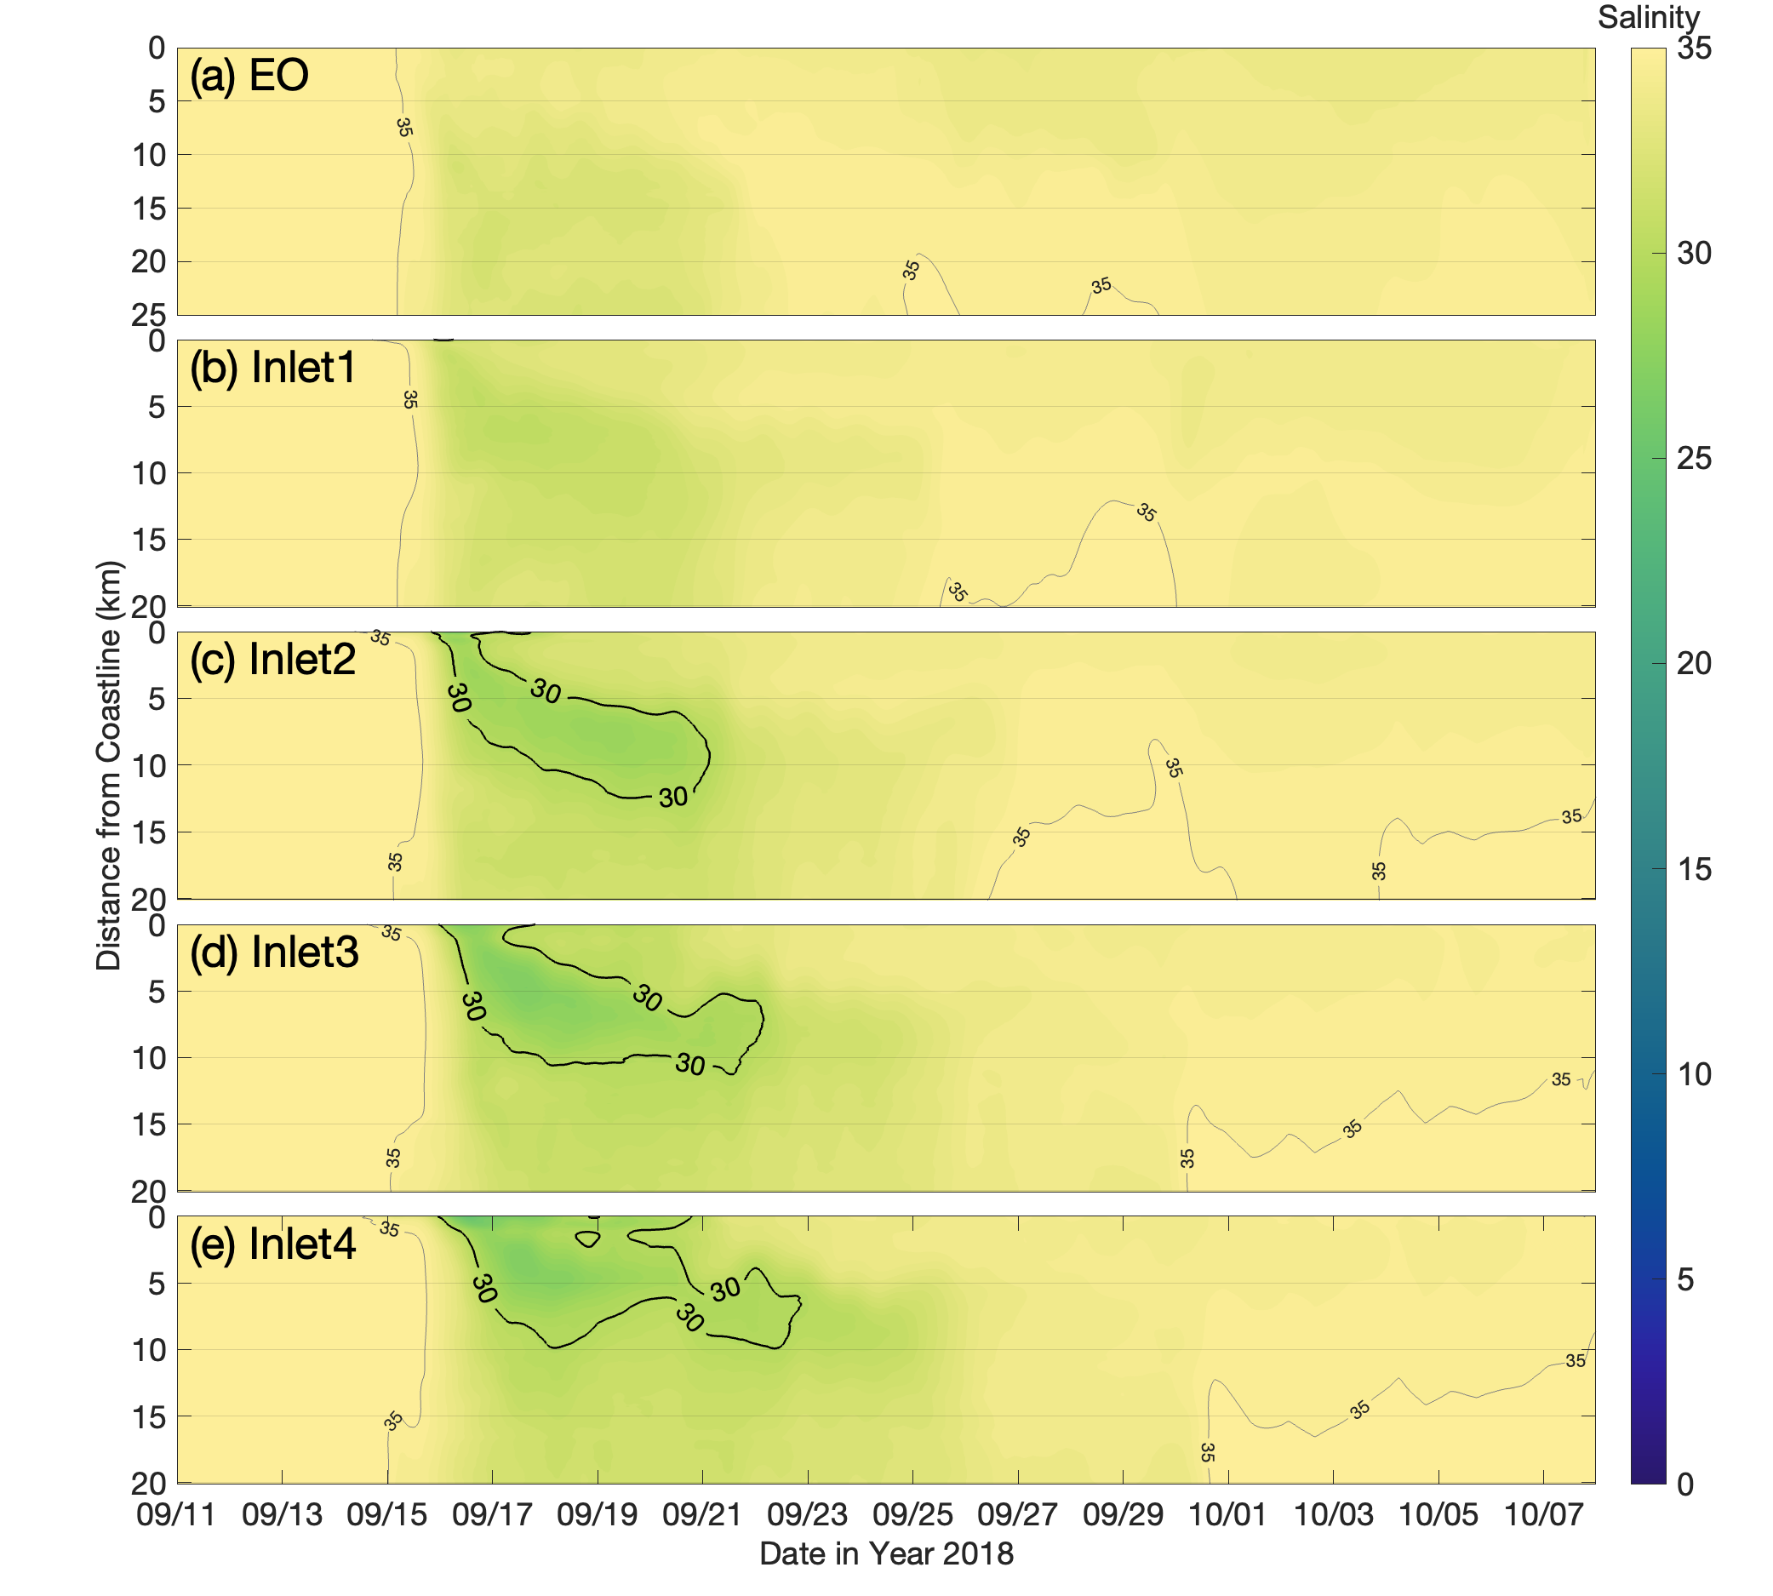
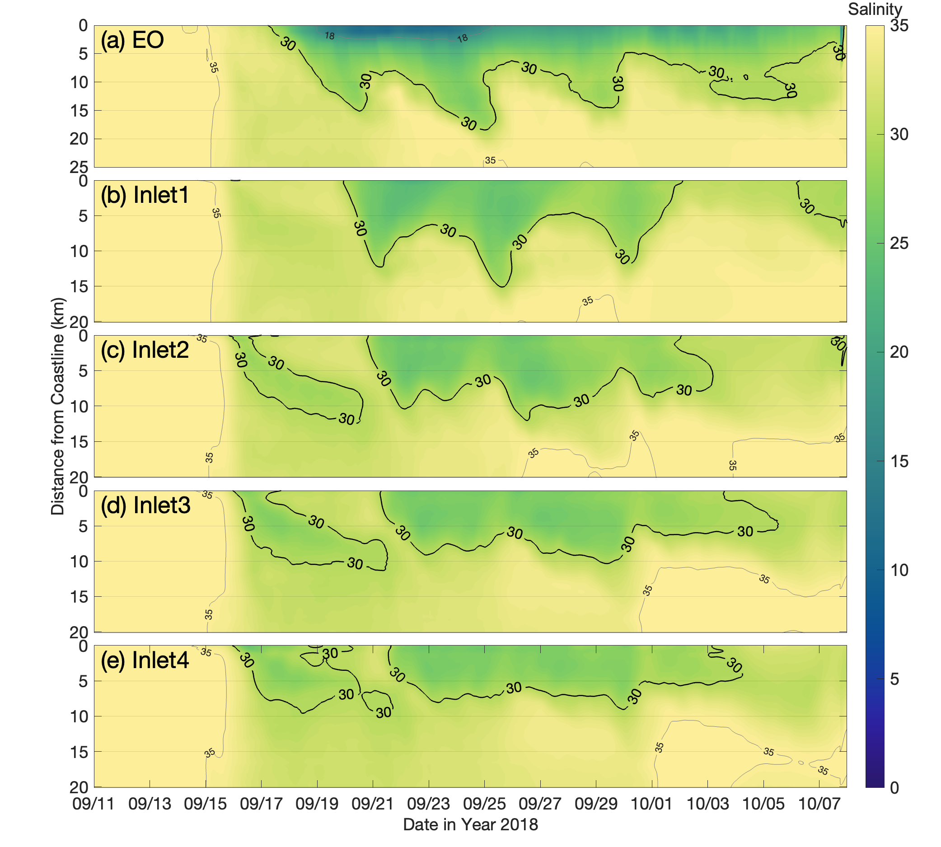
Figure S6
Figure S7
Freshwater
Plume Onset

