Slide 1
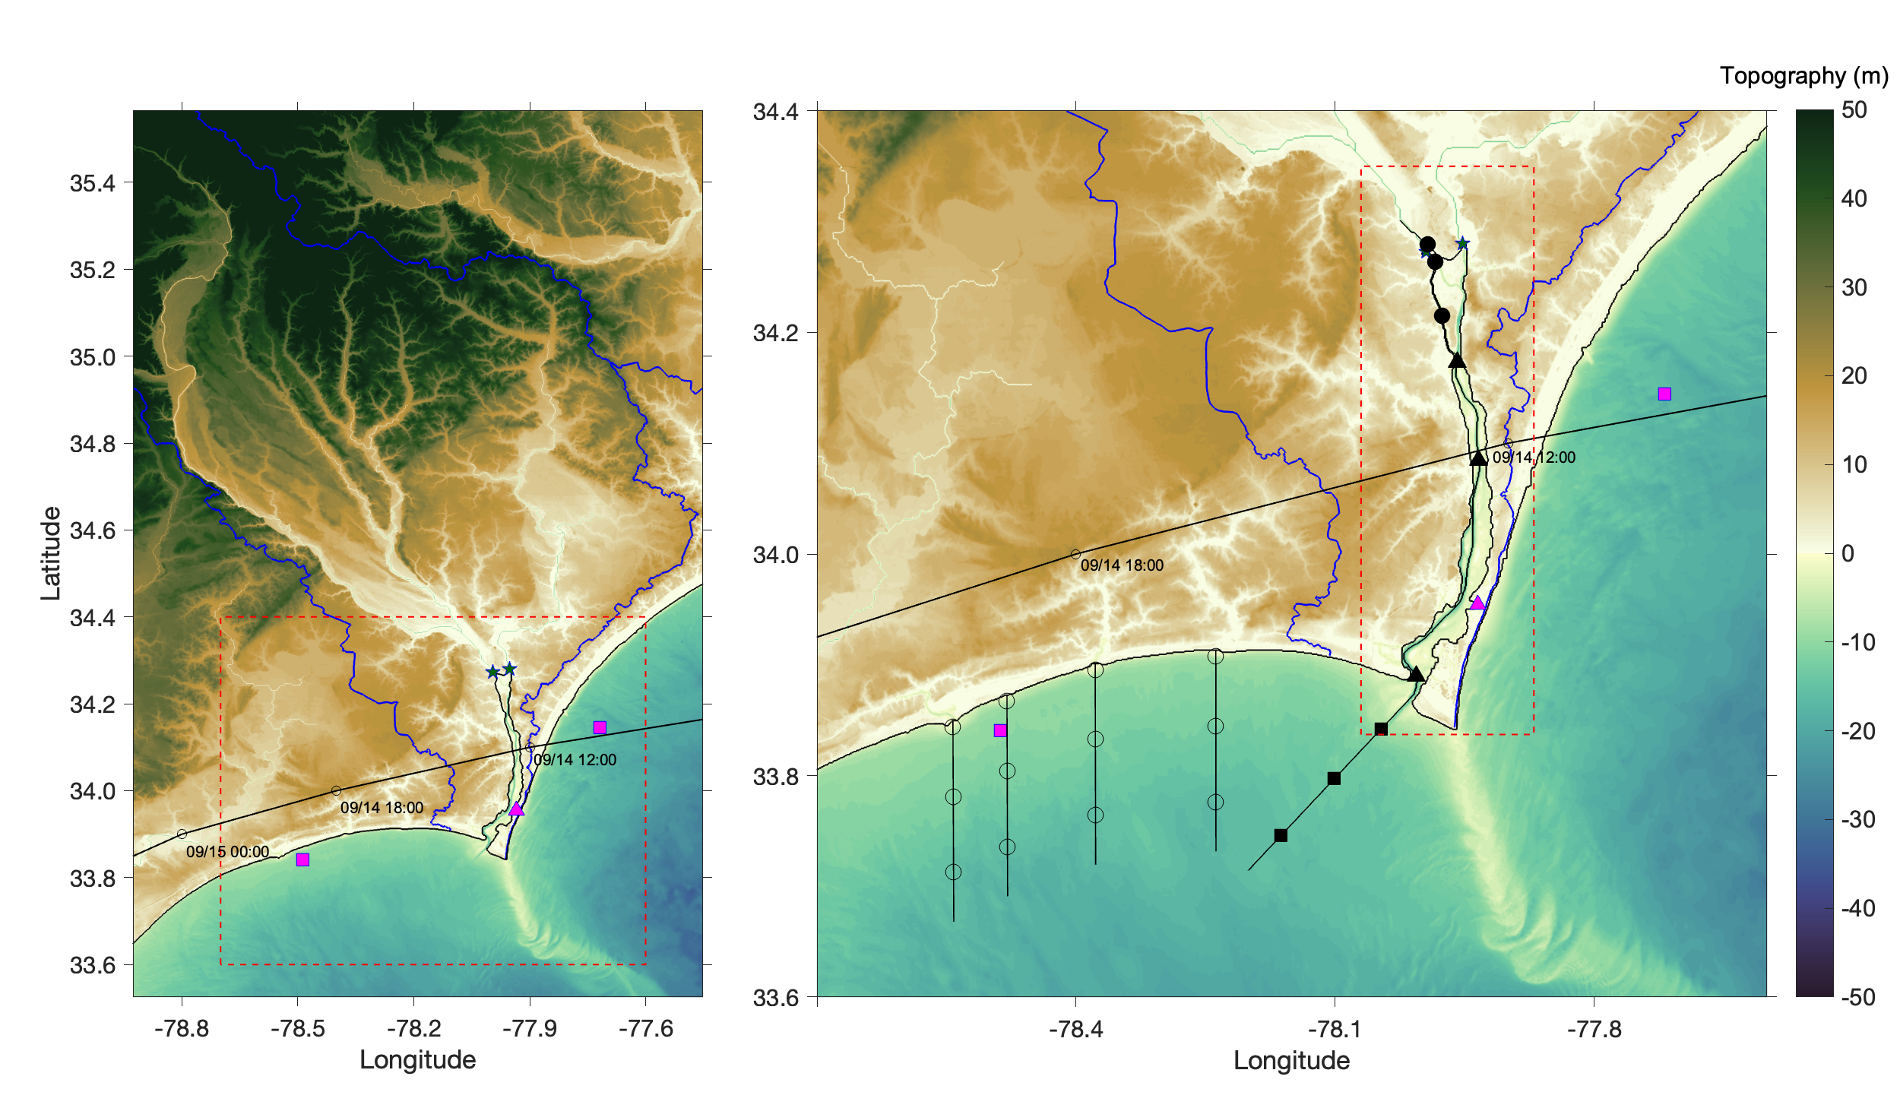
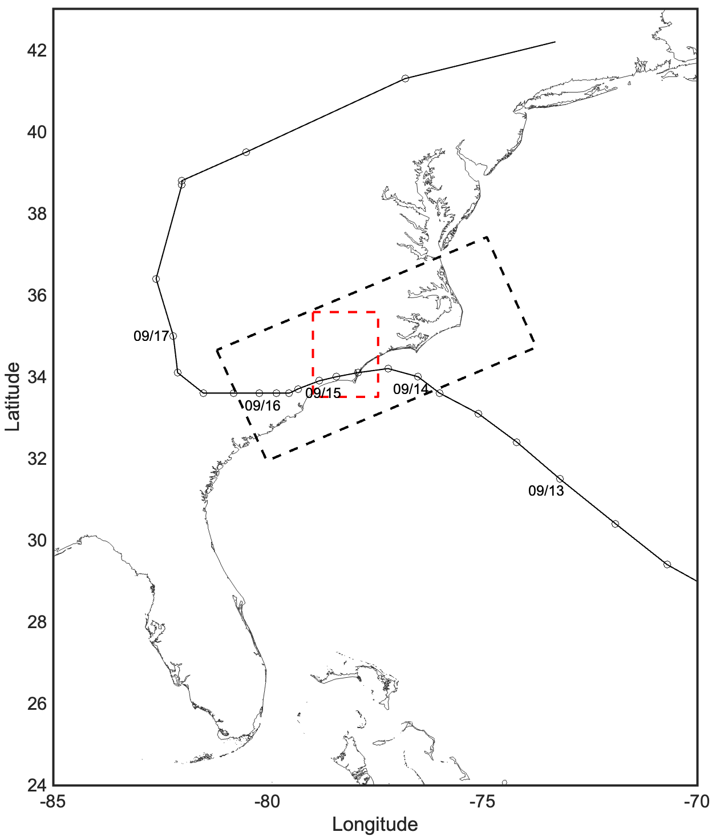
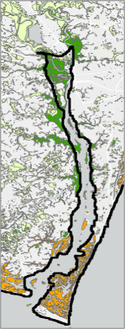
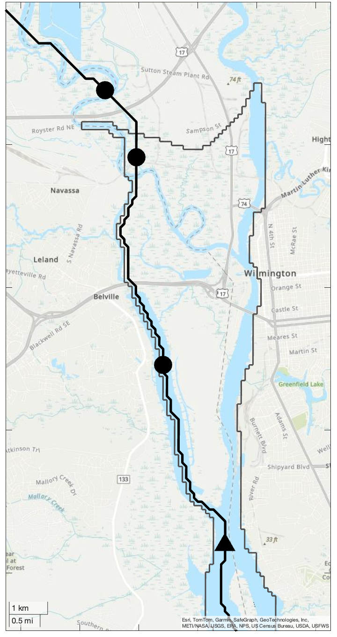
Figure 2. Study sites
(b)
(c)
(d)
(Neuse Watershed)
Middle Basin
LE1
East Basin
LE2
LE3
ES1
ILM2
West Basin
ES2
Middle Basin
Lockwoods Folly (Inlet1)
Shallotte
Inlet (Inlet2)
Tubbs Inlet (Inlet3)
ZB
(c)
East Basin
Litter River (Inlet4)
West Basin
ILM2
ES3
SUN2
EO1
ZB
EO2
SUN2
EO3
(a)
(d)
(e)
LE1
Cape Fear
LE2
Northeast
Cape Fear River
(b)
(e)
“parent” domain
Leland
Wilmington
Wetland Type
Belville
Eagle Island
Freshwater Forested/
Shrub Wetland
LE3
Cape Fear River
Freshwater Emergent Wetland
Atlantic Ocean
Estuarine and Marine Wetland
Brunswick River
Florida
ES1
ES1

