Slide 1
TUM Neue Helvetica 55 Regular

Slide 2
Main challenges of medical image seg
First, ambiguous boundary
Second, uncertainty
(Q: what’s the difference between those two?)

Slide 3
Previous methods
Fully automatic (U-Net): non-boundary-preserving
Interactive (Wang): require facilitation with human intelligence

Slide 4
Proposed framework
Automatic key points selection algorithm
BPB: exploit boundary-related features network arch
SBE: act as supervision/loss in an adversarial manner

Slide 5
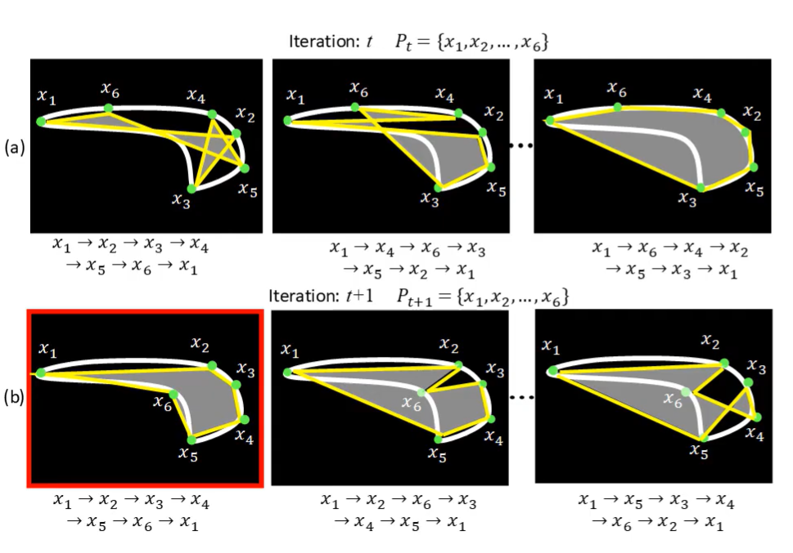
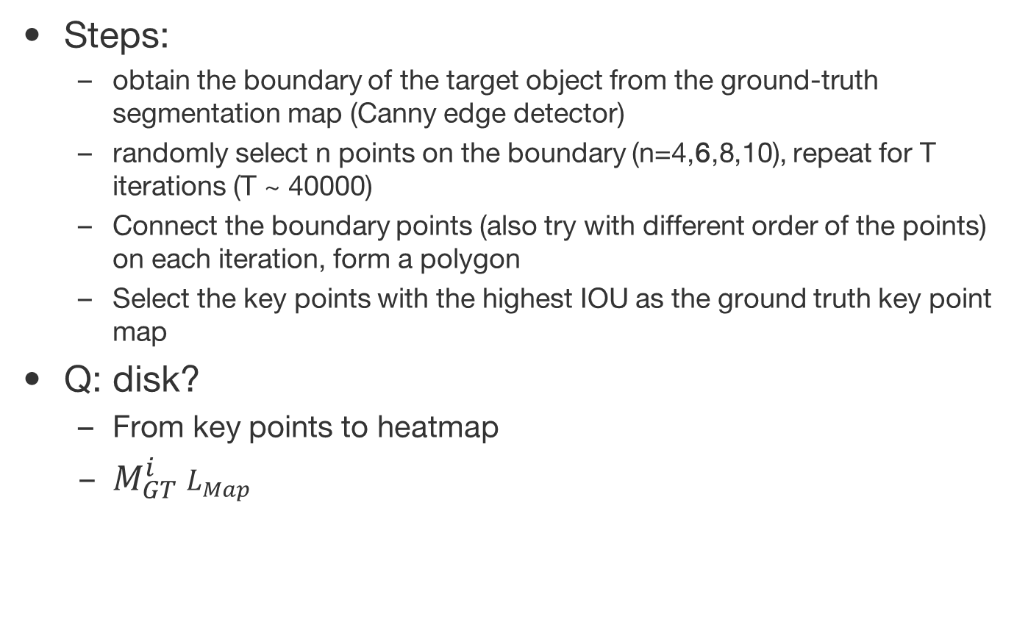
1. Automatic key points selection algorithm
Steps:
obtain the boundary of the target object from the ground-truth segmentation map (Canny edge detector)
randomly select n points on the boundary (n=4,6,8,10), repeat for T iterations (T ~ 40000)
Connect the boundary points (also try with different order of the points) on each iteration, form a polygon
Select the key points with the highest IOU as the ground truth key point map
Q: disk?
From key points to heatmap
$M_{GT}^{i}$ $L_{Map}$

Slide 6
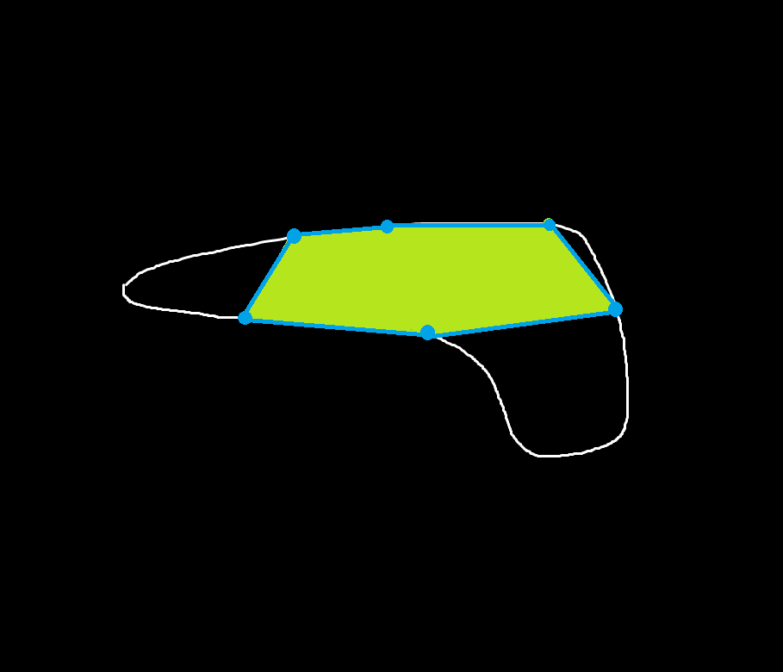

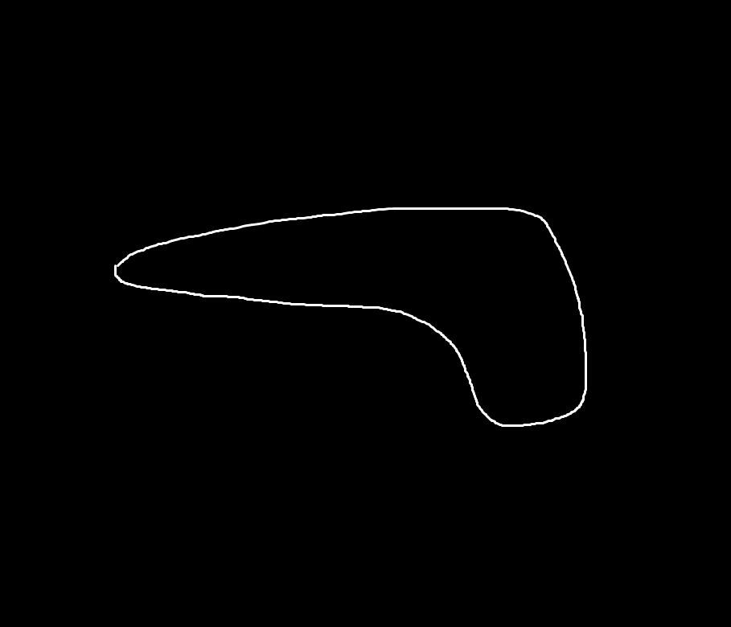
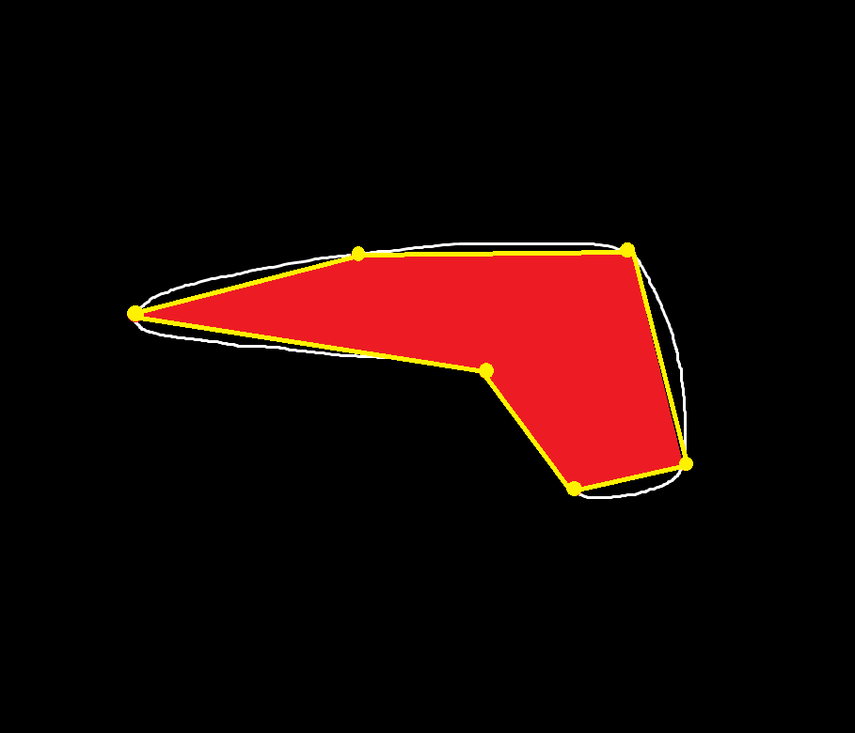
1. Automatic key points selection algorithm
Random point
selection
&
Polygon creation
Edge
detection
……
……
Evaluation

Slide 7
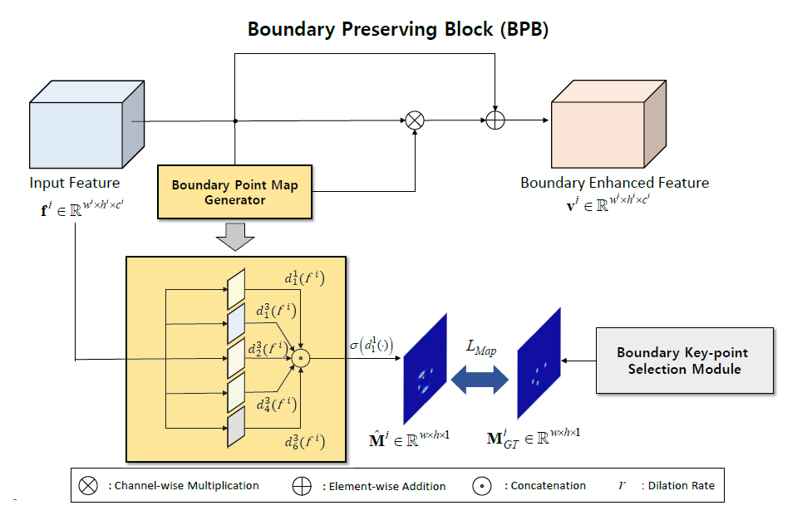
2. BPB
Enhance boundary information of input feature maps
Can be injected into any network arch
Using dilated convolution with various dilation rates
Various dilation rates focus on different receptive fields (small dilation rate is in charge of extracting near-by features, big dilation rate is for long-distance features)
Compare: SE block (enhancing channel-wise feature)
Q: how to get Mi_GT? Is Mi_GT downsampled from M_GT?

Slide 8
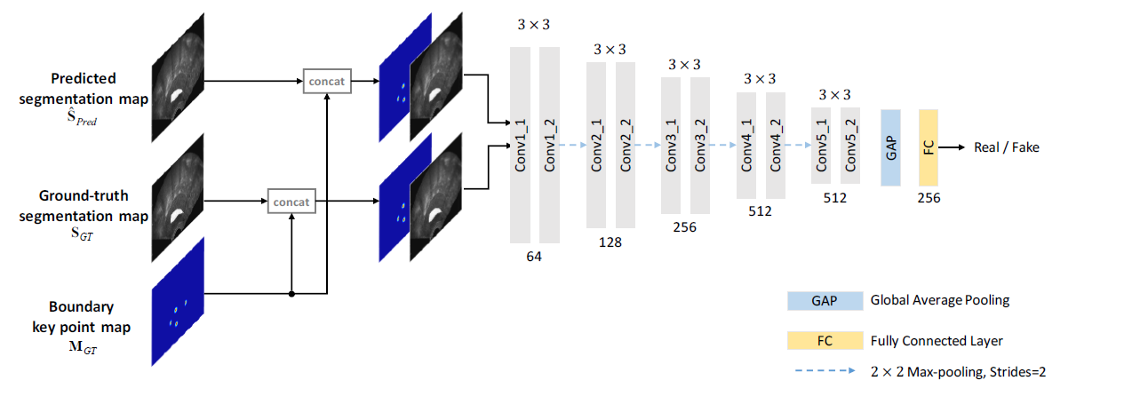
3. SBE
From the perspective of GAN, the SBE acts as a discriminator and the segmentation network acts as a generator.
According to properties of discriminator, a trained SBE should output a high score given the ground truth and a low score given the prediction.
Why training such a discriminator? (-> It facilitates the segmentation network to be trained such that the structure boundary is well-preserved.)

Slide 9
Loss of segmentation network
Conventional segmentation CE loss (S_pred_hat and S_GT)
Key point map loss (measures the similarity between M_i_hat and M_i_GT, aims at minimizing the difference between two key point maps)
Boundary-aware loss (measures the similarity between S_pred_hat and M_GT, aims at minimizing the difference between prediction map and GT key point map)
Simply add three terms together (or weighted)

Slide 10
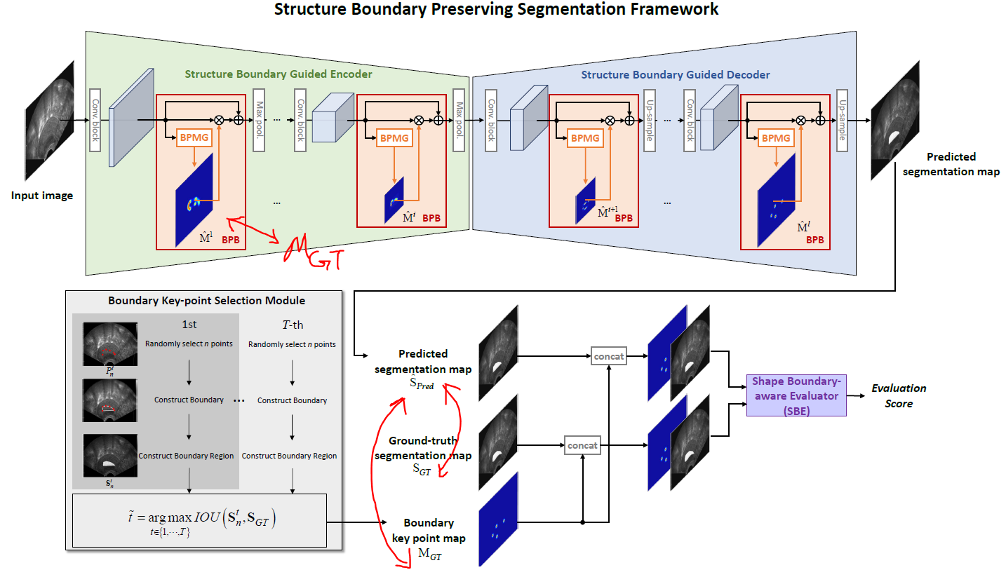
Loss of segmentation network
重新画，把segmentation和SBE分开

Slide 11
Loss of SBE network
Discriminator loss

Slide 12
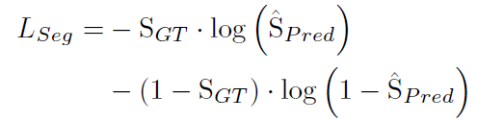

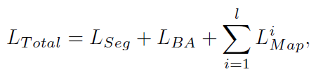
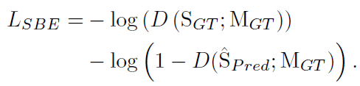
Training
Two networks need to be trained: segmentation network and SBE network
They are trained together in an adversarial way
Loss for segmentation network:
(generator loss)
Loss for SBE network:
(discriminator loss)

Slide 13
Experimental Setups and Results

Slide 14
Datasets and training setups
Datasets
PH2 [31]+ISBI 2016 [10] Skin Lesion Challenge dataset
900 training, 200 testing
Transvaginal Ultrasound (TVUS) dataset. [2]
five-fold cross-validation on 3,360 images
More challenging
Training setups
Trained from scratch
Adversarial training: train the segmentation network 8 times and the SBE network 3 times on each iteration
Batch size of 8, learning rate of 0.0001 with Adam
boundary key point selection algorithm hyper-parameters: n=6, T=40000

Slide 15
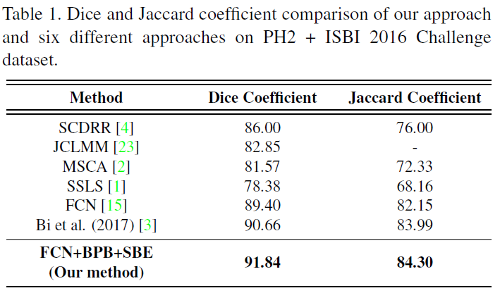
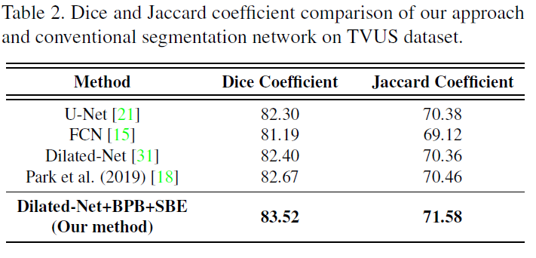
Evaluation baselines and results
1. Quantitative evaluation against previous SOTA methods on each dataset

Slide 16
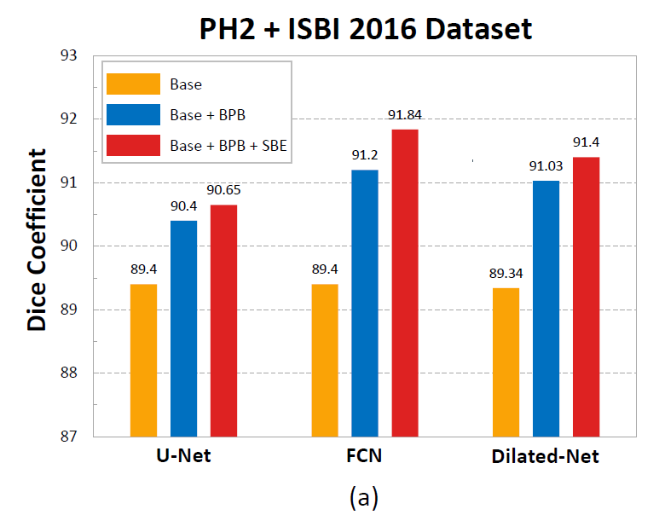
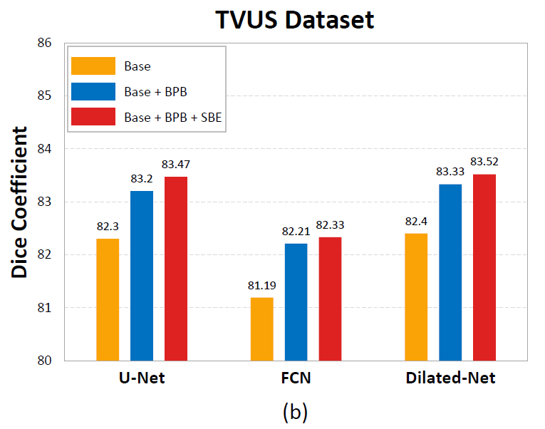
Evaluation baselines and results
2. Ablation studies to verify generalization

Slide 17
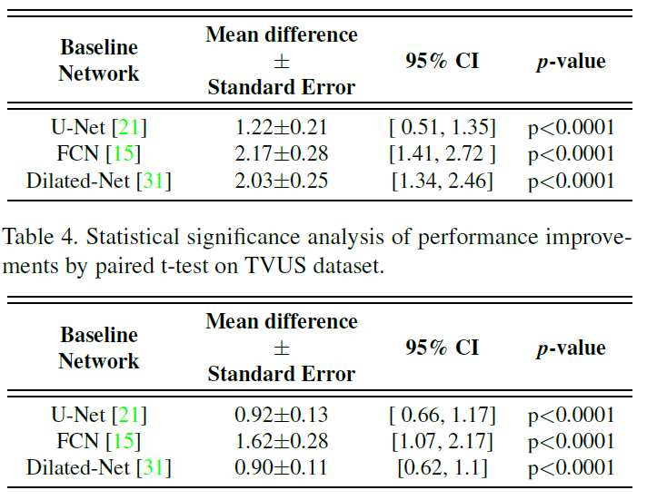
Evaluation baselines and results
3. Statistical significance analysis of performance improvements between baseline and baseline+BPB+SBE with paired t-test

Slide 18
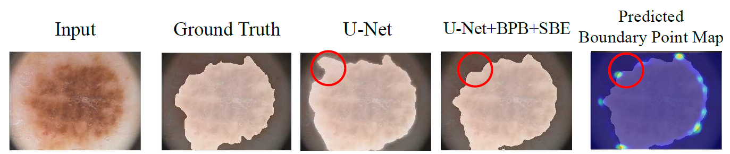
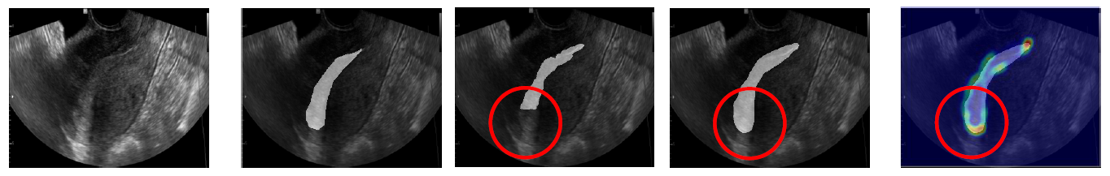
Evaluation baselines and results
4. Qualitative evaluation with visualization of segmentation map and key point map.

Slide 19
Other experiments
Effect of different number and positions of BPBs
More BPBs, more performance gain
Be placed widely across the network
Provides explanation (For example, placed in the 1st layer of U-Net encoder underperforms, since the front of network only extracts low-level features and the introduction of BPB may increase noise)
Effect of hyper-parameters of key point selection algorithm
N=6 for this task

Slide 20
Open questions
I think …, what about your thoughts?
Example: In the paper it said, the SBE tells whether predicted segmentation coincidences with ground truth boundary key point map or not. But I think this SBE is a kind of discriminator and tells whether predicted segmentation coincidences with ground truth segmentation, not the boundary key point map. How to interpret this statement from the author? Is this implicitly done by convolution on concatenated feature maps?
The similarity and difference between BPB and SBE
Possible improvements for the boundary point selection algorithm? (Instead of random selection, is there a way to transfer to an optimization problem? Or an image processing problem detecting sharp edges)
Compared with the boundary loss strategy (which also force the network to learn boundary information) used in U-Net, why is this better?
Perhaps, this actually force the network to learn key points instead of directly learning boundary, which might be easily to learn or easier to generalize.

