Slide 1
Wi-Fi/Bluetooth localization using RSSI Fingerprinting
Xiang Zhou
Biao Xiong
Jiyayao Gao
This Photo by Unknown Author is licensed under CC BY

Slide 2
1.0 Data Collection and Set Up
This Photo by Unknown Author is licensed under CC BY

Slide 3



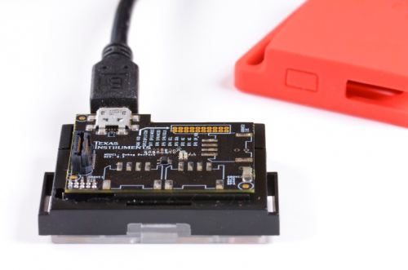
1.1 Hardware & Software
SensorTag
python
C language
Github

Slide 4
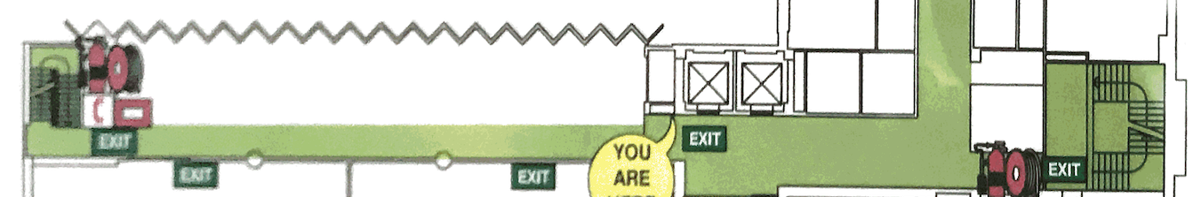
1.2 Arrangement
2
4
1
3
5
Level2 Ainsworth Building J17

Slide 5
1.3 Data Collection
Collection Method:
collects data from 5 sensor tags
Each group collects 3 times from 5 sensors
Time interval between each group is 1 sec
Save all data in a txt file
Data Set 1:
Number of sensor tags : 5
Number of Samples : 25
Period: 1pm-5pm Wednesday
Number of Test Point: 5
Data Set 2:
Number of sensor tags : 5
Number of Samples : 15
Period: 12pm-5pm Sunday
Number of Test Point: 8

Slide 6
1.4 Analysis Collected Data
Data Set 1 is not an appropriate data.
Some different points have the same RSSI values.
Some points have significant drifts at different time.
Reason :
Significant Signal Inference
There are hundreds of electronic devices in the experiment environment.
Data Set 2 is an appropriate data.
There is less inference during collecting data set 2.
Each sample point has slight fluctuation.
Average all values for each point in each group to reduce the error.

Slide 7
2.0 Algorithm
This Photo by Unknown Author is licensed under CC BY

Slide 8
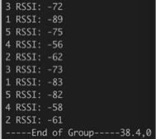
2.1 Raw Data
6 RSSI requests from each sample Points
End of Group is one Sample points Collection
Need to aggregate into one vector of reading from each base station
Deal with stations with failed request

Slide 9
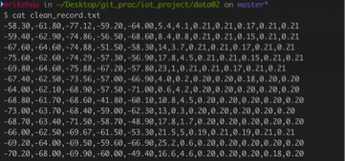
2.2 Data Cleaning
s1, s2, s3, s4, s5, x, y, w1, w2, w3, w4, w5

Slide 10
2.3 K-nearest Neighbour Prediction
For each test points base station reading compare with the sample points readings
Compute the Euclidian Distance applying the weight with each sample points
Find the k sample points with the least distance
Find the center of the k sample points

Slide 11
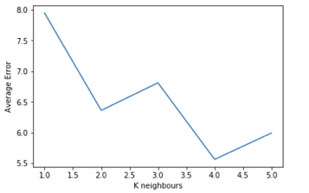
2.3 How to choose K?
By Using the weight we mentioned before the error distance decrease from 6.14 to 5.54 meters
By far applying the weight as well as chose k = 4 seems returns the best outcome

Slide 12
2.4 Discussion for the Error (Hardware)
Sensor Tag
Less Signal Strength
Less Signal Penetration
Less Power Supply
Less Resistant to Noise
PC with WIFI network Card
Stronger WIFI Signal
Better Signal Prorogation
Stale and Sufficient Power
More Adaptive to Noise

Slide 13
2.4 Discussion for the Error (Algorithm)
Minimum Implementation of the Algorithm, more emphasis on experiment implementation(quick and dirty)
Further tweak on the weight when calculation the Euclidian Distance
Use Kalman Filtering to Further improve the data aggregation
Using Least Square Fit ,know base station coordinates and RSSI to predict the location by Trilateral localisation.
Possible leverage of Trilateral localisation and K-nearest Neighbours by taking a weighted average

Slide 14
3.0 Review on project progress
This Photo by Unknown Author is licensed under CC BY

Slide 15
Intermediate Report

Slide 16
4.0 Future Plan
This Photo by Unknown Author is licensed under CC BY

Slide 17
4.1 Plan for algorithm improvement
Hardware Method
Using iBeacon to improve the accuracy
Software (Algorithm) method
applying different weight strategy
Weight based on successful commination times
Weight based on signal strength.
Other possible improvement algorithms

Slide 18
Applying different weight strategy
2
Sample point
1
P
B
Test point
A
3
P
Predict point
4

Slide 19
4.2 Plan for others
Testing
Output
Conclusion

