Slide 1
2.0 Algorithm
This Photo by Unknown Author is licensed under CC BY

Slide 2
2.1 Algorithm Review
K-nearest Neighbors
Find the K sample points such that the Euclidian distance of the base station reading vector with the test points are the smallest.
Then we find the center of the the K sample points which is the prediction point.
Previously we find k = 4 give us the best result.
Apply weight according to base station response frequency per request, reduce error from 6+ metres to 5.5 metres.

Slide 3
2.2 Algorithm Improvement
Another Weight according to signal strength of the received signal from the base stations
The stronger the signal the more weight it assigned to that base station reading when computing Euclidian distance with the sample points.
We have tried many different weight and find out that the more weight we assign to the stronger signal the better result we get.
It turns out that weight of [1,0,0,0,0] will give us the most accurate result, that is assign full weight to the base station with the strongest signal strength

Slide 4
2.3 Algorithm Weight Interpretation
If we assign full weight to the base station with the strongest signal then the algorithm becomes:
We pick the base station with the strongest reading from the test point and then find the 3 sample points such that this base station reading from the 3 sample points are the most similar one to that of the test point. Then based on these 3 sample points we find the center which is the prediction of the test point.

Slide 5
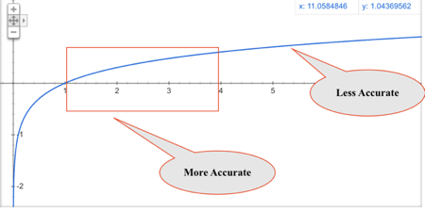
2.4 Algorithm Why This Weight Works?
As we can see from the graph the RSSI strength with distance function is a log function
Only when distance is small ,we could approximate the distance and signal strength relation as linear
So that we could say that if the RSSI Reading is similar then their distance to the source must be similar as well
This induction does not apply when distance is long due to the signal attenuation the small difference between the RSSI reading ,would possibly corresponding to a large distance difference.

Slide 6
2.4 Algorithm Why This Weight Works?
So when we pick the base station from the test point with the strongest reading , it is possible that the test point is nearer to that base station
When we pick the most similar readings of that base station from other 3 sample points, it is also possible that these 3 base stations are within similar distance to that base station(since similar reading implies similar distance to the source).
The prediction is accurate because we choose the most reliable reading available for comparison aka the strongest reading from that base station

Slide 7
2.4 Further Improve the Accuracy
Following the previous logic, if we increase the number of base stations as well as sample points then we would have test points with more reliable readings(since more base stations means test points will get closer to one of the base stations)
Same for the sample points ,we will also have more sample points with stronger readings from the base stations ,since they are closer to one of the base stations.
This would allow us to make more induction in the accurate part of the previous curve we have discussed, therefore possible more accurate result.

Slide 8
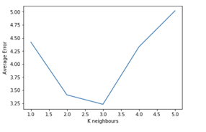
2.4 Further Improve the Accuracy

Slide 9
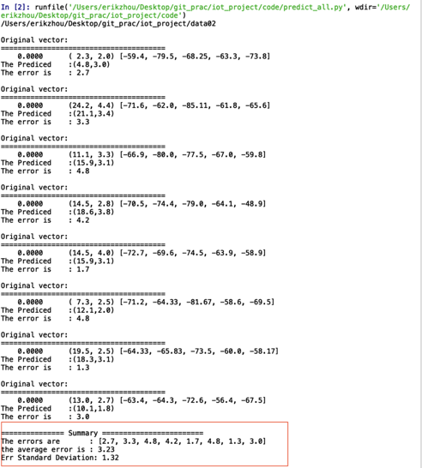
2.4 Further Improve the Accuracy

Slide 10
2.5 Alternative Algorithm
Leverage the know coordinates of the base station as well as the signal strength reading of the base stations ,we could do trilateral localization
RSSI = a*log(Distance) + b
We collect samples at different distance and do least square fit to find a and b and use this formula to predict distance given RSSI
We could simply pick the 3 base station with the strongest reading and do the trilateral fit using least square.

Slide 11
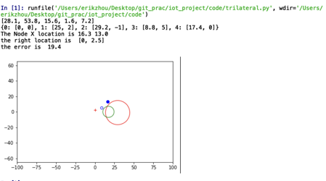
2.5 Alternative Algorithm

Slide 12
2.5 Alternative Algorithm
Same reason as previous discussed: when distance gets longer the using RSSI is not very accurate in predicting distance
Subject to noise ,when RSSI is weak for example -85 vs -86 even though it is only 1 unit of RSSI difference but the actual distance might be 10 meters.
From our experiment, usually reasonably good prediction have to be with 5 meters from the source if using RSSI

Slide 13
5.0 Conclusion

Slide 14
5.1 Experiment Result Discussion
Achieved good accuracy and even better result comparing to the original experiment of about 2 meters
We are using less sophisticated devices , sensor tag vs pc with WIFI as base station
Our communication structure is sophisticated and scalable
Front end app could be developed for user

Slide 15
5.1 Experiment Result Discussion
Pros:
Widely Available cheap device
Relative accurate prediction with 2m error
Sophisticated communication structure with scalability
Cons:
The initial set up to collect data is time consuming and needs to be redone if the circumstances changes
Sensortag unstable performance when power low , need stable power supply
Result subject to interference , would not be accurate if there are too many signal interference.

Slide 16
5.2 Possible Improvments
As discussed before we could possibly add more base station and sample points to improve perdition accuracy
By polling server to render location at short interval of time ,we could track the moving object route. Could use filter to to smooth out the noise of the signal cause by moving and then apply Kalman filtering to make best prediction of the object.
More sophisticated and user friendly app so that at one button click user can localize the object.

