Slide 1
2.0 Algorithm
This Photo by Unknown Author is licensed under CC BY

Slide 2
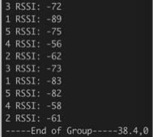
2.1 Raw Data
6 RSSI requests from each sample Points
End of Group is one Sample points Collection
Need to aggregate into one vector of reading from each base station
Deal with stations with failed request

Slide 3
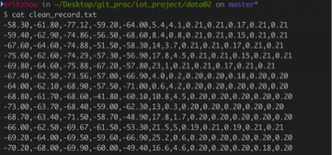
2.2 Data Cleaning
s1, s2, s3, s4, s5, x, y, w1, w2, w3, w4, w5

Slide 4
2.3 K-nearest Neighbour Prediction
For each test points base station reading compare with the sample points readings
Compute the Euclidian Distance applying the weight with each sample points
Find the k sample points with the least distance
Find the center of the k sample points

Slide 5
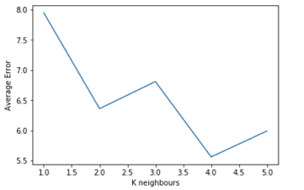
2.3 How to choose K?
By Using the weight we mentioned before the error distance decrease from 6.14 to 5.54 meters
By far applying the weight as well as chose k = 4 seems returns the best outcome

Slide 6
2.4 Discussion for the Error (Hardware)
Sensor Tag
Less Signal Strength
Less Signal Penetration
Less Power Supply
Less Resistant to Noise
PC with WIFI network Card
Stronger WIFI Signal
Better Signal Prorogation
Stale and Sufficient Power
More Adaptive to Noise

Slide 7
2.4 Discussion for the Error (Algorithm)
Minimum Implementation of the Algorithm, more emphasis on experiment implementation(quick and dirty)
Further tweak on the weight when calculation the Euclidian Distance
Use Kalman Filtering to Further improve the data aggregation
Using Least Square Fit ,know base station coordinates and RSSI to predict the location by Trilateral localisation.
Possible leverage of Trilateral localisation and K-nearest Neighbours by taking a weighted average

Slide 8
3.0 Review on project progress
This Photo by Unknown Author is licensed under CC BY

Slide 9
Intermediate Report

Slide 10
4.0 Future Plan
This Photo by Unknown Author is licensed under CC BY

Slide 11
4.1 Plan for algorithm improvement
Hardware Method
Using iBeacon to improve the accuracy
Software (Algorithm) method
applying different weight strategy
Weight based on successful commination times
Weight based on signal strength.
Other possible improvement algorithms

Slide 12
Applying different weight strategy
2
Sample point
1
P
B
Test point
A
3
P
Predict point
4

Slide 13
4.2 Plan for others
Testing
Output
Conclusion

