Slide 1
SpyShield: Preserving Privacy from Spy Add-ons
Zhuowei Li, XiaoFeng Wang and Jong Youl Choi
Indiana University at Bloomington

Slide 2



You are being WATCHED!
Spyware on the loose
  Webroot said 89 percent of the computers it scanned
  INFECTED WITH SPYWARE
  With
  30 PICIECES PER MACHINE!

Slide 3




What are we going to do?
Single-layer defense is always fragile
Defense in Depth
Detection
Prevention
Contain

Slide 4

Spyware containment
Protect sensitive information under spyware surveillance
Complementary to spyware prevention and detection

Slide 5


Spy add-on
COM
Interfaces
BHO

Slide 6

SpyShield
BHO

Slide 7
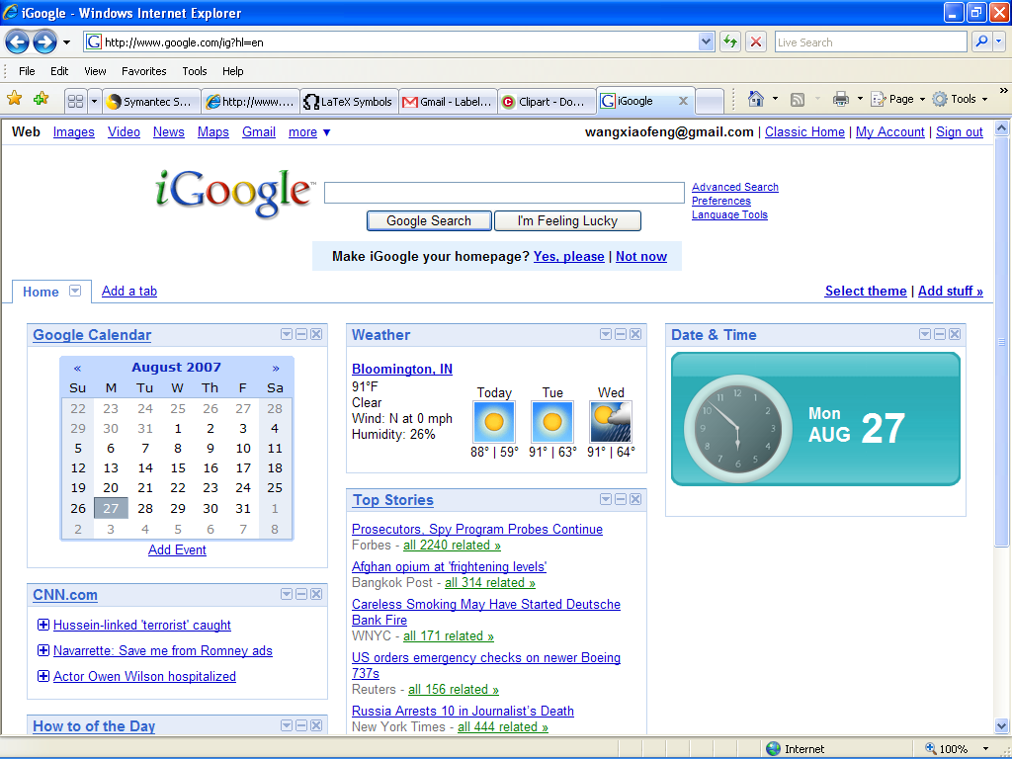
SpyShield
BHO

Slide 8
Related work
Surveillance containment
  Bump in the Ether; SpyBlock
  ⇒ Not for containing spy add-ons
Privilege separation
  Prevent privilege escalations
  Not for control of information leaks
Sandboxing and information flow security
  SpyShield enforces access control to add-on interfaces

Slide 9
Contributions
General protection against spy add-ons
Potential for fine-grained access control
Resilience to attacks
Small overheads
Ease of use

Slide 10
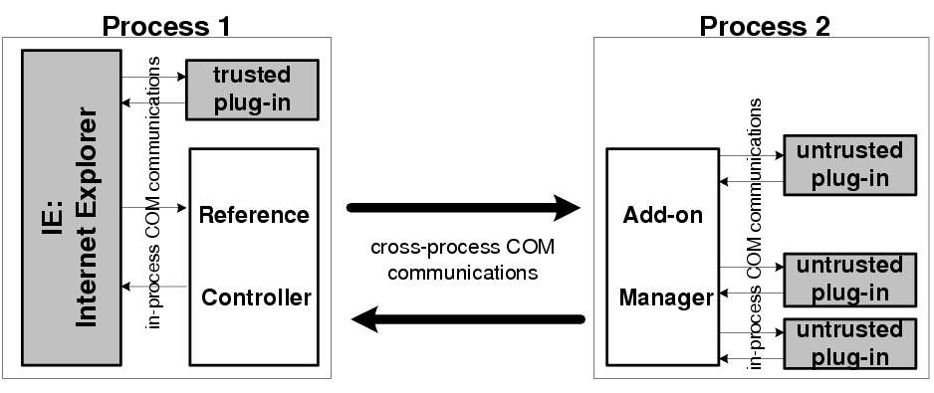
Design
Access-control proxy enforces security policies
Proxy guardian protects the proxy

Slide 11
Access-control proxy
Objective: permit or deny add-ons’ access to host data
Event-driven add-ons:
  Steal information once an event happens
  Proxy: block the events according to security policies
Non-event-driven add-ons
  Poll add-on interfaces
  Proxy: control all interfaces spy add-ons might use
Direct memory access
  Proxy: separate untrusted add-ons from the host
  control the channels for Inter-process communication

Slide 12
Untrusted add-ons
Trusted add-ons are from known vendors
If don’t know, then don’t trust
Use hash values to classify add-ons

Slide 13
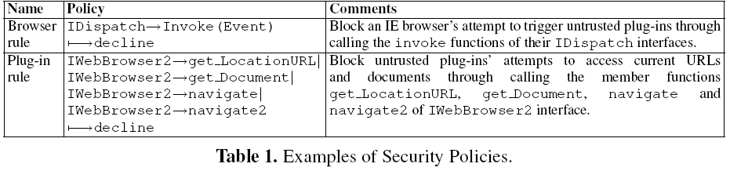
Security policies
Limit untrusted add-ons’ access to host
when sensitive data are being processed
  For example, the bank balance is displayed
Sensitive zones

Slide 14
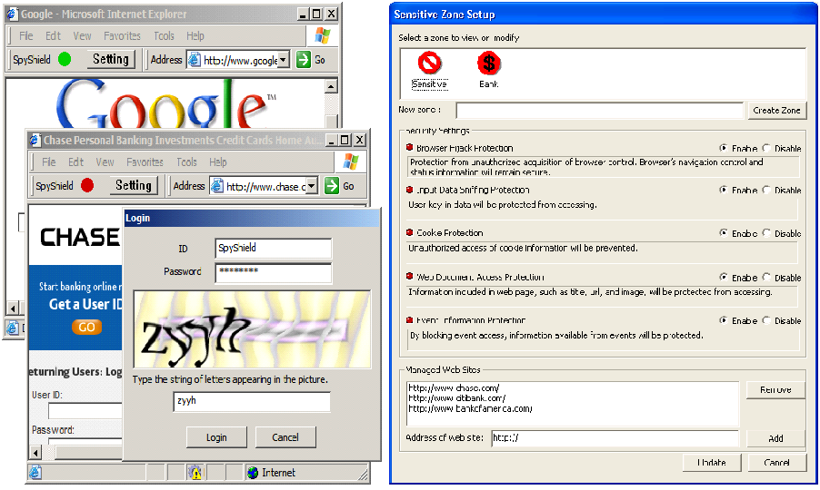
Policy setting

Slide 15
Proxy guardian
Protect the proxy from being attacked
Use system call interposition
Protect data
  Database of the hash values for trusted add-ons
  Policies
Protect proxy processes

Slide 16
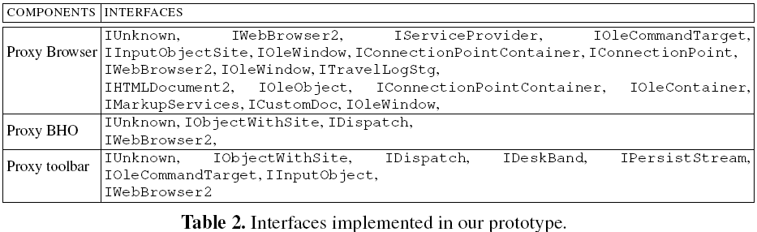
Implementation (1)
We implemented an access control proxy for IE plug-ins
COM interfaces interposed:

Slide 17
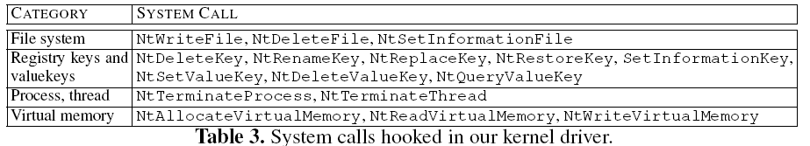
Implementation (2)
Proxy guardian interposed the following system calls:

Slide 18
Evaluations
Setting:
  Pentium 3.2GHz and 1GB memory and Windows XP
Effectiveness test
  Traffic differential analysis [NetSpy]
  Dangerous behavior blocked
Performance test
  Latency for Inter-process communication
  Processing time of function invocations
  Web navigation

Slide 19
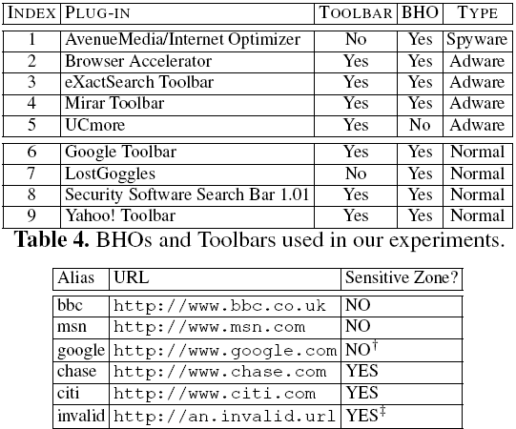
Effectiveness (1)

Slide 20
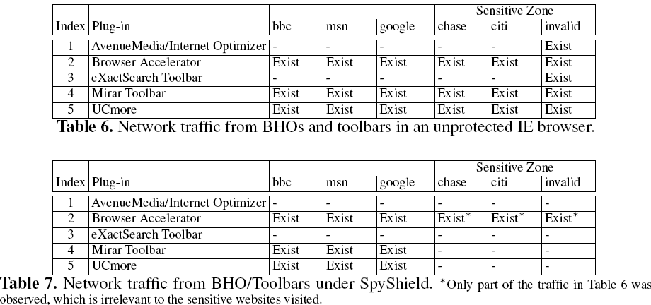
Effectiveness (2)
Differential analysis

Slide 21
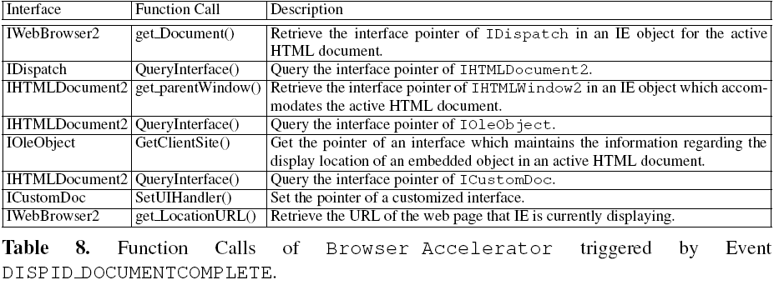
Effectiveness (3)
Block malicious activities

Slide 22
Performance (1)
Overhead for IPC
  1327 times!
However, IPC only takes a SMALL portion of transaction processing time

Slide 23
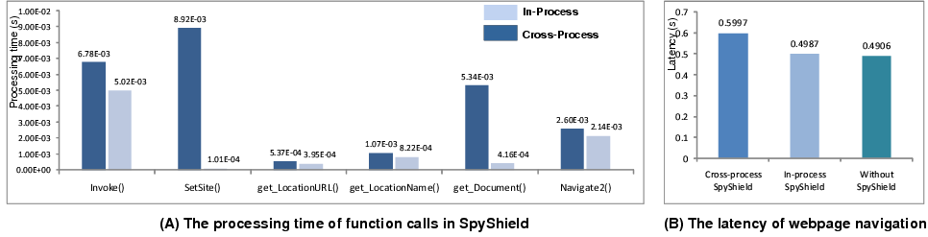
Performance (2)
Function invocation time
Web navigation:
  80% functionalities of google toolbar and 8/9 of Yahoo! Toolbar
Memory costs:
  From 11MB to 15MB
  However, an additional new window only cost an extra 0.1 to 0.5MB

Slide 24
Limitations
Limitations of the design
  Only for protecting add-ons
  Not for defending against kernel-level spyware
Limitations of implementation
  Apply same policies to the whole window object
  How about frames?
  Only wrap the COM interfaces for the plug-ins used in exp

Slide 25
Conclusion and future work
SpyShield offers effective containment against Spy add-ons
Future work: develop policy model and techniques for containing standalone spyware

